Slide 1
Traffic Observation and Study on Virtual Desktop Infrastructure
Date: 2013-11-12
Authors:

Slide 2
Abstract
This presentation provides observations of actual Virtual Desktop Infrastructure (VDI) traffic in a live enterprise system. The study is intended to provide insight into VDI traffic for future modeling and abstraction, for inclusion in Systems Simulation for Enterprise scenario.
Notes:
doc.: IEEE 802.11-08/1101r3
September 2008
John R. Barr, Motorola, Inc.
Page 2

Slide 3
Motivation
Cloud Computing including VDI (Virtual Desktop Infrastructure) is gaining popularity and considered as one of the New/Enhanced applications for HEW [1] [2].
Descriptions and assumptions about the application of cloud-based VDI are presented in usage model #2a (Wireless Office – Private Access and Cellular Offload) [1]. There has been a paucity of discussion on the traffic model of VDI service.
Traffic sampling needed to provide insight on the nature and characterization of VDI traffic, its distribution in time and packet size, to provide opportunity to model and abstract for simulation purposes [3].
It is necessary to include VDI traffic model in HEW.
Notes:
doc.: IEEE 802.11-08/1101r3
September 2008
John R. Barr, Motorola, Inc.
Page 3

Slide 4
Modeling Scope
Office, voice and video services are three typical services in VDI scenario.
Voice and video services are generally well understood as discrete traffic models, independent of VDI; do not perceive that voice and video require separate/special modeling.
Only traffic study and model for office service in VDI scenario is considered currently insufficient, the subject of this presentation.
Notes:
doc.: IEEE 802.11-08/1101r3
September 2008
John R. Barr, Motorola, Inc.
Page 4

Slide 5
Modeling Scheme (1/2)
Packet capture environment
Uplink: Thin Client ➔ AP
Downlink: AP ➔Thin Client
Packets are caught by packet capture software
Notes:
doc.: IEEE 802.11-08/1101r3
September 2008
John R. Barr, Motorola, Inc.
Page 5

Slide 6
Modeling Scheme (2/2)
Except voice and video services, most of the office work applications of VDI can be classified as
Proportion of each service is adjustable, for example, x×100% (0≤x ≤ 1) users work with ppt service, y×100% (0≤y ≤ 1) users work with word service, z×100% (0≤z ≤ 1) users work with network browsing service, (1-x-y-z)×100% users work with desktop operation service. May be adjusted in simulation according to Simulation Scenario requirements. Voice and video services can also be added here.
Service | How to simulate | Which services it corresponding to in practice
PPT | open, close, save, edit, figure drawing, presentation | file operation, presentation, figure drawing, embedded object edit
word | open, close; save, edit | file operation, email writing; code writing; doc writing; other script related application
network browsing | open, close, save, web browsing, picture viewing | file operation; network browsing, email, picture viewing related services
desktop operation | open, close, new file, copy, delete, move, search, mouse pointer | file operation, simple desktop operations
Notes:
doc.: IEEE 802.11-08/1101r3
September 2008
John R. Barr, Motorola, Inc.
Page 6

Slide 7
Parameters
There are two important parameters for the study and modeling:
Packet arrival interval
Study and Model as an exponential distribution for each type of service
Parameter of the exponential distribution is estimated by maximum likelihood estimation
Packet length
Sample statistics on probability of the packets falling into different packet length ranges
Sample statistics on mean and standard deviation of packet length within the packet length range.
Notes:
doc.: IEEE 802.11-08/1101r3
September 2008
John R. Barr, Motorola, Inc.
Page 7

Slide 8
Packet arrival interval study and modeling
For uplink and downlink of each kind of service, study and model the packet arrival interval. Identify as exponential distribution random variable. Estimate parameters ‘lambda’ by maximum likelihood estimation based on the sample data.
In the following slides, comparison between cumulative distribution function (CDF) of the proposed packet arrival interval and the practical CDF of the samples for different services presented.
Notes:
doc.: IEEE 802.11-08/1101r3
September 2008
John R. Barr, Motorola, Inc.
Page 8

Slide 9
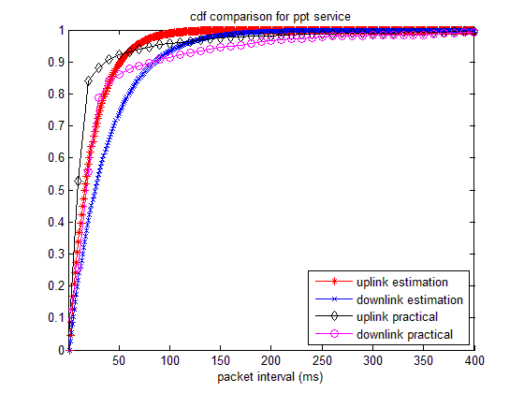
CDF comparison for PPT service
PPT service | Lambda
Uplink | 21.816
Downlink | 36.459
Notes:
doc.: IEEE 802.11-08/1101r3
September 2008
John R. Barr, Motorola, Inc.
Page 9

Slide 10
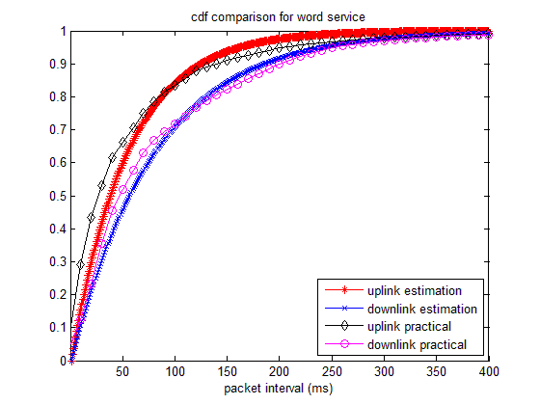
CDF comparison for word service
Word service | Lambda
Uplink | 53.698
Downlink | 80.079
Notes:
doc.: IEEE 802.11-08/1101r3
September 2008
John R. Barr, Motorola, Inc.
Page 10

Slide 11
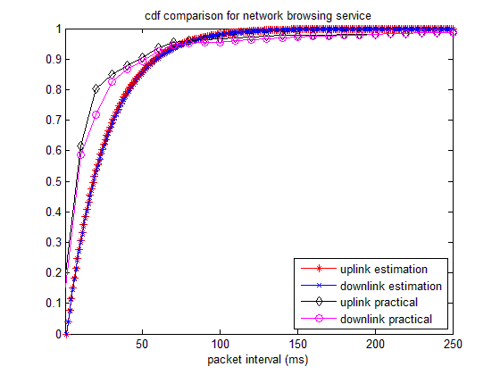
CDF comparison for network browsing service
Network browsing service | Lambda
Uplink | 24.744
Downlink | 25.312
Notes:
doc.: IEEE 802.11-08/1101r3
September 2008
John R. Barr, Motorola, Inc.
Page 11

Slide 12
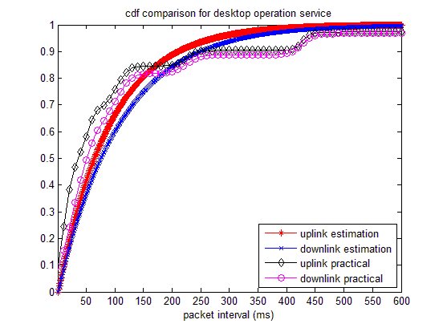
CDF comparison for desktop operation service
Network browsing service | Lambda
Uplink | 90.872
Downlink | 107.57
Notes:
doc.: IEEE 802.11-08/1101r3
September 2008
John R. Barr, Motorola, Inc.
Page 12

Slide 13
Packet length sampling
Packet samples are divided into different groupings according to packet length.
Sample in both UL and DL
Take statistics on probability of the packet samples falling into different packet length ranges.
Take statistics on average packet length of the packet samples in each packet length range.
Notes:
doc.: IEEE 802.11-08/1101r3
September 2008
John R. Barr, Motorola, Inc.
Page 13

Slide 14
Uplink packet length distribution
All of the sampled uplink packets are small packets, less than 80 bytes.
Since all sampled packets are small packets with a fairly consistent mean and small standard deviation, it is reasonable to use a normal distribution with mean packet length of the packet samples as the packet length in the model.
Service type | ppt | word | network browsing | desktop operation
mean packet length (Byte) | 65.883 | 63.994 | 63.943 | 62.843
Standard deviation | 4.9353 | 4.7817 | 5.1703 | 4.7846
Notes:
doc.: IEEE 802.11-08/1101r3
September 2008
John R. Barr, Motorola, Inc.
Page 14

Slide 15
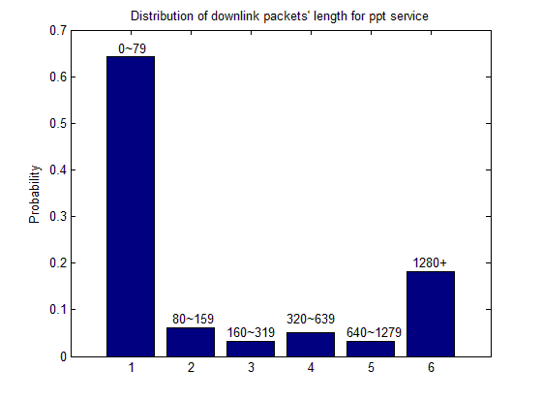
Sample Downlink packet length distribution for ppt service
Packet length range (Byte) | Probability | Mean length (Byte) | Standard deviation
0~79 | 0.6428 | 55.166 | 4.3002
80~159 | 0.060441 | 104.06 | 21.799
160~319 | 0.031854 | 226.64 | 46.76
320~639 | 0.05064 | 478.51 | 87.029
640~1279 | 0.032126 | 900.39 | 177.97
>1280 | 0.18214 | 1488.3 | 26.945
Notes:
doc.: IEEE 802.11-08/1101r3
September 2008
John R. Barr, Motorola, Inc.
Page 15

Slide 16
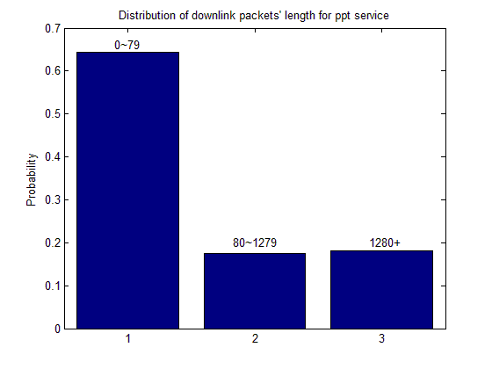
Downlink packets’ length model for ppt service
Packet length range (Byte) | Probability | Mean length (Byte) | Standard deviation
0~79 | 0.6428 | 55.166 | 4.3002
80~1279 | 0.17506 | 380.82 | 302.84
>1280 | 0.18214 | 1488.3 | 26.945
Notes:
doc.: IEEE 802.11-08/1101r3
September 2008
John R. Barr, Motorola, Inc.
Page 16

Slide 17
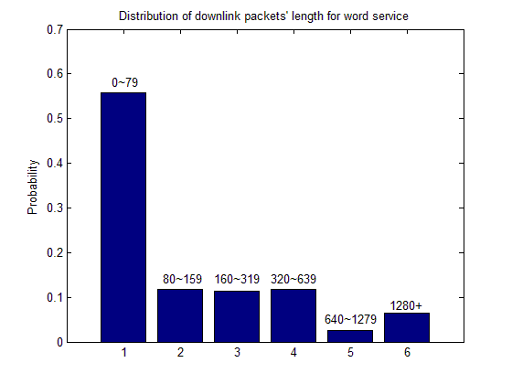
Sample Downlink packet length distribution for word service
Packet length range (Byte) | Probability | Mean length (Byte) | Standard deviation
0~79 | 0.55754 | 62.322 | 8.8023
80~159 | 0.11856 | 97.784 | 23.317
160~319 | 0.11391 | 241.08 | 43.705
320~639 | 0.11817 | 439.53 | 86.262
640~1279 | 0.026346 | 798.76 | 164.99
>1280 | 0.065478 | 1478.9 | 43.77
Notes:
doc.: IEEE 802.11-08/1101r3
September 2008
John R. Barr, Motorola, Inc.
Page 17

Slide 18
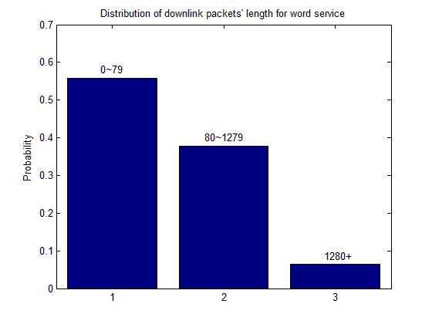
Downlink packets’ length model for word service
Packet length range (Byte) | Probability | Mean length (Byte) | Standard deviation
0~79 | 0.55754 | 62.322 | 8.8023
80~1279 | 0.37699 | 297.2 | 205.86
>1280 | 0.065478 | 1478.9 | 43.77
Notes:
doc.: IEEE 802.11-08/1101r3
September 2008
John R. Barr, Motorola, Inc.
Page 18

Slide 19
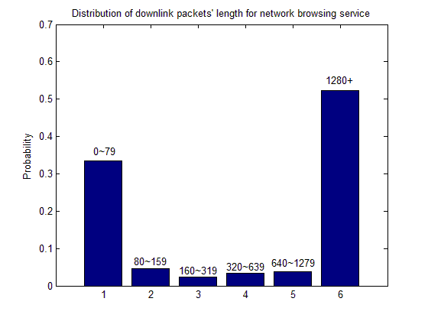
Sample Downlink packet length distribution for network browsing service
Packet length range (Byte) | Probability | Mean length (Byte) | Standard deviation
0~79 | 0.33476 | 56.628 | 6.0693
80~159 | 0.047019 | 104.81 | 22.277
160~319 | 0.023397 | 222.15 | 44.254
320~639 | 0.034646 | 463.84 | 95.105
640~1279 | 0.037795 | 932.19 | 197.07
>1280 | 0.52238 | 1491.7 | 17.81
Notes:
doc.: IEEE 802.11-08/1101r3
September 2008
John R. Barr, Motorola, Inc.
Page 19

Slide 20
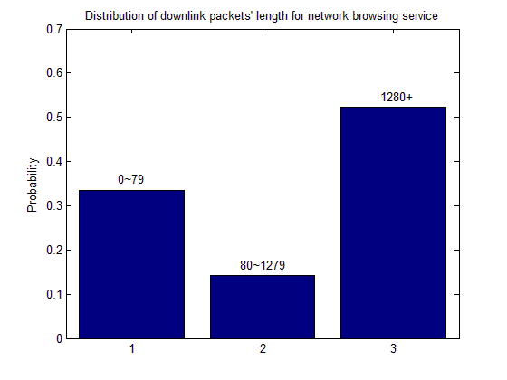
Downlink packet length model for network browsing service
Packet length range (Byte) | Probability | Mean length (Byte) | Standard deviation
0~79 | 0.33476 | 56.628 | 6.0693
80~1279 | 0.14286 | 430 | 349.21
>1280 | 0.52238 | 1491.7 | 17.81
Notes:
doc.: IEEE 802.11-08/1101r3
September 2008
John R. Barr, Motorola, Inc.
Page 20

Slide 21
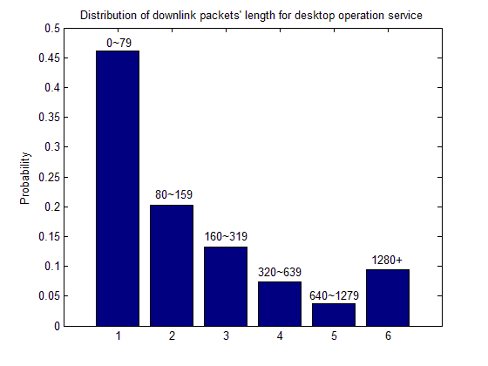
Sample Downlink packet length distribution for desktop operation service
Packet length range (Byte) | Probability | Mean length (Byte) | Standard deviation
0~79 | 0.46145 | 65.689 | 8.9701
80~159 | 0.20285 | 87.035 | 11.572
160~319 | 0.13167 | 268.17 | 28.83
320~639 | 0.073547 | 422.94 | 89.635
640~1279 | 0.036773 | 944.74 | 196.67
>1280 | 0.093713 | 1485.8 | 30.812
Notes:
doc.: IEEE 802.11-08/1101r3
September 2008
John R. Barr, Motorola, Inc.
Page 21

Slide 22
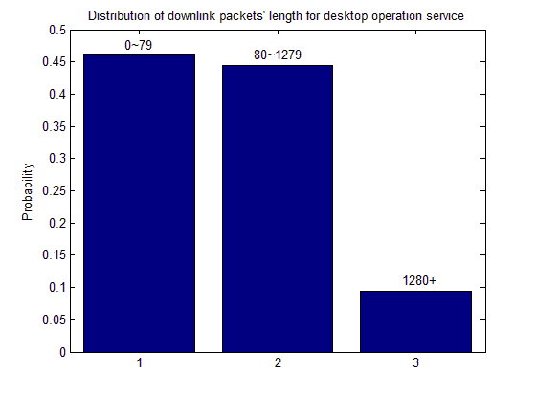
Downlink packets’ length model for desktop operation service
Packet length range (Byte) | Probability | Mean length (Byte) | Standard deviation
0~79 | 0.46145 | 65.689 | 8.9701
80~1279 | 0.44484 | 267.09 | 248.26
>1280 | 0.093713 | 1485.8 | 30.812
Notes:
doc.: IEEE 802.11-08/1101r3
September 2008
John R. Barr, Motorola, Inc.
Page 22

Slide 23
Packet length analysis
The packet length can be fitted to satisfy certain CDF. However, it is too complicated for the model and simulation.
To generate the packet length in the service model, choose one of the values of above average length with certain probability. This probability is that of the packet samples falling into different packet length ranges.
Notes:
doc.: IEEE 802.11-08/1101r3
September 2008
John R. Barr, Motorola, Inc.
Page 23

Slide 24
November 2013
Summary
The proportion of each service is adjustable according to user habits and requirement of the simulation.
For each service, the packets arrive with certain probability which obeys exponential distribution.
The packet length adopts one of the mean values with certain probability within discreet normal distribution curves.
Slide 24
Slide 24
Notes:
doc.: IEEE 802.11-08/1021r0
July 2008
Peter Loc
Page 24
doc.: IEEE 802.11-08/1101r3
September 2008
John R. Barr, Motorola, Inc.
Page 24

Slide 25
November 2013
Next Steps
Future presentations abstracting the modeling of desktop application for VDI are encouraged.
Slide 25
Slide 25
Notes:
doc.: IEEE 802.11-08/1021r0
July 2008
Peter Loc
Page 25
doc.: IEEE 802.11-08/1101r3
September 2008
John R. Barr, Motorola, Inc.
Page 25

Slide 26
November 2013
References
[1] 11-13-0657-06-0hew-hew-sg-usage-models-and-requirements-liaison-with-wfa
[2] 11-13-1133-00-0hew-virtual-desktop-infrastructure-vdi
[3] 11-13-1144-01-0hew-simplified-traffic-model-based-on-aggregated-network-statistics
Slide 26
Slide 26
Notes:
doc.: IEEE 802.11-08/1021r0
July 2008
Peter Loc
Page 26
doc.: IEEE 802.11-08/1101r3
September 2008
John R. Barr, Motorola, Inc.
Page 26

