Slide 1
        Alternative Dual Band AP
        Reference Model Graphic
Date: 2013-13-31
Authors:

Slide 2
Purpose
  Existing 802.11 AP reference models clearly show single band frame processing and forwarding methods.
  For discussion purposes, it may sometimes be useful to visualize frame processing and forwarding methods from a consolidated, dual-band perspective.
  A graphical, three-sided column clearly shows the relationship between the 2.4 GHz, 5 GHz, and Ethernet Portal reference model contained within a dual-band AP.

Slide 3
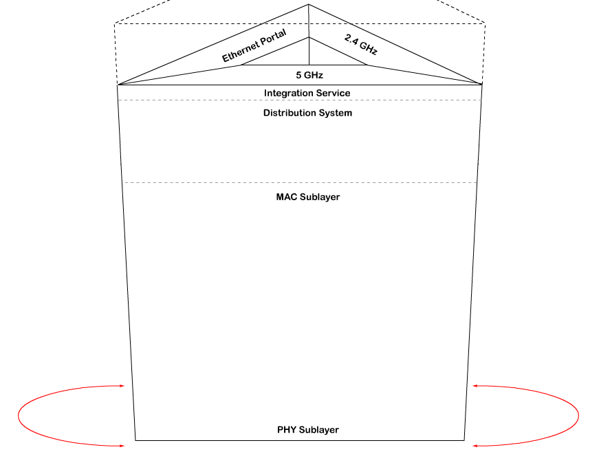
Three-sided column showing 5 GHz Interface

Slide 4
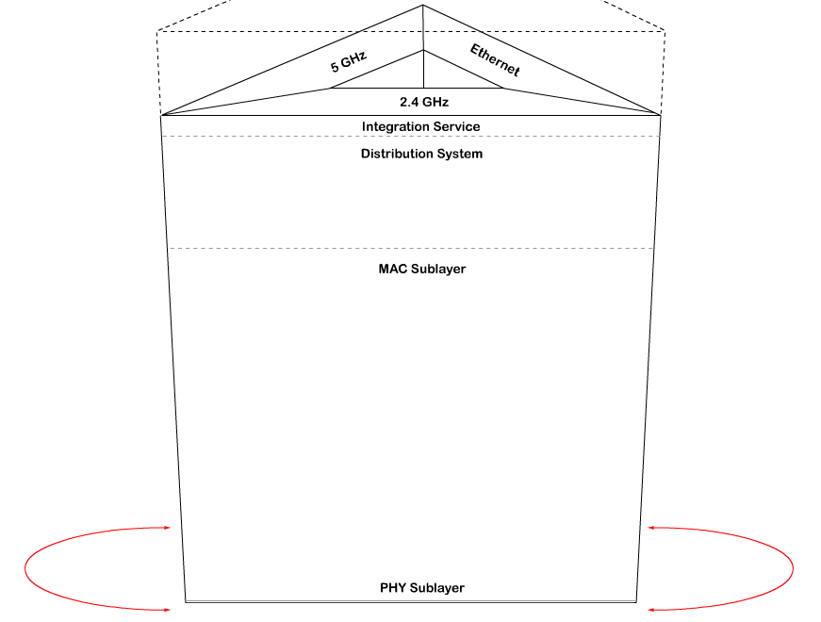
Three-sided column showing 2.4 GHz Interface

Slide 5
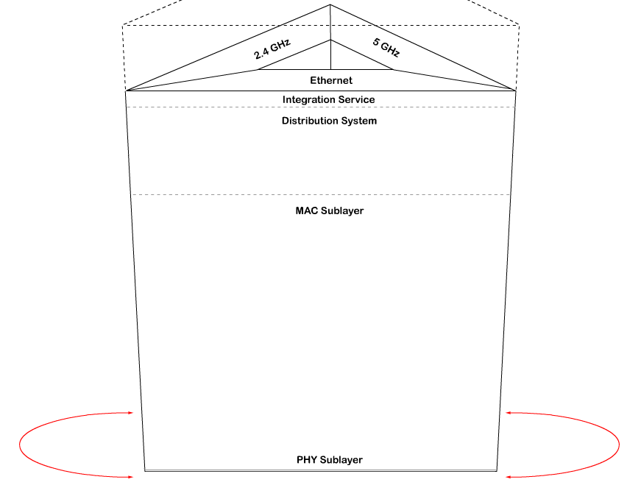
Three-sided column showing Ethernet Interface

Slide 6
Summary
The three-sided column graphical reference model efficiently displays all physical interfaces and protocol stacks within a dual-band AP.

Slide 7
Reference
802 rev-D1-7.pdf

