Slide 1
STR Radios and STR Media Access
Date: 2013-11-12
Authors:

Slide 2
Abstract
Single antenna, in-band STR is coming.
Janus is a centralized STR MAC that uses communication rounds and explicitly schedules all frame transmissions.
Full duplex promises a 100% throughput gain, Janus provides a 150% throughput gain.
Full duplex networks can benefit from more centralized MAC algorithms and protocols.

Slide 3
Wireless Today
“It is generally not possible for radios to receive and transmit on the same frequency band because of the interference that results. Thus, bidirectional systems must separate the uplink and downlink channels into orthogonal signaling dimensions, typically using time or frequency dimensions.” - Andrea Goldsmith, “Wireless Communications,” Cambridge Press, 2005.

Slide 4
Talk in a Nutshell
Single antenna, in-band, STR is coming
  Breaks a fundamental assumption in most wireless designs
  Current best: WiFi with a shared RX/TX antenna (200mW, 80MHz @ 2.4GHz, 110dB of cancellation)
How full duplex changes the MAC layer

Slide 5
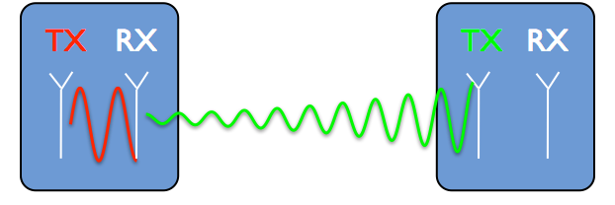
Why Half Duplex?
Self-interference is millions to billions (60-90dB) stronger than received signal
If only we could “subtract” our transmission...

Slide 6
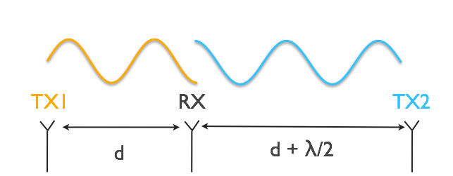
First Prototype: Antenna Cancellation

Slide 7
First Prototype: Antenna Cancellation
~30dB self-interference cancellation
Enables full-duplex when combined with digital (15dB) and hardware (25dB) cancellation.

Slide 8
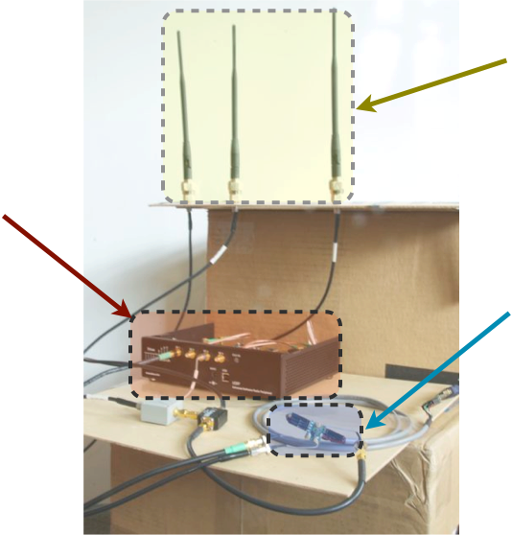
First Prototype
4 antennas, 1 mW, 5MHz @ 2.4GHz
Antenna
cancellation
Digital interference
cancellation
Hardware
cancellation
Jung Il Choi, Mayank Jain, Kannan Srinivasan, Philip Levis and Sachin Katti. “Achieving Single Channel, Full Duplex Wireless Communication.” In Proceedings of the 16th Annual International Conference on Mobile Computing and Networking (Mobicom 2010).

Slide 9
Why Half Duplex?
Self-interference is millions to billions (60-90dB) stronger than received signal
If only we could “subtract” our transmission...

Slide 10
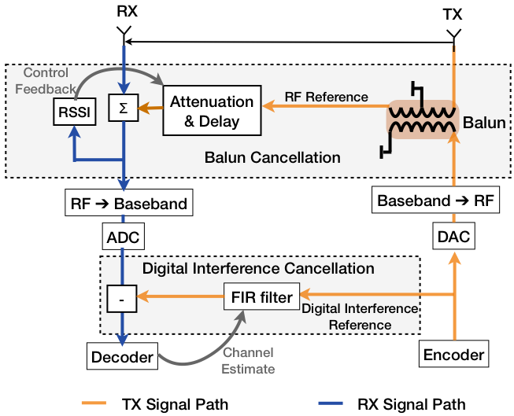
Second Design

Slide 11
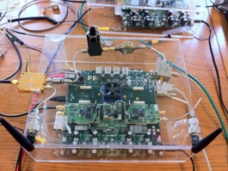
Second Prototype
2 antennas, 200 mW, 20MHz @ 2.4GHz
Mayank Jain, Jung Il Choi, Taemin Kim, Dinesh Bharadia, Kannan Srinivasan, Siddharth Seth, Philip Levis, Sachin Katti and Prasun Sinha. “Practical, Real-time, Full Duplex Wireless.” In Proceedings of the 17th Annual International Conference on Mobile Computing and Networking (Mobicom 2011).

Slide 12
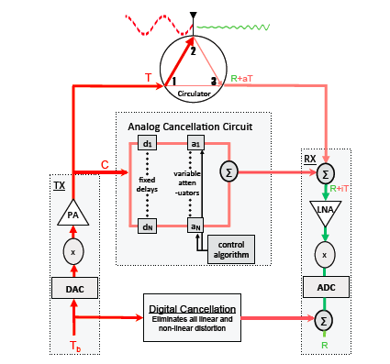
Third Design
One antenna
  Circulator
Adaptive cancellation
  Bank of delay lines
  Handles frequency selective interference
110dB of cancellation
  20dBm, -90dBm noise floor
  80MHz @ 2.4GHz
Dinesh Bharadia, Emily McMillin, and Sachin Katti. “Full Duplex Radios.” In Proceedings of ACM SIGCOMM (2013).

Slide 13
Implications

Slide 14
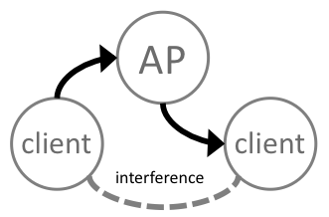
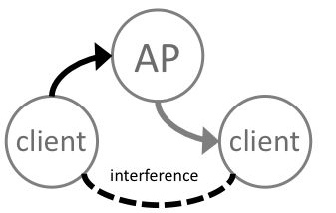
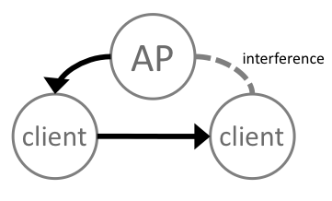
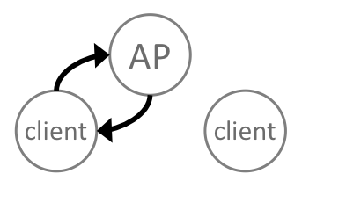
Full Duplex MAC
symmetric
AP-centric asymmetric
asymmetric failure
client-centric asymmetric

Slide 15
Janus
MAC layer for full duplex wireless LANs
Entirely AP-centric and AP-scheduled
Provides per-client fair share of channel
  Fairness of time, not bits
  Nodes with lower SNR receive lower throughput
Full duplex promises 100% throughput gain, Janus provides a 150% gain

Slide 16
Janus Cases
symmetric
AP-centric asymmetric
asymmetric failure
client-centric asymmetric

Slide 17
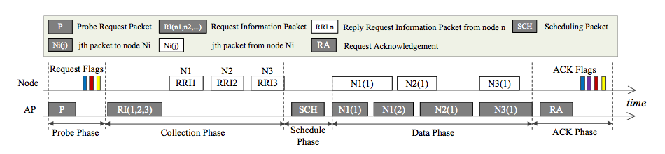
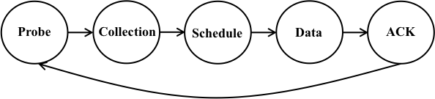
Janus Overview

Slide 18
Probe Phase

Slide 19
Collection Phase

Slide 20
Schedule+Data Phase

Slide 21
ACK Phase

Slide 22
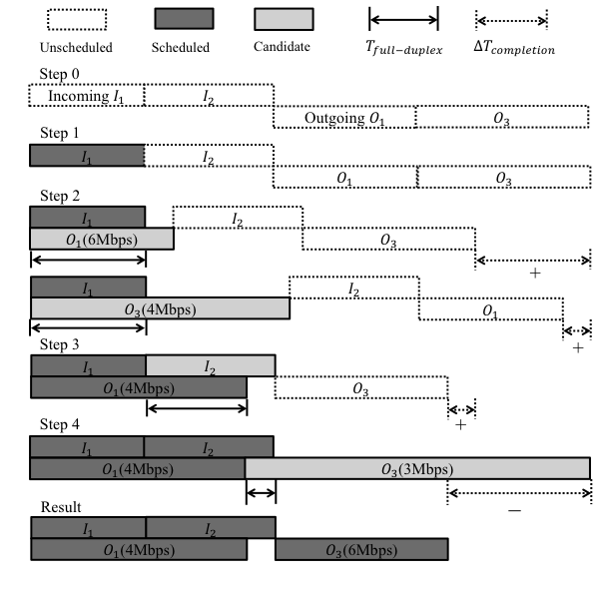
Scheduling Full Duplex
Optimal solution is NP-complete (intractable)
Simple greedy heuristic performs well (90%).

Slide 23
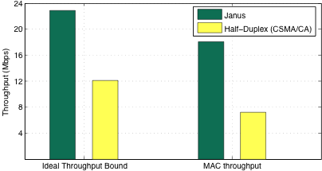
Throughput
90% gain
150% gain

Slide 24
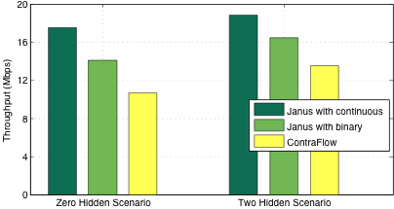
Decomposing Gains
Benefits from SINR map
Benefits from centralization
Contraflow is a full duplex CSMA/CA protocol.

Slide 25
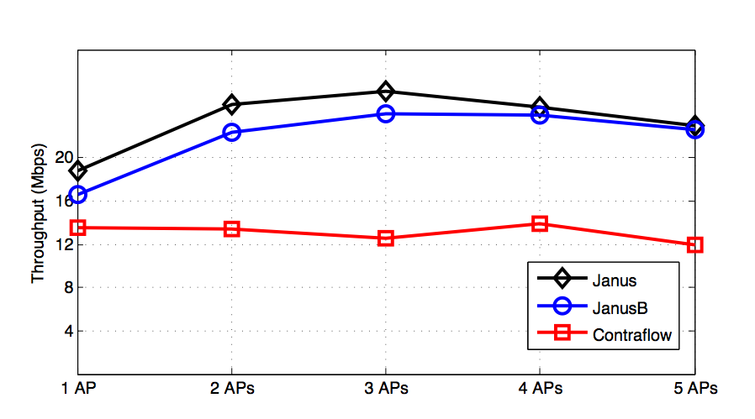
Multiple APs

Slide 26
Full Duplex/Janus
Single-antenna STR is coming
Can benefit from more centralized MAC
Tradeoff between MIMO and STR
Janus shows 150% throughput gain over half-duplex network
Prior results showed full duplex reduces hidden terminals by 88%
Jae Young Kim, Omid Mashayekhi, Hang Qu, Maria Kazandjieva, and Philip Levis. “Janus: A Novel MAC Protocol for Full Duplex Radios.” Stanford University CSTR 2013-02 7/23/13. http://hci.stanford.edu/cstr/reports/2013-02.pdf

Slide 27
Future Wireless LAN
High performance wireless LANs are typically managed today
  Meraki, Aruba, Aerohive, Proxim, etc.
  Frequency planning, careful placement
  Management software on ad-hoc network?
An increasing confluence between mobile telephony and wireless LANs
  What is the right level of control/centralization?

Slide 28
References
Jung Il Choi, Mayank Jain, Kannan Srinivasan, Philip Levis and Sachin Katti. “Achieving Single Channel, Full Duplex Wireless Communication.” In Proceedings of the 16th Annual International Conference on Mobile Computing and Networking (Mobicom 2010).
Mayank Jain, Jung Il Choi, Taemin Kim, Dinesh Bharadia, Kannan Srinivasan, Siddharth Seth, Philip Levis, Sachin Katti and Prasun Sinha. “Practical, Real-time, Full Duplex Wireless.” In Proceedings of the 17th Annual International Conference on Mobile Computing and Networking (Mobicom 2011).
Dinesh Bharadia, Emily McMillin, and Sachin Katti. “Full Duplex Radios.” In Proceedings of ACM SIGCOMM (2013).
Jae Young Kim, Omid Mashayekhi, Hang Qu, Maria Kazandjieva, and Philip Levis. “Janus: A Novel MAC Protocol for Full Duplex Radios.” Stanford University CSTR 2013-02 7/23/13. http://hci.stanford.edu/cstr/reports/2013-02.pdf
Nikhil Singh, Dinan Gunawardena, Alexandre Proutiere, Bozidar Radunovic, Horia Vlad Balan, and Peter Key, Efficient and Fair MAC for Wireless Networks with Self-interference Cancellation, in WiOpt 2011, May 2011

