Slide 1
Simulation Based Study of QoE
Date: 2013-11-12
Authors:
Name | Affiliations | Address | Phone | Email
ChaoChun Wang | MediaTek | San Jose, CA, USA | +1-408-526-1899 | chaochun.wang@mediatek.com
Jianhan Liu | MediaTek | San Jose, CA, USA |  | jianhan.liu@mediatek.com
James Yee | MediaTek | Hsinchu, Taiwan |  | james.yee@mediatek.com
Thomas Pare | MediaTek | San Jose, CA, USA |  | thomas.pare@mediatek.com
James Wang | MediaTek | San Jose, CA, USA |  | james.wang@mediatek.com

Slide 2
Overview
In HEW we have highlighted Quality of Experience (QoE) in the context of dense deployments[1].
What definition of QoE is meaningful to the end user?
QoE is application specific and involves more than just MAC/PHY
QoE is Per-user but can be viewed in Aggregate too
QoE depends on more than STA density but also degree of concurrent application network access
With a useful definition, how do we proceed with the development of HEW?
Using web browsing as an application, we present preliminary simulation results to illustrate QoE and QoE metrics.
Propose that we establish baseline application simulation scenarios for the purpose of evaluating HEW proposals.

Slide 3
Simulation Approach
There are various approaches to simulate network load under different user applications.
We propose to use captured real application traffic load and use them to drive MAC/PHY simulations.
We chose Web Browsing as an example application and captured real traffic statistics.
For MAC/PHY simulation we used a commercial discrete event simulator (estinet[2]) which allows us to use captured traffic load, Linux TCP/IP stack, Apache Server and focus on the effects of MAC/PHY behavior.
Your choice of simulation tools may vary.

Slide 4
QoE Metrics Selection
For Web Page Access, it is well recognized that the QoE depends on Web Page Delays.
From [4]: “Relatively small increases in delay can have a profound impact on how users react to Web sites.” and
“…problems associated with delay will still be present even with the increased use of high-speed connections.” and
“Fundamentally, if the designer’s goal is to promote a positive attitude [QoE], the site delay should be kept below 8 seconds.”
Using Web Page Access Delay as the metric for QoE, we simulate the impact of various network configurations on the QoE.

Slide 5
Web Page Traffic Simulation
Capture data from eight randomly selected actual web sites
www.estinet.com - (33 files, 2.4 MB)
tw.msn.com - (71 files, 773 KB)
www.pchome.com.tw - (129 files, 1.2 MB)
www.amazon.com - (52 files, 985 KB)
www.businessweekly.com.tw - (115 files, 5.4 MB)
www.feib.com.tw - (58 files, 1 MB)
www.thsrc.com.tw - (74 files, 1.9 MB)
www.trtc.com.tw - (68 files, 2.1 MB)
Simulate the concurrent access of these captured web site files from a Server
For each page access, use WGET[3] over HTTP/TCP/IP to access files sequentially from an Apache Server local to a simulated AP.
All STAs start contend for channel access at the same time and continue to do so till the completion of the download. This is the worst case scenario.
Per Page Access delay is the duration from initiating the access of the 1st file until the last file of the site is received.

Slide 6
Simulation Scenarios and Tool
Scenario
MAC/PHY Configuration: 802.11n infrastructure BSS with varying # of STAs contending
Topology: STAs distributed in grid fashion
Tools: Estinet, TCPDump for analysis of simulation results.
Parameters
AP TxPower = 24 dBm
STA TxPower = 21 dBm
Channel Model = SISO_Model_D_80211n
Data Rate = 150 Mbps (40MHz_64QAM_CC5/6_GI400ns) – No rate adaptation
Primary Channel = 36 (5180MHz)
Secondary Channel = 40 (5200MHz)
No bit error considered – Still an ideal case
LongRetryLimit = 4
ShortRetryLimit = 7
AP back haul link is 100 M

Slide 7
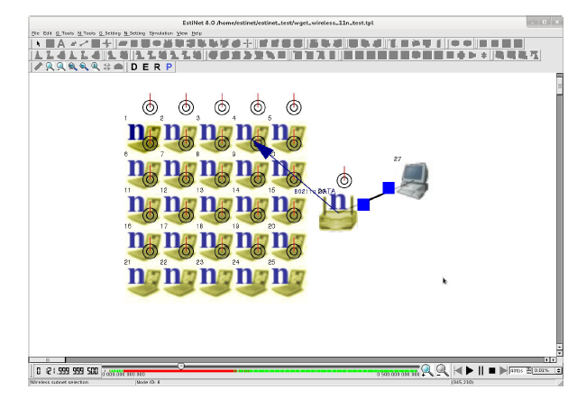
Simulation Set Up - Topology
Exemplary Topology

Slide 8
Simulation Results – Validate using 1 STA
Simulate 1 STA accessing the sites individually
Why are the web session throughput so low?
Examine the timing distribution in accessing the first site using tcpdump
The TCP protocol overhead for setting up 33 connections sequentially takes more than 60% of the total time
Excluding TCP handshakes, the data portion only took 0.303 sec and approximately equal to a throughput of ~78Mb

Slide 9
Simulation Data – 5 Runs with 16 STAs
Average Per Page Delay (sec) vs. STA #

Slide 10
Simulation Data – 48 STAs
Simulation Data – 5 Runs with 48 STAs
Average Per Page Delay (sec) vs. STA #

Slide 11
Simulation Data – Aggregate Results
16 STAs
32 STAs
48 STAs
64 STAs
Avg Per Page Delay (sec) vs. Total # of STA

Slide 12
Observations & Conclusions
QoE is determined by more than just MAC/PHY and is application dependent. An end-to-end system view is needed.
Every layer in the communication stack introduces overhead
Are HEW MAC/PHY enhancements enough to address QoE?
If HEW is to include QoE in its PAR, we should agree on the Application scenarios and System level assumptions.
Simulation is an useful tool for evaluating proposals to meet QoE targets.
QoE depends on Network Load, which is a function of STA Density and the Application.
In general, for a given Application Scenario, how do we defines QoE and QoE metrics?
What metrics should be included from users’ perspective?
What metrics should be included from network designers’ perspective?

Slide 13
Strawpolls
Should HEW define application level scenarios for inclusion into the PAR?
YES: NO: ABSTAIN:
For each application scenario, should defining QoE metrics to be evaluated using simulation be a goal?
YES: NO: ABSTAIN:

Slide 14
References
[1] 11-13-1366-02-0hew-some-propositions-to-progress-towards-the-par-definition.ppt
[2] Estinet (http://www.estinet.com/)
[3] Gnu WGET (http://www.gnu.org/software/wget/)
[4] Galletta, Dennis F.; Henry, Raymond; McCoy, Scott; and Polak, Peter (2004) "Web Site Delays: How Tolerant are Users?," Journal of the Association for Information Systems: Vol. 5: Iss. 1, Article 1. (http://aisel.aisnet.org/jais/vol5/iss1/1)

Slide 15
Backup

Slide 16
Simulation Data – 32 STAs

Slide 17
Simulation Data – 64 STAs
Simulation Data – 64 STAs

