Slide 1
System Level Assessments for Outdoor HEW Deployments
Date: YYYY-MM-DD
Authors:

Slide 2
Abstract
We evaluate the system level performance of outdoor deployments based on .11ac standard. We construct 4 simulation settings each with different number of interferers. Assuming re-use 1 among APs, we evaluate the per-STA average throughput and the average system throughput.
The per-STA average throughput CDF shows a low 5%ile value for outdoor environments.

Slide 3
System level evaluations
Two types of system level evaluations have been presented so far for dense Wi-Fi deployments
Real world Evaluations with data collected from deployed networks [2, 3, 5, 7, 8, 10]
Simulation based modeling of throughput, access delay and other performance metrics [1, 4, 6, 9, 11, 13]
Primary focus was on indoor environments and identifying pain-points in overlapping BSS deployments with interference
Evaluation Methodology document under development also identify scenarios for evaluation [19]
Outdoor specific parameters were identified in [20] and incorporated in [19].

Slide 4
Evaluation in Outdoor Environments
The exact methodology is still being developed.
Objective of this evaluation is to generate an initial assessment of the system performance
We make some assumptions on the system setting as well as the parameters chosen for evaluation
Notes:
Cite history of evaluation methodology document
Initiated by Qualcomm
Further outdoor specific information from Orange
Specific items under discussion
Different outdoor evalauations

Slide 5
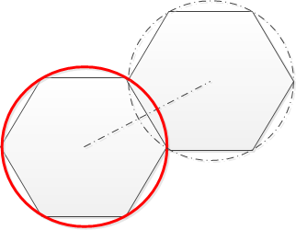
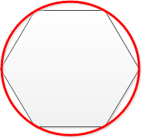
Simulation Settings
Focus on two types of performance in presence of interferers
Throughput with all APs and STAs
Center AP alone with interference
4 different settings considered
SETTING #1: Isolated AP
[Iso AP]
SETTING #2: CELL WITH NEIGHBORING INTERFERER [2 AP]
Notes:
Specific scope of this evaluation is to set benchmarks.
Consider site specific arrangements – single isolated cell, cell with a neighboring interferer, one ring of interference, two rings of interference.
Each cell autonomously acts.
Isolate specific performance parameters – focus only on the center cell. Sensitivity to different distances etc.,

Slide 6
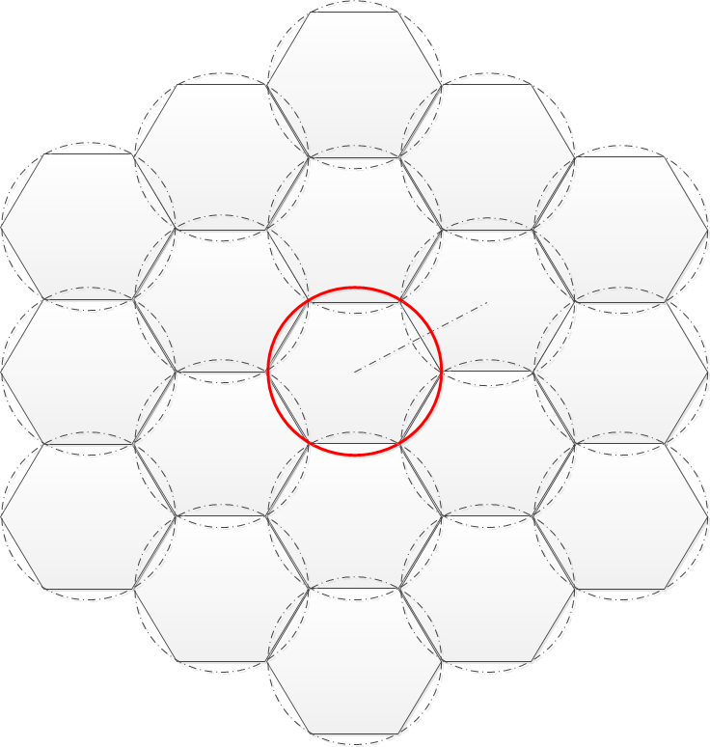
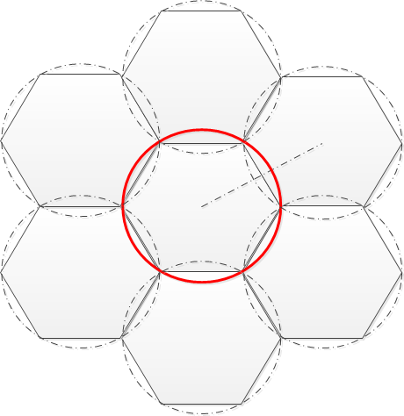
Simulation Settings
Focus on a BSS performance in presence of interferers
SETTING #3: AP with one ring of interferers [7 AP]
SETTING #4: AP with two rings of Interferers [19AP]

Slide 7
Simulation Parameters
Parameter | Value | Parameter | Value
Environment | Outdoor | EDCA | AC_BE TXOP 1ms
Inter-AP Separation | 75m | Aggregation | AMPDU: 64
Channel Model | 2D SCM [ITU UMi, NLOS, 3kmph] | Max. Retries | 10
Transmit Power | AP: 23dBm STA: 19dBm | RTS/CTS | On
Bandwidth | 20 MHz | Block Ack. | Enabled
# of Antennas | AP: 2 STA: 2 | Traffic Model Packet Size | Full Buffer 1500Bytes
Antenna Gain | AP: 0dBi STA: 0dBi | Simulation time per drop | 2s
Link Adaptation | SNR based | # of drops | 5
Rx CCA Threshold | -82dBm | # of STAs per AP | 10

Slide 8
Metrics of interest
Metric #1: Average Data Throughput for one STA
The data throughput of a STA is defined as the ratio of the number of information bits that the user successfully received divided by the amount of the total simulation time.
If STA $u$ has $p_{u}$ packet calls, with$q_{i,u}$ packets for the $i^{th}$ packet call, and $b_{j,i,u}$ bits for the $j^{th}$ packet; then the average user throughput for STA $u$ is
$$R_{u}=\frac{\sum_{i=1}^{p_{u}}{\sum_{j=1}^{q_{i,u}}{b_{j,i,u}}}}{T_{sim}}$$
We can plot a CDF of average data throughput for all STAs in all drops
Metric #2: Average Data Throughput of the system
The average throughput is defined as the sum of the average data throughput of each STA in the system as defined in Definition 1, divided by the total number of STAs in the system.
Notes:
System simulation parameters

Slide 9
CDF of average data throughput per STA
Throughput with all APs and STAs
5%ile throughput

Slide 10
CDF of average data throughput per STA
Center AP alone with interference
5%ile throughput

Slide 11
Average Data Throughput
Simulation Setting | With all APs and STAs | Center AP alone
Iso AP | 5.3995 | 5.3995
2 AP | 4.7766 | 4.8530
7 AP | 4.0637 | 4.1717
19 AP | 4.1404 | 3.7406
Increasing the # of interferers reduces the average throughput seen in the coverage area of the center AP
Trends get a little complicated when we consider the average over all cells. Different interference statistics (2-ring sees more interference free users)
simulating with wrap around assumption may help alleviate this issue

Slide 12
Observations
The average throughput seen in the center cell decreases with increasing number of interferers
Each simulation setting results in a markedly different interference statistics as observed in the different CDF plots
Very low 5%ile throughput
A function of the system level parameters and operating environment
Notes:
Further results if necessary/ conclusions

Slide 13
Possible Next Steps
Arrive at a common understanding on simulation parameters
Discuss and subsequently agree on the different metrics of interest
Average access delay,
collision probability,
… others?

Slide 14
References
11-13-0538-02-0hew-dense-apartment-building-use-case-for-hew.pptx
11-13-0545-01-0hew-wlan-qoe-end-user-perspective-opportunities-to-improve.ppt
11-13-0556-01-0hew-wi-fi-interference-measurements-in-korea.ppt
11-13-0505-00-0hew-mac-efficiecy-analysis-for-hew-sg.pptx
11-13-0523-02-0hew-understanding-current-situation-of-public-wifi-usage.pptx
11-13-0576-03-0hew-performance-evaluation-for-11ac.pptx
11-13-0803-00-0hew-wlan-network-behavior-under-heavy-load.ppt
11-13-0804-00-0hew-impact-of-network-configuration-on-quality-of-experience-in-wlan-networks.ppt
11-13-0847-01-0hew-evaluation-criteria-and-simulation-scenarios.ppt
11-13-0801-00-0hew-issues-of-low-rate-transmission.pptx
11-13-1081-00-0hew-hew-simulation-methodology.ppt
11-13-1113-00-0hew-channel-modeling-for-dense-wi-fi-environments.ppt

Slide 15
References
11-13-1123-01-0hew-capacity-simulation-of-high-density-indoor-wlan-systems.pptx
11-13-1125-03-0hew-outdoor-channel-model-discussions.pptx
11-13-1135-03-0hew-summary-on-hew-channel-models.pptx
11-13-1146-00-0hew-update-on-hew-channel-model.pptx
11-13-0996-02-0hew-outdoor-channel-model-candidates-for-hew.pptx
11-13-1000-02-0hew-simulation-scenarios.ppt
11-13-1001-04-0hew-simulation-scenarios-document-template.docx
11-13-1248-01-0hew-simulation-scenario-contribution-1153-on-dense-hotspot-and-outdoor-large-bss.docx

Slide 16
APPENDIX

Slide 17
Consensus on outdoor channel models
Contributions have studied different outdoor channel models for simulation [12, 14, 17] and a summary is captured in [15]
ITU Urban Micro Channel Model was a unanimous choice for some outdoor deployments
Extensions to the channel model to support up to 160MHz bandwidth is under discussion [16]
For the purposes of this discussion, we focus on ITU Urban Micro Channel Model using 20MHz bandwidth.
Notes:
Consensus on outdoor channel model from last meeting
ITU Urban Micro environment
And its use in this simulations

