Slide 1
Simultaneous Transmission Technologies for HEW
Date: 2013-11-11

Slide 2
Background
HEW SG is aiming to start up a new Task Group to improve the area throughput / per-user-throughput in high density APs/STAs scenarios.
There are three ways to improve the performance by PHY related technologies.
  Simultaneous transmission: More WLANs, Higher density
  Wider bandwidth: More Spectrum
  Higher spatial streams/MCS: spectrum efficiency in each link
Most PHY technologies presented in HEW SG improves the area throughput by simultaneous transmission technologies in the high density APs/STAs scenarios.
This contribution focuses on the technologies for simultaneous transmission for HEW.

Slide 3



Evolution history of IEEE 802.11 PHY techniques
11n supports space division multiplexing to enhance P2P link throughput.
11ac supports DL MU-MIMO to enhance P2MP system throughput.
HEW shall extend the enhancement to the area throughput.
To achieve the goal, straightforward extensions of transmission topology (extended P2MP/MP2P/MP2MP) will be beneficial.
P2MP/MP2P/MP2MP
OFDM
DL MU-MIMO
Simultaneous Transmission
AP
AP
P2MP
SU-MIMO
(P2P link extension)
AP
DL MU-MIMO
(P2MP transmission)
AP
AP
P2P
P2P
SU-MIMO
100G
HEW
SG
10G
Aggregate throughput
[bit/s]
.11ac
1G
.11n
100M
.11a
.11g
10M
.11b
1M
802.11
1995
2000
2005
2010
2015
Year

Slide 4
Expected effect of simultaneous transmission in HEW
Current 802.11 standard shares wireless medium in the time domain by CSMA/CA protocol.
Spatial and frequency domain technologies may enhance the CSMA/CA enabling simultaneous transmission by managing interference and selecting appropriate MCS.
Simultaneous transmission is the reasonable way to improve the area throughput in the high density scenarios.

Slide 5
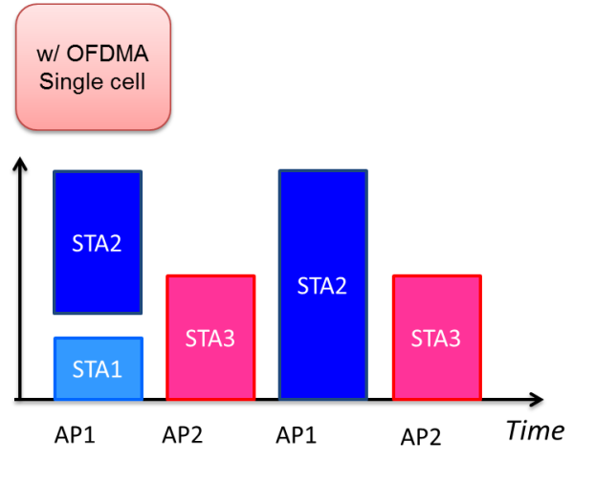
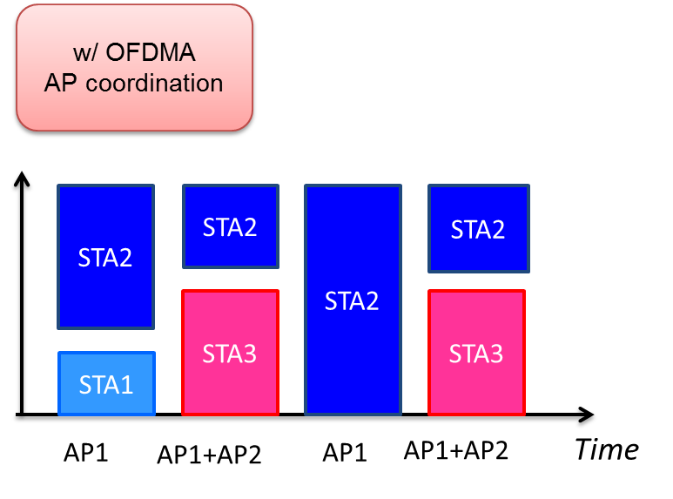
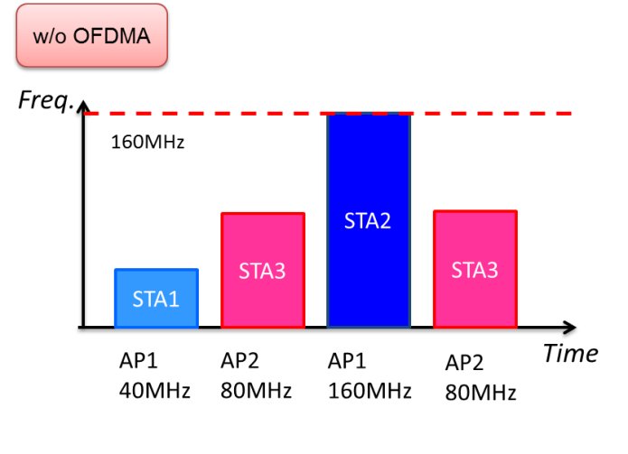
Simultaneous transmission in the frequency domain
Various frequency domain technologies have been presented such as DL OFDMA[1][2] and UL OFDMA[3].
Multi-channel / OFDMA has the capability of utilizing the frequency resource that cannot be used by legacy devices, 11a/g/n/ac, in both uplink and downlink.
It also improves the MAC efficiency for short data packets.
The frequency resource usage becomes flexible with simultaneous transmission with DL/UL OFDMA.
AP coordination obtains further spectrum efficiency improvement.

Slide 6
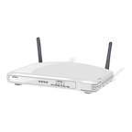




Simultaneous transmission in the spatial domain
DL MU-MIMO is specified in 11ac and improves the spectrum efficiency in P2MP scenarios.
UL MU-MIMO improves the spectrum efficiency in MP2P scenarios [4].
Interference management mechanism in the spatial domain and appropriate setting for transmission power, CCA level, and MCS have the capability of improving the area throughput in MP2MP scenarios [5]-[8].
Enhancing the spatial domain approach to P2MP and MP2MP scenario is the reasonable way to improve the area throughput in the high density scenario.
Dynamic Sensitivity
Control
Interference
management
DL MU-MIMO
UL MU-MIMO
P2MP
MP2P
MP2MP

Slide 7
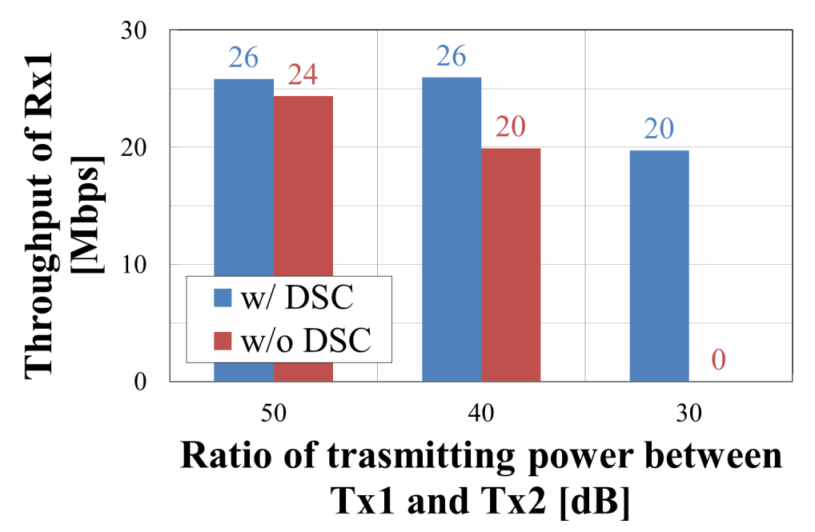
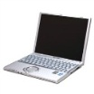
Example of the effect of the simultaneous transmission for MP2MP
The performance is improved by solving the exposed terminal problem due to CSMA/CA.
Dynamic sensitivity control (DSC) or transmitting power control (TPC) has been investigated for this purpose [7].
Measured results indicate that the STA with DSC obtains higher throughput than the STA without DSC.
1m
1m
Desired
Undesired
Tx1
Rx1
Tx2
Rx2
Config.1: DSC Enabled
Config.2: DSC Disabled
(Conventional CSMA/CA)
Tx2 transmits frames consecutively
(WLAN frames are transmitted at SIFS Intervals)

Slide 8
Summary
Straightforward extensions of transmission topology (extended P2MP/MP2P/MP2MP) are beneficial for HEW.
Simultaneous transmission technologies in the frequency and the spatial domain are the reasonable way to improve the area throughput in the high density scenario.

Slide 9
Straw Polls
Do you agree that simultaneous transmission in frequency and/or spatial domain are the reasonable approach to improve the area throughput in HEW?
Result:
Y-N-A =

Slide 10
References
[1] B. Hart (Cisco Systems), “DL-OFDMA for mixed clients,” doc.:IEEE802.11-10/0317r1.
[2] Y. Inoue (NTT), “Improved spectrum efficiency for the next generation WLANs,” doc.:IEEE802.11-12/0820r0.
[3] R. Stacey (Intel), “Technology and use cases for TGac,” doc.:IEEE802.11-09/0789r2.
[4] R. V. Nee (Qualcomm), “UL MU-MIMO for 11ac,” doc.:IEEE802.11-09/0852r0.
[5] Y. Asai (NTT), “Update of interference management using beamforming technique in OBSS environment,” Doc. :IEEE802.11-10/08455r0.
[6] J. Wang (MediaTek), “HEW beamforming enhancements,” doc.:IEEE802.11-13/0877r0.
[7] G. Smith (DSP Group), “Dynamic sensitivity control for HEW,” doc.:IEEE802.11-13/1290r0.
[8] H. Zhang (Marvell), “Beamforming under OBSS interference,” doc.:IEEE802.11-13/1126r0.

