Slide 1
Uplink multi-user transmission
Date: 2013-11-11
Authors:

Slide 2
Introduction
HEW considers high density of STAs in indoor and outdoor ^{[1]}. And uplink traffic will proliferate.
  Many users will use real-time video sharing, cloud service, etc
  Large amounts of uplink feedbacks will be transmitted more frequently for enhancing resource efficiency
UL multi-user transmission can be an approach to achieve uplink efficiency enhancement by
  Efficient resource utilization
  Reducing number of contentions
  Reducing overhead for back-off time, polling, etc.
  In this contribution, we check the PHY and MAC feasibility of UL multi-user transmission.

Slide 3
Agenda
UL MU transmission
  Concept
  Categorization by Multiplexing types
  Categorization by Data types
PHY feasibility check by multiplexing types
  In view of time difference
  In view of frequency difference
  In view of received power difference
MAC feasibility check by data types
  In view of MAC overhead
Conclusion

Slide 4
UL Multi-User Transmission
Concept
  Users transmit their data to a AP at the same time.
Categorization by Multiplexing Types
  Frequency Domain Multiplexing (FDM)
    E.g. OFDMA in a channel or in multiple channels ^{[2][3]}
  Spatial Domain Multiplexing (SDM)
    E.g. UL MU MIMO ^{[4]}
  Code Domain Multiplexing (CDM)
    E.g. UL feedback in cellular network such as 3GPP LTE

Slide 5
UL Multi-User Transmission
Categorization by Data types
  Stand-alone UL frame
    UL data frames are transmitted alone by some rule or indication by AP
  DL-dependant UL frame
    UL data frames are transmitted right after DL frame
    e.g. UL control data corresponding to the DL data transmission

Slide 6
PHY Feasibility Check (Timing)
AP receives UL data from users with different arrival timing.
  Requirement
    If CP length is sufficiently greater than channel delay plus time difference, then performance is not degraded by UL multi-user transmission.
  Analyzed values
    Channel delay: Maximum access delay of 95% users ^{[Appendix, 5]}
    Max. time difference by round trip delay: max round trip delay – min round trip delay (0nsec)
 | Indoor | Outdoor
Max. distance ^{[6]} | 60 meters from 3rd AP | 130 meters from AP
Channel delay | 58 nsec | 800 nsec in UMi channel 1430 nsec in UMa channel
Max. round trip delay | 400 nsec | 833 nsec
Time difference | 458 nsec | 1633 nsec ~ 2263 nsec

Slide 7
PHY Feasibility Check (Timing)
  ➔ Observation
  In indoor, UL MU transmission is possible with the current CP length (800ns).
  In outdoor, UL MU transmission is possible with the CP extension. And time compensation scheme such as transmission timing adjustment may be considered as well.
  According to the simulation results in contribution [4], UL MU MIMO is possible with 400ns CP length in indoor.

Slide 8
PHY Feasibility Check (Frequency)
AP receives UL data from users with different frequency offset.
  In 11ac spec requirement
    22.3.18.3: “The symbol clock frequency and transmit center frequency tolerance shall be ±20 ppm maximum.”
    : Frequency Offset is 30.72% and 64% of the subcarrier spacing at 2.4GHz and 5GHz, respectively.
  In LTE spec requirement ^{[7]}
    Minimum requirement of Frequency error is ±0.05 ~ 0.25 ppm and subcarrier spacing is 15kHz.
    : Frequency Offset is 1.3% ~ 6.7% of the subcarrier spacing at 2GHz.

Slide 9
PHY Feasibility Check (Frequency)
Observation
  In view of multiplexing types,
    In FDM multiplexing case, UL MU transmission can be possible with simple compensation scheme such as guard subcarriers among UL data.
    In SDM/CDM multiplexing case, compensation scheme such as frequency offset adjustment or tighter requirement is needed.
  The requirement of ±20 ppm is used from11a specification. Now we have to consider the realistic requirement.
  According to the simulation results in contribution [4], UL MU MIMO is well performed within 4kHz difference. It means that frequency offset has to be under ±1 ppm.

Slide 10
PHY Feasibility Check (Power)
AP receives UL data from users with different rx power.
  Power difference causes performance degradation due to quantization problem by AGC. That’s more critical in the case of SDM and CDM than in the case of FDM because UL data may be separated in frequency domain before quantization in FDM.
  Path loss among users served by a AP
 | InH LoS | InH NLoS | UMi LoS | UMi NLoS
Distance ^{[6]} | 3~12meter | 3~60meter | 10~130meter | 10~130meter
PL (dB) ^{[8]} | 48.47 ~ 58.64 | 39.76 ~ 90.10 | 57.6 ~ 82.11 | 69.29 ~ 110.17

Slide 11
PHY Feasibility Check (Power)
➔ Observation
  UL MU transmission may be possible in FDM case by doing quantization in user’s own band.
  But some schemes to compensate the difference or to make a UL MU group among users with similar rx power level are needed, especially, in SDM and CDM cases.
  According to the simulation results in contribution [4], there are 0.5/ 1/ 1.5dB loss of PER in users with the weaker power when AP receives UL data with 4/ 6/ 8dB power difference.

Slide 12
Summary of PHY Feasibility Check
 | FDM | SDM, CDM
Timing difference | In indoor, feasible with the current CP In outdoor, infeasible now. Need CP extension, etc
Frequency difference | Feasible with guard subcarriers between users | Infeasible with the current requirement of frequency offset . Need tighter requirement, etc
Power difference | Feasible with division in frequency | Infeasible due to quantization error

Slide 13
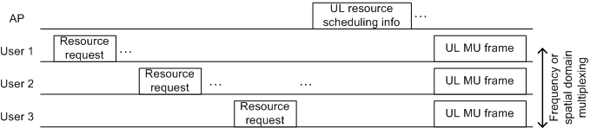
MAC Feasibility Check
  Check the feasibility in view of MAC overhead by data types
  Stand-alone UL data frame
  Users have to know transmission timing and the resource to transmit UL MU data. Then AP has to indicate the scheduling information before UL MU transmission. In order to do that, AP has to gather some information like UL data type/amount.
  UL periodic data such as VoIP packet may be easily known next transmission timing, data amount, etc. And because usually VoIP packet is quite short, it may get more overhead reduction gain.
< An example of stand-alone UL data frame >

Slide 14
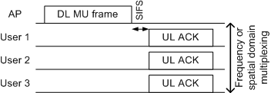
MAC Feasibility Check
DL-dependant UL frame
  Users already know the transmission timing and resource because UL data followed by DL transmission. The DL transmission contains UL scheduling information implicitly or explicitly.
  Therefore there is little scheduling overhead. But the usage is limited.
    e.g. UL MU ACK in response of DL-MU-MIMO frame
    e.g. UL MU Sounding in response of DL NDP frame
< An example of DL-dependant UL frame>

Slide 15
Summary of MAC Feasibility Check
 | Stand-alone UL data frame | DL-dependant UL frame
Delay | Can’t guarantee transmission time (contention-based channel ) | Right after SIFS + DL frame (no contention channel)
MAC overhead | Need new DL & UL control frames UL BW request frame DL scheduling frame | little overhead Just follow the rule of DL frame Add some signaling field in DL frame
Usage | All UL data frames | Limited. ( DL-dependant UL frame only)

Slide 16
Conclusion
UL MU transmission is a method for UL efficiency enhancement
PHY feasibility check
  It’s possible in view of timing offset in indoor, not in outdoor.
  UL MU FDM is feasible in the current requirement
  UL MU CDM/SDM may need some schemes to compensate frequency offset, and power difference.
  MAC feasibility check
  DL-dependant UL transmission is more feasible than stand-alone UL transmission due to some scheduling issue, etc.

Slide 17
Reference
[1] 11-13-0657-06 HEW SG Usage models and requirements liaison with WFA
[2] 11-09-0138-03 OFDMA Related Issues in VHTL6
[3] 11-10-0317-01 DL-OFDMA for Mixed Clients
[4]11-09-1036-00 Uplink MU-MIMO Sensitivity to Power Differences and Synchronization Errors
[5] 11-13-0536-00 HEW SG PHY Considerations For Outdoor Environment
[6] 11-13-1001-03 HEW Simulation scenarios document
[7] 3GPP TS 36.104 V12.1.0 E-UTRA Base Station radio transmission and reception (Release 12)
[8] Report ITU-R M.2135-1(12/2009)

Slide 18
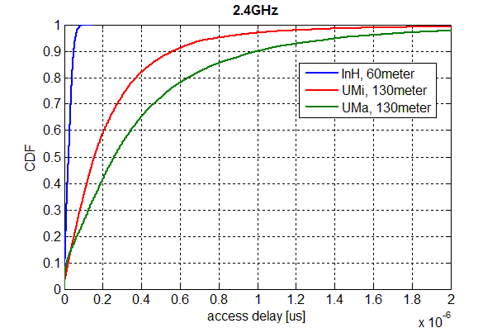
Appendix
Simulation conditions are same in [5].
5% outage line

