Slide 1
Discussions on Penetration Loss
Date: 2013-11-02
Authors:

Slide 2
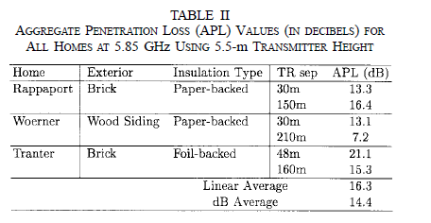
Introduction
Penetration Loss should be considered on almost all the simulation scenarios presented in [1]
For residential scenario, wall/floor penetration happens
For Enterprise Scenario, cubic wall penetration happens
For outdoor scenario, building/house wall penetration happens
Penetration loss is different for different materials and for different frequencies

Slide 3
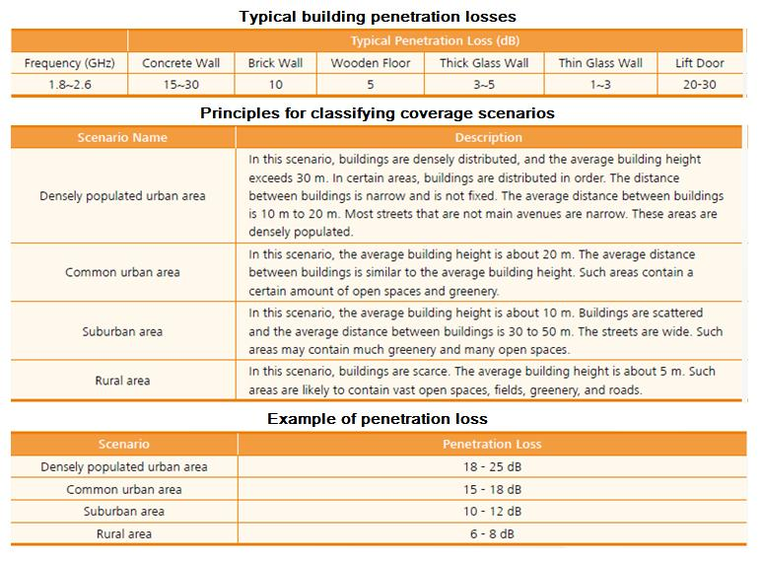

Slide 4
Outdoor-to-Indoor and indoor-to-outdoor Penetration Loss
Measurements and Information:
In [2], it is shown that the measured penetration loss are
Brick exterior wall: 14.5dB
In [3], LTE-advanced simulation setup uses fixed penetration the loss as 20dB
In ITU [4], Baseline evaluation configuration parameter for Macro suburban uses the fixed penetration loss as 20dB
In [7], 20dB at 5GHz exterior wall/floor penetration loss is suggested.

Slide 5
Indoor Wall Penetration Loss
Indoor walls
For residential indoor wall penetration
For Enterprise cubic wall penetration
Our measurements at 2.4GHz
A
B
C
D
E
Range of SNR
Tx
<21dB
>12dB
<12dB
>7dB
>21dB
~12dB
<7dB
Average SNR
Office
Room
23dB
17dB
12dB
7dB
3dB
35[m]

Slide 6
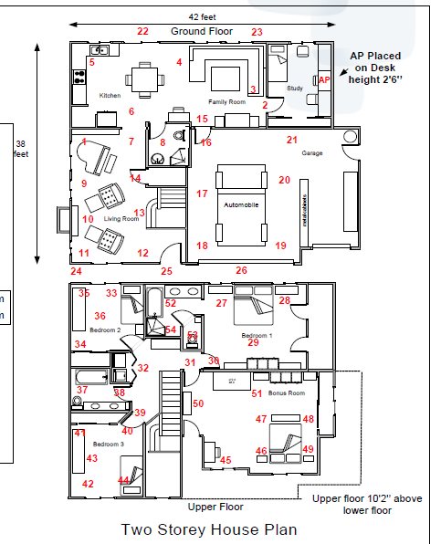
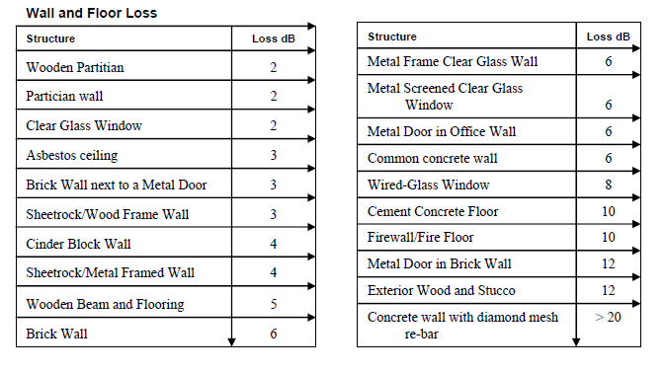
Measurement in WFA [5]
In US, sheertrock/wood frame wall are generally used in famly houses.
In EU and China, Brick wall is more popular.

Slide 7
Indoor Wall Penetration Loss (cont’s)
Base on our measurements, we saw averagely <5dB indoor wall penetration loss.
We did not count the path loss in our measurement.
In [2], the measured penetration loss of interior wall is 4.7dB
In [5], for different walls, it is between 3 to 6dB.
Other literatures show that 5GHz has <0.5dB more penetration loss than 2.4GHz.

Slide 8
Floor Penetration Loss
In [6], a floor penetration loss is measured in 1.8GHz and shows that roughly 18dB for the first floor.
We probably need find more measurements to finalize the floor penetration loss.

Slide 9
How to Model the Penetration Loss?
ITU channel model the penetration by a random variable with a std
Walls/floor are built with different materials and with different thickness.
Other simulation setups use fixed parameters for penetration loss
Maybe simpler for network simulations
More discussion probably is required.

Slide 10
References
“HEW SG Simulation Scenarios”, IEEE 802.11-13/1001r3, Simone Merlin, etc.
“5.85-GHz Radio Path Loss and Penetration Loss Measurements In and Around Homes and Trees”, IEEE COMMUNICATIONS LETTERS, VOL. 2, NO. 3, MARCH 1998.
“Comparison of LTE Advanced HetNets and Wi-Fi”, Qualcomm
“ETSI TR 136 931 V9.0.0 (2011-05)”
” Introduction to Indoor Propagation and Video Range Testing”, WFA 2007, Graham Smith. https://groups.wi-fi.org/apps/org/workgroup/videomarketing/documents.php
“Channel models for D2D performance evaluation “, 3GPP TSG-RAN WG1 #72bis, R1-131620
“HEW Simulation Methodology”, IEEE 802.11-13/1081r0, Sayanta Choudhury, etc.

