Slide 1
DSRC PER versus RSS Profiles
Authors:
Date: Nov. 8, 2013
Brian Gallagher (Denso DIAM ), John Kenney (Toyota ITC)

Slide 2
DSRC PER versus RSS Profiles
Line-of-Sight Vehicle-to-Vehicle Tests
Borrego Springs, CA
September 13, 2013

Slide 3
Purpose & Outline
Purpose
Develop Packet Error Rate (PER) versus Receive Signal Strength (RSS) profiles from vehicle-to-vehicle (V2V) line-of-sight (LOS) tests
Use prototype DSRC radios from two radio suppliers
Outline
Test Setup
Test Environment
PER and RSS Metrics
PER versus RSS Scatter Plots
Brian Gallagher (Denso DIAM ), John Kenney (Toyota ITC)

Slide 4
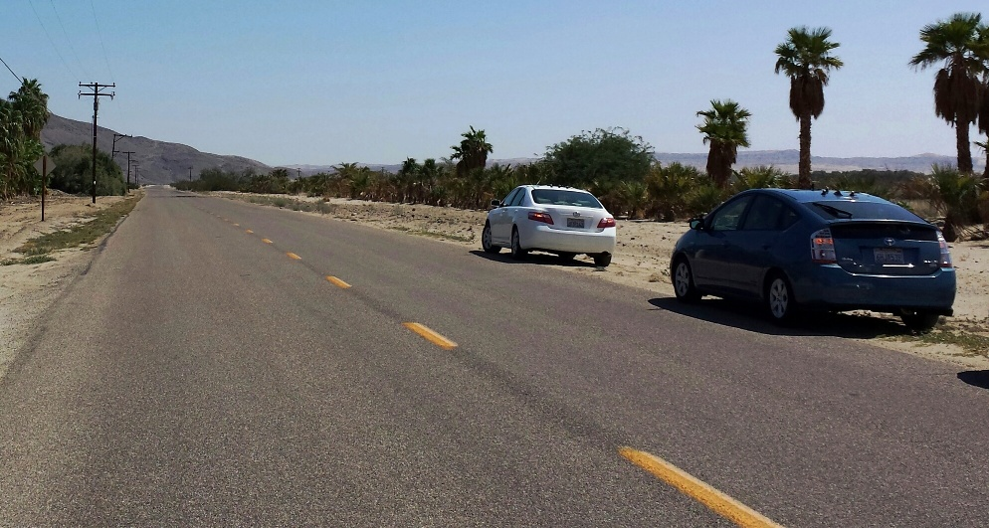
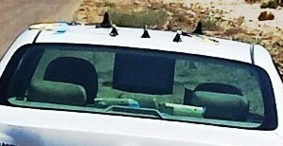
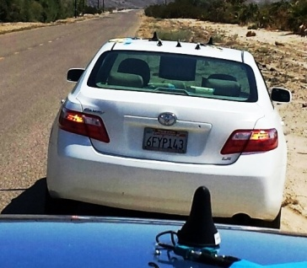
Test Setup
V2V tests performed on an open road
September 13, 2013
In Borrego Springs, CA
1 mobile receiving (RX) vehicle
Supplier 1 receiver
Supplier 2 receiver
Both receiving on 10 MHz channel 172
1 static transmitting (TX) vehicle
Reference transmitter
Radio from supplier 1
10 MHz Channel 172
Rooftop antennas
5.9 GHz DSRC band
Omnidirectional
Magnet-mount
Open road test site
ZOOM VIEW: RX CAR
RX
CAR
TX
CAR
Brian Gallagher (Denso DIAM ), John Kenney (Toyota ITC)

Slide 5
Test Environment
The RX vehicle
Moves outbound & inbound, away from and towards the TX vehicle
Travels at speeds approximately 35 to 40 mph
The environment was line-of-sight throughout drive range
No obstructions between the TX and RX vehicles
Henderson Canyon Road in Borrego Springs, CA
Number of passes: 6 total (3 outbound, 3 inbound)
Brian Gallagher (Denso DIAM ), John Kenney (Toyota ITC)

Slide 6
PER and RSS Metrics
PER
TX vehicle: Broadcasts ~1380 packets per second
Each packet includes a sequence number
PLCP length ~400 bytes
RX vehicle: Calculates PER every 100 ms
Calculated over ~138 incoming packets
Calculated based solely on the sequence numbers
Calculated independently on each supplier’s radio
RSS
RX vehicle: RSS is recorded from the last packet received in each 100 ms epoch
Receive Logs
Captured on each supplier’s radio hardware
Updated every 100 ms
Contains: Calculated PER and Recorded RSS
Brian Gallagher (Denso DIAM ), John Kenney (Toyota ITC)

Slide 7
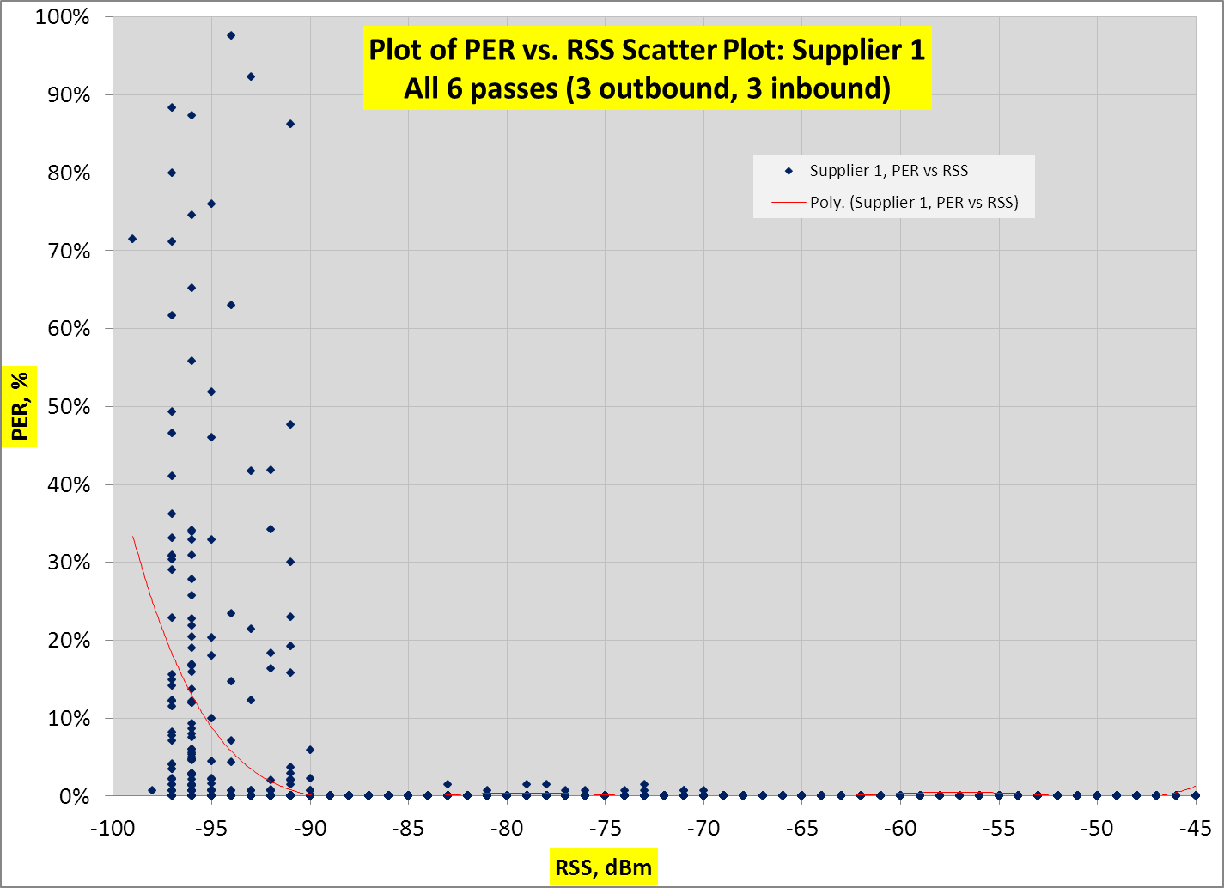
PER versus RSS Scatter Plot: Supplier 1

Slide 8
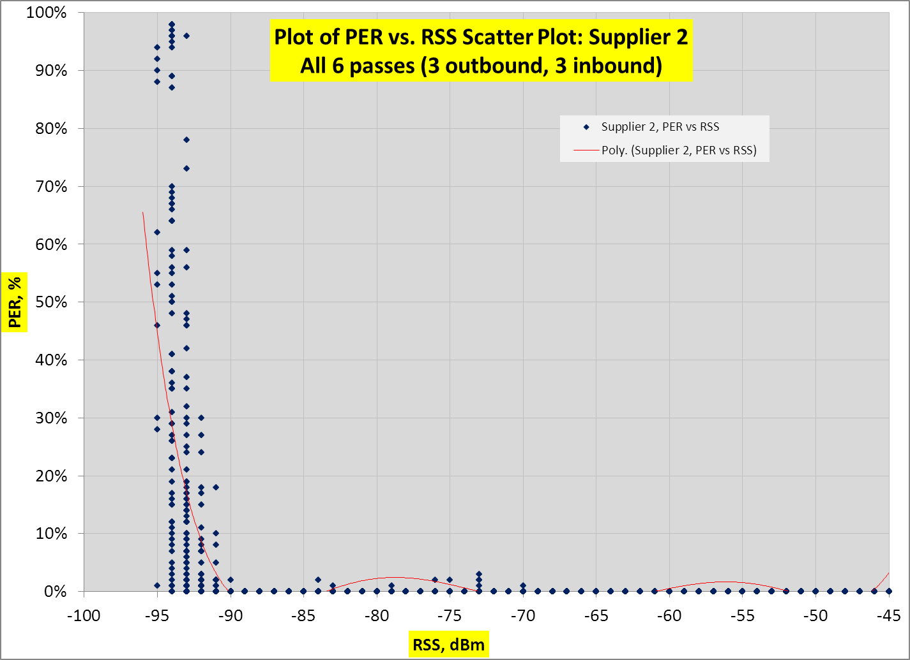
PER versus RSS Scatter Plot: Supplier 2

