Slide 1
Video Traffic Modeling
Date: 2013-11-12
Authors:
Name | Affiliations | Address | Phone | Email
Guoqing Li | Intel | 2111 NE 25th ave, Hillsboro, OR 97124 | 1-503-712-2089 | Guoqing.c.il@intel.com
Yiting Liao | Intel | Same as above | 1-503-264-6789 | Yitingl.liao@intel.com
Dmitry Akhmetov | Intel | Same as above
Robert Stacey | Intel | Same as above
William Carney | Sony Electronics | 16530 Via Esprillo San Diego, CA, 92127 | +1 858 774 9865 | william.carney @am.sony.com
Kåre Agardh | Sony Mobile | Nya Vattentornet 221 88 Lund Sweden | +46 (10) 801 3618 | kare.agardh @sonymobile.com
Hideyuki Suzuki | Sony Corporation | 2-10-1 Osaki Shinagawa-ku, Tokyo, 141-8610 | +81 (50) 3750 2715 | hideyukia.suzuki @jp.sony.com
Lachlan Michael | Sony Corporation | 16530 Via Esprillo, MZ 7032San Diego, CA 92127 | +1-858-942-8848 (Office) | Lachlan.Michael@jp.sony.com
Huairong | Samsung

Slide 2
Traffic Model Elements
There are three elements in traffic modeling
  Application traffic model: defines how a specific application generates traffic—Focus of this presentation
    Video traffic model
    Web browsing traffic model etc.
  Station application profiles: mixing of applications at stations—Please refer to Sony contribution #13/1305
    For example, station 1 has a profile of streaming+web browsing+ftp, station 2 has a profile of video conferencing + web browsing
  Profile configuration: pattern of the application events within a profile—please refer to Samsung contribution #13/1406
    For example, station 1 starts streaming at time 0, web browsing starts at time 10, ftp starts at time 60

Slide 3
Abstract
In previous contribution #13/1059, #13/1061 we have identified different categories of video applications and the associated characteristics
In this contribution, we will describe details of the video traffic modeling for simulating these applications
  We only focus on modeling the video data plane traffic while the session management protocol data is not considered here

Slide 4
Video traffic model in general
Trace-based video simulation
  Matches one or a few particular real videos
  However, the video traces may not represent all video applications and possible video types (animation, movies, mobile sharing, video conferencing etc.)
  Furthermore, trace-based simulation usually takes much longer simulation time since it needs to read from trace files, most likely one data at a time.
Statistical-model based video simulation
  Mostly used in various standards due to generality of the model to various traffic types
  More friendly for simulation modeling and increasing the speed of simulation
We highly recommend statistical-model based video traffic models for HEW simulations
  The statistical models should match the characteristics of the video applications
  The statics models should capture the most impacting factors while leaving the unnecessary details out for simplicity of simulations

Slide 5
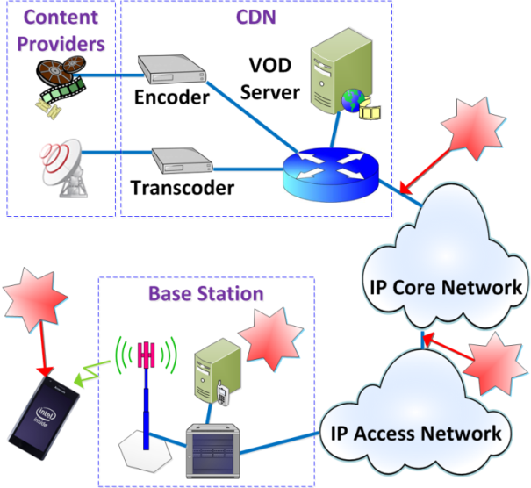
Recap from #13/1061
Buffered Video Streaming
Usually over HTTP/TCP/IP
Highly asymmetric on wireless link
  Video data in one direction
  TCP ACK in another direction
Multi-hop, multi-network domain
Bit rate of 5-8 Mbps is considered HD quality
  Different resolution/frame rate needs to scale the bit rate accordingly

Slide 6
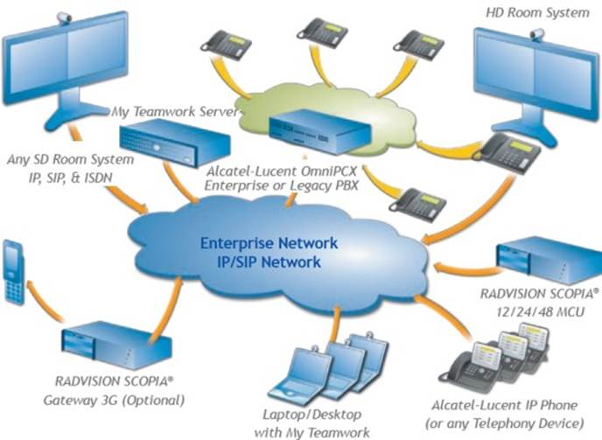
Recap from #13/1061
Video Conferencing
Usually over UDP/IP
Symmetric two-way traffic
Multi-hop, multi-network domain
1.2-4Mbps is considered HD calling
Slide 6

Slide 7
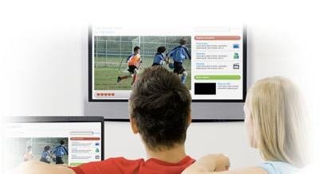
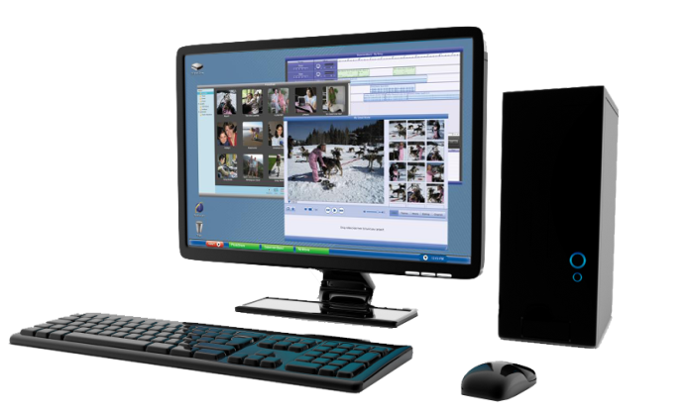
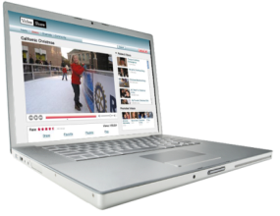
Recap from #13/1061: Wireless Display
Entertainment wireless display
Movie, pictures
Relaxed viewing experience
Distance ~10 feet
Wireless docking
Productivity synthetic video: Text, Graphics
More static scenes
Highly attentive
Close distance ~2 feet
Highly interactive
50-300Mbps is recommended as video bit rate for wireless display
Slide 7

Slide 8
Traffic model for wireless display
[3] describes the traffic model for simulating wireless display
  Each video slice size is modeled as a Normal distribution
  Each slice is generated at fixed interval (i.e., slice interval)
There are some details missing. For example, the packetization of video frames into MPEG-TS packets or other system layer packetization after encoding process
However, these are not essential for HEW simulations. The MPEG-TS only adds minimum header overhead, which can be ignored for HEW simulations
Therefore, we recommend continue using this model for simulating wireless display with slight modification
  The max slice size, slice interval, and packet size should be set according to video format instead of fixed values as in [3]

Slide 9
Traffic Modeling for Buffered Video streaming
Considerations
  Video frame size may vary significantly
  Video packets are fragmented into TCP segments before transmission
    Traffic between AP and STA are small TCP/IP packets instead of big video frames/slices.
  These TCP/IP packets may experience different delays/jitters before they arrive at AP for transmission due to differences in routing and queuing
    As a result, MSDU inter-arrival time is not constant and has little relationship with video frame rate

Slide 10

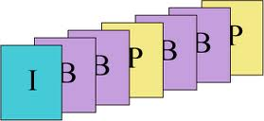
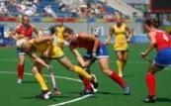

Video frame #3
Video frame #1
Video service, encoding
Video frame #2
Application (Encoder)
frame interval
TCP/IP
IP network
Traffic Model For HEW Simulations
MSDU
MAC
Guoqing Li (Intel)

Slide 11
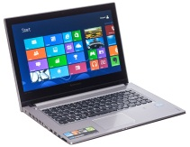
Traffic Modeling for Video Streaming
Step 1: Generate video frame size
Step 3: Add network jitter to each TCP/IP packet
App
App
TCP/IP
TCP/IP
MAC/PHY
MAC/PHY
App
TCP/IP
MAC/PHY
Step 2: Convert video frame size into TCP/IP packets
Note: No need to simulate multiple entities for traffic model. Step 1-3 can all be simulated inside AP

Slide 12
Traffic Modeling for Video Conferencing
App
UDP/IP
MAC/PHY
App
App
UDP/IP
Traffic model for HEW simulation
MAC/PHY
UDP/IP
MAC/PHY
App
UDP/IP
MAC/PHY
Difference from video streaming
  Traffic is a bi-directional traffic
  Video traffic is usually over UDP/IP
Traffic Model
  STA→AP: no delay to be added since there is no network latency
      Step 1: Generate video frame size (same as video streaming)
      Step 2: Convert video frame size into the number of UDP packets
  AP→STA: same as video streaming

Slide 13
Traffic Modeling for Video Streaming (cont.)
Step 1: Generate video frame size
Step 2: Convert video frame size into TCP/IP Packets
Step 3: Add network jitter to each TCP/IP packet

Slide 14
Modeling Video frame size
There have been many references on video frame size modeling for MPEG-4/H.264 videos [4-9,13]
However, these models may not be applicable for HEW
  For example, some models require modeling of the correlation of video frames, which are not necessary for HEW. In fact, today video conferencing may not have a GOP structure at all and such correlation is not applicable
  Some models require information regarding video server strategy, estimation of the E2E BW, and/or client playback policy
  Some video models were derived from video traces at very low bit rate such as 64K, whose distribution and parameters may be different for the data rate considered for HEW
Due to these limitations, we generated video traces based on the bit rate range and typical codec settings suited for HEW use cases, and derived video frame size model based on these traces

Slide 15
Video Traces
Frame size (Cars@4Mbps)
Video streaming traces
  Animation video (Cars, Big Buck Bunny)
  Documentary films
  Natural video (5th Elementary, Tears of Steel)
Video conferencing traces
  Mobile: similar to social video sharing, more motion
  Stationary plain: traditional video conferencing scene
  Busy: background scene is less motion, but with high complexity
Bit rate range: 1.2M—8M
Total of 100 video traces with ~2 million video frames

Slide 16
Distribution fitting
Distributions fitted
  Exponential, gamma, weibull, pareto, lognormal, normal, loglogistic
Examples of distribution fitting results
Movie: big bunny @4Mbps
Tear @4.5M

Slide 17
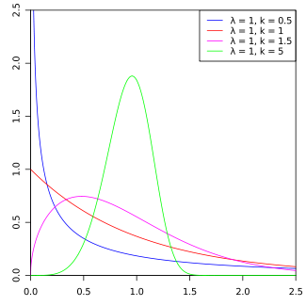

Summary of the distribution fitting results
Majority of the traces fit best with Weibull distribution with some exceptions
Weilbull pdf is shown below
Because video frame size is upper bounded by uncompressed video frame size, we recommend using a truncated Weibull distribution with the parameters described in #13/1335
  An example, for1080p30@ 6Mbps: lamda (scale) =20850, k (shape)=0.8099

Slide 18
Approaches for video stream traffic modeling
Step 1: modeling video frame size
Step 2: convert video frame size into TCP/IP packets
Step 3: add network jitter for each packet

Slide 19
Approaches for video stream traffic modeling
Step 1: modeling video frame size
Step 2: convert video frame size into of TCP/IP packets
Step 3: add network jitter for each packet

Slide 20
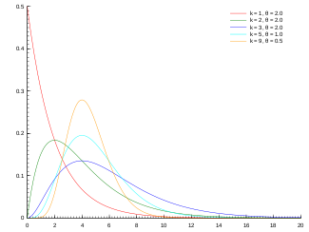

Modeling network latency
Network latency can be modeled either Jitter, i.e., latency difference between two adjacent packets such as model described in [11]
However, jitter generation can result in a negative value which is very hard to model for time-event simulation tools (e.g., ns3)
Alternatively, we can model the network latency directly with the distribution derived in [12]
  Network latency follows gamma distribution
    For example, K =0.2463, Theta =55.928 gives mean of 14.583ms
  Given limited simulation, truncated value is recommended.
    If delay>end of simulation, regenerate the delay
  More details are described in doc#13/1335

Slide 21
Summary of traffic modeling for Video Streaming
One directional video traffic from AP→STA
Video traffic runs over TCP/IP
Generation of video traffic follows three steps
  Step 1: generate video frame size according to truncated Weibull distribution at fixed frame rate
  Step 2: Fragment video frame size into TCP/IP packets, assuming a fixed TCP segment size
  Step 3: add network latency according to Gamma distribution

Slide 22
Summary of Traffic modeling for video Conferencing
Video traffic is bi-directional
Traffic is over UDP/IP
AP→STA: traffic model is the same as video streaming
STA→AP: traffic model follows the first two steps of video streaming traffic model

Slide 23
Metrics to evaluation
MAC layer performance metrics
  Throughput, latency etc.
TCP throughput for video streaming
  TCP performance is what is perceived by the application
  Behavior of TCP such as success/failure in delivery of TCP ACK has great impact on application performance
  Therefore, it is critical to evaluate TCP performance metrics addition to MAC layer metrics

Slide 24
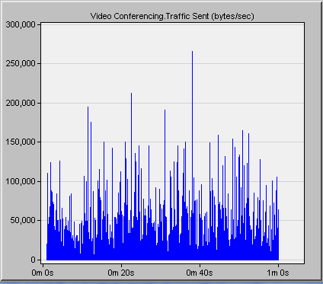
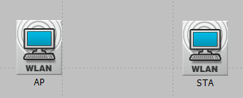
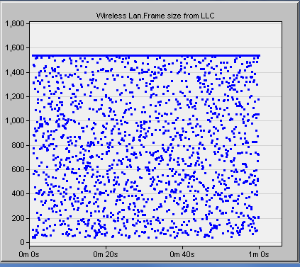
An Example of video traffic simulation
Step 1: Generate video frame size
App
TCP/IP
MAC/PHY
Step 2: Convert video frame size into TCP/IP packets
Step 3: Add network latency to TCP/IP packet

Slide 25
Summary
We have proposed statistical-model based video traffic models for HEW simulations
The models were derived based on the characteristics of the video applications and the real video traces
We believe the proposed models have captured the essential details of the video applications while leaving the unnecessary details out for simplicity of simulations
  Specifically, both bursty-ness of the video packet size as well as bursty-ness of the packet arrival schedule at AP have been captured
Please refer to doc#13/1334 for more details

Slide 26
References
[1] 11-13-1162-01-hew-vide-categories-and-characteristics
[2] 11-13-1059-01-hew-video-performance-requirements-and-simulation-parameters
[3]11-09-0296-16-00ad-evaluation-methodology.doc
[4] Rongduo Liu et al., “An Emperical Traffic Model of M2M Mobile Streaming Services ”, International conference C on Multimedia information networking and security, 2012
[5] JO. Rose, “ Statistical properties of MPEG video traffic and their impact on traffic modeling in ATM systems ”, Tech report, Institute of CS in University of Wurzburg
[6] Savery Tanwir., “A survey of VBR traffic models”, IEEE communication surveys and tutorials, Jan 2013
[7] Aggelos Lazaris et al., “A new model for video traffic originating from multiplexed MPEG-4 videoconferencing streams”, International journal on performance evaluation, 2007
[8] A. Golaup et al., “Modeling of MPEG4 traffic at GOP level using autoregressive process”, IEEE VTC, 2002
[9] K. Park et al., “Self-Similar network traffic and performance evaluation”, John Wiley&Son, 2000
[10] M Dai et al., “A unified traffic model for MPEG-4 and H.264 video traces”, IEEE Trans. on multimedia, issue 5 2009.
[11] L Rezo-Domninggues et al., “Jitter in IP network: A cauchy approach”, IEEE Comm. Letter, Feb 2010
[12] Hongli Zhang et al., “Modeling Internet link delay based on measurement”, International conference on electronic computer technology, 2009.
[13] Ashwin et al., “Network characteristics of video streaming traffic”, ACM CoNext 2011
Slide 26

