Slide 1
Harmful Interference to DSRC Systems
Authors:
Date: Nov. 1, 2013
John Kenney (Toyota ITC), Brian Gallagher (Denso DIAM)

Slide 2
Part 15 General Conditions:
“no harmful interference”
Title 47 – Telecommunication
Chapter I – Federal Communications Commission
Part 15 – Radio Frequency Devices
§15.5 General conditions of operation.
(a) Persons operating intentional or unintentional radiators shall not be deemed to have any vested or recognizable right to continued use of any given frequency by virtue of prior registration or certification of equipment, or, for power line carrier systems, on the basis of prior notification of use pursuant to §90.35(g) of this chapter.
(b) Operation of an intentional, unintentional, or incidental radiator is subject to the conditions that no harmful interference is caused and that interference must be accepted that may be caused by the operation of an authorized radio station, by another intentional or unintentional radiator, by industrial, scientific and medical (ISM) equipment, or by an incidental radiator.
(c) The operator of a radio frequency device shall be required to cease operating the device upon notification by a Commission representative that the device is causing harmful interference. Operation shall not resume until the condition causing the harmful interference has been corrected.
(d) Intentional radiators that produce Class B emissions (damped wave) are prohibited.

Slide 3


Harmful Interference to 5.9 GHz DSRC Connected Vehicles for Intelligent Transport Systems
Short Intro to DSRC
V2V Safety and DSRC Channel Plan
Harmful Interference
Most of this material was prepared by:
and has been presented to various stakeholders

Slide 4
Introduction to DSRC
5.9 GHz DSRC is essential for V2V crash-imminent safety applications, and must be protected from U-NII-3 and U-NII-4 devices.
V2V safety has stringent communications requirements, but future pre-crash and automation requirements may be even more stringent.
All current DSRC channels are needed for future applications and re-channelization and channel use rule changes are not feasible.
Currently in final stages of U.S. DOT NHTSA mandate decision.
Thorough testing is needed to determine whether sharing with U-NII devices is possible.

Slide 5
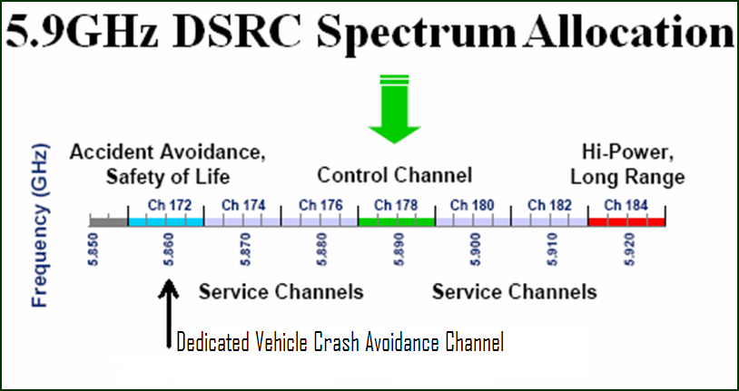
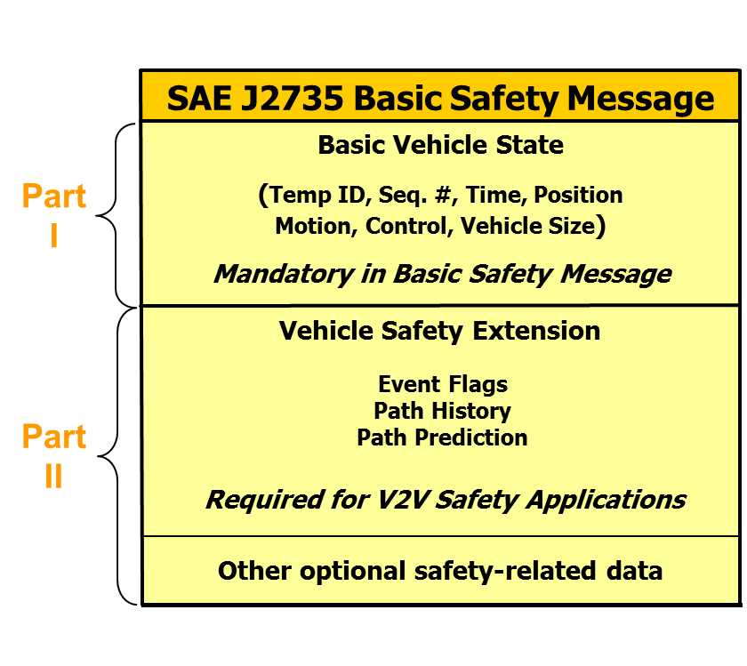
Dedicated Short Range Communications (DSRC)
75 MHz of spectrum @ 5.9 GHz for ITS
Key Benefits
  802.11p technology similar to 802.11a
  Low latency communication (<< 50 ms)
  High data transfer rates (3 – 27 Mbps)
  Line-of-sight, up to 1000 m and 360º
  Low power message reception (< -90 dBm)
Standards
  IEEE: 802.11p, 1609.2 – 1609.4, 1609.12
  SAE: J2735, J2945
V2V Basic Safety Message (BSM)
  Average message size: ~320 to 350 bytes
  Default transmit rate: 10 Hz
    More sophisticated protocols in development
  Default transmit power: 20 dBm
  Enables multiple V2V Safety Applications

Slide 6
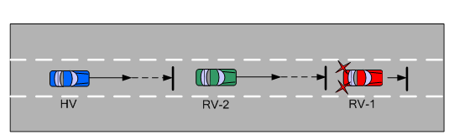

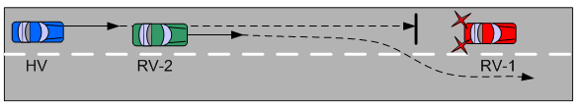

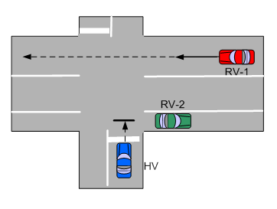
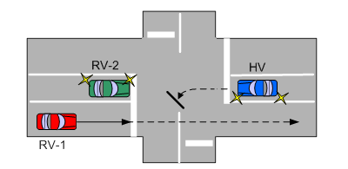
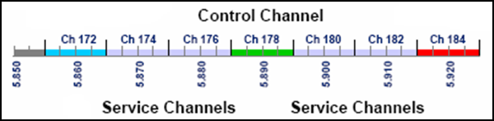
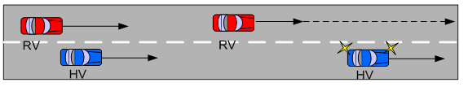

V2V Safety Communications – Summary
  Different manufacturers
  Communicating on the same channel
  Exchanging the same BSM information
  Enables multiple V2V safety applications
Emergency Electronic Brake Lights (EEBL)
Forward Collision Warning (FCW)
Left Turn Assist (LTA)
Intersection Movement Assist (IMA)
Blind Spot / Lane Change Warning (BSW / LCW)
Do Not Pass Warning (DNPW)

Slide 7
Illustrative DSRC Channel Plan
Ch 172 -Vehicle-to-Vehicle: Crash Avoidance Safety *
Ch 174 – Vehicle-to-Vehicle: Autonomous Vehicle and Pre-Crash
Ch 176 - Vehicle-to-Infrastructure: RSU for Heavy Traffic and Multi-Lane Highway Automation
Ch 178 - Central Control Channel *
Ch 180 – Vehicle-to-Infrastructure: Security Communications (Anti-Hacking)
Ch 182 - Vehicle-to-Infrastructure: Work Zone Safety, Tolling, Road Condition Warnings, Driver Assistance, Commercial Uses, etc.
Ch 184 - Vehicle-to-Infrastructure: Public Safety Agencies, State Highway Agencies, etc. (Intersection Safety, Emergency Vehicle Signal Priority) *
*- Use restriction designated in FCC rules

Slide 8
Harmful Interference to 5.9 GHz DSRC Connected Vehicle Safety
"Harmful Interference" includes any "interference which endangers the functioning of" DSRC safety services, due to the fact that the opportunity for DSRC to potentially prevent a collision would be impaired. 47 C.F.R §2.1
Interference should not lead to the delay or omission of a timely safety action (e.g., warning information or control actions provided to the driver/vehicle) that could have otherwise been provided in order to prevent a crash.
The threat of an imminent crash could arise instantaneously during driving conflicts. Therefore, any delay in timely warning or control actions caused by interference must be imperceptible.
DSRC Safety messages can be received at near their threshold sensitivity levels. U-NII-to-DSRC impairments are not an inherent part of DSRC countermeasures.

Slide 9
Harmful Interference to 5.9 GHz DSRC Connected Vehicle Safety - Metrics
PER: Ratio of the number of missed packets (i.e. safety messages) at a receiver from a particular transmitter and total number of packets sent by that transmitter.
IPG: Inter-Packet Gap - Time between successive successful packet (i.e. safety message) receptions from a particular transmitter.
Link Range: Dependable communication range between a particular transmitter and receiver.
TTC: Time-to-collision is frequently used as a descriptor of how urgent a conflict situation has become, as well as potentially how a driver perceives stimuli during a pre-crash event.

Slide 10
Harmful Interference to 5.9 GHz DSRC Connected Vehicle Safety - Sources
Unlicensed UNII-4 Co-Channel Interference
Unlicensed UNII-4 Cross-Channel Interference
Unlicensed UNII-3 Out-of-Band Interference
All of these
  Result in raised noise floor
  Result in increased PER and IPG
  Result in increased channel congestion
  Result in channel access delay
  Result in reduced link range

Slide 11
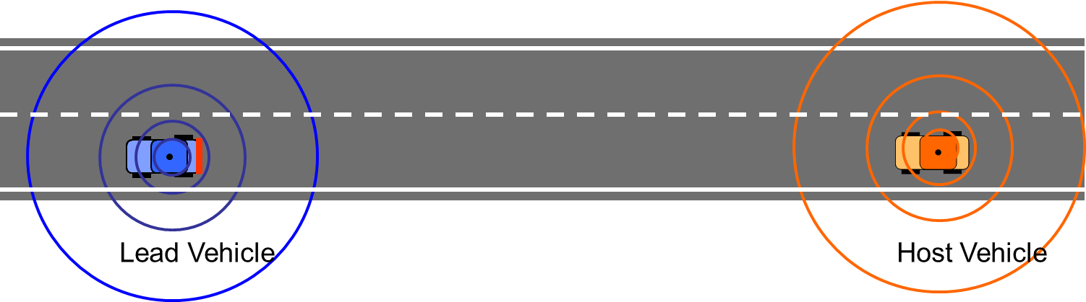
Harmful Interference to 5.9 GHz DSRC Connected Vehicle Safety – e.g. FCW
Forward Collision Warning (FCW)
Cooperative FCW feature provides alerts intended to assist drivers in avoiding or mitigating a rear-end crash.
FCW may alert the driver to an approaching (or closing) conflict a few seconds before the driver would have detected such a conflict (e.g., if the driver's eyes were off-the-road), so the driver can take any necessary corrective action (e.g., steering, hard braking, etc.).
The goal of the alert timing approach is to allow the driver enough time to avoid the crash, and yet avoid annoying the driver with alerts perceived as occurring too early, too often or unnecessarily.

Slide 12
Harmful Interference to 5.9 GHz DSRC Connected Vehicle Safety – e.g. FCW
Forward Collision Warning (FCW) Lead Vehicle Decelerating (LVD) Scenario
LV & FV = 45 MPH
Distance between vehicles 10 m
LV brakes at 0.6g
TTC = 1.8 seconds
Interference from U-NII devices could result in delay of timely warning information provided to the driver, or the warning could be completely missed. In either case, the opportunity for the driver to potentially prevent a crash is impaired.
U-NII devices operating in the DSRC band could cause significant interference to packet (i.e. safety messages) reception, leading to unknown and perhaps high Inter-Packet Gap (IPG) and Packet Error Rate (PER).
Consequently, they could cause harmful interference affecting the performance (and the benefits to be derived from) these safety systems.
High IPG and PER would also affect security verification since the messages with certificates attached may be lost or delayed due to interference from U-NII devices.

Slide 13
U-NII Transmission Scenarios Manifesting Harmful Interference
Examples
Hidden Node Collisions
Hidden Node Collision: one-sided detection
Countdown Collision: mutual detection
Simple Delay
Extended Delay
Indefinite Delay – Multi-U-NII senders
Indefinite Delay – Multi-WLAN
Note: All of these can be induced via:
    U-NII-4 Co-channel interference
    U-NII-4 Cross-channel interference
    U-NII-3 Out-of-band Interference

Slide 14
U-NII Harmful Interference
1. Hidden node collisions
RSSI_{U-NII} < -65 dBm
RSSI_{DSRC} < -62 dBm
U-NII
U-NII CCA state = idle
U-NII packet K
U-NII packet K+1
time
COLLISION
DSRC Packet N
not received
COLLISION
DSRC Packet N+1
not received
DSRC N
DSRC N+1
DSRC Lead CCA state = Idle

Slide 15
U-NII Harmful Interference
2. Hidden node collision: one-sided detect
RSSI_{U-NII} < -65 dBm
U-NII
U-NII ready to send packet K, backoff
U-NII packet K
time
COLLISION
DSRC Packet N+1
not received
IFS_{U}
DSRC N
U-NII inter-frame space
DSRC N+1

Slide 16
U-NII Harmful Interference
3. Countdown collision: mutual detect
RSSI_{U-NII} > -65 dBm
U-NII
U-NII uses IFS_{D}
U-NII packet K
U-NII packet K+1
time
IFS_{D}
COLLISION
DSRC Packet N
not received
U-NII ready to send
packet K+1, backoff
DSRC inter-frame space
DSRC N
DSRC ready to send packet N, backoff

Slide 17
U-NII Harmful Interference
4. Simple Delay
RSSI_{U-NII} > -65 dBm
U-NII
U-NII packet
time
IFS_{D}
DSRC N
DSRC ready to send packet N, backoff
DSRC packet N sent

Slide 18
U-NII Harmful Interference
5. Extended Delay
RSSI_{U-NII} > -65 dBm
U-NII
U-NII
U-NII
U-NII
U-NII
U-NII
time
Frame concatenation
IFS_{D}
DSRC N
DSRC ready to send packet N, backoff
DSRC packet N sent

Slide 19
U-NII Harmful Interference
6. Indefinite Delay: Multiple senders
RSSI_{U-NII} > -65 dBm
U-NII
U-NII
U-NII
U-NII
U-NII
time
IFS_{U}
IFS_{D}
DSRC N
DSRC packet N sent
DSRC ready to send packet N, backoff

Slide 20
U-NII Harmful Interference
7. Indefinite Delay: Multi-WLAN
RSSI_{U-NII} > -65 dBm
U-NII
U-NII
U-NII
U-NII
U-NII
U-NII
time
IFS_{U}
IFS_{D}
DSRC N
DSRC ready to send packet N, backoff
DSRC packet N sent
U-NII
U-NII
U-NII
U-NII

Slide 21
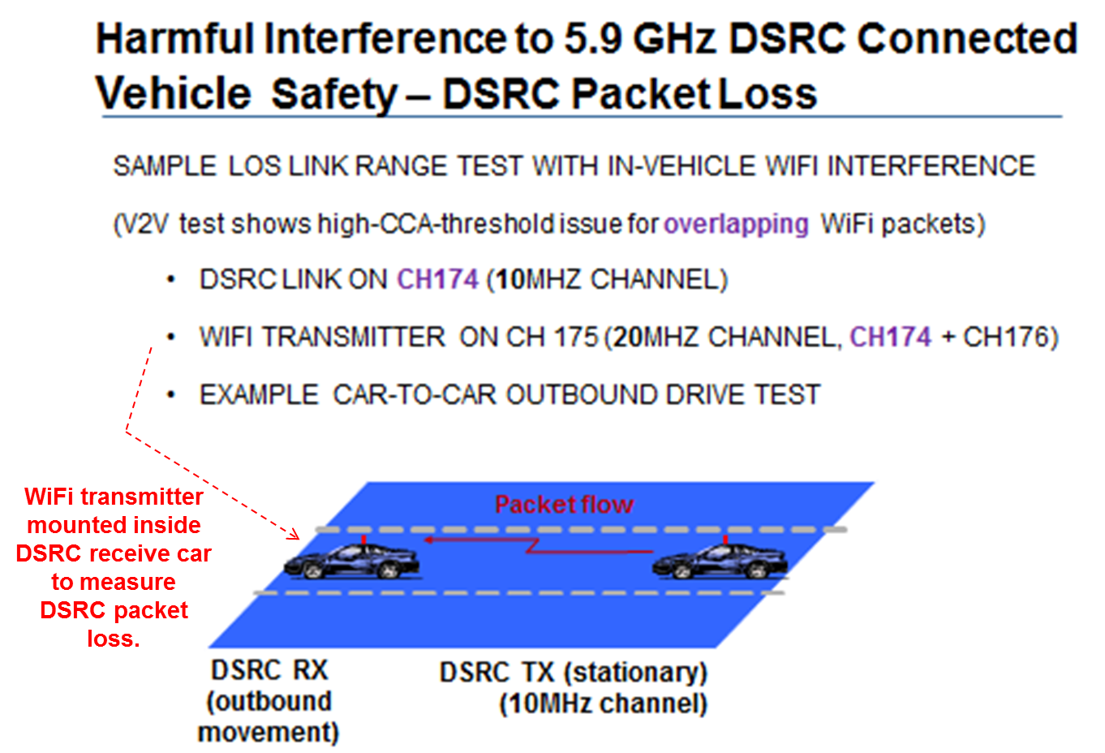
Diagram of WiFi Interference Experiment:
LOS outbound test performed with & without WiFi Interference

Slide 22
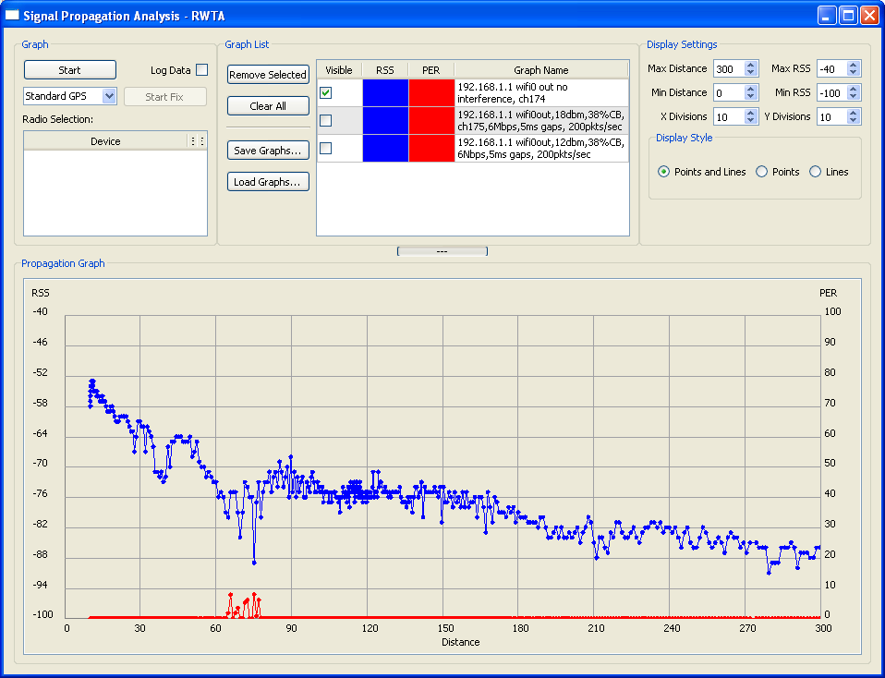
Reference plot:
DSRC car-to-car link range on city street
No in-vehicle WiFi interference
Green shading shows low PER over link range
With no WiFi interference: Low PER

Slide 23
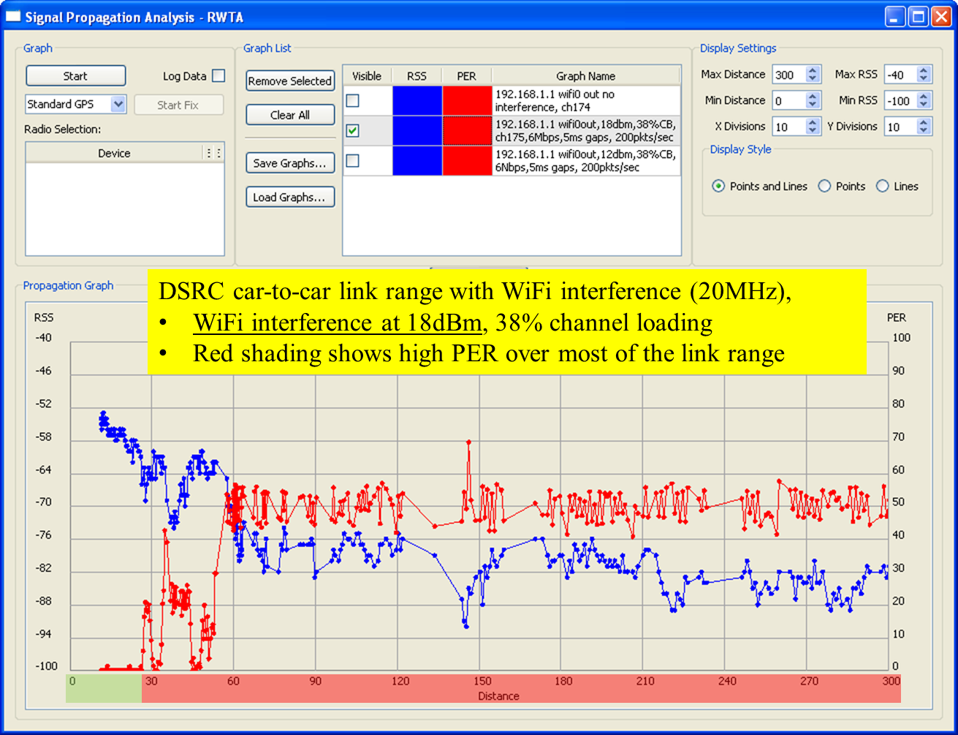
With WiFi interference (18dBm): High PER, Limited range

Slide 24
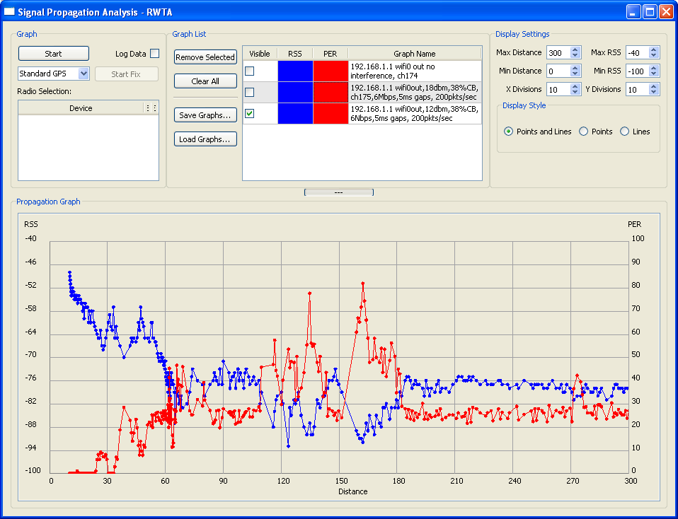
DSRC car-to-car link range with WiFi interference (20MHz),
WiFi interference at 12dBm, 38% channel loading
Red shading shows high PER over range >45m
With interference (12dBm): High PER, Limited range

Slide 25

Harmful Interference to 5.9 GHz DSRC Connected Vehicle Safety – DSRC Packet Loss in EEBL (Overlapping WiFi packets)
Emergency Electronic Brake Light (EEBL)
EEBL (Emergency Braking warning rec’d)
EEBL (no Emergency Braking warning)
DSRC RX
DSRC TX (10MHz ch.)
DSRC RX
DSRC TX (10MHz ch.)
HV = Host Vehicle
(Receives BSMs & gives collision warnings)
= In-Vehicle
WiFi xmtr (20-160MHz channel)
The driver of the HV won’t be warned of the hard braking event due to interference.
The green area indicates low packet error between the BSM sender and the HV.
The red area indicates regions with high packet loss due to overlapping WiFi packets.

Slide 26
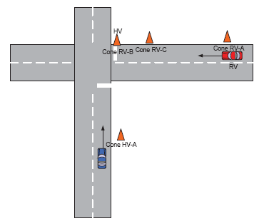
Harmful Interference to 5.9 GHz DSRC Connected Vehicle Safety – DSRC Packet Loss in Cross-Path Collision (Overlapping WiFi)
Cross-Path Collision (driver gets warning)
Cross-Path Collision (no driver warning)
DSRC TX
(10MHz channel)
DSRC TX
(10MHz channel)
DSRC RX
DSRC RX
HV = Host Vehicle
(Receives BSMs and gives collision warnings)
= In-Vehicle
WiFi xmtr
(20-160MHz channel)
The driver of the HV will not receive the cross-path collision warning.
The green area indicates low packet error between the BSM sender and the HV.
The red area indicates regions with high packet loss due to overlapping WiFi packets.

Slide 27
WiFi Network Types: Notional Impact on DSRC
WiFi network Interference source | BSM loss/ packet loss (CCA-below threshold) | DSRC hidden node -packet collisions/IPG (unbalanced EIRP) | DSRC IPG growth (deferral with CCA-above threshold) | TTC/ IPG growth | Reduced link range
In-Vehicle WiFi | X |  | X | X | X
City/Cable WiFi | X | X | X | X | X
WISP WiFi | X | X | X | X | X
Carrier WiFi | X | X | X | X | X

Slide 28
Harmful Interference to 5.9 GHz DSRC Connected Vehicle Safety - Testing
Significant real world testing is required to assess the consequences of introducing U-NII devices into the DSRC band.
Need to understand the various options and proposals for sharing between U-NII devices and DSRC services in the DSRC band, including U-NII operations in the U-NII-3 band that may cause out-of-band harmful interference.
Develop prototype implementations of devices that implement the sharing protocols.
Develop a test plan to conduct detailed harmful interference testing to address
  U-NII-4 Co-Channel Interference
  U-NII-4 Adjacent-Channel Interference
  U-NII-3 Out-of-Band Interference

Slide 29
Summary
5.9 GHz DSRC is essential for V2V crash-imminent safety applications, and must be protected from U-NII-3 and U-NII-4 devices.
V2V safety has stringent communications requirements, but future pre-crash and automation requirements may be even more stringent.
All current DSRC channels are needed for future applications and re-channelization and channel use rule changes are not feasible.
Currently in final stages of U.S. DOT NHTSA mandate decision.
Thorough testing is needed to determine U-NII device sharing constraints and appropriate requirements.

Slide 30
Additional Background Slides

Slide 31
Example V2X Safety Applications
Communications Between Vehicle and Infrastructure
Blind Merge Warning
Curve Speed Warning
Emergency Vehicle Signal Preemption
Highway/Rail Collision Warning
Intersection Collision Warning
In Vehicle Amber Alert
In-Vehicle Signage
Just-In-Time Repair Notification
Left Turn Assistant
Low Bridge Warning
Low Parking Structure Warning
Pedestrian Crossing Information at Intersection
Road Condition Warning
Safety Recall Notice
SOS Services
Stop Sign Movement Assistance
Stop Sign Violation Warning
Traffic Signal Violation Warning
Work Zone Warning
Communications Between Vehicles
Approaching Emergency Vehicle Warning
Blind Spot Warning
Cooperative Adaptive Cruise Control
Cooperative Collision Warning
Cooperative Forward Collision Warning
Cooperative Vehicle-Highway Automation System
Emergency Electronic Brake Lights
Highway Merge Assistant
Lane Change Warning
Post-Crash Warning
Pre-Crash Sensing
Vehicle-Based Road Condition Warning
Vehicle-to-Vehicle Road Feature Notification
Visibility Enhancer
Wrong Way Driver Warning
Do Not Pass Warning
Intersection Movement Assist
Control Loss Warning
Applications developed and evaluated under the Safety Pilot Model Deployment

Slide 32
Introduction to DSRC
Congress created the Intelligent Transportation System (ITS) program in 1991.
Administered by USDOT.
Uses advanced electronics to improve traveler safety, decrease traffic congestion, reduce air pollution, and conserve fossil fuels.
Dedicated short-range communications (DSRC) is a wireless (IEEE 802.11) ITS system designed for automotive use.
DSRC is a short-to-medium-range wireless communication protocol that permits very low latency data transfer critical in communications-based active safety applications.

Slide 33
Introduction to DSRC (cont’d)
DSRC includes both on-board units (OBUs) and roadside units (RSUs).
An OBU is a DSRC transceiver that is normally mounted in or on a vehicle, or which may be portable. OBUs can operate while a vehicle is stationary or mobile, and they transmit and receive on one or more radio frequency channels.
An RSU is a DSRC transceiver that is mounted along a roadway or other fixed location. It may also be mounted on a vehicle or be hand carried, but may only operate when stationary.

Slide 34
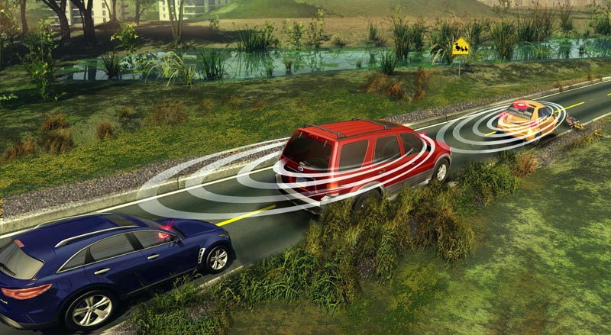
DSRC = OPPORTUNITY FOR SAFER DRIVING
November 2013
Vehicle crashes account for: 32,367 deaths/year (2011)
5,338,000 crashes/year
leading cause of death for
ages 4-34
Greater situational awareness
  Your vehicle can “see” nearby vehicles and knows roadway conditions (e.g., road works) you can’t see
  360 degree “visibility”
Reduce or even eliminate crashes thru:
  Driver Advisories
  Driver Warnings
  Vehicle Control
NHTSA estimates that connected vehicles have the potential to address approximately 80% of vehicle crash scenarios involving unimpaired drivers
Notes:
Enables vehicles with 360-degree awareness to inform a driver of hazards and situations they can’t see.
CV safety applications have the potential to reduce or eliminate crashes through a combination of Driver Advisories; Driver Warnings; and Vehicle Controls.
CV has the capability of addressing the majority of crash situations and prevent tens of thousands of deaths every year.

Slide 35
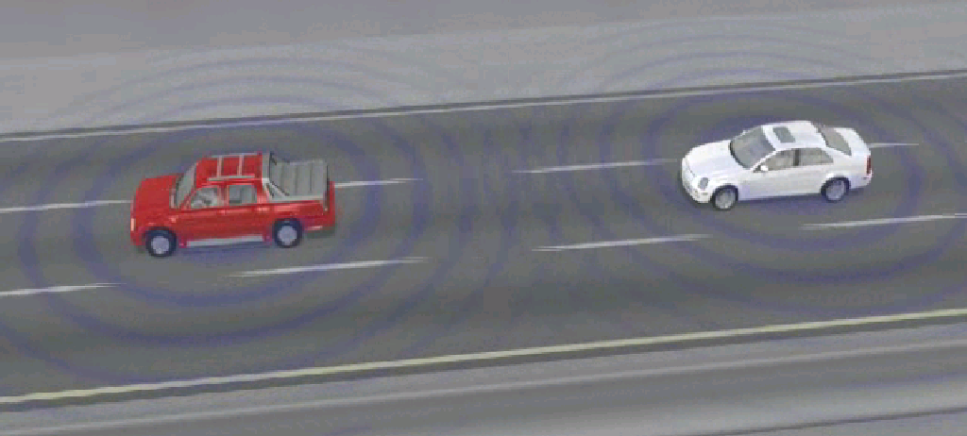
DSRC + GPS: A New Safety Sensor
November 2013
V2I
V2V
Lower cost enables deployment to all market segments, not just luxury
Offers new features not possible with existing obstacle detection-based driver assistance systems
Enhances existing obstacle detection-based driver assistance systems
Reduced cost & complexity
Robust performance: Immune to extreme weather conditions
Notes:
35

Slide 36
Safety Applications vs. Crash Scenarios Mapping
 | V2V Safety Applications Crash Scenarios | EEBL | FCW | BSW | LCW | DNPW | IMA | CLW
1 | Lead Vehicle Stopped |  | ✓
2 | Control Loss without Prior Vehicle Action |  |  |  |  |  |  | ✓
3 | Vehicle(s) Turning at Non-Signalized Junctions |  |  |  |  |  | ✓
4 | Straight Crossing Paths at Non-Signalized Junctions |  |  |  |  |  | ✓
5 | Lead Vehicle Decelerating | ✓ | ✓
6 | Vehicle(s) Not Making a Maneuver – Opposite Direction |  |  |  |  | ✓
7 | Vehicle(s) Changing Lanes – Same Direction |  |  | ✓ | ✓
8 | LTAP/OD at Non-Signalized Junctions |  |  |  |  |  | ✓
EEBL: Emergency Electronic Brake Lights
FCW: Forward Collision Warning
BSW: Blind Spot Warning
LCW: Lane Change Warning
DNPW: Do Not Pass Warning
IMA: Intersection Movement Assist
CLW: Control Loss Warning
Note: Crash Scenario reference: “VSC-A Applications_NHTSA-CAMP Comparison v2” document, USDOT, May 2 2007. Selected based on 2004 General Estimates System (GES) data and Top Composite Ranking (High Freq., High Cost and High Functional Years lost).

Slide 37
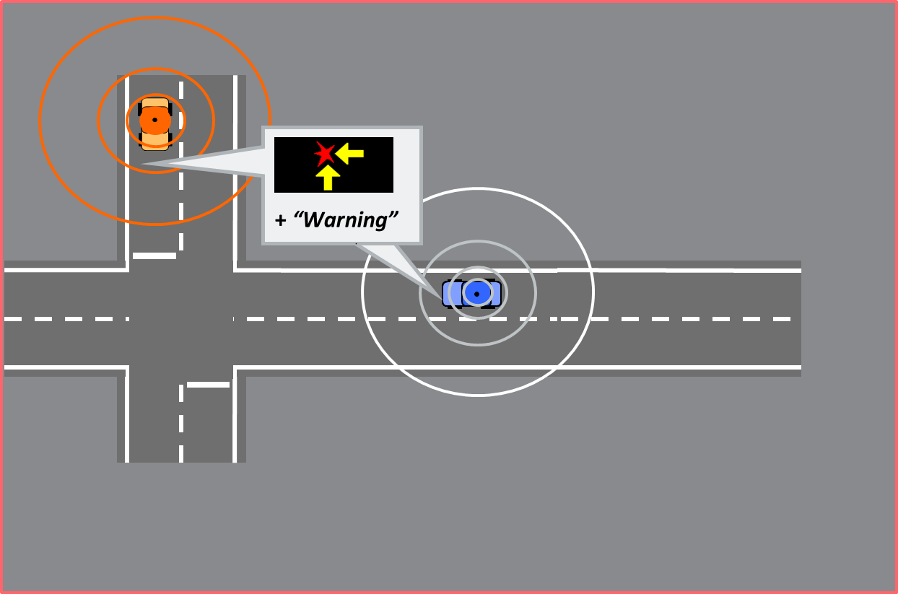
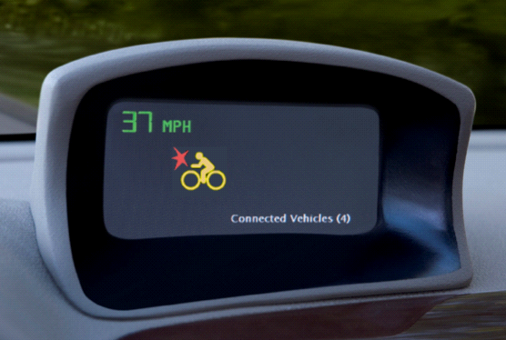

V2V Safety Feature Examples
November 2013
Cooperative Forward Collision Warning Feature
Cooperative Intersection Movement Assist Feature

Slide 38


Cooperative Intersection Collision Avoidance System – Violations (CICAS-V)
November 2013
1) DSRC equipped vehicle approaches
CICAS-V intersection
2) Vehicle receives local GPS correction
over DSRC. GPS position is corrected to
~ 0.5m accuracy allowing intersection
approach matching
3) Vehicle receives map (Geometric
Intersection Description or GID) over DSRC
4) Vehicle position mapped to intersection approach using GID
7) Warning algorithm determines that the
vehicle cannot safely proceed based on the
current vehicle dynamics and the time to
“red” phase.
8) A warning is issued to the driver at the
appropriate time.
5) Vehicle receives Signal Phase and
Timing (SPaT) information over DSRC
6) Vehicle warning algorithm processes
current vehicle dynamics information and
determines if the vehicle can safely
proceed through the intersection
5
1
0
4
3
2
DSRC radio
On Board Equipment (OBE)
Processor
GPS
Map storage
Road Side
Equipment
(RSE)
Traffic
Control Device
GPSC
GID
SPaT

