Slide 1
Labeling Diversity
Date: 2013-11-12
Authors:
Notes:
September 2012

Slide 2
Outline
Diversity
BI-STCM-ID
Labeling diversity
Analytical & simulation results
Discussion

Slide 3
Diversity
To protect signal against fading effects
Information transmitted through a number of diversity branches to get independent replicas
Diversity branches:
  time
  frequency
  polarization
  space → multi-antenna transmission and/or reception (SC, EGC, MRC, etc.) , multi-path transmission
  space-time

Slide 4

Bit-Interleaved
Space-Time Coded Modulation
Transmitter

Slide 5
Bit-Interleaved
Space-Time Coded Modulation
(+ iterative decoding)
Receiver
Extrinsic inf.
of decoder
Information
from channel
Extrinsic inf.
of demapper
Decisions

Slide 6
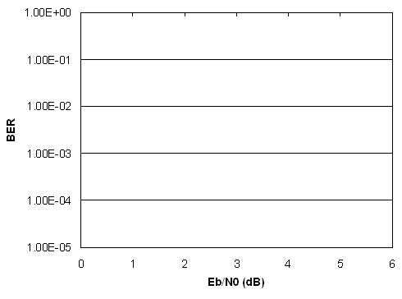


Iteratively-decoded systems
− error bounds
Error-free-feedback (EF) bound
Asymptotic BER performance and coding gain
10 ⁰
10⁻⁴
10⁻⁸
10⁻¹²
10⁻¹⁶
10⁻²⁰
Gray labeling
optimal labeling
R − data rate
a ∼ d_{f}
c = const.
BER
E_{b}/N₀ (dB)

Slide 7
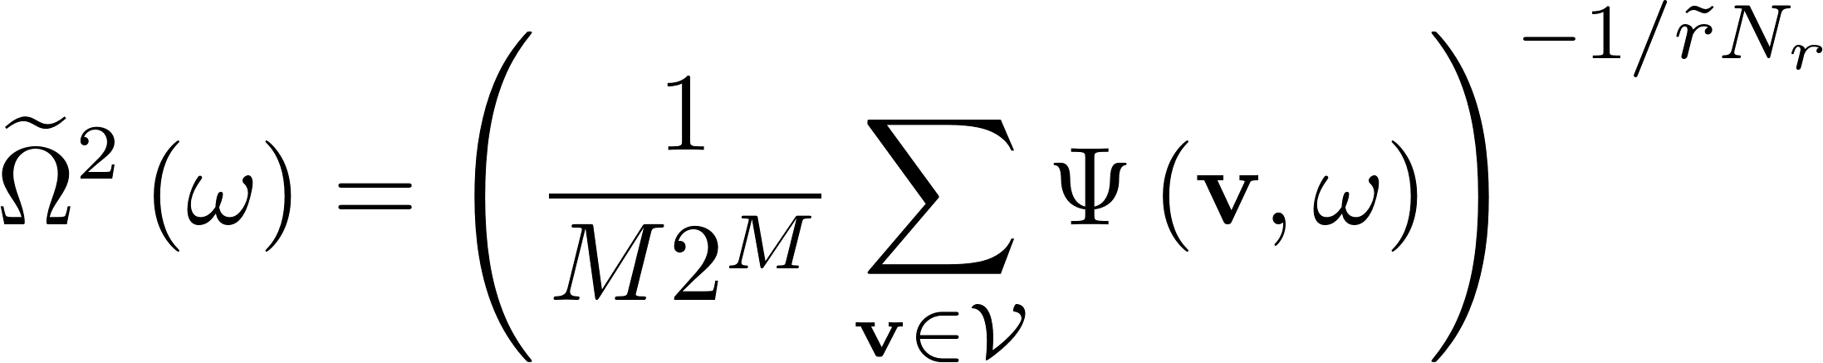
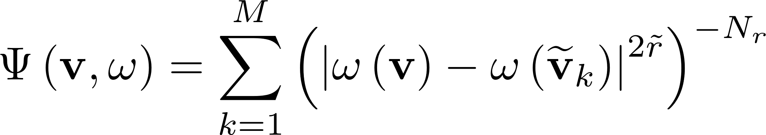
Asymptotic coding gain in BI-STCM-ID
ω (0100)
ω (1101)
ω (1100)
ω (1110)
ω (1000)

Slide 8
Labeling diversity
Antenna #1
Antenna #2
ω ⁽¹⁾(0000)
ω ⁽¹⁾(0010)
ω ⁽¹⁾(0010)
ω ⁽¹⁾(0000)
ω ⁽²⁾(0000)
ω ⁽²⁾(0010)

Slide 9
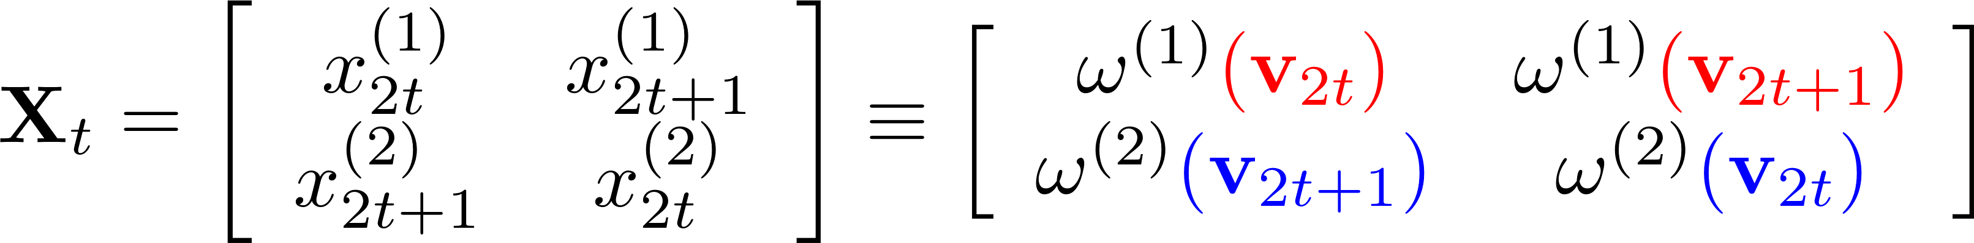
Transmitter exploiting labelling diversity
x
(1)
2
t
Mapper
ω ⁽¹⁾
x
(1)
mapper
2
t
+1
ω
v
(
1
)
2t
X
d
u
v
t
Conv.
π
2t+1
Encoder
(2)
(2)
x
x
2
t
2
+1
t
Mapper
ω ⁽²⁾
x
(2)
x
(2)
mapper
2
t
+1
Π
2
t
ω
(
2
)
ω ⁽¹⁾ ω ^{(2) ?}

Slide 10
Transmitter exploiting labeling diversity
Intuitive labeling diversity*
ω ⁽¹⁾ – optimal BI-STCM-ID labeling ω ⁽²⁾ – improved BI-STCM-ID labeling
* M. Krasicki, „Labelling diversity for MIMO systems”, Proc. European Wireless 2011, Wien, April 27-29, 2011
ω ⁽¹⁾ ω ^{(2) ?}
Improved labeling diversity**
ω ⁽¹⁾ – optimal BI-STCM-ID labeling ω ⁽²⁾ – found by Binary Switching Algorithm
** M. Krasicki, „Improved labelling diversity”, Proc. Int. Wireless Comm. and Mobile Computing 2011 Conf., Istanbul, April 27-29, 2011

Slide 11
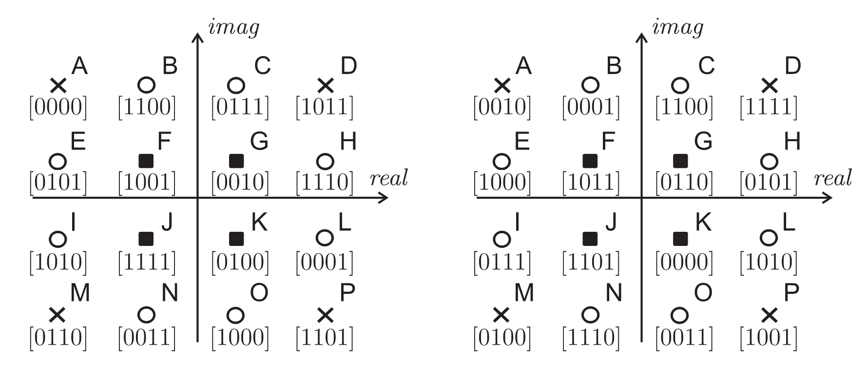
Improved 16-QAM labeling pair

Slide 12
Asymptotic coding gain

Slide 13
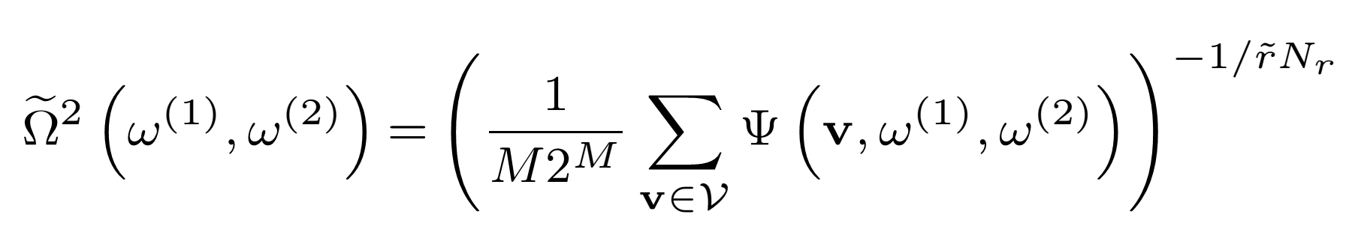
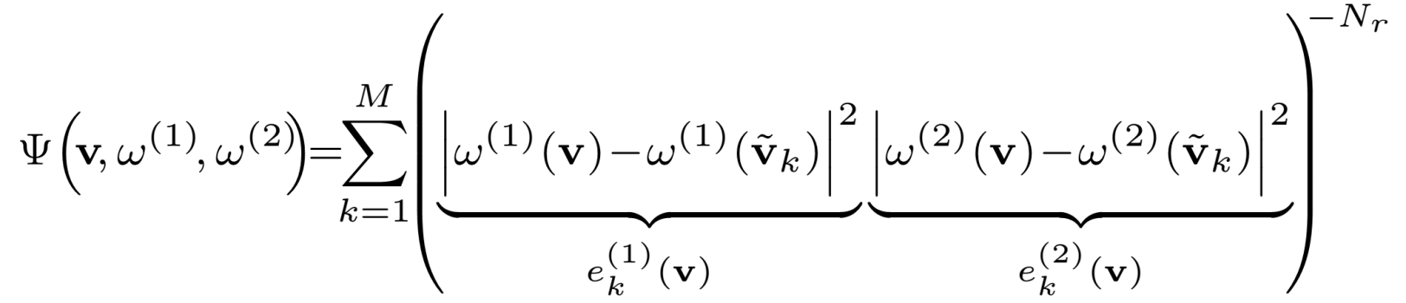
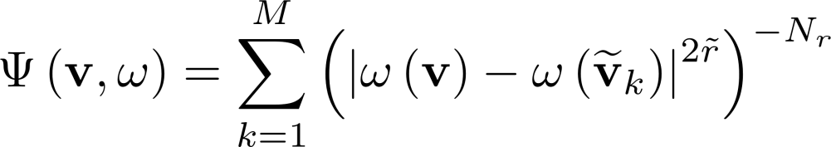
Joint optimization of labeling map pairs*
Compare with the one for BI-STCM-ID:
* M. Krasicki, „Essence of labelling diversity”, Electronics Letters, vol. 49, Issue: 8, April 2013, pp. 567-569, http://dx.doi.org/10.1049/el.2012.4275

Slide 14
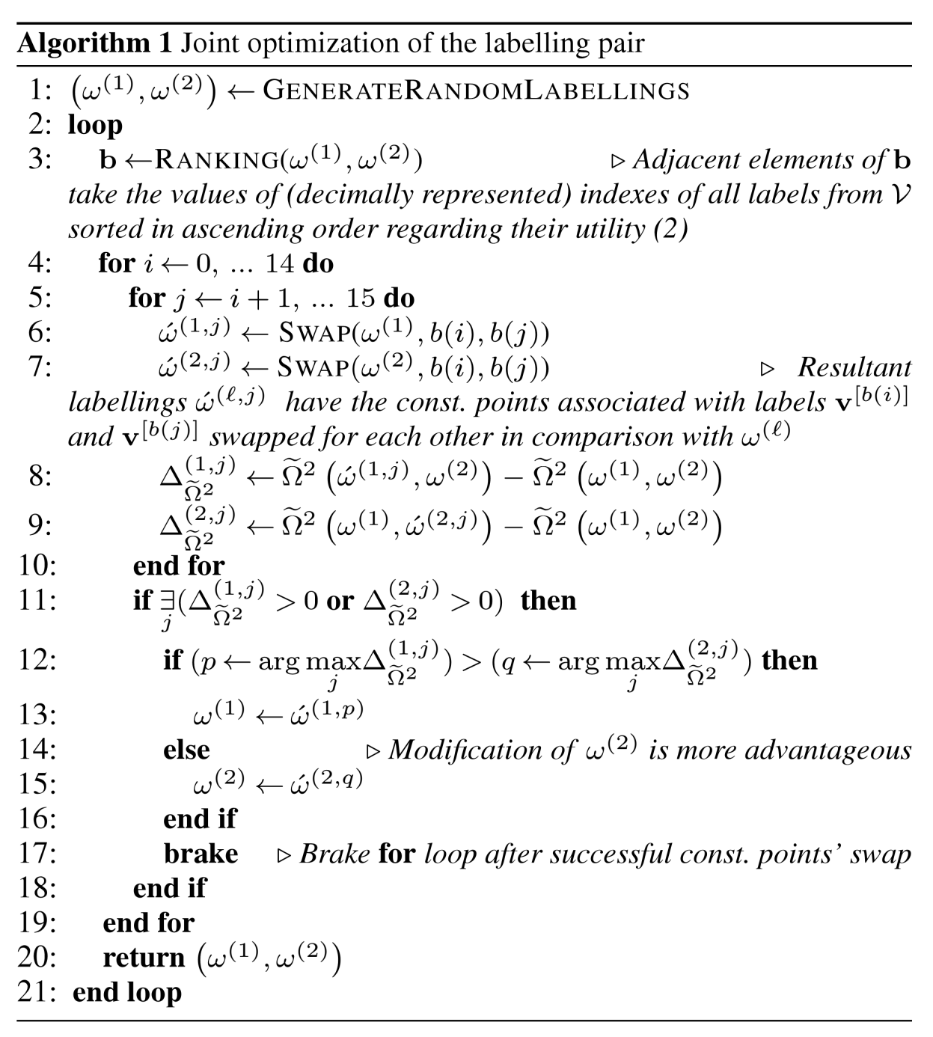

Slide 15
Point-wise distance spectrum
- categorization of const. points

Slide 16
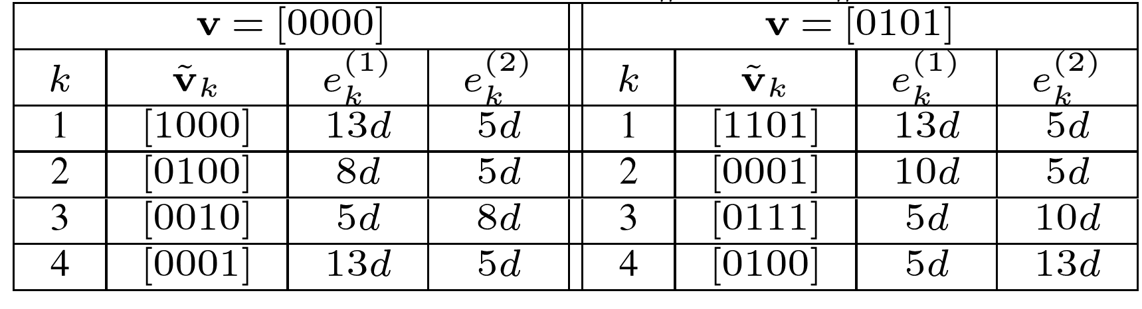

Slide 18
EXIT chart analysis

Slide 19
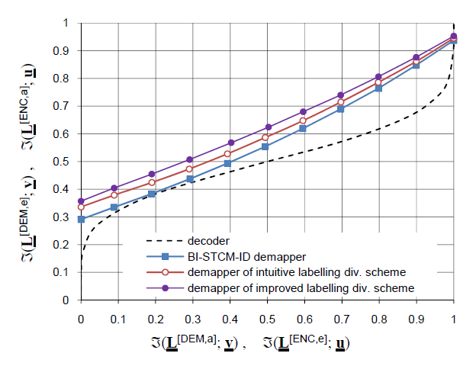
EXIT chart analysis
E_{b}/N₀ = 1dB

Slide 20
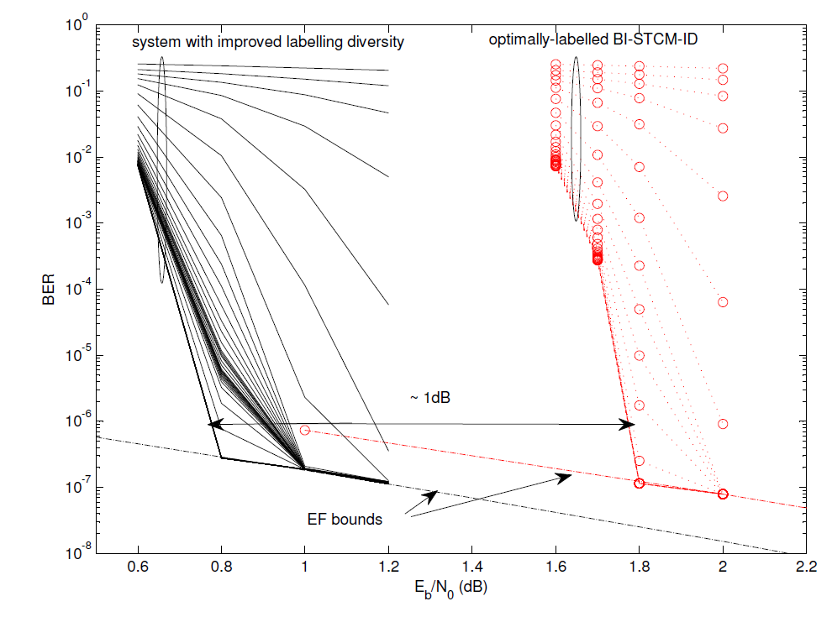
BER simulation results
2000 data bits per frame • Transmission through uncorrelated Rayleigh fading channel

Slide 21
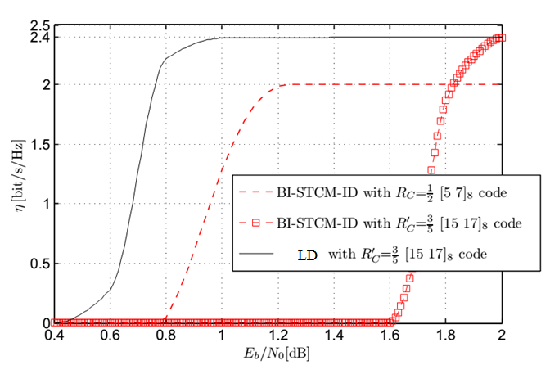
Towards higher spectral efficiency
LD

Slide 22
Discussion
Could WLANs benefit from LD?
Modification of labeling maps required
Need for efficient receivers working on the real-time basis
Should be considered for different modulation orders
Random bit interleaver with high interleaving depth
Short-constrained-length codes for early convergence

Slide 23
Straw Poll
Do you think the next generation WLANs should be designed for iterative decoding?
Do you think labeling diversity merits further consideration for WLANs?

