Slide 1
Labeling diversity
Date: 2013-11-12
Authors:
Notes:
September 2012

Slide 2
Outline
Diversity
BI-STCM-ID
Labelling diversity
Analytical & simulation results
Discussion

Slide 3
Diversity
To protect signal against fading effects
Information transmitted through a number of diversity branches to get independent replicas
Diversity branches:
  time
  frequency
  polarization
  space → multi-antenna transmission and/or reception (SC, EGC, MRC, etc.) , multi-path transmission
  space-time

Slide 4

Bit-Interleaved
Space-Time Coded Modulation
Transmitter

Slide 5
Bit-Interleaved
Space-Time Coded Modulation
(+ iterative decoding)
Receiver
Extrinsic inf.
of decoder
Information
from channel
Extrinsic inf.
of demapper
Decisions

Slide 6
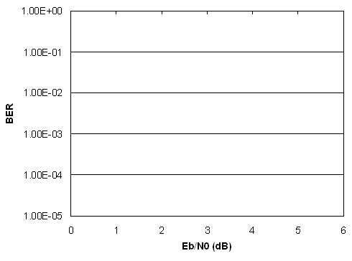


Iteratively-decoded systems
− error bounds
Error-free-feedback (EF) bound
Asymptotic BER performance and coding gain
10 ⁰
10⁻¹
10⁻²
10⁻³
10⁻⁴
10⁻⁵
BER
R − data rate
a ∼ d_{f}
c = const.
E_{b}/N₀ (dB)

Slide 7
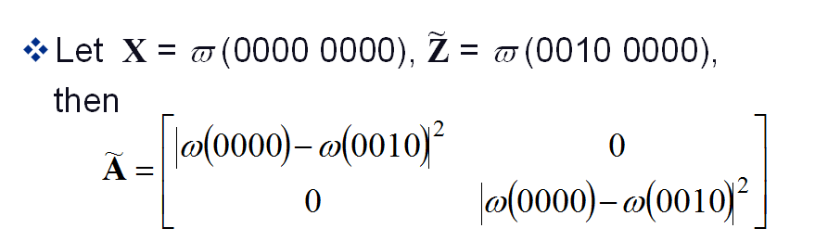
Asymptotic coding gain, distance between space-time codewords in BI-STCM-ID
Asymptotic coding gain
|ω(0000)-ω(0000)|²
|ω(0000)-ω(0000)|²

Slide 8
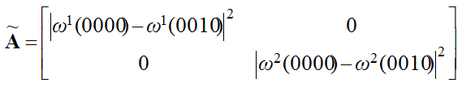
Labeling diversity
Antenna #1
Antenna #2
ω¹(0000)
ω¹(0010)
ω¹(0000)
ω¹(0010)
ω ²(0000)
ω ²(0010)

Slide 9
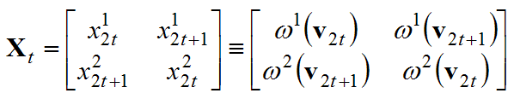
Transmitter exploiting labelling diversity
x
(1)
2
t
Mapper
(ω¹)
x
(1)
mapper
2
t
+1
v
ω
(
1
)
t
2
X
d
u
v
t
2
t
Conv.
π
+1
Encoder
x
(2)
x
(2)
2
t
2
t
+1
Mapper
(ω²)
x
(2)
x
(2)
mapper
2
t
+1
Π
2
t
ω
(
2
)
ω⁽¹⁾ ω^{(2) ?}

Slide 10
Transmitter exploiting labeling diversity
Intuitive labeling diversity*
ω⁽¹⁾ – optimal BI-STCM-ID labeling ω⁽²⁾ – improved BI-STCM-ID labeling
* M. Krasicki, „Labelling diversity for MIMO systems”, Proc. European Wireless 2011, Wien, April 27-29, 2011
ω⁽¹⁾ ω^{(2) ?}
Improved labeling diversity**
ω⁽¹⁾ – optimal BI-STCM-ID labeling ω⁽²⁾ – found by Binary Switching Algorithm
** M. Krasicki, „Improved labelling diversity”, Proc. Int. Wireless Comm. and Mobile Computing 2011 Conf., Istanbul, April 27-29, 2011

Slide 11
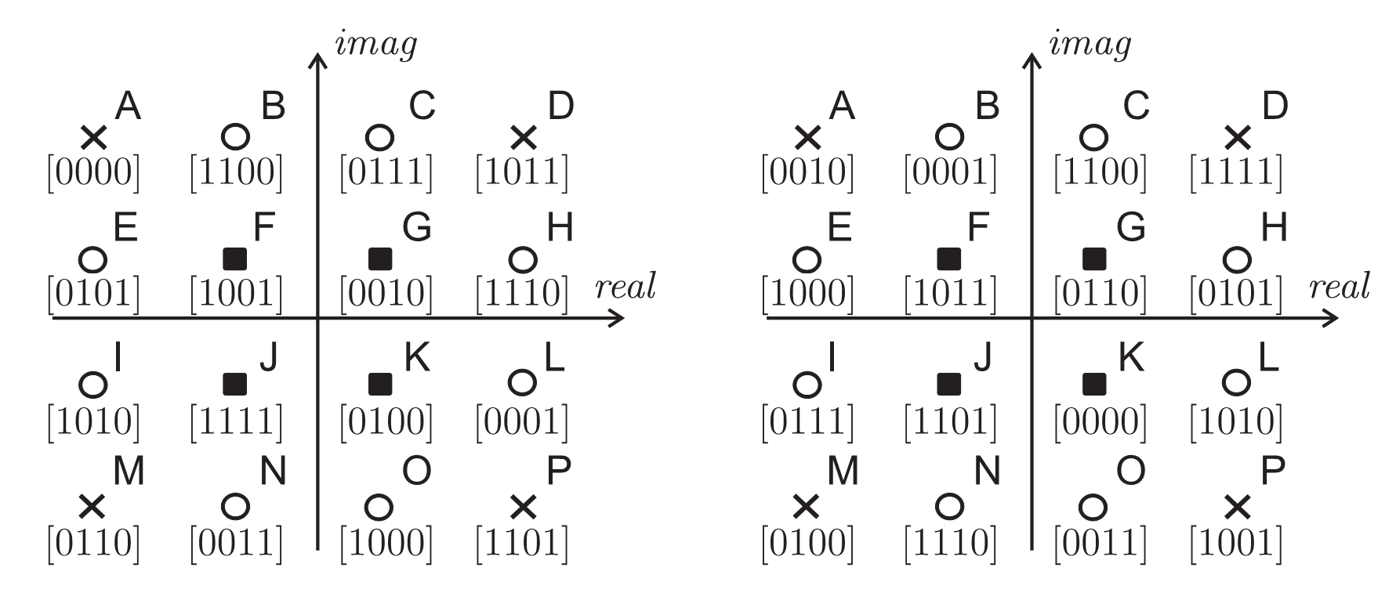
Improved 16-QAM labeling pair

Slide 12
Asymptotic coding gain

Slide 13
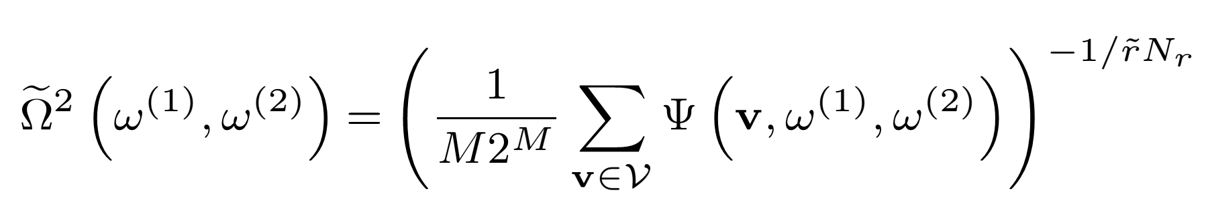
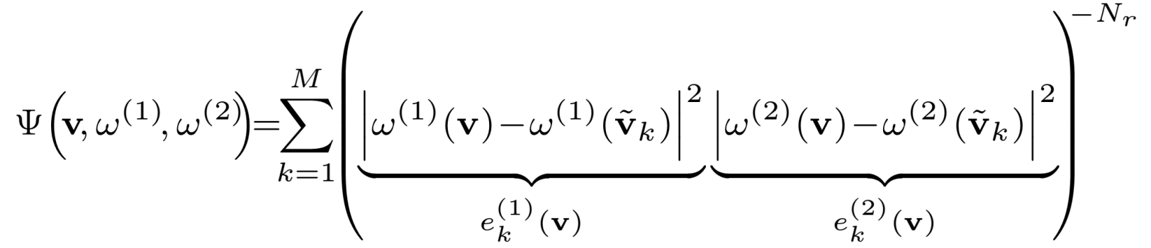
Joint optimization of labeling map pairs*
* M. Krasicki, „Essence of labelling diversity”, Electronics Letters, vol. 49, Issue: 8, April 2013, pp. 567-569, http://dx.doi.org/10.1049/el.2012.4275

Slide 14
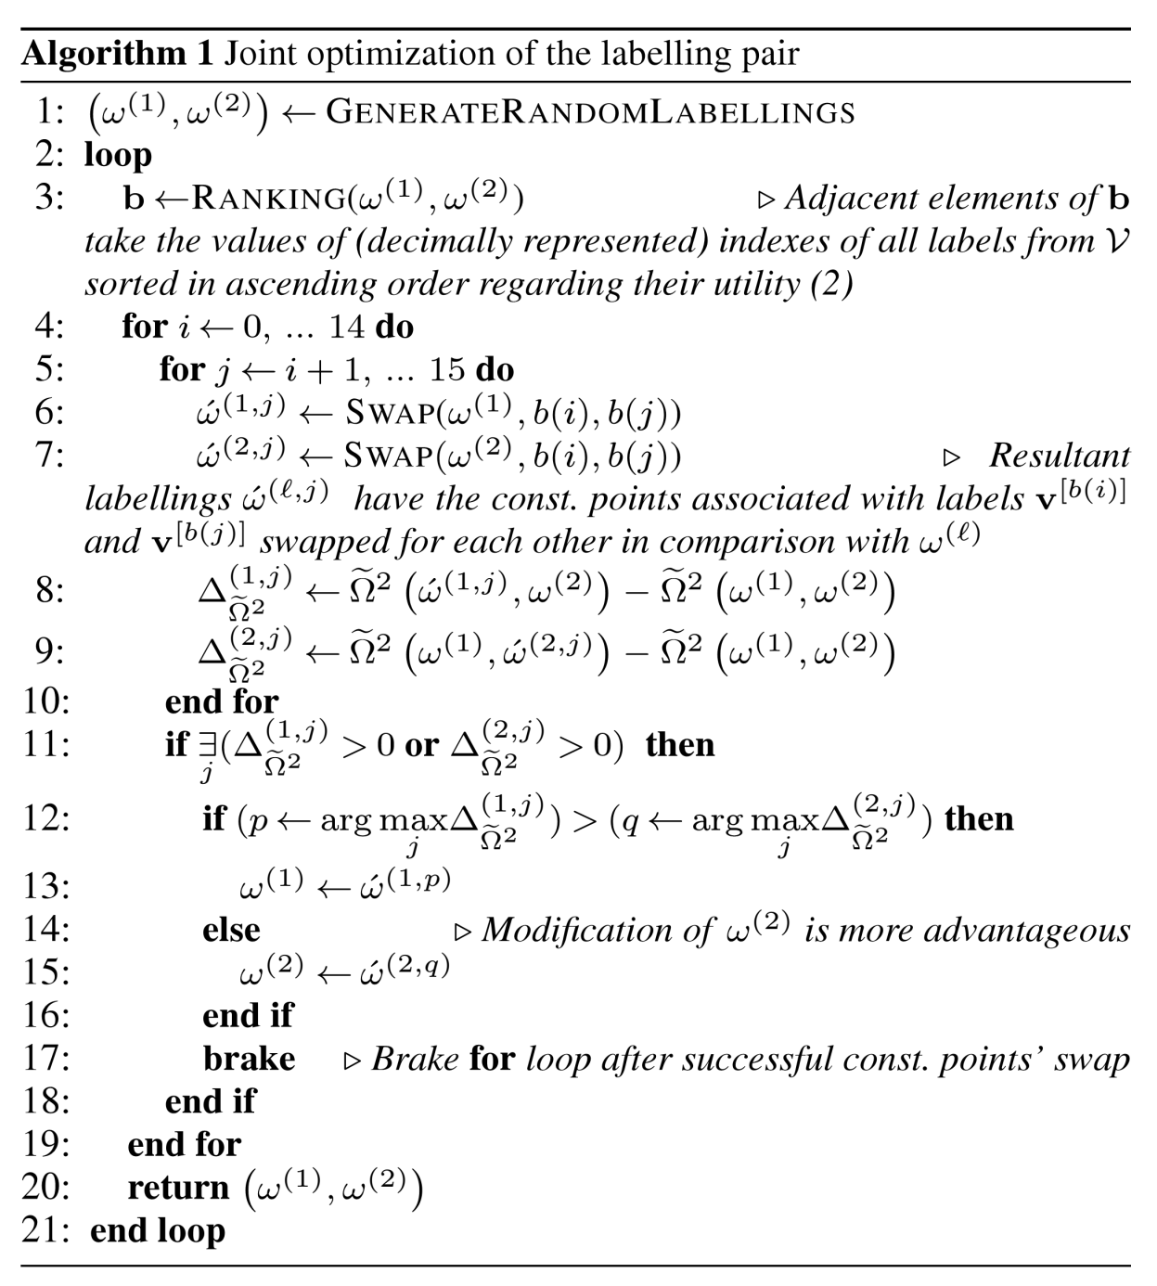

Slide 15
Point-wise distance spectrum
- categorization of const. points

Slide 16
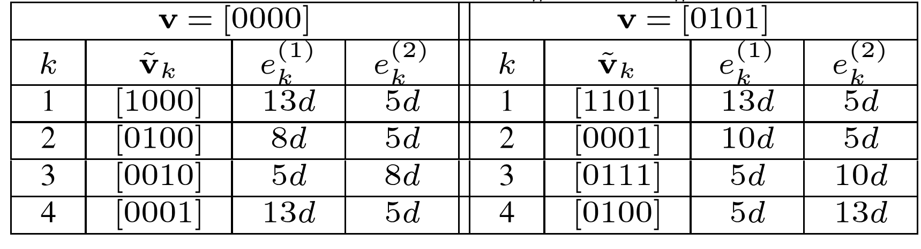

Slide 18
EXIT chart analysis

Slide 19
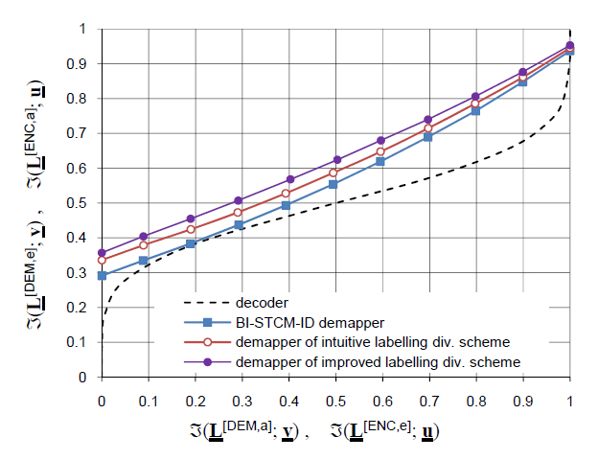
EXIT chart analysis
E_{b}/N₀ = 1dB

Slide 20
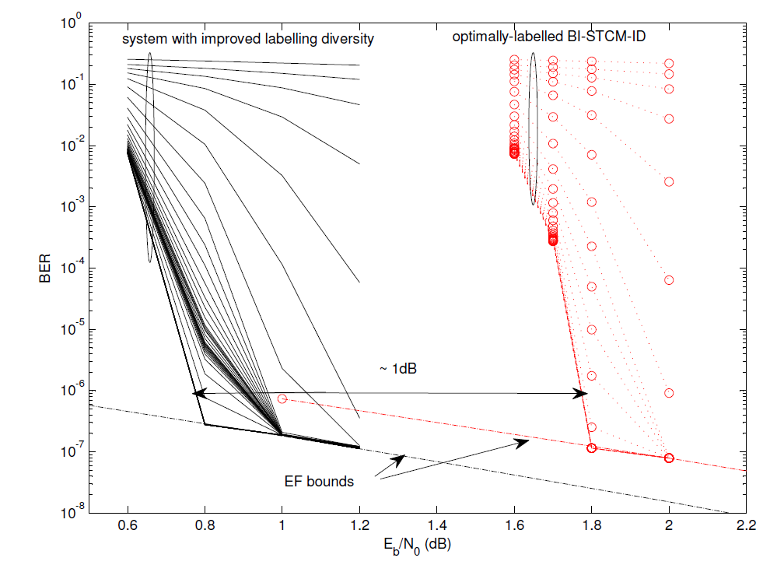
BER simulation results
2000 data bits per frame • Transmission through uncorrelated Rayleigh fading channel

Slide 21
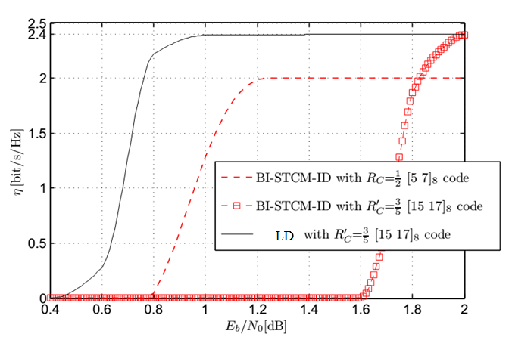
Towards higher spectral efficiency
LD

Slide 22
Discussion
Could WLANs benefit from LD?
Modification of labeling maps required
Need for efficient real-time receivers
Should be considered for different modulation orders
Desired for any iteratively-decoded BI-STCM:
Random bit interleaver with high interleaving depth
Short-constrained-length codes for early convergence

