Slide 1
TGaj Complete Proposal(60GHz)
Date: 2013-11-12
Presenter:

Slide 2
Authors/Supporters List

Slide 3
Authors/Supporters List
(This will grow to reflect those providing explicit contributions/review comments and support of this document. Please feel free to let author know if any name is missing from this list.)

Slide 4
Proposal overview
This presentation is an overview and in support of the complete proposal described in 802.11-13/1301r1 (slides) and 802.11-13/1302r0 (text) that:
  Enables the low power/low cost portable/mobile devices and the high performance devices, guaranteeing interoperability and communication between 11aj and 11ad devices
  Supports dynamic bandwidth operation at 1.08GHz/2.16GHz channel
  Supports dynamic channel transfer to coordinate the allocation of operating channel
  Supports opportunistic transmissions and refined spatial sharing
  Supports enhanced mobile device support mode
  Supports distortion compensation for I/Q imbalance and PA nonlinearity

Slide 5
Complete and new technique proposal list
ID | Item | Type | Subclauses form 802.11-13/1302r0(text) | Doc#
1 | Complete proposal overview | Complete Proposal(CP) | High-level proposal overview | Slides:802.11-13/1301r0 Text:802.11-13/1302r0
2 | MAC (Dynamic bandwidth control) | New Technique (NT) | 8.3.4.1, 9.40 | 802.11-13/1291r1
3 | MAC (Dynamic Channel Transfer) | NT | 6.3.95, 8.5.8.27-30, 10.39 | 802.11-13/1345r0
4 | MAC (Opportunistic transmissions) | NT | 8.4.1.7, 8.4.2.134, 9.33.11 | 802.11-13/1293r1
5 | MAC (Spatial sharing) | NT | 9.35.2.5, 10.31.3 | 802.11-13/1292r1
6 | MAC (Clustering mechanism) | NT | 9.34.6 | 802.11-13/1346r0
7 | PHY (PHY design for 1.08GHz ) | NT | 22 | 802.11-13/1109r1

Slide 6
Additional proposal supporting documents
To meet the TGaj PAR, FRD, EVM and selection procedure requirements, the following additional supporting documents complement this proposal
Therefore, this proposal meets all the requirements in the TGaj selection procedure to be classified as a complete proposal
Item | Doc#
PAR, FRD and EVM declaration | 802.11-13/1350r0
MAC simulation results and methodology | 802.11-13/1348r1
PHY simulation results and methodology | 802.11-13/1109r1

Slide 7
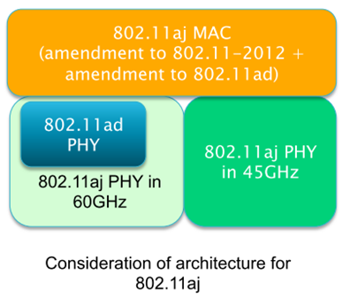
IEEE 802.11aj MAC/PHY proposal overview
802.11aj provides amendment and enhancement to existing IEEE802.11 specification across mm-Wave bands (60GHz & 45GHz) in China:
  This proposal covers amendment and enhancement for 60GHz only
  Keeping backward compatibility/interoperability with 802.11ad and the 802.11 user experience when it operates in the 59-64 GHz frequency band in China.
  Enhancing support of portable and mobile devices

Slide 8
MAC

Slide 9
IEEE802.11aj MAC features
(Described in detail in separate technique proposal )
A protocol to support dynamic bandwidth between 1.08 GHz and 2.16GHz , while maintaining backward compatibility with IEEE802.11ad standard.
A procedure of dynamic channel transfer that coordinates the allocation of operating channel.
An opportunistic transmissions mechanism that enables to increase the system throughput in multiple alternative channels.
More efficient resource allocation of spatial sharing among pair of devices.
Other amendments to support 802.11aj devices to operate with 802.11ad devices in the same BSS.

Slide 10
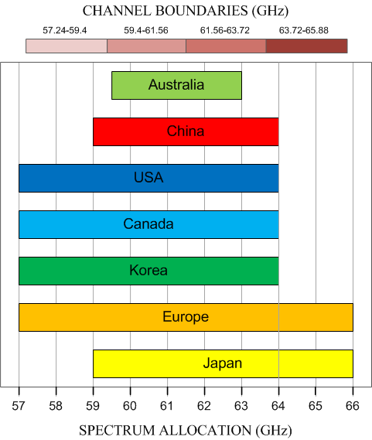
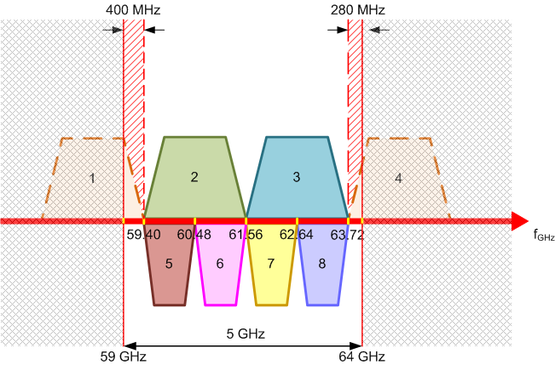
MAC Protocol to Support Dynamic Bandwidth for 802.11aj (1/2)
Channelization for 60GHz bands in China
China only has 5GHz bandwidth available in 59-64GHz, i. e., only two logical channels with 2.16 GHz bandwidth.
802.11aj further divides each 2.16GHz bandwidth channel into two 1.08GHz bandwidth channels, which produces 6 logical channels: 2 channels with 2.16GHz bandwidth (Channel 2 & 3), 4 channels with 1.08GHz bandwidth (Channel 5, 6, 7, 8)；
Capable of supporting wider applications for lower power, e.g. Smart Phone, Tablet etc.
Need a MAC protocol to support this dynamic bandwidth mechanism and keep the backward compatibility and interoperability with 802.11ad devices.

Slide 11
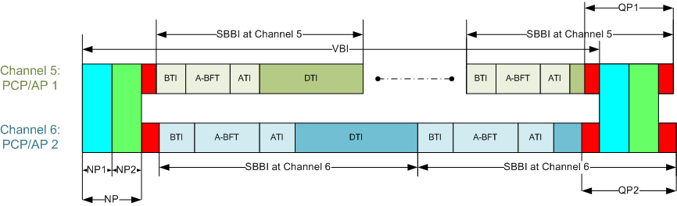
MAC Protocol to Support Dynamic Bandwidth for 802.11aj (2/2)
When operating in 2.16GHz channel (Channel 2 & 3), it is capable of keeping backward compatibility and interoperability with 802.11ad devices.
When operating in 1.08GHz (Channel 5, 6, 7 and 8), it sends common beacon frames over 2.16 GHz channel. The common beacon frame can use the same structure with 802.11ad beacon frame as a baseline so that 802.11ad device can detect and recognize them.
This allows 802.11aj device to keep the backward compatibility and interoperability with 802.11ad device while exploring the benefits in channels with 1.08GHz bandwidth.
(Described in detail in 802.11-13/1291r1)
Proposed frame structure for IEEE 802.11aj
Common Beacon frames
(e.g., 802.11ad DMG Beacon frames)

Slide 12
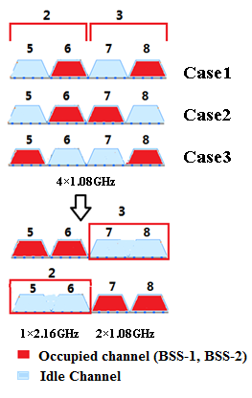
Dynamic Channel Transfer(DCT) procedure for
802.11aj
According to the channelization in 60GHz band in China, 802.11aj devices can operate on channels with 1.08 GHz bandwidth, which may require a mechanism to coordinate the allocation of operating channel to improve the efficiency.
  Case 1 for example, Channel 6, 8 are occupied by existing BSS-1 and BSS-2 at channel with 1.08GHz BW, while a new STA (to become PCP/AP-3) wants to start a new BSS-3 at a channel with 2.16GHz BW.
    PCP/AP-3 can request BSS-1 on channel 6 to move to channel 7, or request BSS-2 on channel 8 to move to channel 5.
    PCP/AP-1 or PCP/AP-2 shall assess the request according to its capabilities and the impact on its BSS’s performance.
    PCP/AP-1 or PCP/AP-2 may refuse the request for some reasons such as their BSS are busy and so on.
    If the request is confirmed, PCP/AP-3 may have a chance to use channel 2 or channel 3 (2.16GHz) to start a new BSS.
  Case 2 and 3 are similar to Case 1
Other cases are described in more detail in 802.11-13/1345r0.

Slide 13
Opportunistic Transmissions in Multiple Alternative Channels in 802.11aj (1/2)
Objective:
    To increase the system throughput of an 802.11aj network.
Method:
    If PCP/AP 1 cannot allocate enough time slots on Channel 5 to satisfy the traffic scheduling requirement, we can use this opportunistic transmission mechanism to schedule the transmissions (e.g., pair of STAs Src 1 and Dst 1, and pair of STAs Src 2 and Dst 2) in alternative channels 6, 7, 8 or/and 3 if they are available.
Definitions:
    Assume that a network with the designated device PCP/AP 1 sets up on Channel 5.
    Channel 5 is called dedicated channel and other channels, i.e., 6, 7, 8 and 3, are called alternative channels.
2
3
5
6
7
8
PCP/AP 1
Src 1 ←→ Dst 1
Src 2 ←→ Dst 2
Example of opportunistic
transmission mechanism.

Slide 14
Opportunistic Transmissions in Multiple Alternative Channels in 802.11aj (2/2)
  Source STA Src 1 sends the allocation request, then PCP/AP 1 grants to allocate the service period (SP) for transmission pair (Src 1, Dst 1) in Channel 7 (8 or 3).
  Both Src 1 and Dst 1 scan in Channel 3 for at least aMaxBIDuration. If Channel 3 is available, Src 1 and Dst 1 proceed to do beamforming and transmit in the assigned SPs. Otherwise, Src 1 or Dst 1 will report the failure reasons to PCP/AP 1 after the scanning.
  The allocated SPs in Channel 7 (8 or 3) cannot extend the duration up to N × aMaxBIDuration.
  After that, Src 1 and Dst 1 can either switch back to Channel 5 or stay in Chanel 7 (8 or 3). In either way, they must suspend transmissions in Channel 7 (8 or 3) for a period of (B – 1) × aMaxBIDuration.
(Described in detail in 802.11-13/1293r1)
Example of opportunistic transmission mechanism

Slide 15
Proposed Spatial Sharing Mechanism in 802.11aj (1/2)
Background
The existing spatial sharing mechanism in 802.11ad:
    Spatial sharing can only be done in Service Period (SP), not Contention Based Access Period (CBAP)
    Both the existing SPs and candidate SPs need to perform measurement before usage
    The mechanism is not efficient. From the PCP/AP’s perspective, it is a blind selection process.
Example of existing spatial sharing assessment

Slide 16
Proposed Spatial Sharing Mechanism in 802.11aj (2/2)
Proposed Method:
A method to recommend an initial SP for spatial sharing between a pair of unscheduled devices and a pair of scheduled devices under directional transmissions.
Assumption:
PCP/AP is updated with the beamforming training results between any pair of two STAs, in terms of best selected sector IDs.
PCP/AP has scheduled SP₁ and SP₂ for pair (A, B) and (C, D), respectively.
Purpose and Benefits :
To recommend an initial SP for the candidate SP with pair (E, F) from the existing SP set {SP₁, SP₂} for spatial sharing
Fast and accurate allocation of spatial sharing among pair of devices, etc.
(Described in detail in 802.11-13/1292r1)

Slide 17
PCP Selection Considering Supported
Channels Capability
  In the PBSS mode, one STA assumes the role of the PCP. The decision whether the STA performs in the role of PCP is done by comparing the value of the STA’s PCP Factor (self_PCP_factor) and the PCP Factor of the peer STA.
In 802.11aj, dynamic channel widths lead to multiple channel width support capabilities for STAs.
  60GHz: 2.16GHz, 1.08GHz;
  To support the 802.11aj multi-channel PCP/AP clustering and to facilitate the 60GHz band transition, a PCP with higher multi-channel operating capability is required.
  “Supported Channel Width Set” field is added in the PCP Factor (see 10.1.4.3.4 in 802.11ad ) to indicate the multi-channel support capability of a STA.
  Same as 802.11ad, the STA with the maximum PCP Factor is selected as a candidate PCP.
  (Described in detail in 802.11-13/1183r0)

Slide 18
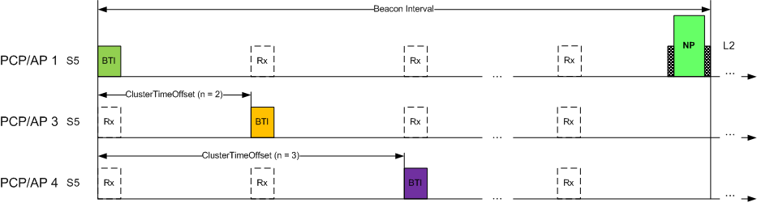
Decentralized Clustering for 802.11aj
802.11aj PCP/AP can operate as S-PCP/S-AP or member PCP/AP on either small band or large band channel.
To achieve the above aims, modifications to 802.11ad are given as below:
  Active cluster probe scheme is proposed to facilitate the discovery of large band cluster for small band PCP/AP.
  The cluster member announces its cluster switching state to other cluster members, as to facilitate cluster merge on different channels, or coordinate their joining sequence.
  Particular procedure of joining cluster is also proposed for small band DBC PCP/AP.
  (Described in detail in 802.11-13/1346r0)

Slide 19
PHY

Slide 20
Contents
Channelization
PHY Overview
  PHY general parameters
1.08GHz PHY MCS
  1.08GHz Ctrl MCS
  1.08GHz MR (Moderate rate) Single Carrier MCS
  1.08GHz HR (High rate) Single Carrier MCS
  1.08GHz OFDM MCS
  1.08GHz Low Power MCS
IQ Imbalance Estimation and Compensation
PA Nonlinearity Treatment
Enhancing Support of Mobile Devices in TGaj

Slide 21
Channelization for 802.11aj (1/2)
The released 60GHz spectrum in China only has 5GHz bandwidth, i.e. only two 2.16 GHz channels, which may limit the performance of 802.11ad devices.
Further divide 2.16GHz channel used in 802.11ad into two 1.08GHz channels, then it becomes 6 logical channels: 2 channels with 2.16GHz bandwidth (Channel 2 & 3), 4 channels with 1.08GHz bandwidth (Channel 5, 6, 7 and 8);
Channelization for Chinese 60GHz bands
Capable of supporting wider applications for lower power, e.g. Smart Phone, Tablet etc.
Capable of keeping the backward compatibility and interoperability with 802.11ad devices.

Slide 22
Channelization for 802.11aj (2/2)
Channelization for Chinese 60GHz bands
Transmit mask
Channel ID | Center Freq.(GHz) | Channel width (GHz) | OFDM Sampling Rate(MHz) | SC Chip Rate(MHz)
2 | 60.48 | 2.16 | 2640 | 1760
3 | 62.64 | 2.16 | 2640 | 1760
5 | 59.94 | 1.08 | 1320 | 880
6 | 61.02 | 1.08 | 1320 | 880
7 | 62.1 | 1.08 | 1320 | 880
8 | 63.18 | 1.08 | 1320 | 880

Slide 23

1.08GHz PHY General parameters
Sampling rate
  SC PHY MCS set Symbol Rate = 880MHz
  OFDM MCS set Sampling Rate = 1320MHz
    Sampling Rate is Exactly 1.5x the SC symbol rate
SC block – 512 symbols of which 64 chips GI
OFDM nominal sample rate 1320MHz = 1.5 times SC symbol rate
    512 samples FFT
    128 samples GI
    336 data subcarriers
    16 pilot subcarriers
Common Packet Structure (same as 802.11ad)

Slide 24
1.08GHz PHY MCS (1/4)
Ctrl PHY
CMCS Index | Modulation | Code Rate (Spreading Factor if not = 1) | Payload Rate，11ad (Mbps) | Payload Rate，1.08GHz (Mbps)
0 | Pi/2-DBPSK | 1/2 (32, with pi/2-rotation) | 27.5 | 13.75
MR(moderate rate) SC PHY
CMCS Index | Modulation | Code Rate (Spreading Factor if not = 1) | Payload Rate，11ad (Mbps) | Payload Rate，1.08GHz (Mbps)
1 | pi/2-BPSK | 1/2 (2) | 385 | 192.5
2 | pi/2-BPSK | 1/2 | 770 | 385
3 | pi/2-BPSK | 5/8 | 962.5 | 481.25
4 | pi/2-BPSK | 3/4 | 1155 | 577.5
5 | pi/2-BPSK | 13/16 | 1251.25 | 625.625
6 | pi/2-QPSK | 1/2 | 1540 | 770
7 | pi/2-QPSK | 5/8 | 1925 | 962.5
8 | pi/2-QPSK | 3/4 | 2310 | 1155
9 | pi/2-QPSK | 13/16 | 2502.5 | 1251.25
Remark: CMCS – China Modulation and Coding Scheme

Slide 25
1.08GHz PHY MCS (2/4)
HR(high rate) SC PHY
CMCS10 to 12 are the same as 802.11ad
CMCS13 to 17 are new MCSs based on16QAM and 64QAM in 802.11aj .
CMCS Index | Modulation | Code Rate (Spreading Factor if not = 1) | Payload Rate，11ad (Mbps) | Payload Rate，1.08GHz (Mbps)
10 | pi/2-16QAM | 1/2 | 3080 | 1540
11 | pi/2-16QAM | 5/8 | 3850 | 1925
12 | pi/2-16QAM | 3/4 | 4620 | 2310
13 | pi/2-16QAM | 13/16 | \ | 2502.5
14 | pi/2-64QAM | 1/2 | \ | 2310
15 | pi/2-64QAM | 5/8 | \ | 2887.5
16 | pi/2-64QAM | 3/4 | \ | 3465
17 | pi/2-64QAM | 13/16 | \ | 3753.75

Slide 26
1.08GHz PHY MCS (3/4)
OFDM PHY
CMCS Index | Modulation | Code Rate (Spreading Factor if not = 1) | Payload Rate，11ad (Mbps) | Payload Rate，1.08GHz (Mbps)
18 | SQPSK | 1/2 | 693 | 346.5
19 | SQPSK | 5/8 | 866.25 | 433.125
20 | QPSK | 1/2 | 1386 | 693
21 | QPSK | 5/8 | 1732.5 | 866.25
22 | QPSK | 3/4 | 2079 | 1039.5
23 | 16QAM | 1/2 | 2772 | 1386
24 | 16QAM | 5/8 | 3465 | 1732.5
25 | 16QAM | 3/4 | 4158 | 2079
26 | 16QAM | 13/16 | 4504.5 | 2252.25
27 | 64QAM | 5/8 | 5197.5 | 2598.75
28 | 64QAM | 3/4 | 6237 | 3118.5
29 | 64QAM | 13/16 | 6756.75 | 3378.375

Slide 27
1.08GHz PHY MCS (4/4)
Low power PHY
CMCS Index | Modulation | Code Rate (Spreading Factor if not = 1) | Payload Rate，11ad (Mbps) | Payload Rate，1.08GHz (Mbps)
30 | pi/2-BPSK | 13/28 | 626 | 313
31 | pi/2-BPSK | 13/21 | 834 | 417
32 | pi/2-BPSK | 52/63 | 1112 | 656
33 | pi/2-QPSK | 13/28 | 1251 | 625.5
34 | pi/2-QPSK | 13/21 | 1668 | 834
35 | pi/2-QPSK | 52/63 | 2224 | 1112
36 | pi/2-QPSK | 13/14 | 2503 | 1251.5

Slide 28
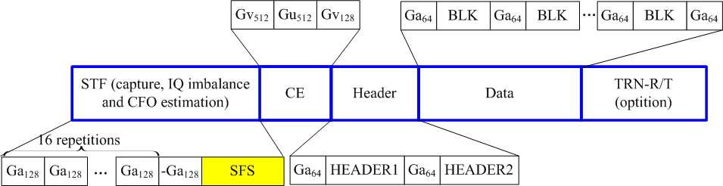

IQ imbalance estimation and compensation
Proposed HR(high rate) SC frame structure
Added SFS (Single Frequency Sequence) in the end of STF field:
IQ imbalance distortion can be estimated from the received baseband signal, and then can be compensated.
(Described in detail in 802.11-13/1109r0)

Slide 29
PA nonlinearity treatment
Proposed HR(high rate) SC frame structure
Added TBLK in the Header field :
TBLK and payload BLK are with the same modulation scheme;
Every constellation point appears with the same probability in the TBLK.
Distortion caused by PA nonlinearity can be estimate from the received TBLK signal, and then can be compensated.
(Described in detail in 802.11-13/1109r1)

Slide 30
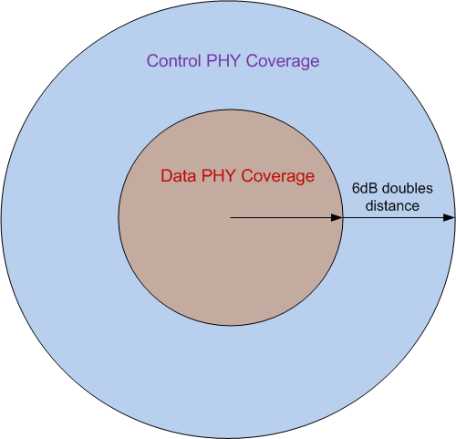
Enhancing Support of Mobile Devices in 802.11aj (1/2)
Coverage problem for mobile devices with 4 antennas
  Control PHY and Data PHY has 12dB ΔSNR
  True ΔSNR is less than 10*log10(4) ~ 6dB
  Coverage of Data PHY is a quarter of Coverage of Control PHY
Enhanced Mobile Device Support Mode
  Adding enhanced mode to fix the coverage problem for mobile devices
  The simplest method is to reduce the spreading factor of Control PHY
  Spreading sequences still use Golay complementary sequences
    Length 8: Ga(8)=(+1, +1, +1, −1, +1, +1, −1, +1)
    Length 4: Ga4=(+1, +1, +1, −1)
Enhanced Mode | Rate | Modulation & Coding | Spreading Ratio | ΔSNR | # of Antennas
0 | 108 Mbps | Pi/2-DBPSK, ½ Rate coding | 8 | 6 dB | 4
1 | 216 Mbps |  | 4 | 9 dB | 8

Slide 31
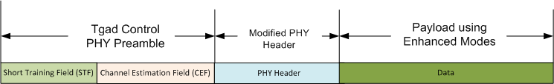
Enhancing Support of Mobile Devices in 802.11aj (2/2)
Modified PHY header in TGaj
Field name | Number of Bits | Starting Bit | Description
Reserved | 1 | 0 | Set to 0 (differential detector initialization).
Scrambler Initialization | 4 | 1 | Bits of the initial scrambler state
Length | 10 | 5 | Number of data octets in the PSDU. Range 14-1023.
Packet Type | 1 | 15 | TRN packet type
Training Length | 5 | 16 | Length of the training field.
SIFS response | 1 | 21 | Set to 1 if the STA is transmitting a packet during an SP or TXOP.
Enhanced-Mode (Reserved 2-bit in 11ad) | 2 | 22 | Set to 0: CPHY, ignored by the receiver. Set to 1: EPHY, Enhanced-Mode 0 Set to 2: EPHY, Enhanced-Mode 1 Set to 3: Reserved
HCS | 16 | 24 | Header Check sequence.

Slide 32
Conclusions
This complete proposal meets all the requirements of the TGaj PAR and FRD:
  Maintains the network architecture of the 802.11 system and 802.11 management plane.
  Maintains backward compatibility with the IEEE 802.11ad standard when it operates in the Chinese 59-64 GHz frequency band.
  Supports 6 logical channels when it operates in Chinese 59-64 GHz frequency band.
  Enables the low power/low cost portable/mobile devices and the high performance devices, guaranteeing interoperability and communication between 802.11aj and 802.11ad devices .
  Supports fast session transfer among 2.4GHz, 5GHz and 60GHz.
  Provides a means of enhanced robust transmission for mobile devices with small size antenna.

Slide 33
References
11-10-0432-01-00ad-cp-presentation.ppt
11-13-0643-02-00aj-tgaj-call-for-proposals-60ghz.doc
11-13-1291-01-00aj-Dynamic-Bandwidth-Control-for-802-11aj(60ghz NT).ppt
11-13-1345-00-00aj-dynamic-channel-transfer-procedure-for-ieee-802-11aj-60ghz.ppt
11-13-1293-01-00aj-Opportunistic-Transmissions-in-Multiple-Alternative-Channels-in-802.11aj(60Ghz NT).ppt
11-13-1292-01-00aj-Spatial-Sharing-Mechanism-in-802-11aj(60Ghz NT).ppt
11-13-0176-00-00aj-proposal-of-channelization-for-802-11aj.ppt
11-13-1109-01-00aj-consideration-of-phy-design-for-1-08ghz-channel.ppt
11-13-1346-00-00aj-Decentralized-Clustering-Mechanism-for-802.11aj (60GHz NT)
11-13-1348-01-00aj-mac-simulation-results-and-methodology.ppt

Slide 34
Revision History of the IEEE802.11aj
Usage Model Document
Revision | Comments | Date | Remark
R0 | Initial version of the TGaj complete proposal (60GHz) | November 8, 2013
R1 | Added revision history. Fixed some typos and document number errors in slides and references. Changed figure:“Proposed HR(high rate) SC frame structure” in slide 29. | November 12, 2013

Slide 35
Thank YOU!

