Slide 1
Dynamic Sensitivity Control for HEW SG
Date: 2013-11
Authors:

Slide 2
Background
802.11 uses CSMA/CA carrier sense multiple access with collision avoidance.
STA listens before transmitting
Two methods of sensing the medium
Physical Carrier Sense Is there RF energy present?
Virtual Carrier Sense Is there an 802.11 signal present?
Clear Channel Assessment (CCA)
OFDM transmission => minimum modulation and coding rate sensitivity (6Mbps) (-82dBm for 20MHz channel, -79dBm for 40MHz channel)
If no detected header, 20 dB higher, i.e. -62dBm

Slide 3
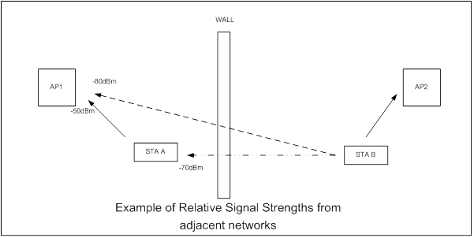
Example – background to idea
AP1 to STA A -50dBm, (also AP2 to STA B)
STA B is 4x as far from AP 1 as STA A.
Therefore AP1 receives STA B at -80dBm (50 + 20* +10 wall) *10dB per octave
STA A receives TX from STA B at -70dBm (50 +10* +10wall)
Note: AP1 receives AP2 <-82dBm so CCA is not exerted
STA A and STA B could both transmit successfully to their APs at the same time
BUT each is prevented by CCA.

Slide 4
Dynamic Sensitivity Control - DSC
Imagine a scheme where STA measures the RSSI of the AP Beacon (R dBm)
Then sets its RX Sensitivity Threshold at (R – M) dBm, where M is the “Margin”
Hence, for example:
STA receives Beacon at -50dBm, with Margin = 20dB STA sets RX Sensitivity Threshold to -70dBm.
Also set an Upper Limit, L, to Beacon RSSI at, say, -30 or -40dBm to cater for case when STA is very close to AP.
Need to ensure that all the STAs in the wanted area do see each other. Hence if one STA very close to AP, then it could set RX Sensitivity too high.

Slide 5
RX Sensitivity
L = Upper Limit M = Margin R = Received RSSI
RX Sensitivity, RxS
Reff = MIN (RxS, L)
RxS = (Reff – M)
Example, FOR L = -40dBm and M = 20dB
RSSI, R dBm | Reff | Rx Sensitivity, dBm
-30 | -40 | -60
-40 | -40 | -60
-50 | -50 | -70
-60 | -60 | -80

Slide 6
Apartments
Consider an apartment
Using DSC complete apartment coverage
but overlap is confined mostly to direct neighbors
Only ‘worse case’ STA overlap
Extends into 2nd neighbor

Slide 7
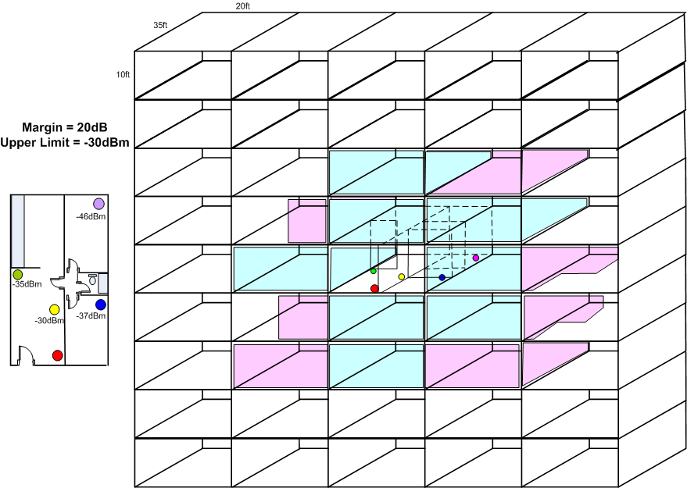
Apartment Block
No DSC
45 Overlapping
With DSC
7 to 8 overlapping
NOTE: Dense apartment block is a priority Use Case

Slide 8
Terrace/Town Houses

Slide 9
Terrace/Town Houses

Slide 10
Terrace/Townhouse
No ‘hidden’ STAs in garden

Slide 11
Enterprise/Hotspots

Slide 12
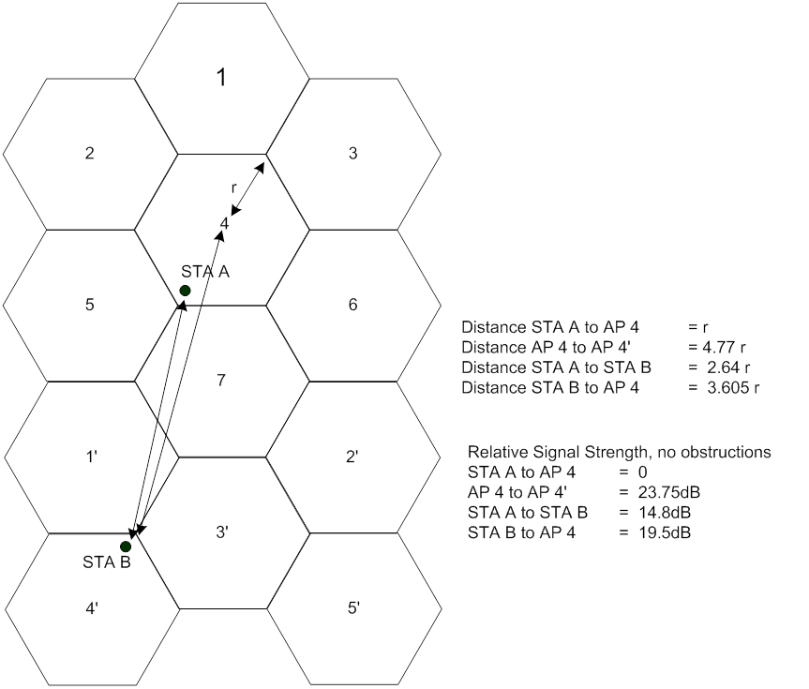
Enterprise and Hotspots
Note if STA A moves, then
it loses the DSC protection and then
it is encouraged to switch channels
as now has lower throughput.
Note that this type of cell cluster is impossible
without TPC or DSC. TPC fails if any one not complying
But also would make TX at highest data rates difficult.
DSC ensures highest data rates used.

Slide 13
AP CCA Setting
Pure ‘circles’ no obstructions

Slide 15
Flexible system
Parameters can be adjusted to suit conditions and desired coverage

Slide 16
Flexibility
Upper Limit and Margin can be adjusted to suit the application for an optimum result (AP can control)
20dB Margin suggested as 20dB is approx required SNR for higher data rates
Upper Limit can be used to define the network coverage area. (This is shown later)
AP then sets its own Sensitivity or CCA
Based upon the Margin and Upper Limit

Slide 17
Legacy STAs – No problem if in separate network
In each of the cases considered, Apartments, Houses, Cell Cluster, the legacy STA is UNAFFECTED
If the Legacy STA is in a separate network, we see that in examples, both DSC STA and Legacy STA can TX at the same time.
If STA does not use DSC then:
If already started to TX it will complete (DSC STA can TX at same time)
If Legacy STA not started to TX it will hold off with CCA in the normal fashion if DSC STA is TX – no difference
DSC simply allows the STA using it to TX at the same time.
Legacy network performance improves as need not wait so long for DSC network to TX (simultaneous TX)

Slide 18
Legacy STA – Same Network
If any STA is outside the coverage area set by the DSC, then it is at a disadvantage as its TX could be stepped on by the DSC STA that is close to the AP. This is the same situation as “hidden STA”.
“Hidden STA” situation exists now so nothing new
Detection area is set by the Upper Limit and Margin.
Set correctly, possibility of ‘hidden STA’ is greatly reduced
Note distances and compare to house sizes. Hence, possibility of hidden legacy or DSC STA is remote.
Consider also need to keep high data rates hence want to restrict range. (Especially if using 40MHz channels or higher).
Finally
If outdoor and large area coverage required, DSC could be disabled by AP IE.

Slide 19
Discussion
We can expand the examples to specific enterprise, office environments.
Network coverage is NOT simple circles. It is bounded by walls, floors, obstructions such that the propagation is not dB linear it suffers from jumps, e.g. 10dB per outside wall, 3 – 6dB inside walls.
Network coverage can be made ‘cell like’ so as to improve the overall coverage.
If only one network uses DSC it does not impact performance on other network – in fact it lessens impact as now TX simultaneously so other network does not need to wait so long.
DSC Limit can be set to cover desired network area. STAs in same network, are at disadvantage only if at far distance.
Can be mitigated with correct choice of Upper Limit.
Also probability comes into play, chance of close STA, chance it is TX, etc. In practice not a significant problem
DSC combined with channel selection can mitigate OBSS.
DSC can improve overall Wi-Fi throughput in an area.
AP can control settings – see next slide

Slide 20
AP Considerations
AP can set the Upper Limit and Margin parameters for STAs
Advertises settings (similar to EDCA parameters)
AP bases its own CCA on the DSC parameters it advertises
Based upon advertised settings
Based upon desired coverage
AP can issue “No DSC” to be used
For large area coverage outdoors, for example.
AP could learn OBSS situation while simply listening to Beacons from other network(s). Set Upper Limit accordingly.
Part of Channel Selection process (as per 11aa)
Sets Upper Limit so that OBSS is mitigated
Could be dynamic with periodic scans
All could be covered in 802.11 Standard now
Directly applicable to HEW SG as it improves the effective throughput in an area

Slide 21
Straw Poll
Do you think that DSC merits further consideration for HEW?
Yes
No

