Slide 1
Date: 2013-10-11
Proposal for DSRC band coexistence

Slide 2
Abstract
This proposal aims
to promote a discussion of a potential compromise solution between the automotive and Wi-Fi industries to address concerns about spectrum sharing.
to promote dialog and resolution to avoid undue delay in deploying DSRC for safety-of-life services

Slide 3
Concerns with NPRM Proposal
The NPRM proposal opens all DSRC spectrum for Wi-Fi operations, which may invalidate DSRC testing done so far and hence cause significant impact (delay) on the coming DSRC rule making
Detecting and coexistence with DSRC can lead to low usage of the new 160MHz for Wi-Fi
UNII devices may have to detect 10MHz operation of DSRC, which is quite different from radar detection and requires new hardware changes and testing procedure

Slide 4
A Compromise Proposal with Two Points
Point #1: Where not to share and where to share:
Upper fraction of the spectrum could be dedicated to DSRC operation
The spectrum sharing discussion would be contained in the lower fraction of the spectrum
Point #2: How to share:
20MHz operation for DSRC can make spectrum sharing easier

Slide 5
Point #1: DSRC should retain exclusive right to 5.895GHz - 5.925GHz spectrum
Currently available channels
Potential channels
IEEE channel #
36
40
44
48
52
56
60
64
68
72
76
80
84
88
92
96
100
104
108
112
116
120
124
128
132
136
140
144
149
153
157
161
165
169
173
177
181
20 MHz
40 MHz
80 MHz
160 MHz
UNII-1
UNII-2
NEW
UNII-2
UNII-3
NEW
5250
MHz
5350
MHz
5470
MHz
5725
MHz
5825
MHz
5895
MHz
5925
MHz
Wide bandwidth channels desired to support high throughput requirements (802.11ac targeted at 1.7Gbps data rate per user)
Higher bandwidth channels (80MHz, 160MHz) are very valuable assets for 802.11ac
Ch. 181 (5.895 – 5.915GHz) is of limited importance to Wi-Fi – only adds a new 20MHz channel
We should contain discussions of spectrum sharing to spectrum between 5.850GHz – 5.895GHz

Slide 6
Why is this important?
A critically important principle on which we hope all can agree is that the NHSTA decision on DSRC should not be delayed, allowing the community to move toward V2V safety deployment without waiting for technical solutions for spectrum sharing
Existing research and testing programs on V2V safety are based on exclusive right of the spectrum
Moving V2V safety to this portion of the spectrum can be a viable option to ensure existing results are still valid, and require only a limited amount of additional testing
It buys time to determine a well-considered technical solution to share in the lower fraction of the spectrum
Wi-Fi and DSRC industries can jointly determine a solution in this portion of the spectrum with a less stringent time constraint and significantly less controversy

Slide 7
Point #2: 20MHz DSRC operation in the lower portion can make spectrum sharing easier
The overhead of 10MHz signal detection
Not decodable by existing Wi-Fi devices
New hardware has to be developed and tested, following rigorous testing procedures
Left-over interference has to be characterized and tested for all DSRC applications and potentially all use scenarios
20MHz operation makes the DSRC signals understandable by Wi-Fi devices; transmission priority can be provided to DSRC by existing Wi-Fi mechanisms
For example, EDCA defined in IEEE 802.11e

Slide 8
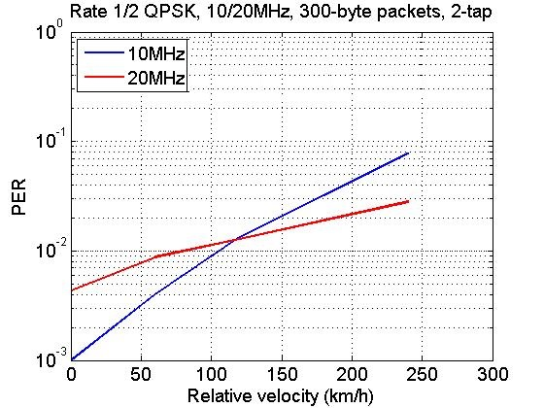
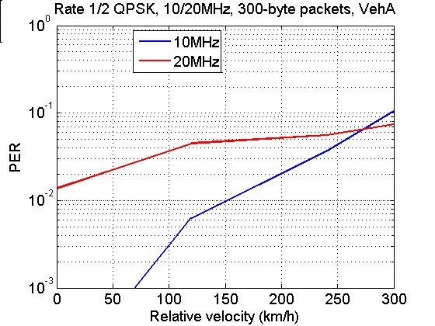
20MHz Channelization Performance
Comparable performance for most vehicular channels as compared to 10MHz
20MHz leads to shorter packet transmission and thus better channel tracking in high mobility channel models, as compared to 10Mhz channelization
20MHz has shorter GI (0.8us) and thus more self-interference when delay spread is longer than GI
Maximum excess delay: 0.5us
Maximum excess delay: 2.5us

Slide 9
Putting the two points together
Proposed boundary of UNII4
DSRC Band
DSRC Channels
173
177
161
165
169
173
177
X
181
Wi-Fi Channels
80MHz
80MHz
160MHz
Open only the lower fraction of the spectrum to UNII devices
Leave 20MHz or 30MHz dedicated spectrum for DSRC
Share the Channel 173 and 177 between DSRC and UNII
Ensure Chanel 181 is NOT used by UNII devices
For the shared spectrum
Encourage 20MHz operation → much easier for Wi-Fi to detect and provide higher priority to DSRC signals
Develop sharing solutions in IEEE (refer to 994r0)

Slide 10
Current Proposed Spectrum Allocation and OOBE Requirements in NPRM
161
165
169
173
177
181
U-NII Worldwide
U-NII 3
U-NII 4
30 – 10log₁₀(B) dBm/MHz
24 – 10log₁₀(B) dBm/MHz
-17 - G dBm/MHz
-27 - G dBm/MHz
DSRC Band
Available for WLAN
5470
5725
5825
5835
5850
5875
5895
5925
Frequency [MHz]

Slide 11
Proposed Scheme 1: Spectrum Allocation and OOBE Requirement
182
184
161
165
169
173
177
U-NII Worldwide
U-NII 3
U-NII 4
30 – 10log₁₀(B) dBm/MHz
24 – 10log₁₀(B) dBm/MHz
-17-GdBm/MHz
-27-GdBm/MHz
-27 - G dBm/MHz
Frequency [MHz]
5895
5925
Available for WLAN
5905
5470
5725
5825
5835
DSRC Band
5850
5875
Keep Ch182 and Ch184 for DSRC dedicated use
The same UNII-4 rule as in NPRM, but stops at 5905MHz
Notes:
Questions:
What is the basis of picking OOBE rule? (Mike)
What is band next to DSRC band? (Mike)
What is the current OOBE rule for DSRC channels? (Check with Amir, Roger, John or Sue)

Slide 12
Proposed Scheme 2: Spectrum Allocation and OOBE Requirement
182
180
184
161
165
169
173
177
U-NII Worldwide
U-NII 3
U-NII 4
30 – 10log₁₀(B) dBm/MHz
24 – 10log₁₀(B) dBm/MHz
-5-GdBm/MHz
-17-GdBm/MHz
-27-GdBm/MHz
-27 - G dBm/MHz
Frequency [MHz]
DSRC Band
5470
5725
5825
5835
5895
Available for WLAN
5850
5875
5925
Keep Ch180, 182 and 184 for DSRC dedicated use
Relax the OOBE requirement for UNII devices in DSRC band
Notes:
Questions:
What is the basis of picking OOBE rule? (Mike)
What is band next to DSRC band? (Mike)
What is the current OOBE rule for DSRC channels? (Check with Amir, Roger, John or Sue)

Slide 13
Benefits of the compromise scheme
Reserve upper portion of spectrum as dedicated channels for critical DSRC applications
Easier to define mechanisms (or enhance existing mechanisms) to give higher priority to DSRC transmissions, due to easy detection of 20MHz waveforms
Minimize uncertainty and disruption to DSRC and provide 160MHz channel to Wi-Fi at minimal additional cost
Avoid or reduce lengthy joint testing and possible technical gridlock
Wi-Fi keeps the same number of 80MHz/160MHz channels as current NPRM proposal; lose one 20MHz channel
Much better utility of 160MHz channel for Wi-Fi if 20MHz operation is adopted by DSRC in shared spectrum

Slide 14
Appendix

Slide 15
Technical Issues and Mitigation
Cross-channel interference: does the proposed compromise make the cross channel interference worse?
Not really. The two 10MHz channels in dedicated DSRC spectrum will see less cross-channel interference as compared to the NRPM proposal or current DSRC channelization
Cross-channel interference has always been a problem between existing service channel and safety channel; the compromise does not make things worse
High power public safety channel (aka Ch184) and potentially other channels requested by other ITS players:
Ch184 has not been the focus of existing model deployment
A good time to revisit the need or spectrum allocation for such channel
May be combined with the V2x safety channel
May be assigned to the shared spectrum rather than using the dedicated spectrum
20MHz channelization and performance degradation in shared spectrum: 20MHz channelization does not necessarily lead to performance degradation with the latest receiver technology

Slide 16
Cross-Channel Interference Comparison (I)
Previous DSRC channel plan
Ch172 is 5MHz away from the ISM band
ISM band has OOBE rule of only -20dBr from the PSD limit (33dBm/MHz with 30dBm peak power)
Ch172 can potentially see maximum 13dBm/MHz interference leakage from ISM band
Total Power ≤ 30 dBm
FCC 15.247(b)(3)
0 dBr
172
-20 dBr
FCC 15.247(d)
5.725
5.85
5.875
Frequency [GHz]
Available for WLAN
DSRC Band

Slide 17
Cross-Channel Interference Comparison (II)
NPRM channel allocation
Ch172 overlaps Ch173 (20MHz) and corresponding 40MHz, 80MHz and 160MHz channels
Remaining interference may exist from spectrum sharing techniques
Ch172 is right next to Ch169 (20MHz) and 10MHz away from Ch177
Interference from adjacent channels with potentially no protection
172
161
165
169
173
177
181
U-NII Worldwide
U-NII 3
U-NII 4
30 – 10log₁₀(B) dBm/MHz
24 – 10log₁₀(B) dBm/MHz
-17 - G dBm/MHz
DSRC Band
Available for WLAN
5470
5725
5825
5835
5850
5875
5895
5925
Frequency [MHz]

Slide 18
Cross-Channel Interference Comparison (III)
Proposed compromise scheme
10MHz away from closet Wi-Fi channel (Ch177)
Maximum interference limited by -17dBm/MHz (-7dBm over 10MHz channel)
Practical interference from measurement: Ch182 sees -17dBm/MHz+pathloss (35dB attenuation at 10MHz edge); Ch184 sees -27dBm/MHz+pathloss (45dB attenuation at 20MHz edge)
Can further be improved by limiting the maximum transmit power allowed on Ch177
48dB free space pathloss for co-located 5.9GHz transmitter/receiver at 1m apart
184
182
161
165
169
173
177
U-NII Worldwide
U-NII 3
U-NII 4
30 – 10log₁₀(B) dBm/MHz
24 – 10log₁₀(B) dBm/MHz
-17-GdBm/MHz
-27 - G dBm/MHz
Frequency [MHz]
5895
5925
Available for WLAN
5905
5470
5725
5825
5835
DSRC Band
5850
5875

Slide 19
Cross-Channel Interference between DSRC Channels
In current DSRC channelization, service channel and safety channels are next to each other with no guard band
When transmitting at service channel, the leakage will contaminate the reception capability on the safety channel
May be controlled by lowering the maximum allowed power on service channel
May require improved receiver to further mitigate the problem
Proposed compromise does not change or worsen the nature of the problem

