Slide 1
802.11 Supplementary Plenary Information - November 2013
Date: 2013- November -15
Authors:
Name
Company
Address
Phone
email
Bruce Kraemer
Marvell
5488 Marvell Lane,
Santa Clara, CA, 95054
+1 (321) 751-3958
bkraemer@
marvell
.com
Abstract: Additional Information on topics for 802.11 Plenary meeting – November 2013
being held in Dallas, Texas
Notes:
November 2011

Slide 2
Monday
Notes:
November 2011

Slide 3
IEEE LOA Database – November 09, 2013
Friday Agenda Item 3.2.1
http://standards.ieee.org/db/patents/pat802_11.html
35 entries with 2013 submission dates
Request for LOAs - 8 sent

Slide 4
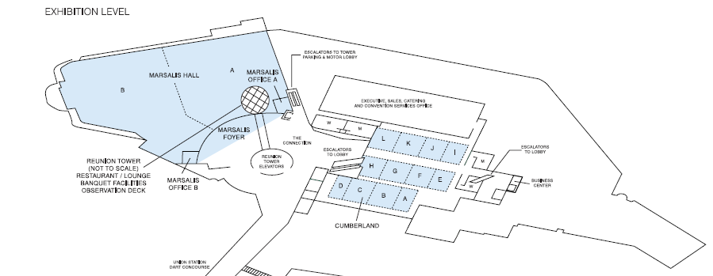
Meeting Areas
Monday Agenda Item 4.1.3

Slide 5
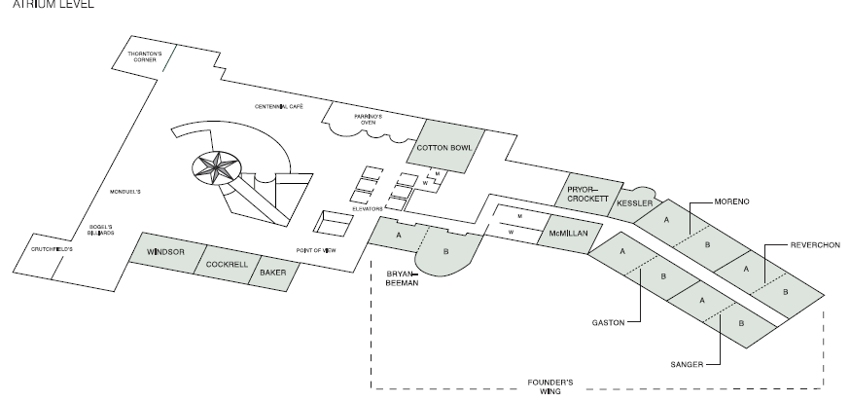
Meeting Areas
Monday Agenda Item 4.1.3

Slide 6
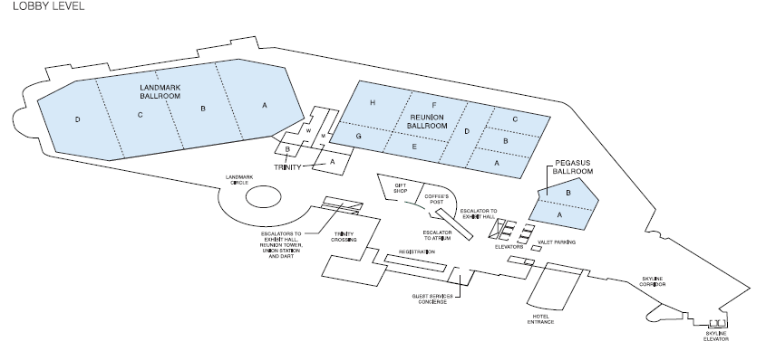
Meeting Areas
Monday Agenda Item 4.1.3

Slide 7
Joint Meetings
Monday Agenda Item 4.1.4
External:
none
Internal:
AK and 802.1 Thursday am1 room Landmark D

Slide 8
November 2013 PARS
Monday Agenda Item 4.1.5
802 - Standard for Local and Metropolitan Area Networks: Overview and Architecture - PAR extension request
802.1AX-REV - PAR modification request
802.1Q-REV - PAR modification request
802.3br - amendment: Interspersing Express Traffic, PAR and 5C
802.3bt - amendment: DTE Power via MDI over 4-Pair, PAR and 5C
802.3bu - amendment: 1-Pair Power over Data Lines, PAR and 5C
802.22 - Revision, PAR
OmniRAN EC SG - Recommended Practice, Network Reference Model and Functional Description of IEEE 802 Access Network , PAR and 5C

Slide 9
Group Room assignments
Monday Agenda Item 4.1.6
WG | Level | Room
1 | Atrium | Reverchon A,B
16 | Atrium | Bryan Beeman A
18 | Atrium | Kessler
19 | Atrium | Sanger B
21 | Atrium | Moreno A VC Anthony Chen
22 | Atrium | Moreno A
24 | Atrium | Cockrell
OMNIRAN | Atrium | Cockrell
Notes:
November 2011

Slide 10
Group Room assignments
Monday Agenda Item 4.1.6
WG | Level | Room
802.11 Monday Plenary | Lobby | Landmark C
802.11 Wednesday Plenary | Lobby | Landmark C
802.11 Friday Plenary | Lobby | Landmark D
MC
AC
AF
Editors
AH
AI
AJ
AK
AQ
REG
WNG
JTC1
HEW
ARC
Spread across Lobby or Atrium
Check monitors
or
http://802world.org/attendee
or IMAT
Notes:
November 2011

Slide 11
WG Agendas
Monday Agenda Item 4.1.6
18: Agenda 18-13-0105 r1
Opening Report 18-13-
19: Agenda 19-13-0132 r0
Opening Report 19-13- 0133 r0
21: Agenda 21-13-0201 r0
Opening Report 21-13-
22: Agenda 22-13- 0155 r0
Opening Report 22-13-
24: Agenda 24-13-0040 r0
Opening Report 24-13-0041 r0
OmniRAN Agenda omniran-13-0088 r0
Opening Report omniran-13-

Slide 12
802.18 topics – Timeslots to be assigned
Monday Agenda Item 4.1.6
Status Updates, Open FCC Proceedings:
> 95 GHz Petition by IEEE USA, followup on status, new supporting comments
FCC_SEEKS_COMMENT_LICENSING_3550-3700_MHz_FCC-13-144A1, (18-13/108r0)

Slide 13
January 10-15, 2013 Los Angeles, California, US
Monday Agenda Item 4.1.7
IEEE 802.11 Interim Session
Hotel Registration OPEN
Meeting Registration OPEN
Early bird discount closes Wednesday Nov 20
http://www.ieee802.org/11/Meetings/Meeting_Plan.html

Slide 14
Dallas Meeting Registration (~829)
Monday Agenda Item 4.1.8
802.1 58
802.3 282
802.11 275
802.15 108
802.16 8
802.18 6
802.19 10
802.21 12
802.22 11
802.24 4
None 26
XX 29
Staff, Guests, Students, ??

Slide 15
IEEE Staff on site
Monday Agenda Item 4.1.9
Trish Gerdon
Jodi Haasz
Kathryn Bennett (subbing in for Michelle Turner this time)
Lisa Perry
Karen McCabe
Catherine Berger
Walter Pienciak
Bob Labelle

Slide 16
FOOD & BEVERAGE SERVICES Continental Breakfast Landmark Circle & Concourse 7:30 AM to 9:00 AM Morning Coffee/Tea Landmark Circle & Concourse 9:00 AM to 11:00 AM Grab n’ Go Lunches: Landmark Concourse available Monday through Thursday from 11:30am until1:30pm Afternoon Coffee/Tea/Snacks Landmark Circle & Concourse 2:00 PM to 4:00 PM Snacks from 3:00 PM to 4:00 PM
Monday Agenda Item 4.1.10

Slide 17
Social - starts at 6:30pm Held in the Marsalis Hall A Exhibition Level Wear your name badge to the social Obtain guest badges by Wednesday noon
Monday Agenda Item 4.1.10
802 Plenary Meeting, Dallas
11 – 15 November 2013

Slide 18
Publication & Awards 802.11ac publication expected before end of 2013 802.11af publication expected February 2014 Award distribution for both AC and AF planned for May 2014 (Hawaii)
Monday Agenda Item 4.1.10

Slide 19
Ethernet Anniversary Landmark B cash bar opens at 6:30 pm Anniversary event starts at 7:00 pm Bob Metcalf Keynote Panel Celebration Food after the speakers Badge not required Cameras and recording allowed
Monday Agenda Item 4.1.11
802 Plenary Meeting, Dallas
11 – 15 November 2013

Slide 20
Current Membership Status - November
Monday Agenda Item 4.1.11
Status | Number
Aspirant | 111
Potential Voter | 48
Voter | 323
Definitions:
Aspirant: a member who has attended 1 qualifying meeting
Potential Voter: a member who has attended 2 qualifying meetings and will become a voter at the start of the next plenary they attend
Data as of 2012-11-06

Slide 21
802.11 HEW Liaison request
Monday Agenda Item 4.1.11
Use case document sent to WFA for comment and prioritization (July 21)
WFA Response received by Chair on Friday November 08
Copyright statements render the document unacceptable for posting (yet)
Hope to resolve and post before end of week.

Slide 22
Wednesday/Friday Plenary Topics
Monday Agenda Item 4.1.12
AQ mini-tutorial Stephen McCann
Webex experiment Adrian Stephens
1900.1 participation offer - update
November EC workshop topics
Venue information preparation
Future venues
802.3 Request
Special Thanks

Slide 23
802.3 Request
Monday Agenda Item 4.1.12
IEEE 802.3 400 Gb/s Ethernet Study Group
To: Mr. Bruce Kraemer, Chair, IEEE 802.11 Working Group (bkraemer@ieee.org)
Subject: Request for Information – Impact of Future IEEE 802.11 Wireless Activities
Dear Bruce,
The IEEE 802.3 400 Gb/s Ethernet Study Group is exploring the need for 400 Gb/s Ethernet. As the IEEE 802.11 High Efficiency WLAN Study Group (HEW SG) is considering the improvement of spectrum efficiency to enhance the system throughput/area in high density scenarios of wireless access points and stations, we would like to understand the potential use cases to determine the impact on the supporting wireline network.
We would also appreciate any other data or trends that you feel would be beneficial to us as we define 400 Gb/s Ethernet for wireline applications.
As companion specifications in the IEEE 802 family of standards, both of our respective groups are faced with growing bandwidth requirements. Given the inherent symbiotic relationship of the wired and wireless networks, we look forward to future interaction that will enable the mutual success of our standards.
Suggest sending HEW use case document (or variant)

Slide 24
802.1 Architecture Document
Monday Agenda Item 4.1.13
Recirculation sponsor ballot just closed
ARC discussion topic Monday am1 & Wednesday am1

Slide 25
802.11 Topics for November 2013 EC
Monday Agenda Item 4.1.15
Begin Sponsor Ballot? none
Submit to RevCom? AC, AF
New project PAR to NesCom? none
PAR Extension ? none
Revision PAR? none
Study Group start up? Depends upon results of WNG meeting
Study Group extension? HEW (11-13-1100)
Press Release? AC publication, AF publication

Slide 26
November Tutorials
Monday, July 15, 2013
Monday Agenda Item 4.1.16
http://ieee802.org/Tutorials.shtml
Monday, Nov 11, 2013
Ethernet 40th Celebration (7:00 - 9:00pm) Presentation John D'Ambrosia, Dell Bob Metcalfe
Tuesday, Nov 12, 2013 Tutorial #1 (6:00–7:30 pm): Wireless SDN in Access and Backhaul Roger Marks, EthAirNet Associates Juan Carlos Zuniga, InterDigital Antonio de la Oliva, Universidad Carlos III de Madrid Nader Zein, NEC
Tutorial #2 (7:30–9:00 pm): Tutorial #3 (9:00 – 10:30) Discussion Topic: next slide

Slide 27
What the *%#! do we do with 64 bit addressing Not a tutorial, not a presentation A technical discussion between 802.15 - & 802.1 on homogeneous 64 bit networks and heterogeneous 48/64 bit networks - starts at 7:30pm in Cotton Bowl
Monday Agenda Item 4.1.16
802 Plenary Meeting, Dallas
11 – 15 November 2013

Slide 28
Notable ExCom or SA Activities
Monday, July 15, 2013
Monday Agenda Item 4.1.17
802 operations manual changes Modification of 5Cs postponed to November EC Workshop in November
40th Anniversary of Ethernet celebration planned for Nov Special event on Monday Tutorials shifted to Tuesday IEEE elections completed

Slide 29
Wednesday
Notes:
November 2011

Slide 30
FOOD & BEVERAGE SERVICES Continental Breakfast Landmark Circle & Concourse 7:30 AM to 9:00 AM Morning Coffee/Tea Landmark Circle & Concourse 9:00 AM to 11:00 AM Grab n’ Go Lunches: Cancelled Afternoon Coffee/Tea/Snacks Landmark Circle & Concourse 2:00 PM to 4:00 PM Snacks from 3:00 PM to 4:00 PM
Wednesday Agenda Item 2.7

Slide 31
Social in Dallas 6:30pm Wednesday
Wednesday Agenda Item 2.7
Marsalis Hall A Exhibition Level
Please make sure you wear your name badge to the social
- Obtain guest badges by Wednesday noon

Slide 32
802.11 HEW Liaison request
Monday Agenda Item 4.1.11
Use case document sent to WFA for comment and prioritization (July 21)
WFA Response received by Chair on Friday November 08
Copyright statements render the document unacceptable for posting
Update
Copyright clearance received Tuesday Nov 12.
Cleared document posted Wednesday Nov 13.
Document 11-13-1443
https://mentor.ieee.org/802.11/dcn/13/11-13-1443-00-0hew-liaison-from-wi-fi-alliance-on-hew-use-cases.ppt

Slide 33
Wednesday/Friday Plenary Topics
Monday Agenda Item 4.1.12
4.1 802.3 Request Bruce
4.4 November EC workshop topics
4.5 Venue information preparation
4.6 AQ mini-tutorial Stephen McCann
4.7 1900.1 participation offer - Bruce
4.8 Webex experiment Adrian Stephens
Special Thanks
Future Venues - Friday

Slide 34
802.3 Request
Monday Agenda Item 4.1.12
IEEE 802.3 400 Gb/s Ethernet Study Group
To: Mr. Bruce Kraemer, Chair, IEEE 802.11 Working Group (bkraemer@ieee.org)
Subject: Request for Information – Impact of Future IEEE 802.11 Wireless Activities
Dear Bruce,
The IEEE 802.3 400 Gb/s Ethernet Study Group is exploring the need for 400 Gb/s Ethernet. As the IEEE 802.11 High Efficiency WLAN Study Group (HEW SG) is considering the improvement of spectrum efficiency to enhance the system throughput/area in high density scenarios of wireless access points and stations, we would like to understand the potential use cases to determine the impact on the supporting wireline network.
We would also appreciate any other data or trends that you feel would be beneficial to us as we define 400 Gb/s Ethernet for wireline applications.
As companion specifications in the IEEE 802 family of standards, both of our respective groups are faced with growing bandwidth requirements. Given the inherent symbiotic relationship of the wired and wireless networks, we look forward to future interaction that will enable the mutual success of our standards.
Suggest sending HEW use case document (or variant)

Slide 35
Webex Experiment
Monday Agenda Item 4.1.1
Adrian

Slide 36
Wednesday Agenda Item 4.7
1900.1 Participation Offer
Dear Colleagues,
The IEEE 1900.1 Standards Working Group (http://grouper.ieee.org/groups/dyspan/1/) is preparing a revision of its published IEEE Std 1900.1™-2008 standard, entitled: “IEEE Standard Definitions and Concepts for Dynamic Spectrum Access: Terminology Relating to Emerging Wireless Networks, System Functionality, and Spectrum Management”. The key purpose of IEEE 1900.1 is to promote a common understanding among experts and to act as a baseline in the definition of a number of key terms pertinent to dynamic spectrum access, cognitive radio, spectrum sharing, opportunistic spectrum access, and other related technologies, capabilities and functionalities. It is intended that though such ends, the prospects for dynamic spectrum access and related technologies are enhanced.
We hereby invite you to contribute to the development of this revision standard. Your contribution can enhance the standard by introducing new prominent concepts to the terms and definitions covered therein. It can also give the opportunity to express your opinion on any necessary changes to terms and associated definitions in the current standard. Moreover, IEEE 1900.1 also aims to guide professionals on aspects such as the relationship between the various concepts in the scope of dynamic spectrum access and related technologies, as covered in the standard. Your contribution could also cover such aspects.
Contributing to IEEE 1900.1 will present many benefits to you and to your organization, particularly if you or your organization have interest in or are stakeholders in dynamic spectrum access and related beyond 2020 mobile communications or next generation wireless technologies. IEEE 1900.1 is a highly cited standard and guide to the understanding of next generation radio concepts within the mobile and wireless community. Further, your personal input will be acknowledged in the standard (if desired).
Should you wish to contribute to the standard, please express your interest to the Chair of IEEE 1900.1 (Oliver Holland, oliver.holland@kcl.ac.uk) and Secretary (Michael Gundlach, michael.gundlach@nsn.com). The “Subject” field of your email should be the exact following text: “IEEE 1900.1 Revision Expression of Interest”, and your email text should included some brief information about you, your organization, and you and your organization’s work and interest areas. Based on your emailed expression of interest, we will contact you with more detail on the process for contributing to the revision standard, and you will be invited to participate in future IEEE 1900.1 meetings in order to present and discuss your contribution/opinion.
The deadline for you to respond to this call for interest is the end of 30 September 2013, US Eastern Daylight Time. Any emailed responses received after that time will not be processed.
Many thanks for your kind attention to this email.
Kind regards,
Oliver Holland, IEEE 1900.1 Chair
Michael Gundlach, IEEE 1900.1 Secretary

Slide 37
Wednesday Agenda Item 4.7
DySPAN Background
IEEE DySPAN Standards Committee (DySPAN-SC)
Future Meetings
(a detailed calendar for future meetings, including information on telephone conferences, is available on the meeting information page)
[DySPAN-SC] 2-5 December 2013, Tokyo, Japan [Meeting Information] [Registration]
Background
The IEEE P1900 Standards Committee, (DySPAN-SC's predecessor), was established in 2005 IEEE SCC41 was approached by the IEEE ComSoc Standards Board (CSSB) in late 2010, as ComSoc Standards Board was extremely interested in SCC41 being brought back directly under its wing. SCC41 voted to be directly answerable to ComSoc in December 2010, and was thereby renamed as IEEE DySPAN-SC. At its December 2010 Meeting, the IEEE Standards Association Standards Board (SASB) approved the transfer of projects from SCC41 to CSSB.
Scope
The scope of the DySPAN-SC includes the following:
dynamic spectrum access radio systems and networks with the focus on improved use of spectrum,
new techniques and methods of dynamic spectrum access including the management of radio transmission interference, and
coordination of wireless technologies including network management and information sharing amongst networks deploying different wireless technologies.

Slide 38
Wednesday Agenda Item 4.7
1900.1 Participation Offer
IEEE 1900.1 Working Group on "Definitions and Concepts for Dynamic Spectrum Access: Terminology Relating to Emerging Wireless Networks, System Functionality, and Spectrum Management"
IEEE 1900.1 aims to standardize terms and definitions in the field of dynamic spectrum access and related technologies. It is hoped that through this effort a common understanding on such technologies will be achieved among interested stakeholders, therefore the prospects of these technologies will be further enhanced.
The baseline IEEE 1900.1 standard was published on September 26th, 2008. The standard can be obtained at:http://standards.ieee.org/findstds/standard/1900.1-2008.html.
From February 2011 until December 2012 the 1900.1 Working Group worked on a new amendment project, IEEE 1900.1a, primarily aiming to incorporate updated terms and definitions from other IEEE 1900 Working Groups into the standard. This work, entitled "1900.1a:IEEE Standard Definitions and Concepts for Dynamic Spectrum Access: Terminology Relating to Emerging Wireless Networks, System Functionality, and Spectrum Management Amendment: Addition of New Terms and Associated Definitions" was published in January 2013 and is available here:http://standards.ieee.org/findstds/standard/1900.1a-2012.html.
Since January 2013 the IEEE 1900.1 Working Group has been concentrating on preparing a root-and-branch revision of the original baseline standard that was published in 2008. It is intended that this revision will provide an up-to-date viewpoint on the associated fast-moving technology areas. It is also intended that this revision will enhance the informative content detailing the relationship between the various concepts covered by the standard.
Should you wish to be involved in IEEE 1900.1, please contact the Chair and Secretary as listed at the end of this page.
Contacts
Oliver Holland, Ph.D. IEEE 1900.1 Working Group Chair
Michael Gundlach, Ph.D. IEEE 1900.1 Working Group Secretary

Slide 39
Wednesday Agenda Item 4.7
Dear Colleague,
Many thanks for your response to the call for expressions of interest in contributing to the revision of the IEEE 1900.1 standard.
We hereby invite you to contribute to the process of assessing and re-working the terms and definitions in the published IEEE 1900.1-2008 standard, a key objective of the revision of the standard.
Attached you will find a template within which to provide your input. Using this, please can you add a separate instance of Table 1 for each proposed revision or deletion of a term, or for each proposed new term. You may use Table 2 as reference for the terms and definitions currently published in IEEE 1900.1-2008. For the penultimate row in each instance of Table 1, you should provide information on which group you believe you are representing in providing the associated opinion, or otherwise leave this blank if you do not believe you are representing another group. Note that you must also provide proof of authorization from that group if you believe you are representing it (e.g., an email from the Chair of the group, forwarded to the Chair and Secretary of IEEE 1900.1, would be sufficient for this purpose).
The deadline to return your contributions is the 29 November, noting that it is sufficient to email your contributions to the Chair of IEEE 1900.1 (myself, oliver.holland@kcl.ac.uk) copying the Secretary (Michael Gundlach, michael.gundlach@nsn.com). However, this is an ongoing process and we realize that this deadline could be challenging especially for those groups that you are indirectly or directly representing. So, this deadline is very flexible; please do inform if you believe you need more time than that.
You will be invited to attend future meetings and/or telephone conferences of IEEE 1900.1 to present and discuss your contributions.
Many thanks for your kind attention to this email.

Slide 40
Wednesday Agenda Item 4.2
Should you wish to contribute to the standard, please express your interest to the Chair of IEEE 1900.1 (Oliver Holland, oliver.holland@kcl.ac.uk) and Secretary (Michael Gundlach, michael.gundlach@nsn.com). The “Subject” field of your email should be the exact following text: “IEEE 1900.1 Revision Expression of Interest”, and your email text should included some brief information about you, your organization, and you and your organization’s work and interest areas. Based on your emailed expression of interest, we will contact you with more detail on the process for contributing to the revision standard, and you will be invited to participate in future IEEE 1900.1 meetings in order to present and discuss your contribution/opinion.

Slide 41
Wednesday Agenda Item 5.1
Room Changes
Remove time slots for
ah Wednesday PM1 Landmark C meeting room
Add time slots for
HEW SG would like the Wednesday PM1 Landmark C
TGai would like an additional slot for Wed PM2
Notes:
November 2011

Slide 42
Wednesday Agenda Item 5.2
Revised Agenda Graphic
If needed

Slide 43
Wednesday Agenda Item 5.3
Mid-week Officer Changes
Additions
ARC vice-chair: Joe Levy - Interdigital
AJ technical editor: Thursday pm2
AH technical editor:

Slide 44
WG11 Task & Study Group Officers – November 2013
Cat | Group | Chair | Vice Chair | Technical Editor | Secretary
WG | WG11 | Bruce Kraemer | Jon Rosdahl Adrian Stephens | Adrian Stephens Peter Ecclesine | Stephen McCann
TG | MC | Dorothy Stanley | Mark Hamilton, Jon Rosdahl | Adrian Stephens | Jon Rosdahl
TG | AC | Osama Aboul-Magd | Menzo Wentink, Joonsuk Kim | Robert Stacey | David Yang
TG | AF | Richard Kennedy | Peter Ecclesine, Zhou Lan | Peter Ecclesine | Zhou Lan
TG | AH | Dave Halasz | Yongho Seok | OPEN | Li Chia CHOO
TG | AI | Hiroshi Mano | Marc Emmelmann, | Lee Armstrong Ping Fang | Hitoshi Morioka
TG | AJ | Xiaoming Peng | Eldad Perahia, Haiming Wang | OPEN | HAO Peng
TG | AK | Donald Eastlake | NYRQ | Donald Eastlake Norm Finn | ZHUANG Yan
TG | AQ | Stephen McCann | Yunsong YANG, | Dan Gal | Dapeng Liu
SC | WNG | Clint Chaplin | Jim Lansford
SC | ARC | Mark Hamilton | OPEN
SC | JTC1 | Andrew Myles
SC | REG | Richard Kennedy
SG | HEW | Osama Aboul-Magd |  |  | Yasuhiko Inoue
NYRQ = Not yet required, nominations are not open
OPEN = Candidate Nominations are open
NEW

Slide 45
Friday

Slide 46
IEEE LOA Database – Nov 09, 2013
Friday Agenda Item 2.08
http://standards.ieee.org/db/patents/pat802_11.html
35 entries with 2013 submission dates
Request for LOAs - 8 sent

Slide 47
IEEE Store Contents - November 2013
Friday Agenda Item 2.09
http://www.techstreet.com/ieeegate.html
http://standards.ieee.org/about/get/802/802.11.html
Amendment | Draft in TechStreet Nov 09 | Draft in Members Area | Publication in Get 802 November
AF | D6.0 $250 pdf | 6.0
AC | D7.0 $250 pdf | 7.0
AD-2012 | $360 print |  | P
AE-2012 | $105 print |  | P
AA-2012 | $180 print |  | P
802.11 -2012 | $540 print |  | P
802.11REVmc | D2.0 $500 pdf | 2.0
b, k, i, n, p, y, r, w, u, v, z, s | $100 - $305
802.11-2007
Notes:
November 2011

Slide 48
802.11 drafts to ISO/IEC JTC1/SC6
Friday Agenda Item 2.10
Task Group | After Vancouver | After Geneva
TGac | D5.0 | D6.0
TGaf |  | D5.0
Notes:
November 2011

Slide 49
802 drafts to ISO/IEC JTC1/SC6
Friday Agenda Item 2.10
Task Group | After Vancouver | After Geneva | Afterr Dallas
802.11ac | D5.0 | D6.0 | D7.0
802.11af |  | D5.0 | D6.0
Others?
Notes:
November 2011

Slide 50
Other 802 stuff to ISO/IEC JTC1/SC6
Friday Agenda Item 2.10
Task Group | After Vancouver | After Geneva | Afterr Dallas
802.11mc reply comments
Others?
Notes:
November 2011

Slide 51
Future Venues -2013
Friday Agenda Item 6.3
2013
# 137 January 13-18, 2013 - --Hyatt Regency Vancouver, BC, CA
#137.5 January 23-24, Grand Mercure, Shenzhen, CN
# 138 March 17-22, 2013 –Caribe Royale, Orlando, FL, USA
# 139 May 12-17, 2013 ----Hilton Waikoloa, Big Island, HI
#139.5 April 24-25 – Beijing, China
# 140 July 14-19, 2013 --- Geneva , CH ITU headquarters
# 141 September 15-20, 2013- Zhong Shan Hotel, – Nanjing, China
# 142 Nov 10-15, 2013 Hyatt Regency Dallas, TX, USA
Notes:
November 2011

Slide 52
Future Venues - 2014
Friday Agenda Item 6.3
2014
# 143 January 19-24, 2014 -Hyatt Century Plaza, Los Angeles, CA, US
#143.5 January 8-9, 2014 - Sanya, China
# 144 March 16-21, 2014 – Beijing, China
# 145 May 11-16, 2014 ----Hilton Waikoloa, Big Island, HI
#145.5 May 21-22, 2014 - China
# 146 July 13-18, 2014 - Manchester Grand Hyatt, San Diego, CA, US
# 147 September 14-19, 2014----Hilton Athens, Greece
#147.5 September 24-25, 2014 - China
# 148 November 2-7, 2014 Hyatt Regency San Antonio, TX, US
Notes:
November 2011

Slide 53
Future Venues - 2015
For Year 2015 |  | Session | Type
January 18-23 | Hyatt Regency Atlanta, Atlanta, GA, USA | 149 | Interim*
March | Singapore (TBD) | 150 | Plenary
May |  | 151 | Interim*
July |  | 152 | Plenary
September | European / Asian venue TBD | 153 | Interim*
November | Hyatt Regency, Dallas, TX, USA | 154 | Plenary

Slide 54
November 10-15, 2013 Dallas, Texas, US
Friday Agenda Item 7.0
IEEE 802 Plenary Session
Hotel Registration OPEN
Meeting Registration OPEN
Early bird discount closes Friday October 4
http://www.ieee802.org/11/Meetings/Meeting_Plan.html

Slide 55
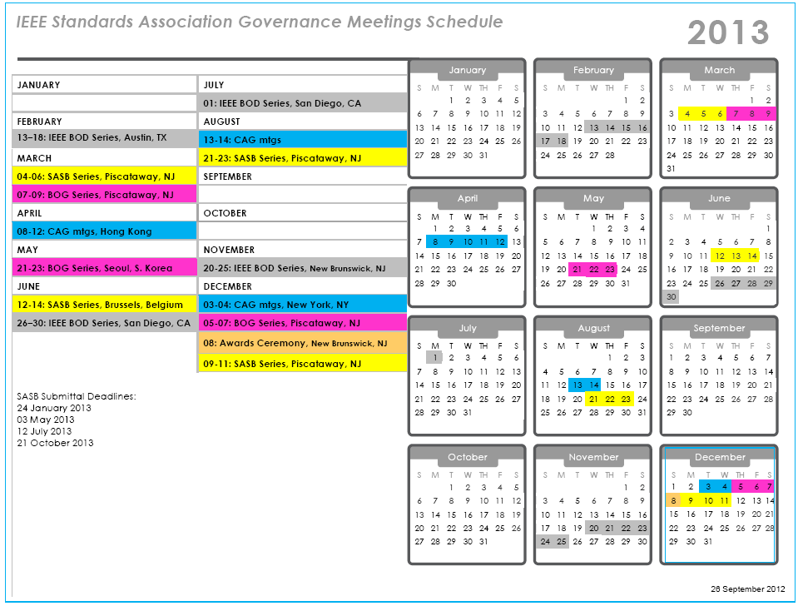
Next SASB deadline:
21 October 2013

Slide 56
