Slide 1
Some Par and 5C Requirements
Date: 2013-9-17
Authors:

Slide 2
PAR Background – Defining the Scope of Work
What is a PAR: http://standards.ieee.org/faqs/pars.html
The PAR defines a IEEE-SA project and includes sections for:
5.2.a. Scope of the complete standard:
The scope includes phrases to focus the groups work, like: ” ... Improve performance in dense environments ...”
5.2.b. Scope of the project:
5.4 Purpose:
5.5 Need for the Project:
So how much technical detail do we need in the PAR
Very little, just enough to scope the project
However, we all really do want to know we are about to create
Use cases discussions and the 5C targets are very valuable

Slide 3
HEW Study Group Current Discussions
Topics of discussion have included ...
Carrier offload, Efficiency, Dense Environments ,Improved performance, modeling, use cases, etc.
This background requirements will map into the PAR scope phrases as that might include:
... Improving the efficiency and performance of ...
... Include XYZ feature ...
etc.
What has been missing in the current scope discussions?
Security
Security is usually an afterthought in 802.11
Proactively addressing security results in less hacks to put it in later
Adding security work to the scope can do more than improve security

Slide 4
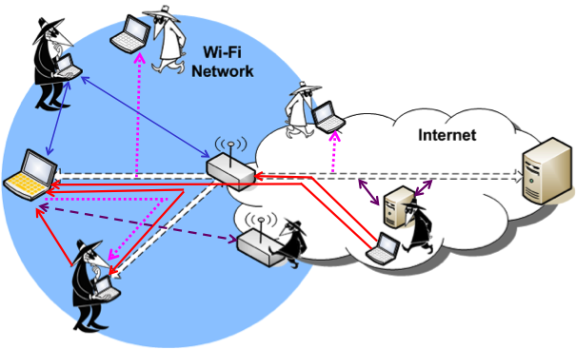
Improving Security in HEW
Security is typically viewed as preventing potential attacks
Security work in HEW could also:
Improve efficiency
Support new use cases
Increase throughput
Enable new operational models (e.g. OBSS)
Increased robustness
Provide for ease-of-use
Wi-Fi Attack Vectors (2011) doc.: IEEE 802.11-11-1250-00-00ai

Slide 5
Security Related Areas for Possible HEW Technical Work
Security Improvements topics that could be considered:
Group key and OBSS security
Encapsulation algorithms
Algorithm initialization (PN.IV, Sequence Num)
Device to device authentication
Privacy

Slide 6
Group Keys and Broadcast Security
The AES-CCM Algorithm requires a unique key/nonce pair
Stream cipher uses XOR, so stream must be unique
In a non-star topology every device must have it’s own unique broadcast key
Every device must then give every other device it’s key
For N devices, this is N^2 protocol exchanges!!!
Other encryption modes would not have this problem!
AES would still be used, but a new mode
Benefits: scalable P2P security, OBSS security, efficiency, etc
This would be a new encapsulation algorithm/mode

Slide 7
Algorithm Initialization
802.11 use of the PN is odd and inefficient
Issues and with multiple traffic queues
Possible solutions and work
802.11ah has some proposed improvements that could be used and extended
New modes of operation may have less stringent requirements
Benefits:
Improved efficiency
Faster initialization / authentication

Slide 8
Privacy
Privacy is important
New services in dense environments will expose mobile users
Very strong public concern for consumer privacy
Demonstrated DIY tools: creepydol-wifi-surveillance-project-debuts-at-blackhatdefcon
Possible mechanisms:
Local MAC addresses integrated with authentication protocol
Privacy and authentication are possible at the same time

Slide 9
Device to device authentication
IEEE 802.11 does NOT have a have a good peer-to-peer authentication mechanism!
This could be AP-to-AP (OBSS)
Mobile-to-mobile
Benefits would include
Very interesting new use cases with strong security
Trust in OBSS communications
Greatly improved ease of use

Slide 10
Summary
The HEW PAR and 5C should include “security and privacy” in the scope and 5C.
Possible phrases for inclusion might look like:
This amendment defines standardized modifications to .... supporting: ... - Enhancements to improve security and privacy ... ”

