Slide 1
Video Performance Requirements and Simulation Parameters
Date: 2013-09-15
Authors:
Name | Affiliations | Address | Phone | Email
Guoqing Li | Intel | 2111 NE 25th ave, Hillsboro, OR 97124 | 1-503-712-2089 | Guoqing.c.il@intel.com
Yiting Liao | Intel | 2111 NE 25th ave, Hillsboro, OR 97124 | 1-503-264-6789 | Yitingl.liao@intel.com

Slide 2
Abstract
In contribution #1032, we identified different categories of video applications and described their characteristics
In this contribution, we will focus on the performance requirements and simulation parameters for the identified video categories

Slide 3
Outline
How to measure video performance?
How to set video traffic parameters in HEW simulation?
Slide 3
Notes:
doc.: IEEE 802.11-08/1101r3
September 2008
John R. Barr, Motorola, Inc.
Page 3

Slide 4
Outline
How to measure video performance?
How to set video traffic parameters in HEW simulation?
Slide 4
Notes:
doc.: IEEE 802.11-08/1101r3
September 2008
John R. Barr, Motorola, Inc.
Page 4

Slide 5
Video Quality/Experience Metrics
Video quality
  Subjective, objective
  Mostly related to distortion against original video pixels
Video experience
  Video start time, re-buffering event, latency, bit rate, packet loss rate
  Mostly related to network capacity, QoS provisioning policy along the data path and device capabilities
Slide 5

Slide 6



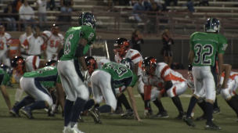
Video Quality Metrics
Subjective scores (MOS): human-involved evaluation score
Objective metrics: an estimate of subjective quality
  Reference-based: e.g., PSNR, SSIM, MS-SSIM
    Not accurate reflection of user experience
    Need to calculate the metrics based on pixels
  Non-reference based: e.g., ITU-P1202
Source: Intel IDF 2012
14 video clips, 96 compressed bit streams
Same PSNR can correspond to MOS from 1.3 (Bad) to 4.6 (excellent)
Slide 6

Slide 7
Video Quality Metrics (cont.)
The video layer quality metrics deal with either
  Human testing
  Pixels-level calculation (e.g., PSNR, MS-SSIM)
  Analysis of compressed bit stream (e.g, P1202.1)
These video quality metrics are NOT suited for HEW evaluation methodology
Slide 7

Slide 8


Video Experience Metrics--Buffering
  Buffer has the largest impact on video streaming experience [1]!
  Rubuffering event = playout buffer is empty when it is time to display the next packet/video unit
  Rebuffering ratio =percentage of time that the video is being rebuffered during the entire viewing duration
For streaming video, a big buffer typically exists for smoothing out large delay and thus individual packet delay does not directly impact video experience
Instead, E2E throughput against video load has more impact on rebufferiing events
0.5%--1% rebuffering ratio is considered above industry-average [1]
Slide 8

Slide 9
Video Experience Metrics--Freezing
Similar to rebuffering, Freezing happens in video conferencing and wireless display
  Caused when the receiver buffer is empty when it is time to display the next packet/video unit
Freezing ratio = percentage of time the video freezes during the entire video conferencing
Unlike buffered steaming, there is no big buffer at RX due to low latency requirement, and thus not able to absorb large individual packet latency
As a result, each packet needs to arrive in time in order to be display at the right time, which means Latency for every packet matters
Freezing event happens when E2E latency for video frames/slices exceed some E2E latency requirement
0.5-1% freezing ratio is recommended based on the number used in buffered streaming?

Slide 10
Video Experience Metrics-Latency
E2E latency
  Buffered Streaming video: [2] recommends 5s for initial delay, but no hard requirement on each packet
    As long as video can be downloaded before playout buffer is empty, the system can tolerate large delay variations
  Wireless display
    Home: recommend 50ms based on the requirement in [3]
    Office: recommend 20ms based on wireless display requirement in [5]
  Video conferencing: E2E150ms is recommended [2]
    What is the latency requirement for the HEW portion?
Slide 10

Slide 11
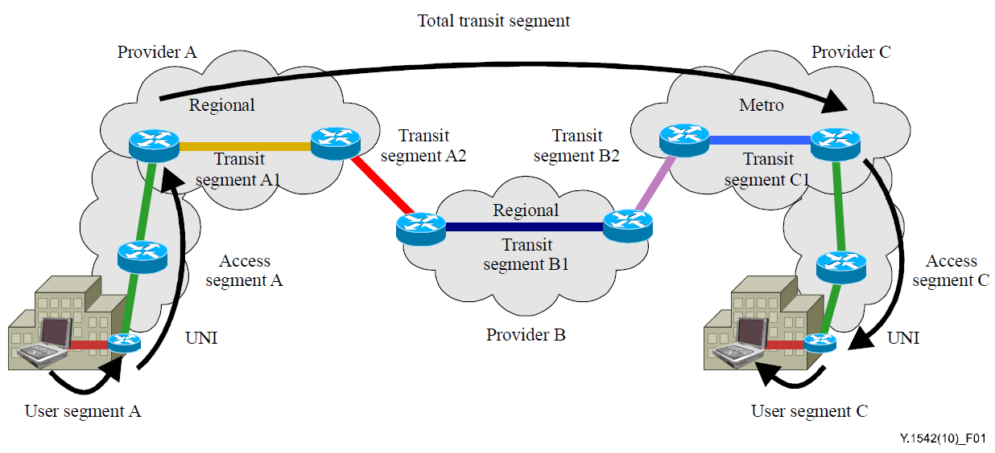
Video Experience Metrics-Latency (cont.)
HEW latency
  For Video conferencing
    HEW latency: (150ms-IP network latency)/2
    IP network latency varies significantly in regions, e.g., <45ms within North America, <90ms between London-NY [15]
    →e.g., <30ms HEW latency required if the conf call is between London-NY
  Buffer streaming: no requirement on each packet
  Wireless display: same as E2E latency since it is one-hop
Slide 11

Slide 12
Video Experience Metrics –Bit Rate
Even though bit rate can vary significantly for different video contents, some empirical data exists that we can consider as video bit rate requirement as well as for traffic modeling
Video bit rate
  For video streaming: 5-8Mbps is recommended for HD [10][11]
  For video conf: 0.5Mbps-2.5Mbps for HD calling [7][8]
  For wireless display
    Docking: recommend 300Mbps@1080p (compression ratio = 10) to achieve visually lossless [9]
    Entertainment: 60Mbps@1080p? (compression ratio=50)
Future video bit rate will increase with the new video formats and more adoption of 3D
  E.g., 4K video bit rate is about 4 times higher than 1080p, i.e., 20-32Mbps
Slide 12

Slide 13
Video Experience Metrics –Packet Loss
Similarly, some empirical data exists for packet loss requirement
Packet Loss requirement
  For buffered streaming
    5% (IP layer) is recommended in [2]
    Note: after TCP layer, the video PER is close to 0.
  For video conferencing, mostly based on UDP
    1% (IP layer) is recommended in [2]
  For wireless display
    Home: 1e-3 (based on gaming app in [3])?
    Office: 1e-6 (highest requirement in [3])?
Slide 13

Slide 14
Summary of video experience metrics and requirements
app | Packet loss | E2E delay | HEW latency | Rebuffering/freezing ratio | Bit rate per HD stream
Buffered Streaming | 5% | 5s (no requirement) | N/A | 0.5-1% | 5-8Mbps
Video conf | 1% | 150ms (E2E) | 30ms (assume conf between Eruope-NA) | 0.5-1% for Prob (latency>E2E requirement) | 0.5-2.5Mbps
Wireless display-home | 1e-3 | 50ms | 50ms | 0.5%? | 60Mbps?
Wireless display—office/gaming | 1e-6 | 20ms | 20ms | 0.5%? | 300Mbps
Slide 14

Slide 15
Outline
How to measure video performance?
How to set video traffic parameters in HEW simulation?
Notes:
doc.: IEEE 802.11-08/1101r3
September 2008
John R. Barr, Motorola, Inc.
Page 15

Slide 16
Video Traffic Parameters
[12] gives some details regarding video traffic model, but it did not suggest the average video bit rate
We suggest to set the average bit rate as follows for different video applications, assuming 1080p:
  Buffered video: 6Mbps
  Video Conf: 1.5Mbps
  Wireless display at home: 60Mbps
  Wireless display in enterprise: 300Mbps
Slide 16

Slide 17
Summary
Video applications will consume the majority of future traffic. However, user are not satisfied with the QoE today
It is critical for HEW to deliver satisfying QoE for video in order to meet such future demand
There are different types of video applications today, and they have very different characteristics
As a result, performance requirements as well as video simulation modeling should be set accordingly for different applications
  On performance requirements: we recommend buffer/freezing ratio, latency, packet loss as performance metrics for HEW evaluation instead of video layer metrics
  On simulation modeling: we recommend different bit rates for different video applications
Slide 17

Slide 18
References
[1] Conviva, H1 2013 Viewer Experience report
[2] Cisco report, Quality of service design overview
[3] 3GPP 23.203, Technical Specification Group services and System aspects; policy and charging control architecture
[4] ITU-T Y.1542, Framework to achieve E2E performance
[5] WiGig Display Market Requirement Document 1.0
[6] 11-13-0787-00-0hew-followup-on-functional-requirements
[7] Lync report, network bandwidth requirement for multimedia traffic
[8] Skype report, how much bandwidth does Skype need
[9] WiGig contribution, H.264 intra quality evaluation
[10] Netflex article, Internet connection recommendation
[11] Youtube article, advanced encoding setting
[12] 11-13-0722-00-0hew-hew-evaluation-methodology
[13] Cisco Visual Networking Index: Forecast and Methodology, 2012–2017
[14] Baek-Young Choi et al., Analysis of Point-to-point packet delay in an operatorational network, Infocom 2004
[15] Verizon report, IP latency Statistics 2012-2013
[16] Cisco white paper, The Zettabyte Era—Trends and Analysis
Slide 18

