Slide 1
PHY Abstraction for HEW System Level Simulation
Date: 2013-09
Authors:
Name | Affiliations | Address | Phone | Email
Zhang Jiayin | Huawei Technologies | No. 2222, Xin Jinqiao Rd. Pudong, Shanghai, China | +862138900662 | zhangjiayin@huawei.com
Ma Chixiang |  | Shanghai |  | machixiang@huawei.com
Zhu Jun |  | Shanghai |  | zhujun75@huawei.com
Peter Loc |  | San Jose |  | peterloc@iwirelesstech.com
Phillip Barber |  | Dallas |  | pbarber@broadbandmobiletech.com
Edward Au |  | Ottawa |  | edward.au@huawei.com
Wookbong Lee | LG Electronics |  |  | wookbong.lee@lge.com

Slide 2
Abstract
A method of MIESM (Mutual Information Effective SINR Mapping) is introduced for PHY abstraction for HEW system level simulation.
In order to fit the channel model and MCS for 11ac, some adjustment to parameters is proposed

Slide 3
Motivation
To evaluate system performance with more realistic assumptions, some existing dynamic PHY features should be reflected in system level simulation, e.g.
  Adaptive modulation and coding schemes
  OFDM with Scalable bandwidth
  ACK transmission
  (SU/MU)-MIMO, including CSI feedback

Slide 4
Motivation
Complex simulation scenarios impede real-time link level simulation for all communication links in system level simulation.
  There will be a large number of APs and STAs deployed in HEW simulation scenario, e.g. tens of APs and hundreds of STAs.
  There will be mixed channel models in one simulation scenario, NLOS/LOS, indoor/outdoor.
  Different links adopt different transmission modes (e.g. MCS, streams).
  It takes a long time to do channel coding/decoding simultaneously for many links, especially with LDPC.

Slide 5
State of the art in Wi-Fi
PHY abstraction is to predict the packet error rate (PER) for a given received channel realization across the OFDM subcarriers used to transmit the coded FEC block.
In early 11ac, the TG re-investigated PHY abstractions proposed in 11n for MU-MIMO, but no consensus reached.[1]
  Unified “Black Box” [2]
    Use of look-up tables giving PHY performance vs. channel conditions via channel capacity
    Large computation and storage required
  PER prediction [3]
    Calculate the effective SNR by assuming AWGN channel during the frame length, and then map effective SNR to PER using mathematical properties of BCC channel coding.
    Inaccuracy in complex interference and mobility environment

Slide 6
State of the art in cellular
Effective SINR Mapping (ESM) method
Currently, Effective SINR Mapping[4] were widely used in system level simulation for 3GPP LTE[5] and IEEE 802.16m[6] ,
  Step 1: calculate post SINRs on each OFDM resource element considering the receiver algorithms, such as ZF/MMSE.
  Step 2: Calculate the effective SINR ( ) , using the following equation
  Step 3: Reference the AWGN link performance curves of different MCSs to obtain the mapping between effective SINR and BLER.
It is similar to PER prediction except for the effective SNR calculation.

Slide 7
Our proposal
Mutual Information ESM (MIESM)
Two mapping functions are generally used [4].
  EESM (Exponential ESM):
    It is only accurate at high error rate.
  MIESM :
    Also called RBIR (Received Bit mutual Information Rate) [6]
    It is a nonlinear mapping from post SNR to symbol-level mutual information.

Slide 8
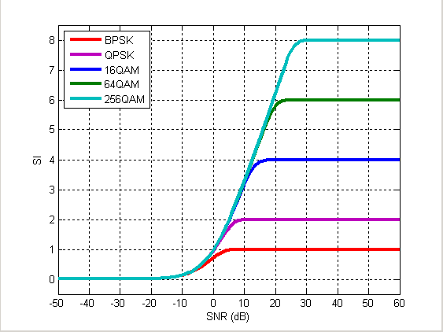
MIESM in 11ac (1)
The effective SNR mapping curves for 11ac modulations.

Slide 9
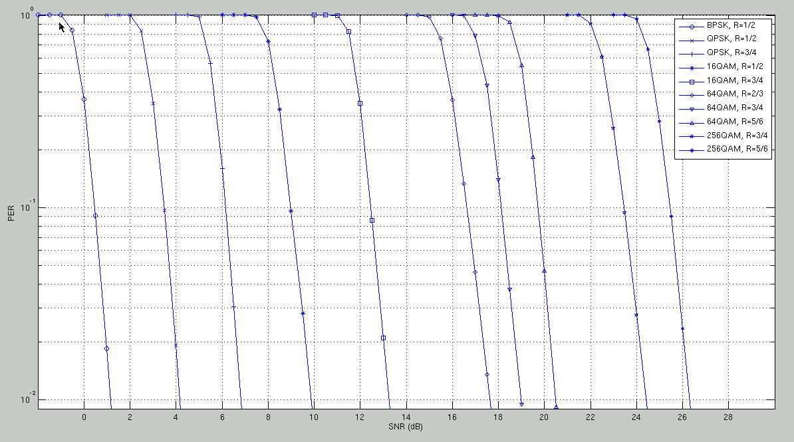
MIESM for 11ac (2)
The predicted PER can be mapped from the effective SNR to BLER curves
  BLER performance in AWGN channels.

Slide 10
MIESM in 11ac (3)
Performance deviation from link level simulation
MCS | α₁ | α₂ | MSE
0 | 0.33 | 2 | 0.7073
1 | 0.83 | 0.1 | 1.0114
2 | 0.95 | 0.1 | 1.3849
3 | 0.74 | 0.22 | 0.1235
4 | 0.89 | 0.45 | 0.1682
5 | 0.86 | 0.63 | 0.3563
6 | 0.91 | 0.67 | 0.2142
7 | 0.93 | 0.67 | 0.3028
8 | 0.89 | 0.69 | 0.4045
9 | 0.92 | 0.74 | 0.3141

Slide 11
Summary
MIESM(RBIR) can provide a quick, channel model independent prediction of instantaneous error rate given the post SINR across the resource element of OFDM used to transmit codeword.
It can be used as one of the PHY abstractions for HEW SLS.
Other abstraction methods, e.g. MMIB, can also be used as long as the prediction accuracy can be justified.

Slide 12
Reference
[1] 11-09/1039r0 Simulation Methodology Proposal
[2] 11-04/0218r3 Unified “Black Box” PHY Abstraction Methodology, Mar. 2004
[3] 11-04/0174r1 PHY Abstraction for System Simulation, Feb. 2004
[4] Karsten Brueninghaus, “Link Performance Models for System Level Simulations of Broadband Radio Access Systems”, PIMRC 2005
[5] 3GPP TR 25.892 V2.0.0 “Feasibility Study for OFDM for UTRAN enhancement”, June 2004.
[6] IEEE 802.16m-08/004r5, Jan. 2009
[7] 11-13/1059r0 PHY abstraction for HEW, Sept. 2013

Slide 13
Appendix 1
Justification procedures used to get curves in slide 10. [1]

Slide 14
Appendix 2
Mean Mutual Information per Bit (MMIB)
  An alternative method in 16m [6][7]
  It is a nonlinear mapping from post SNR to mutual information per coded bit
MIB function
QPSK
16QAM
64QAM

Slide 15
QPSK, 1/2 BCC

Slide 16
16QAM, 1/2 BCC

Slide 17
64QAM, 2/3 BCC

