Slide 1
CCA Channelization and Levels for 11ah
Date: 2013-09-16
Authors:

Slide 4
Outline
Part 1:
  High/Low CCA Levels Channelization
  Intended High TxBW Levels
Part 2:
  CCA Levels

Slide 5
Part 1: Two Use Cases and Different Preferred CCA Levels
Extend range WiFi (e.g. cellular offload)
  High Tx power
  Generally operates at high data rates (with high sensitivity level) and wide bandwidth
  Can tolerate higher interference level
  Prefer higher CCA level to improve the medium utilization rate
Sensor
  Very low Tx power: no PA in many cases
  But coverage range is still essential: e.g. whole house coverage
    Has to rely on very low data rates (thus very low sensitivity level) to extend range
  Sensitive to interference
    Low data rates lead to long Tx duration, which increases the likelihood of being hit with interference
  Prefer low CCA level to protect the transmissions from sensor devices
Very difficult to find optimal CCA levels to satisfy the needs of both use cases

Slide 6
Type 1/Type 2 Solution
Define CCA levels for 2 types of channels:
  Type 1 channels with lower CCA levels, thereby protecting low BW transmissions from sensors
    Optimized for coverage rage
  Type 2 channels with higher CCA levels, thereby giving preference to higher BW devices (e.g. cellular offload use-case)
    Optimized for good re-use
Type 1/Type 2 split to apply to US, China channelization:
  Allowable TxPower levels and availability of channels make high data rate use cases logical
  In other regions, all channels use Type 1 levels

Slide 7
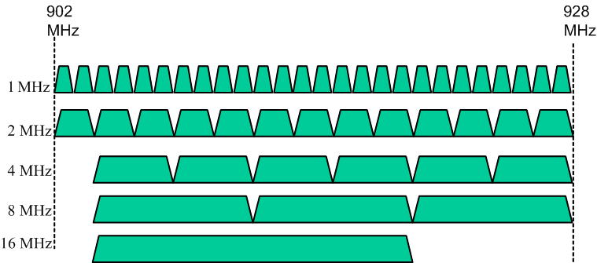
Type1/Type 2 Split for US Channelization
26 1MHz channels, 13 2MHz channels, 6 4MHz channels, 3 8MHz channels and one 16MHz channel
Type 1: Lower CCA Channels
Type 2: Higher CCA channels

Slide 8
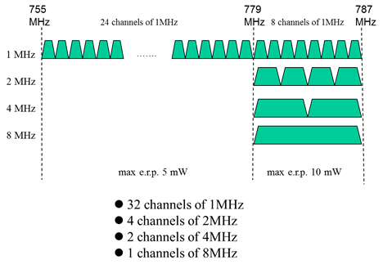
Type 1/Type 2 Split for China Channelization
Type 1: Lower CCA Channels
Type 2: Higher CCA channels

Slide 9
Part 2: CCA Levels
CCA Levels for 11ah defined as:
  11ah signals occupying Primary 2MHz channel
  11ah signals not occupying Primary 2MHz channel
  Any signal (Energy Detect levels)
Recall that Type 2 channels get higher CCA levels to give advantage to higher BW devices
  Type 2 channel CCA levels and Type 1 channel CCA levels separated by Delta factor (in dB)
  Delta determines the reduction of sensitivity to PPDUs of that bandwidth

Slide 10
Preamble Detect CCA Levels for Type1/Type2 channels
-80dBm
Type 1 is scaled 11ac levels
    Type2 Levels @ [-89, -89, -86, -83,-80] dBm for 1/2/4/8/16 MHz PPDUs
  Delta above all Type 1 levels reduces CCA sensitivity to all transmissions
  Sensitivity to 1MHz PPDUs (in Pri 1MHz) is aligned to 2MHz level
  Scaled CCA level within Primary 2MHz is constant for PPDUs of >2MHz BW.
    [-89, -89, -89, -89] dBm for 2/4/8/16MHz PPDUs
    Eases implementation slightly as Rx does not need to know BW of >=2MHz PPDUs before checking CCA level on Primary 2MHz
-83dBm
16MHz
PPDU
-86dBm
8MHz
PPDU
-89dBm
-89dBm
4MHz
PPDU
2MHz
PPDU
1MHz
PPDU

Slide 11
CCA for High Intended TxBW
For higher transmit BWs such as 8MHz and 16MHz, the power density for the transmission is lower relative to lower transmit BW transmissions
  For fixed power, scales inversely according to TxBW
  Interference to OBSS from wide bandwidth transmissions is reduced accordingly.
Desirable to allow higher CCA levels for wider intended transmission bandwidth PPDUs
Propose to use higher CCA Levels for 8/16MHz intended transmit bandwidth

Slide 12
Proposed Required Rules for Wide Tx Bandwidth Related CCA
If a backoff countdown process for BW greater than 2MHz is employed, the actual transmission BW shall be greater or equal to the BW used for determining the CCA level during the back-off process
If a STA detects a transmission and its PAID or BSSID matches with its own, it shall maintain PHY-CCA.indication busy for the predicted duration of the transmitted PPDU
If Tx BW related CCA levels are applied, a dynamic bandwidth result that is narrower than the BW used for channel access backoff may be ignored.
Transmit BW related CCA levels are only applicable to Type 2 channels

Slide 13
Preamble Detect CCA levels for 8/16MHz Intended TxBW
Proposed CCA Levels for Type 2 8/16MHz intended BW
  [-86,-86,-83,-80,-77] dBm for 1/2/4/8/16MHz PPDU
  Delta of 3dB above regular (non-TxBW specific CCA levels)

Slide 14
Secondary Channel CCA Levels
11ac used Midpacket detection for Secondary channel CCA
  Checked for PIFS duration before backoff expiration
    Intended for catching OBSS transmissions not occupying Primary 20MHz, at levels ~10dB higher than Preamble detect levels
Same Secondary channel CCA procedure can be used for 11ah
  Type 2 (Scaled 11ac levels), Type 1 (=Type 2 – 4dB)
 | 2MHz PPDU | 4MHz PPDU | 8MHz PPDU
Secondary 2MHz | -82dBm (Type 2) -86dBm (Type 1)
Secondary 4MHz | -82dBm (Type 2) -86dBm (Type 1) | -82dBm (Type 2) -86dBm (Type 1)
Secondary 8MHz | -82dBm (Type 2) -86dBm (Type 1) | -82dBm (Type 2) -86dBm (Type 1) | -79dBm (Type 2) -83dBm (Type 1)

Slide 15
Energy Detect CCA Levels
11ac uses ED Levels of 20dB higher than Min. Sensitivity levels:
  Can use same gap for 11ah
  Use same levels for Type 1/Type 2
The CCA-ED Level for Energy Detection (for Type 1/Type 2)
  -75dBm/1MHz
  -72dBm/2MHz
  -69dBm/4MHz
  -66dBm/8MHz
  -63dBm/16MHz

Slide 16
Summary
Proposed concept of Type 1/Type 2 channelization split for CCA levels
Proposed CCA levels for Type 1/Type 2 channels

Slide 17
Strawpoll #1
Do you agree with the Type1/Type2 classification concept in slide 6 and the splits for the US and China described in Slides 7 and 8?
  Y
  N
  A

Slide 18
Strawpoll #2
Do you agree with the preamble detect CCA levels for Type1 and Type2 channels as described in slide 10?
  Y
  N
  A

Slide 19
Strawpoll #3
Do you agree with the Wide Intended TxBW specific CCA levels and rules for Type2 channels as described in slides 11-13?
  Y
  N
  A

Slide 20
Strawpoll #4
Do you agree with the Secondary channel CCA levels for Type1 and Type2 channels as described in slide 14?
  Y
  N
  A

Slide 21
Strawpoll #5
Do you agree with the Energy Detect CCA levels for Type1 and Type2 channels as described in slide 15?
  Y
  N
  A

