Slide 1
Beamforming Under OBSS Interference
Date: 2013-09-16
Authors:

Slide 2
Introduction
As shown in [1], dense deployment is one of the major use cases considered in HEW.
In dense 11abgn/ac deployments, co-channel interference (CCI) or collision from OBSS is unavoidable using current WLAN channel access methods. In [2], some beamforming enhancement ideas were discussed to reduce collision, in particular at cell edges.
[2] lists some major benefits of TxBF for reducing CCI:
Reduced interference to OBSS (beamformed transmission)
Reduced interference from OBSS interference (beamformed reception)
This presentation tries to evaluate the performance of TxBF under CCI by true measurements.
Different from [2], here we do not discuss any new scheme, but evaluate the baseline performance using existing SU-TxBF method in 11n/11ac.
Benefit #2 from [2] (beamformed reception) is verified by the results.

Slide 3
CCI Impacts
Perfect “time sharing” among OBSS is not catastrophic:
In this “TDMA-like” case, all traffic are protected by RTS/CTS/CTS-to-self, which can be heard by all devices in the OBSSs, no collision happens.
In this case the sum throughput should be averaged single-link throughput—which is not catastrophic.
However, in reality, different APs are not coordinated, therefore perfect time sharing is almost not possible. Collisions among OBSS will happen and significantly affect sum throughput and for some users it could be catastrophic (near zero throughput).
E.g. RTS/CTS/CTS-to-self frames themselves could be under collision or not decodable by hidden nodes.

Slide 4
Beamforming Effect on CCI (1)
Beamforming increases the robustness against CCI:
The CCI is not white at Rx, it fluctuates significantly across different tones-shaped by wireless channels. Some tone could have a very low SINR. WiFi is a BICM-OFDM system where performance is mainly determined by the few weakest tones (equivalently, geometric mean of per-tone SINRs). As a result, an X dB reduction in time domain average SINR may cause TP-vs-dBm performance drop for much more than X dB.
TxBF leverages array gain plus diversity gain,and may “save” the few bad tones and turn the performance back under strong CCI!
Compared with non-beamforming (omni) case, in theory more energy is “focused” to the “direction” of the intended client, hence on average the energy leakage to other unintended devices may also reduce (also mentioned in [2])
Depending on geometrical locations.
When all adjacent APs do SU TxBF to their own clients, the overall SINR at each client and AP in the whole area can be greatly improved, so as the network throughput.
Similar conclusion was made in [4] based on system simulations.

Slide 5
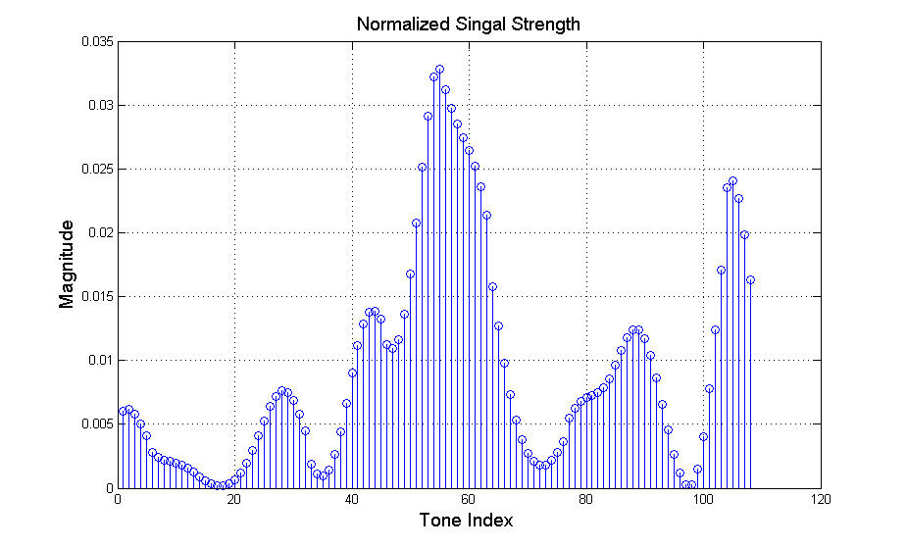
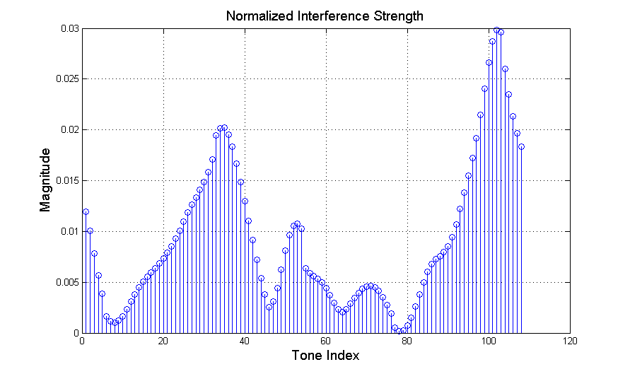
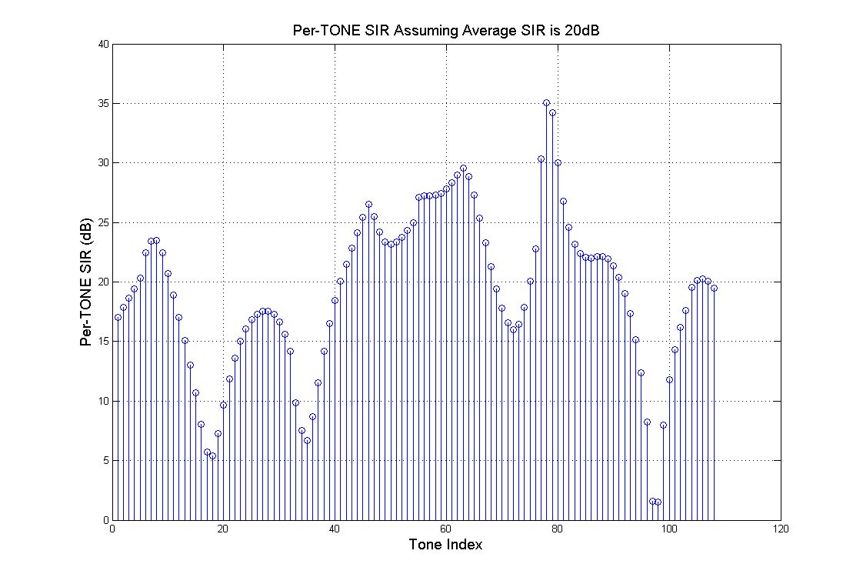
Beamforming Effect on CCI (2)
SIR Illustration: assume CCI is 20dB lower than signal on average, signal and CCI travel through independent 11n 40MHz DNLOS channels, worst per-tone SIR is less than 10dB.

Slide 6
Beamforming Effect on CCI (3)
Beamforming improves per-client throughput, hence reducing the airtime for fixed quantity of data for each client.
The most common usage case in public hotspot is internet browsing, or texting, etc—with fixed data amount (e.g. load a webpage).
Airtime for the fixed-amount service data is reduced proportionally to throughput increase brought by TxBF.
Shorter airtime further reduces the chance of OBSS collisions (interference) to adjacent BSSs, and it also reduces required TxOP durations.

Slide 7
Beamforming Effect on CCI (4)
When CCI/OBSS happens, for perfect time sharing (unrealistic assumption): the throughput gain from TxBF should be just the averaged TxBF gain in link level.
For collision scenarios (realistic cases), TxBF could lead to much larger % gain in throughput, especially for clients with catastrophic impacts from OBSS collisions without BF (see earlier slides).

Slide 8
OTA Measurements

Slide 9
Test Setup
In office hallway, place two APs ~80m apart NLOS, place STA1 close to middle point, change different locations of STA2.
STA1 associated/pinged with AP1, STA2 associated/pinged with AP2, respectively.
5GHz, CH36, 40MHz, for both APs.
AP1 and AP2 are both 4x4, with beamformer capability; STA1 and STA2 are both 1x1, with beamformee capability.
AP1 is placed with fixed direction, AP2 is placed on a turn-table with speed1rpm. Averaged throughputs were measured over one rotation (1 min) of AP2’s turn table.
Both APs start UDP traffic simultaneously in different test cases.

Slide 10
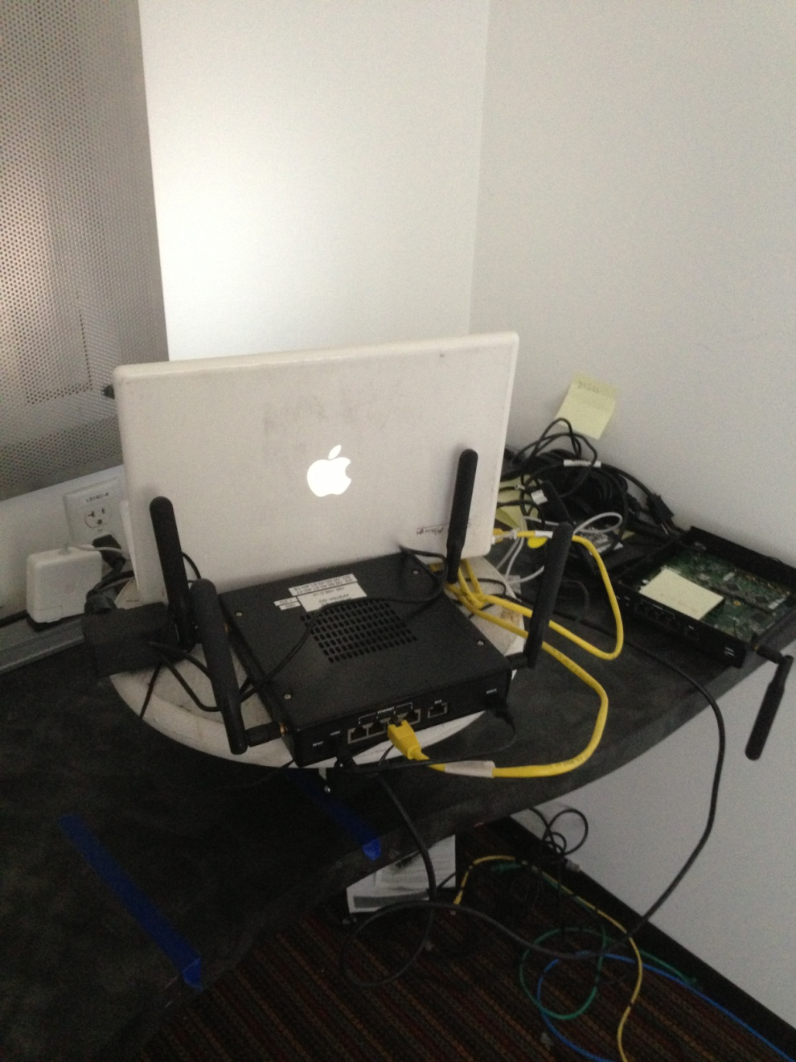
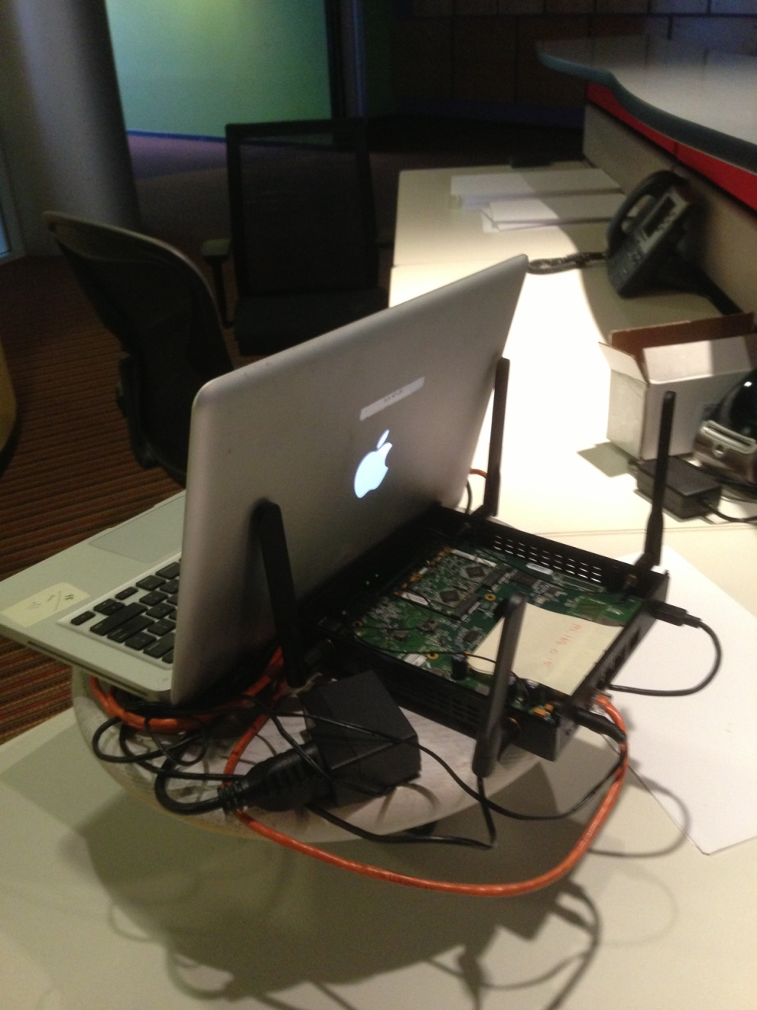
AP1 and AP2
AP1
AP2

Slide 11
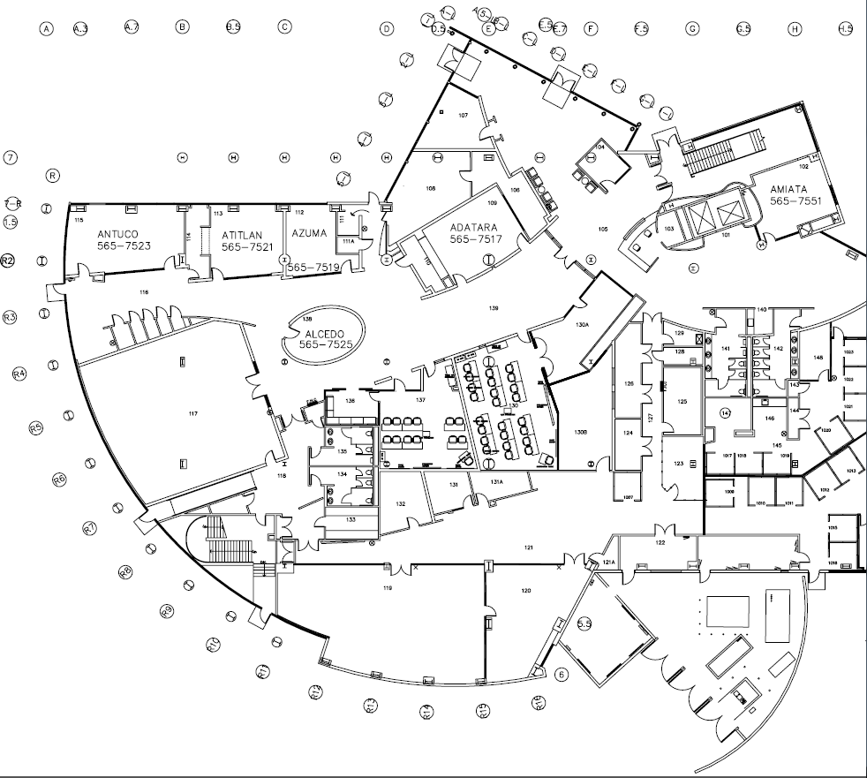
Case-1: STA2 is close to AP2
AP2
STA2
STA1
AP1

Slide 12
Case-1 Results
Throughputs in Mbps:
 | AP2 BF OFF (UDP) | AP2 BF ON (UDP) | AP2 Traffic OFF
AP1 BF OFF (UDP) | TP1=8.62, TP2=100 TPsum = 108.62 | TP1=9.64, TP2=97.4 TPsum = 107 | TP1=56.8
AP1 BF ON (UDP) | TP1=39.6, TP2=81 TPsum = 120.6 | TP1=37.2, TP2=90.4 TPsum = 127.6 | TP1=96
AP1 Traffic OFF | TP2=120 | TP2=120
ON/ON vs OFF/OFF:
4x throughput gain for STA1, and 17% sum throughput gain
(STA1 has catastrophic impact from CCI without BF)

Slide 13
Case-2: STA2 is close to cell boundary toward direction of AP1
AP2
STA1
STA2
AP1

Slide 14
Case-2 Results
Throughputs in Mbps:
 | AP2 BF OFF (UDP) | AP2 BF ON (UDP) | AP2 Traffic OFF
AP1 BF OFF (UDP) | TP1=7.34, TP2=11.3 TPsum = 18.64 | TP1=5.74, TP2=45.9 TPsum = 51.64 | TP1=56.8
AP1 BF ON (UDP) | TP1=29.2, TP2=22.1 TPsum = 51.3 | TP1=26.3, TP2=42.8 TPsum = 69.1 | TP1=96
AP1 Traffic OFF | TP2=70 | TP2=96
ON/ON vs OFF/OFF:
4x throughput gain for STA1 and STA2 respectively, and 4x sum throughput gain
(STA1 and STA2 have catastrophic impact from CCI without BF)

Slide 15
Case-3: STA2 is in opposite direction of AP1
STA2
AP2
STA1
AP1

Slide 16
Case-3 Results
Throughputs in Mbps:
 | AP2 BF OFF (UDP) | AP2 BF ON (UDP) | AP2 Traffic OFF
AP1 BF OFF (UDP) | TP1=15.25 , TP2= 34.4 TPsum = 49.65 | TP1=7.2, TP2=88.3 TPsum = 95.5 | TP1=56.8
AP1 BF ON (UDP) | TP1=38.2, TP2=32.7 TPsum = 70.9 | TP1=23. 7, TP2=85 TPsum = 108.7 | TP1=96
AP1 Traffic OFF | TP2=53 | TP2=107
ON/ON vs OFF/OFF:
50% throughput gain for STA1, 2.5x throughput gain for STA2, and 2x sum throughput gain

Slide 17
Discussions
We evaluated the performance benefit of TxBF in OBSS environment by OTA measurements: the baseline TxBF, even without any new improvements, shows great performance gain against CCI/collisions.
Great throughput gain to intended STA.
The effect of leakage to other users (discussed in [2]) is not as obvious from the test results—highly location-dependent.
HEW may consider fully explore baseline 11ac TxBF as a mandatory baseline feature for APs.
As discussed in [3], “HEW should fully explore all features in old standards”.
To evaluate any new scheme, the evaluation methodology should assume 11ac TxBF as the baseline performance metric, for comparison.
Possible HEW improvements:
Tx: BF enhancements for CCI mitigation/avoidance.
Rx: Interference cancellation/mitigation.
AP coordinations.

Slide 18
References
[1] 11-13-0657-04-0hew-hew-sg-usage-models-and-requirements-liaison-with-wfa, Laurent Cariou, et. al.
[2] 11-13-0877-01-0hew-hew-beamforming-enhancements, James Wang, et. al.
[3] 11-13-0549-00-0hew-a-perspective-on-what-any-high-efficiency-wireless-tg-should-and-should-not-do, Brian Hart, et. al.
[4] S. Catreux, P. F. Driessen, and L. J. Greenstein, “Attainable throughput of an interference-limited multiple-input multiple-output (MIMO) cellular system,” IEEE Trans. Communications, vol. 49, no. 8, pp. 479-493, Aug 2001.

