Slide 1
HEW Outdoor Channel Model Discussions
Date: 2013-09-16
Authors:
Name | Affiliations | Address | Phone | email
Hongyuan Zhang | Marvell Semiconductor | 5488 Marvell Ln, Santa Clara, CA 95054 | 1-408-222-1837 | hongyuan@marvell.com
Yan Zhang | Marvell Semiconductor
Hui-Ling Lou | Marvell Semiconductor
Yakun Sun | Marvell Semiconductor
Mingguang Xu | Marvell Semiconductor

Slide 2
Introduction
HEW outdoor channels were discussed in [1]~[3].
In this presentation, we study the effective range of outdoor WiFi, based on which choose the right model. PER performances is also studied.
Link budget analysis conducted across different MCSs.
PER simulations conducted across different MCSs.

Slide 3
I. Link Budget Analysis
2.4GHz, BW=20MHz, 1SS, for longest possible distance.
 | TxPwr (dBm) | Tx Ant Gain (dBi) | Rx Ant Gain (dBi) | Fading Margin (dB) | Rx Sensitivity (dBm) | Distance for UMi LOS (m) | Distance for UMi NLOS (m) | Distance for UMa LOS (m) | Distance for UMa NLOS (m)
MCS0 | 30 | 6 | 0 | 3 | -82 | 758 | 137 | 1113 | 191
MCS2 | 30 | 6 | 0 | 3 | -77 | 569 | 100 | 835 | 142
MCS4 | 28 | 6 | 0 | 3 | -70 | 339 | 57 | 497 | 84
MCS7 | 28 | 6 | 0 | 3 | -64 | 238 | 39 | 352 | 59
* Path Loss model and parameters for UMi and UMa uses Table A1-2 in reference [4].
NLOS Path Loss using Hexagonal layout.
* Shadow fading is added for different cases according to Table A1-2 in reference [4].
UMi-LOS, σ = 3dB; UMi-NLOS, σ = 4dB
UMa-LOS, σ = 4dB; UMa-NLOS, σ = 6dB
* The large Tx Power may be achieved by high-end PA, and multiple antennas; Tx power is
backed off for higher MCSs for better TxEVM.

Slide 4
Link Budget Analysis (2)
The probability of LOS channel is a function of distance, specified by Table A1-3 in [4].
The average distance for each MCS in UMi and UMa is then
UMi | P_{LOS} = min (18/d,1) ⋅ (1 – exp (–d / 36)) + exp (–d / 36) (for outdoor users only)
UMa | P_{LOS} = min (18/d,1) ⋅ (1 – exp (–d / 63)) + exp (–d / 63)
 | Average Distance UMi (m) | Average Distance UMa (m)
MCS0 | 152 | 206
MCS2 | 115 | 157
MCS4 | 72 | 99
MCS7 | 54 | 75

Slide 5
Link Budget and Channel Model Discussions
No matter assuming UMa or UMi, the above link budget analysis indicates a longest distance (MCS0) ~200m.
Considering the idealized output power and antenna gain assumptions, and limitations in uplink TxPower, the actual distance could be shorter.
5GHz also has shorter distances due to FCC limit, larger PL, etc.
According to [4][5], this distance is more suitable for small-cell channel—UMi.
As also indicated in [6], “outdoor WiFi is by nature a small-cell deployment”.
Therefore we believe UMi should be used for baseline HEW outdoor channel model.
UMa may be considered for some special far-distance scenarios, but may allow some performance degradation, and/or may be limited to low MCS in low SNR regime.

Slide 6
II. Link Level Simulations for UMi
Use SCM UMi-NLOS and UMi-LOS channel model as defined in [5].
UMi-LOS channel assumes K=10dB.
Here we just use SCM as an example, not stressing on the exact SCM model for HEW.
11ac 20MHz, 1x1, MCS0, 2, 4, 7 representing BPSK, QPSK, 16QAM and 64QAM, try different channels.
11ac 20MHz, 4x1, MCS 4, 7, TxBF v.s. Open-Loop.
All assuming normal GI (0.8us).

Slide 7
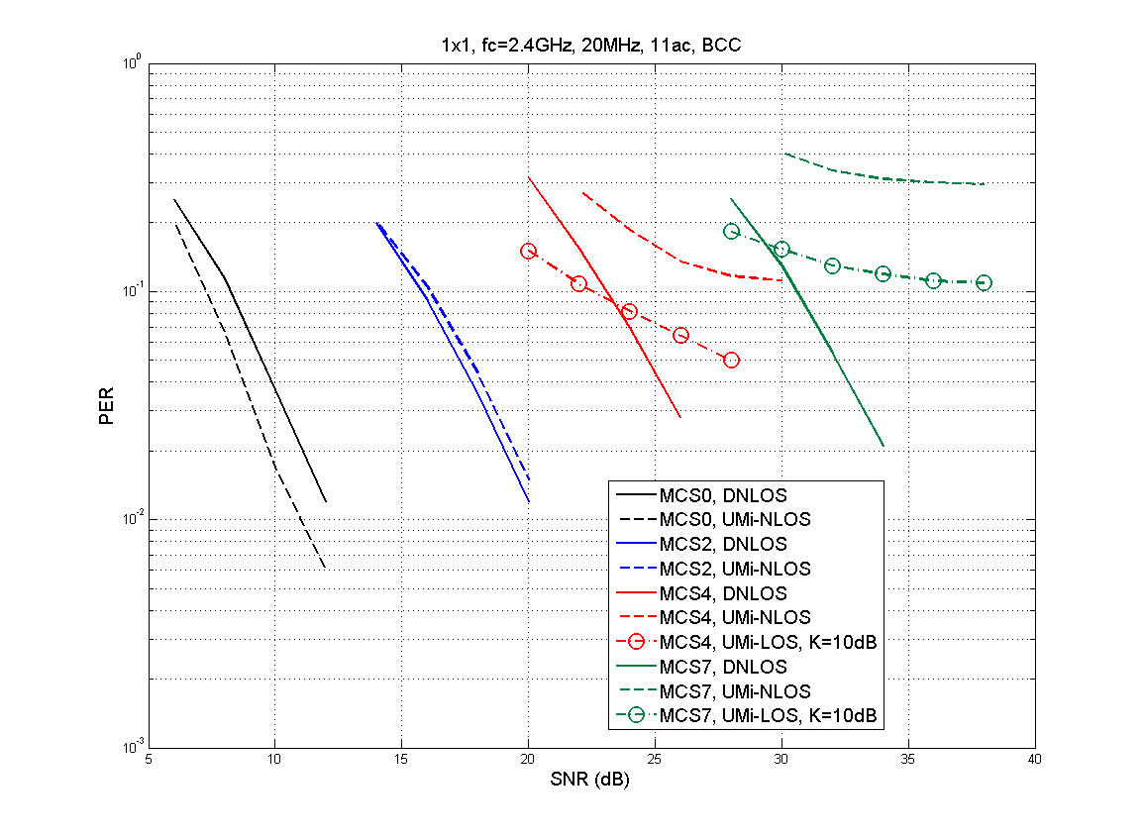
1x1, 20MHz, Different Channels

Slide 8
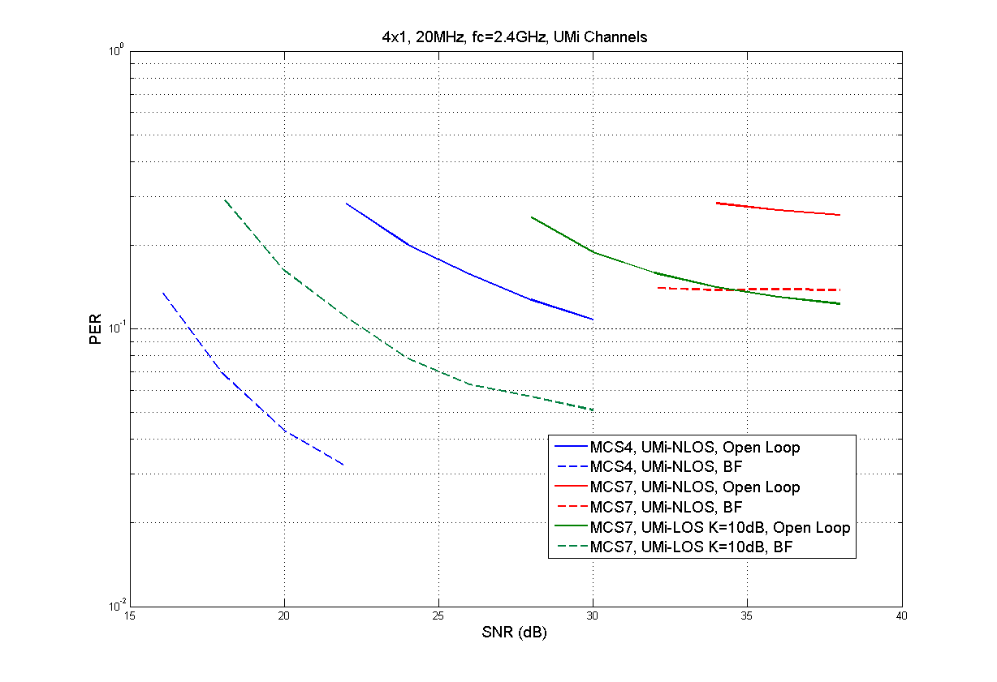
4x1, 20MHz, UMi, TxBF v.s. Open-Loop

Slide 9
Discussions (1)
UMi-NLOS channel using SCM model has little/no impact on low data rate BPSK and QPSK, but impacts 16-QAM and beyond.
UMi-NLOS channel does not prevent a backward-compatible preamble design, which is essentially modulated by MCS0.
UMi-LOS at closer range has more chance to support high MCSs.
MCS7 is still tough without BF, but may get better for larger K-factor and/or LDPC (not simulated)
Beamforming flattens the freq domain channel, hence shortening the effective time-domain channel delay-spread.
16QAM with TxBF may get through UMi-NLOS, 64QAM with TxBF may get through UMi-LOS.
We may need to take a closer look on what is appropriate channel model for high MCSs.
Next page.

Slide 10
Discussions (2)
For UMi-NLOS, rms delay is ~250ns, longest tap might be ≥1us.
This DS value might be reasonable for long distance, but not for shorter distance (high MCS).
For example, average distance for MCS7 is 54m the best (assume max output power and antenna gain), and actual range of MCS7 could be much shorter.
A counterpart is 11n/11ac link-level simulations, where people may simply use channel model DNLOS to simulate 64QAM or 256QAM.
Although DNLOS channel won’t break high MCS, our measurements showed that the actual indoor channel within the range of 256QAM and 64QAM is usually of much shorter DS than what model D defined.
For outdoor HEW, we should be more careful for models used for 64QAM/256QAM.
We cannot assume UMi-NLOS for all MCSs in link-level sims, suggest to use distance-dependent channel model.
We may use ITU UMi with variant LOS component based on effective distance of UMi model.
Different MCSs assume different effective distances based on their SNR ranges.

Slide 11
Conclusions
We studied the effective distance of WiFi signals using link budget analysis, and concluded that UMi should be the baseline HEW outdoor channel model.
UMa may be considered for some cases.
Simulations show that SCM UMi-NLOS channel is ok for low MCSs conforming to 11n/ac PHY format, but is tough with ≥16QAM.
Beamforming makes freq domain channel flatter, hence shortening effective time domain channel delays.
We suggest to consider distance-dependent outdoor channel model for link level simulations.
Future works:
Cross check results using ITU models (UMI and UMA).
True 11n/ac device outdoor measurement if feasible.

Slide 12
References
[1] 11-13-0536-00-0hew-hew-sg-phy-considerations-for-outdoor-environment, Wookbong Lee, et. al.
[2] 11-13-0756-01-0hew-channel-model, Ron Porat et. al.
[3] 11-13-0858-00-0hew-hew-channel-model, Shahrnaz Azizi et. al.
[4] Report ITU-R M.2135-1 (12/2009) Guidelines for evaluation of radio interface technologies for IMT Advanced
[5] 3rd Generation Partnership Project; Technical Specification Group Radio Access Network; Spatial channel model for Multiple Input Multiple Output (MIMO) simulations (Release 10), 3GPP TR 25.996 V10.0.0 (2011-03)
[6] 11-13-0872-01-0hew-clarifications-on-outdoor-deployments, Laurent Cariou, et. al.

