Slide 1
September 2013
doc.: IEEE 11-13/1105r0
Discussion on Access Mechanism for HEW
Date: 2013-09-18
Authors:
Name | Affiliations | Address | Phone | Email
Meng Yang | China Academy of Telecommunication Research (CATR) | No. 52 Hua Yuan North Road, Beijing, China | 86 10 62300167 | yangmeng@ritt.cn
Zhendong Luo | CATR |  | 86 10 62300171 | luozhendong@catr.cn
Bo Sun | ZTE Corporation |  | 86 29 88724130 | Sun.bo1@zte.com.cn
Feng Li | CATT |  | 86 10 62305566 | lifeng@catt.cn
Submission
Slide 1
Meng Yang (CATR)

Slide 2
September 2013
doc.: IEEE 11-13/1105r0
Abstract
This presentation will analyze the possible access mechanisms to stimulate technical discussions on access mechanism for HEW.
Submission
Slide 2
Meng Yang (CATR)

Slide 3
September 2013
doc.: IEEE 11-13/1105r0
Motivation
HEW SG focus on:
  Improving spectrum efficiency and area throughput
  Improving real world performance in indoor and outdoor deployments
    in the presence of interfering sources, dense heterogeneous networks
    in moderate to heavy user loaded APs
Based on the aims, HEW involved more functional requirements, like: supporting large number of users, interference suppression (OBSS), QoE, ……
In order to meet the functional requirements, needs to improve the access mechanism at first.
Submission
Slide 3
Meng Yang (CATR)

Slide 4
September 2013
doc.: IEEE 11-13/1105r0
Background
Existing CSMA/CA-based access mechanisms:
  DCF:
    Distributed contention-based
    Supports asynchronous transmission
    Provides equal opportunities for the channel access for all users, without priority and QoS guarantees.
  PCF:
    Contention free-based
    Supports synchronous transmission
    Differentiation considered based on priority, poor QoS performance.
  EDCA:
    DCF Extension, contention-Based channel access
    Supports prioritized QoS
HEW needs to improve the real world performance in high density scenarios developments.
In the present 802.11 protocols, AP just supports a small number of STAs. When a large number of STAs request to transmission at the same time, probability of conflict will be increased, causing interference and congestion.
Therefore, improving the access mechanism is necessary for HEW.
Submission
Slide 4
Meng Yang (CATR)

Slide 5
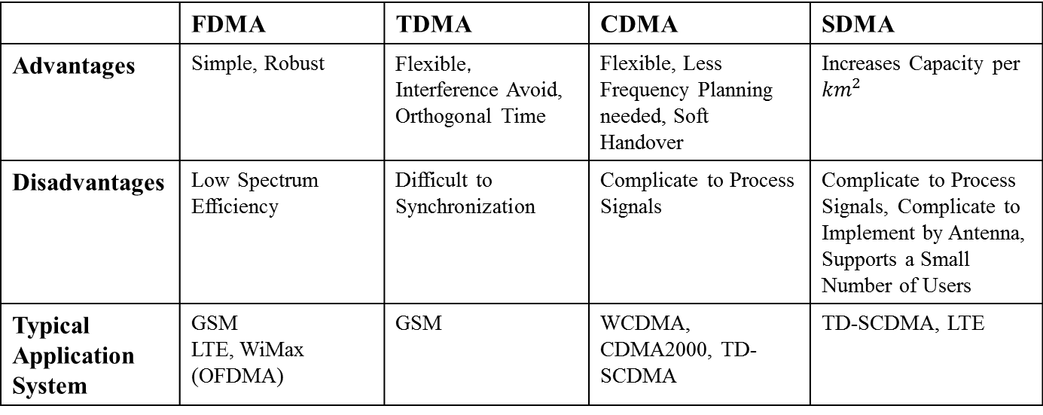
September 2013
doc.: IEEE 11-13/1105r0
Traditional Access Mechanisms
 | FDMA | TDMA | CDMA | SDMA
Advantages | Simple, Robust | Flexible，Interference Avoid, Orthogonal Time | Flexible, Less Frequency Planning needed, Soft Handover | Increases Capacity per ${km}^{2}$
Disadvantages | Low Spectrum Efficiency | Difficult to Synchronization | Complicate to Process Signals | Complicate to Process Signals, Complicate to Implement by Antenna, Supports a Small Number of Users
Typical Application System | GSM LTE, WiMax (OFDMA) | GSM | WCDMA, CDMA2000, TD-SCDMA | TD-SCDMA, LTE
Code
Code
Code
STA
STA
Frequency
Frequency
Frequency
AP
STA
Time
FDMA
Time
TDMA
Time
CDMA
SDMA
Submission
Slide 5
Meng Yang (CATR)

Slide 6
September 2013
doc.: IEEE 11-13/1105r0
Discussion on Feasibility in HEW (1/2)
SDMA:
  SDMA utilizes beamforming to support multiple users.
  SDMA is limited by the number of antennas and cannot support too many users.
CDMA：
  CDMA cannot maintain the backward compatibility with legacy devices using OFDM.
Submission
Slide 6
Meng Yang (CATR)

Slide 7
September 2013
doc.: IEEE 11-13/1105r0
Discussion on Feasibility in HEW (2/2)
TDMA:
  TDMA can avoid interference, congestion and unnecessary resource consumption caused by excessive competition.
  However, HEW only using TDMA cannot maintain the backward compatibility with legacy devices.
FDMA:
  The synchronous OFDMA (as in LTE) is difficult to use in WLAN architecture. (It can be used in the downlink easily, but it’s complicated to implement control and scheduling in the uplink.)
  In 802.11a/g/n/ac, the bandwidth of channels are 20/40/80/160MHz. FDMA can divide channel into multiple sub-band (20/40/80MHz, maybe 160MHz) to support more users with perfect backward compatibility.
Submission
Slide 7
Meng Yang (CATR)

Slide 8
September 2013
doc.: IEEE 11-13/1105r0
Possible Enhancement Access Mechanism
  TDMA + CSMA:
    Put the time scheduling concept of TDMA and the contention-based access mechanism of CSMA together, to make the channel access becomes both flexible and controllable.
    In fact, 802.11ah has already adopted a similar access mechanism. Since the use cases of HEW are very different from those of 802.11ah, the TDMA+CSMA mechanism need be improved and redefined for HEW.
  Dynamic FDMA:
    Using 20MHz as the smallest resource unit, HEW can support multiple channels in 20 MHz, 40 MHz, 80MHz, etc. For example, the BSS is deployed to 80MHz channel which covers 4x20MHz, 2x40MHz, or the other combining channels.
    AP can assign STAs into multiple different channels to reduce the number of users per channel and avoid collisions. The channel widths can be flexibly adjusted to meet the requirements of different scenarios.
  Combining the above two methods can support some ultra-dense scenarios with extremely large number of users.
Submission
Slide 8
Meng Yang (CATR)

Slide 9
September 2013
doc.: IEEE 11-13/1105r0
Summary
This presentation proposes to introduce TDMA+CSMA and Dynamic FDMA mechanisms as the potential technique for HEW for improving the channel access in the high density scenarios.
Submission
Slide 9
Meng Yang (CATR)

Slide 10
September 2013
doc.: IEEE 11-13/1105r0
Reference
11-13-0657-05-0hew-hew-sg-usage-models-and-requirements-liaison-with-wfa
11-13-0768-00-0hew-td-ucsma
11-13-0871-00-0hew-discussion-on-potential-techniques-for-hew
Submission
Slide 10
Meng Yang (CATR)

