Slide 1
Markov Modeling of the Channel for HEW System Level Simulations
Date: 2013-09-17
Authors:

Slide 2
Abstract
This contribution proposes that a Markov Model be used in system level simulations to provide an accurate and efficient means of including fast fading of outdoor channels for HEW system level modelling. Similar methods have been used by 3GPP for LTE modelling and 802.16 for 802.16e modelling.

Slide 3
Motivation
To provide an accurate and efficient outdoor physical channel model for HEW system level simulations.
Markov modeling techniques can provide such a system level simulation model. ([2], [5], [10])
The Markov modeling technique can be used for any agreed channel model (e.g. WINNER2, ITU, or customized)
The modeling approach and channel model(s) used for system level simulations are important considerations which should be agreed to allow for meaningful comparison of performance results.
(10^5)
(10^5)

Slide 4
Discussion
This contribution provides:
A description of the proposed Finite State Markov Chain (FSMC) system level modeling
Examples of calculated transition probability matrix (TPM) for some channel models of interest.
(10^5)

Slide 5
Description of the proposed Finite State Markov Chain (FSMC) system level modeling

Slide 6
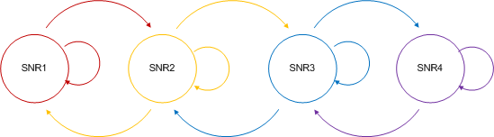
Finite State Markov Chain
Model the channel SNR as a finite-state Markov chain (FSMC)
Each state represents a given value (range) of the SNR
  The following example has four different SNR states

Slide 7
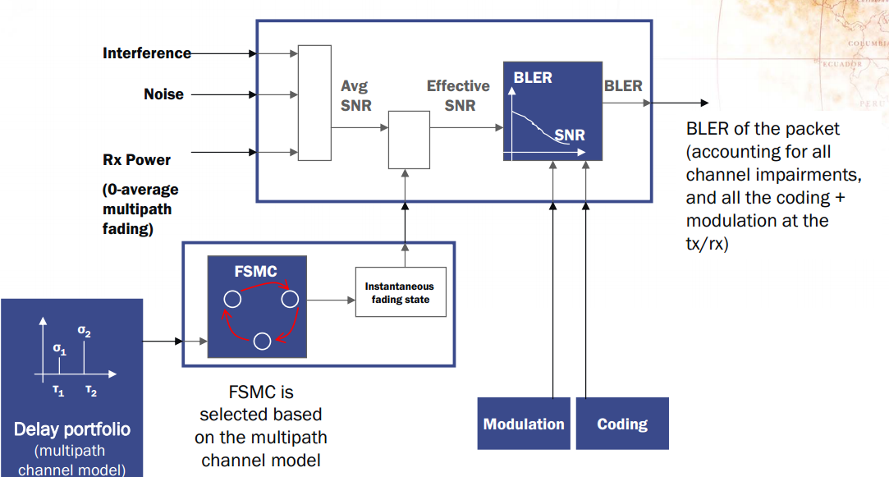
Use of FSMC in System Level Simulations

Slide 8
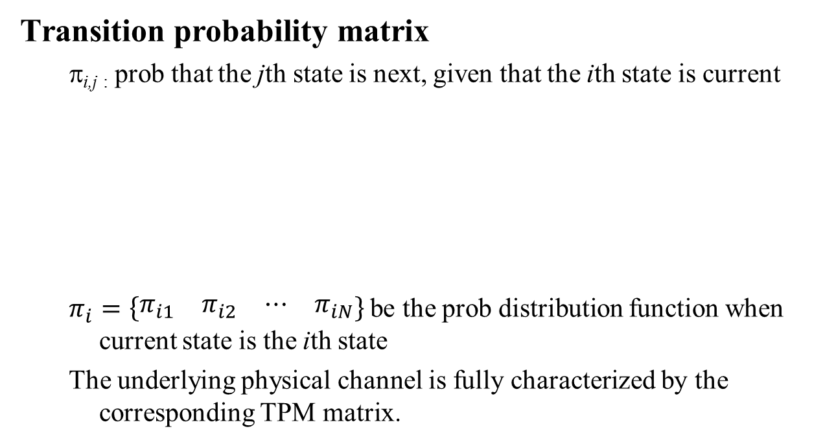
Transition Probability Matrix (TPM)
Transition probability matrix
  π_{i,j :} prob that the jth state is next, given that the ith state is current
  $π_{i}=\left\{\begin{matrix}\begin{matrix}π_{i1} & π_{i2}\end{matrix} & \begin{matrix}⋯ & π_{iN}\end{matrix}\end{matrix}\right\}$be the prob distribution function when current state is the ith state
  The underlying physical channel is fully characterized by the corresponding TPM matrix.

Slide 9
Multi-Carrier SNR Mapping
In modeling the physical channels, we need to convert multiple SNR values (one per subcarrier) into one single SNR value
Potential approaches
  Throughput averaging (algo 1)
    Straightforward, not MCS dependent
    effective channel amplitude square
  SNR averaging (algo 2)
    Used by OPNET for LTE downlink/uplink
  Exponential effective SNR mapping (EESM), received bit mutual information (RBIR), Mean mutual information per bit (MMIB) [10]
    MCS dependent (not studied herein)

Slide 10
Examples of calculated transition probability matrix (TPM) for some channel models of interest.

Slide 11
Proposed HEW Use Cases [9]
1 | High density of APs and high density of STAs per AP | a | stadium
 |  | b | airport/train stations
 |  | c | exhibition hall
 |  | d | shopping malls
 |  | e | E-Education
 |  | f | Multi-media Mesh backhaul
2 | High density of STAs – Indoor | a | dense wireless office
 |  | b | public transportation
 |  | c | lecture hall
 |  | d | Manufacturing Floor Automation
3 | High density of APs (low/medium density of STAs per AP) – Indoor | a | dense apartment building
 |  | b | Community Wi-Fi
4 | High density of APs and high density of STAs per AP – Outdoor | a | Super dense urban Street
 |  | b | Pico-cell street deployment
 |  | c | Macro-cell street deployment
5 | High throughput demanding applications | a | surgery/health care (similar to 2e from 11ac)
 |  | b | production in stadium (similar to 1d-1e from 11ac)
 |  | c | smart car

Slide 12
Urban Micro Channels in HEW
Urban Micro cellular environment fits well in HEW [8]
  “The microcellular test environment focuses on small cells and high user densities and traffic loads in city centers and dense urban areas. The key characteristics of this test environment are high traffic loads, outdoor and outdoor-to-indoor coverage. This scenario will therefore be interference-limited, using micro cells.” [7]
WINNER 2 model
  Metropolitan (C2)
  Typical Urban (B1, B4)
  Indoor to outdoor (A2)
  Rural macro (D1)
ITU model
  Urban macro (UMa)
  Urban micro (UMi)
  Indoor (InH)
  High speed (RMa)

Slide 13
TPM Generation Algorithm
Generate multiple (10^5) pairs of channel samples, each pair are separated by N OFDM symbols (N * 3.2 μs)
  Each consists of multiple taps according to the channel model, e.g. WINNER 2 or ITU
  Will serve as current state and next state in statistics collection
For each sample in the channel sample pair,
  Convert it to freq domain using DFT
  Convert multiple subcarrier SNRs into one effective SNR (either SNR averaging or throughput averaging)
Quantize the effective SNRs into P (16) equi-prob states
Find the probability of each state transitioning into other states accordingly

Slide 14
Simulation Assumptions
  Channel Scenarios: WINNER 2 B1, ITU UMi
    Directly comparable channel scenarios
  Single transmit and single receive antenna
  OFDM symbol separation between current and next state: 10 or 100
  Large scale signal to noise ratio: 0 or 20dB
  Mobile velocity: 3 or 30 km/hr
  Two algorithms considered for determination of effective SNR:
    Throughput averaging
    SNR averaging

Slide 15
ITU/WINNER 2 Comparison, 100 symbols. 20dB SNR, 30 km/h, Throughput Averaging
The generated TPM are more or less similar for WINNER 2 B1 and ITU UMi

Slide 16
ITU/WINNER 2 Comparison, 100 symbols. 20dB SNR, 30 km/h, SNR Averaging
The generated TPM are more or less similar for WINNER 2 B1 and ITU UMi

Slide 17
SNR Comparison, 20dB vs. 0dB, 100 symbols, 30 km/h, WINNER 2 B1 Throughput Averaging
Large scale SNR does not change the TPM noticeably (throughput averaging)

Slide 18
Discussion on Multi-Carrier SNR Mapping
SNR averaging
  Simple, independent of large scale SNR
  SNR averaging occurs in the linear domain
Throughput averaging
  Strictly speaking depending on large scale SNR
  This dependence is weak though (see comparison on previous page) and may be removed for simplicity
    The mapping may thus be approximated by SNR averaging in the dB domain
Throughput averaging
SNR averaging
in the dB domain

Slide 19
Simulation Summary
Markov modeling of PHY multipath channels in HEW
  TPM more or less similar for ITU UMi and WINNER 2 B1 channel
  Faster velocity leads to more state changes in TPM
  Larger separation leads to more state changes in TPM
  Converting multiple subcarrier SNRs into a single value
    SNR averaging in the linear domain
    Throughput averaging
      may be approximated by SNR averaging in the dB domain
    More complex averaging may be used
The general method may be applied to any other indoor or outdoor channels for HEW system level simulations
  ITU channels
  WINNER 2 channels
  and others

Slide 20
Potential Items of Agreement
Use of Markov modeling of PHY multipath channels
  Channel model(s) to be used (e.g. ITU UMi and WINNER 2 B1)
  Velocities to be considered
  SNR to be considered
  Number of Symbols to be averaged
Method of converting multiple subcarrier SNR
  Throughput averaging
  More complex averaging
TPM for each agreed configuration
  Generate multiple (e.g. 10^5) pairs, number of symbols separating pairs, N
  Number of equi-probable states, P (e.g. 16)

Slide 21
References
[1] IEEE 802.11-13/0722r1, “HEW SG Evaluation Methodology”, Intel.
[2] IEEE 802.11-04/0184r0, “802.11n TGn proposal for PHY abstraction in MAC simulators,” ST Microelectronics.
[3] R. Yaniv et. Al., “CINR measurements using the EESM method”, IEEE C802.16e-05/141r3.
[4] L. Hentilä, P. Kyösti, M. Käske, M. Narandzic , and M. Alatossava. (2007, December.) MATLAB implementation of the WINNER Phase II Channel Model ver1.1 [Online]. Available: https://www.ist-winner.org/phase_2_model.html
[5] OPNET Technologies Inc., “LTE PHY Multipath Fading Models – Design Document”.
[6] Software implementation of IMT.EVAL channel model, doc num: IST-4-027756
[7] Report ITU-R M.2135-1 (12/2009) Guidelines for evaluation of radio interface technologies for IMT Advanced
[8] IEEE 802.11-13/0996r1, . “Outdoor Channel Model Candidates for HEW”, K. Josiam, R. Taori, and F. Tong,
[9] IEEE 802.11-13/0657, “Usage models for IEEE 802.11 High Efficiency WLAN study group (HEW SG) – Liaison with WFA”, Laurent Cariou
[10] IEEE 802.16m-08/004r5, “IEEE 802 16m Evaluation Methodology Document (EMD)”

Slide 22
Additional TPM plots

Slide 23
Velocity Comparison, 30 km/h vs. 3 km/h, 100 symbols, 20dB, WINNER 2 B1 Throughput Averaging
Faster velocity leads to more state transitions

Slide 24
Packet Duration Comparison, 10 vs. 100 symbols, 20dB, 30 km/h, WINNER 2 B1 Throughput Averaging
Larger separation leads to more state transitions

Slide 25
Algorithm Comparison,100 symbols, 20dB, 30 km/h, WINNER 2 B1

Slide 26
Algorithm Comparison,100 symbols, 20dB, 30 km/h, ITU Channel UMi

