Slide 1
Access Control Enhancement
Date: 2013-09-14
Authors:

Slide 2
Abstract
Low rate frames have critical impacts on QoE under densely deployed scenarios.
This submission proposes inclusion of access control mechanism enhancement for HEW requirements to moderate these impacts and to allocate time resources for HEW devices.

Slide 3
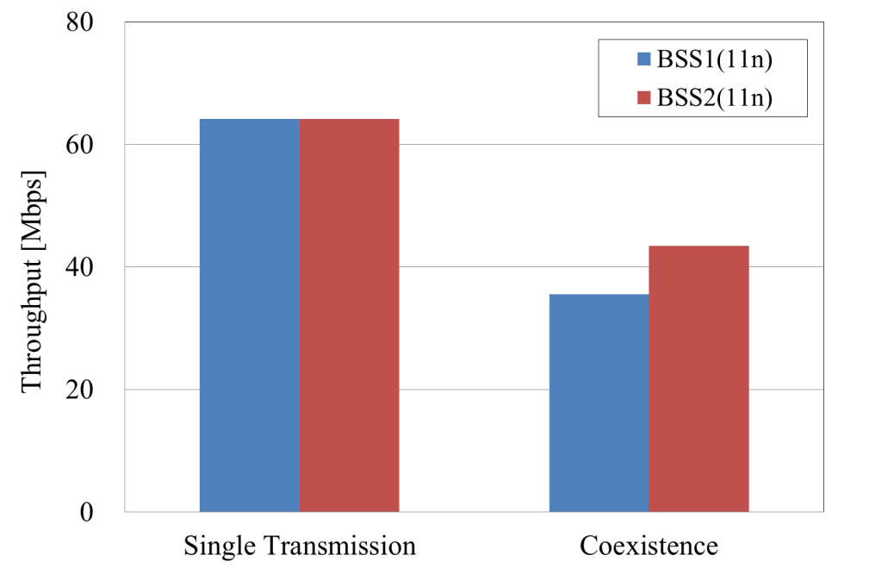
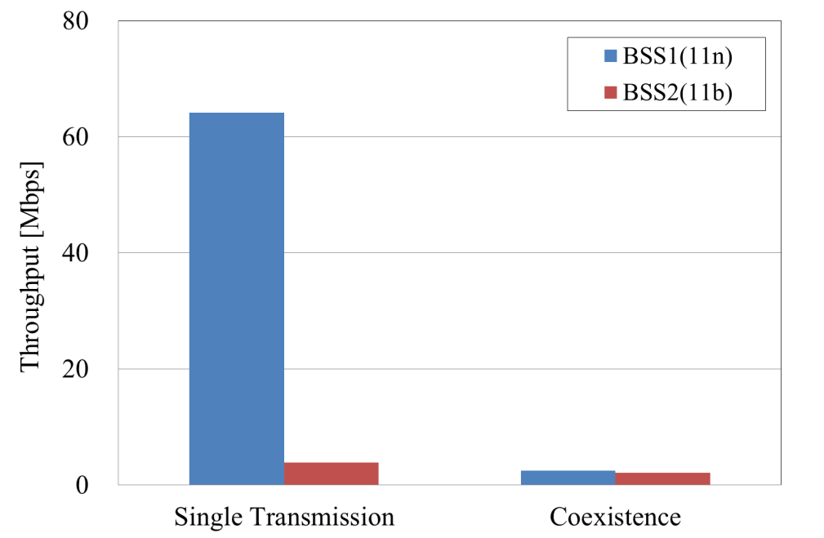
Low-rate transmissions by legacy STAs consume more wireless channel time
11-13/0801r1 (NTT)
Throughput of each BSS (BSS2:11n)
Throughput of each BSS (BSS2:11b)
45% decrease
96% decrease
BSS1 throughput greatly decreased when 11b link coexisted.

Slide 4
Occupied air-time
Occupied air-time of lower rate frame is relatively longer for every transmission opportunity.
Occupied air-time for transmitting IP packets is as follows:
when transmitting 1500 bytes length IP packet,
11b@1Mbps : 13154 usec
11a/g@6Mbps : 2234 usec
11a/g@54Mbps : 390 usec
when transmitting 5x1500 bytes length IP packets aggregated,
11n@6.5Mbps : 9853 usec
11n@65Mbps : 1210 usec
Note: Factors like conflicts, retry, management/control frames weren’t considered.
* @X Mbps: data rate
Ref: calculation derivations are on spread sheets IEEE 11-13/1074r0

Slide 5
Theoretical throughput
In coexisting cases, the theoretical throughputs of 11n MCS7 (65Mbps) on IP level are calculated as follows:
Coexisting link | Math formula | Expected throughput | Degradation
No coexisting link | 1500*5*8 * [bps] | 49.6Mbps | 0%
11n@65Mbps | 49.6 * [Mbps] | 24.8Mbps | -50%
11a/g@54Mbps | 49.6 * [Mbps] | 37.5Mbps | -24%
11n@6.5Mbps | 49.6 * [Mbps] | 5.4Mbps | -89%
11a/g@6Mbps | 49.6 * [Mbps] | 17.4Mbps | -65%
11b@1Mbps | 49.6 * [Mbps] | 4.2Mbps | -92%
1
1210 * 10⁻⁶
1210
1210 + 1210
1210
1210 + 390
1210
1210 + 9853
1210
1210 + 2234
1210
1210 + 13154

Slide 6
Result summary
Time resources are equally shared among links of the same standard and the same data rate.
Comparing with 11b/g/a, 11n can transfer much more data by frame aggregation in one transmission opportunity.
Coexistence with low-rate frames, especially 1Mbps frames of 11b deteriorates 11n performance.
Even the coexisting link is 11n, performance degradation is much when its data rate is low. Because the aggregated low-rate frames occupy much time.

Slide 7
Consideration-1/2
To simplify consideration, 100Mbps throughput is assumed for single 100Mbps data rate link.
When 100 STAs are communicating, time resources are shared by them and 1Mbps throughput is expected for each link.
* 100Mbps is assumed as data rate for each link.
1Mbps
e.g.
100STAs
1Mbps
100Mbps
1Mbps
In other words, each link has 10msec transmission opportunity per a second.
When low-rate links enter in this environment, it will be difficult to maintain this 10msec.

Slide 8
Consideration-2/2
High efficiency WLAN under APs/STAs densely deployed scenario has been targeted to consider.
It means that limited time resources will be shared by many WLAN devices. So we have to accept that the given time rate per a device rationally will be limited.
Various measures may be considered to maintain the given time for each HEW device.

Slide 9
Potential Requirements for HEW
A control mechanism on AP for allocating time resources may be potential requirement. It may be TDMA like access control enhanced from PCF.
Low-rate transmissions should be restricted also in order to prevent a device consuming much time under high dense situation.
A coordination mechanism for sharing time resources among BSSs is also needed.

Slide 10
References
Doc.: IEEE 11-13/0801r1 Issues of Low-Rate Transmission, Akira Kishida/NTT
Doc.: IEEE 11-13/1074r0 Occupied air-time calculation, Katsuo Yunoki/KDDI R&D Labs.

