Slide 1
Discussion on Massive MIMO for HEW
Date: 2013-09-15
Authors:

Slide 2
Abstract
We propose to use Massive MIMO technology in HEW to meet the requirements of HEW use cases .

Slide 3
Background(1/2)
802.11n/ac have already adopted MIMO technology and designed relevant MAC and PHY layer protocol, such as CSI measurement and feedback, MCS, etc. All of these provide foundation for further application of MIMO.
To improve 802.11 in HEW, we consider the following requirements:
Dense networks with large number of STAs
High speed transmission ,at the level of 10 G bit/s
Improving spectrum efficiency and average throughput
High energy-efficiency

Slide 4
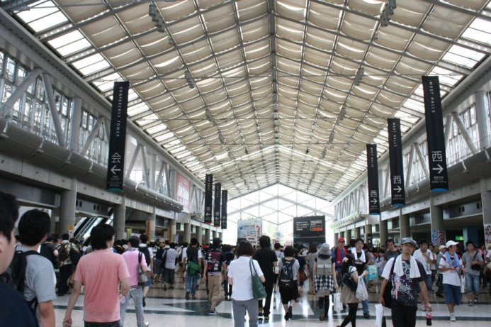
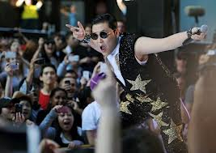
Background(2/2)
The usage cases for HEW proposed by Orange include wireless office, stadium, airport waiting halls, shopping mall, etc. It is of high density of APs and STAs.
802.11n support maximum 4 spatial streams and 802.11ac support 8. Naturally we consider to increase the number of antenna to support more spatial streams.
to suppress interference, increase capacity and improve efficiency, we consider using Massive MIMO technology. Dozens of antennas could bring better multiplexing effect and greater throughput.
Exhibition halls
Shopping mall
Performance Outdoor
Source: Orange proposal^{[4]}

Slide 5
Massive MIMO
Massive MIMO is a new proposed technology based on traditional MIMO. It is a system that use antenna array with dozens of antennas, which could simultaneously serve tens of terminals in the same time-frequency resource.
Advantages are summarized as follows
Increased capacity: Massive MIMO can increase the capacity 10 times or more, owing to more independent spatial streams can be sent out simultaneously;
Improved energy efficiency: With large number of antennas, AP’s emitted energy can be focused sharply into the spatial directions where the terminals are located;
Reduced interference: massive antennas make AP control emitted energy more accurately, which would suppress spreading interference.

Slide 6
Capacity
In SU-MIMO , ^{[2]} . Let m, snr and H be, respectively, the number of transmit antenna, SNR and channel matrix. It is easy to see, with the transmitting and receiving antennas increases, the capacity will increase.
In MU-MIMO system , we simulate capacity VS transmit antenna
Simulation environment:
MMSE precoder
QPSK modulation
mean receive SNR=10dB
K: number of receivers
Assume receiver is of single antenna
Conclusion:
It can be concluded from the results, in the next generation WLAN which could serve a large number of users and increase throughput, there are advantages of applying massive antennas.
For a fixed curve, system capacity grows with the number of transmit antennas increases, and the growth slows when the number of transmit antennas equal to receiver antennas. We can use different number of antenna as usage model in HEW required.

Slide 7
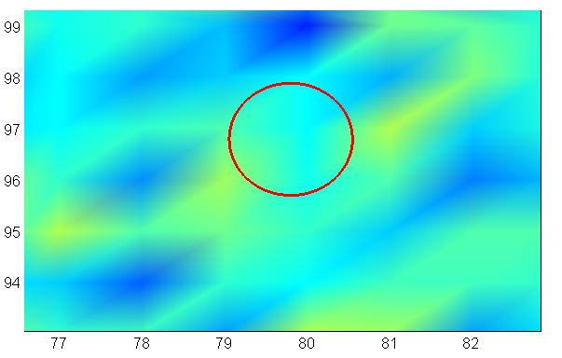
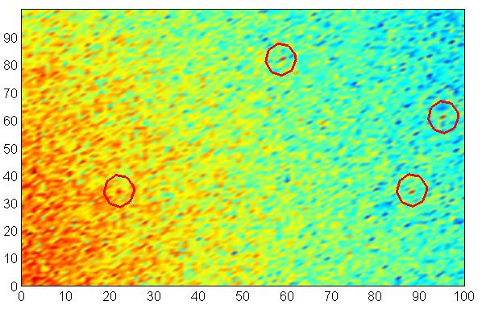
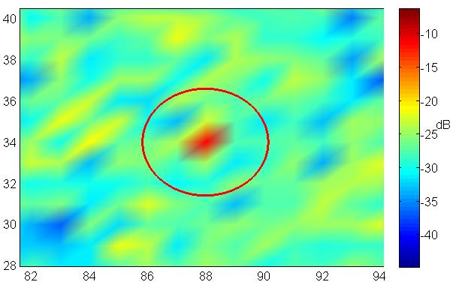
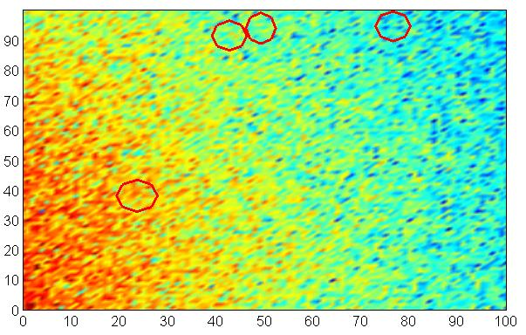
Concentration of Emitted Power
A large number of antenna can obtain better spatial multiplexing effect. As it could focus energy sharply into a small spatial region by coherent superposition. From the simulation result, we could see that more antennas can improve the ability to concentrate energy.
This could lead energy-efficient and interference suppression.
Simulation environment:
4 uniformly distributed receiver
λ: signal wavelength, 2.4GHz band
ZFBF precoder is used
M: the number of transmitter antenna
Multipath component
Large-scale: path loss and shadow fading
small-scale: rayleigh fading^{[3]}
1200λ
receiver
Transmitter
0 100λ 200λ
M=100
M=10
Fading map with the number of transmitting antenna equal to 10, red circle indicate the location of STA, right image is part magnification of the left
When the number of transmitting antenna change to 100, the attenuation on the places where STA stand is significantly smaller than surrounding

Slide 8
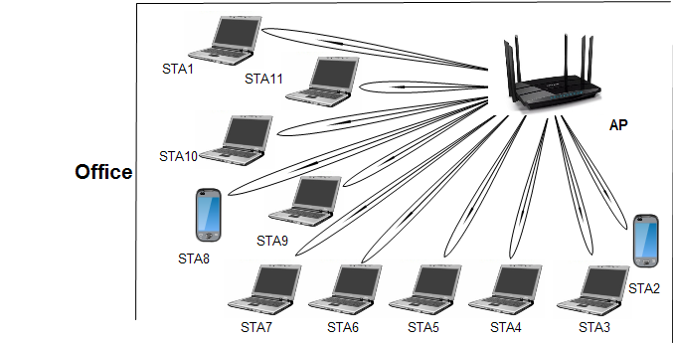
Deployment Scenarios
As previously described, AP which adopt Massive MIMO could concentrate emitted energy sharply into a small spatial regions around the STA, and it could distinguish the STAs which are served simultaneously by the propagation characteristic. Therefore, the AP could communicate with STAs simultaneously which stand closely.
for example:
This scenarios is in wireless office, there are a large number of STAs and they placed closely

Slide 9
Challenge
Antenna Installation
MIMO system requires the spacing of each antenna no less than half a wavelength. If an AP install dozens of antennas, its size would be large and it is difficult to realize.
CSI measurement and feedback
Overhead of channel sounding: 802.11ac use channel sounding procedures to get CSI . The more CSI need, the more time spend and the more sounding PPDUs need.
Overhead of CSI feedback: the feedback matrix will be large as the antennas increase. Feedback these information will occupy a lot of bandwidth and time. We need to find a solution to compress them.
Beamforming
As the increasing number of transmitting antennas and more dense of STAs, the steering matrix should be more accurate. Otherwise, the transmitted signal could not be exactly controlled within a small range. This may increase the interference.
The same challenge as CSI measure and feedback

Slide 10
Conclusions
Massive MIMO can be used for HEW to significantly improve the spectrum efficiency and suppress interference.
On the other hand ,we still need further studies on massive MIMO for applying in WLAN.
Notes:
11111111

Slide 11
References
[1] Thomas L. Marzetta, “Noncooperative Cellular Wireless with Unlimited Numbers of Base Station Antennas,”
IEEE TRANSACTIONS ON WIRELESS COMM UNICATIONS, VOL. 9, NO. 11, NOVEMBER 2010.
[2] F. Kaltenberger,D. Gesbert,R. Knopp ,”Correlation and Capacity of Measured Multi-user MIMO Channels”
[3] Y. R. Zheng, C. Xiao, “Simulation Models With Correct Statistical Properties for Rayleigh Fading Channels,” IEEE TRANSACTIONS ON COMMUNICATIONS, VOL. 51, NO. 6, JUNE 2003
[4] 13/0657r3 “Usage models for IEEE 802.11 High Efficiency WLAN study group (HEW SG) – Liaison with WFA”, Laurent Cariou(Orange)

