Slide 1
Video Application Categories and Characteristics
Date: 2013-09-15
Authors:
Name | Affiliations | Address | Phone | Email
Guoqing Li | Intel | 2111 NE 25th ave, Hillsboro, OR 97124 | 1-503-712-2089 | Guoqing.c.il@intel.com
Yiting Liao | Intel | 2111 NE 25th ave, Hillsboro, OR 97124 | 1-503-264-6789 | Yitingl.liao@intel.com

Slide 2
Abstract
In this contribution, we will identify a few video application categories and describe their associated characteristics
Based on the categories identified in this contribution, #1159 will discuss the performance requirements and simulation parameters for these video applications

Slide 3
Outline
Video traffic growth and QoE today
Categories and characteristics of video applications
Slide 3
Notes:
doc.: IEEE 802.11-08/1101r3
September 2008
John R. Barr, Motorola, Inc.
Page 3

Slide 4
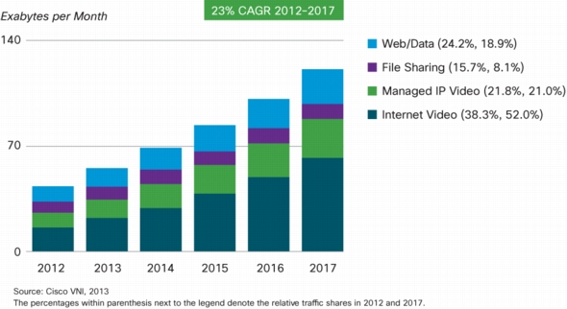
Video Traffic Growth
In 2017, 73% of global IP traffic will be video
→It is difficult to overstate the importance of video traffic demand for HEW networks

Slide 5
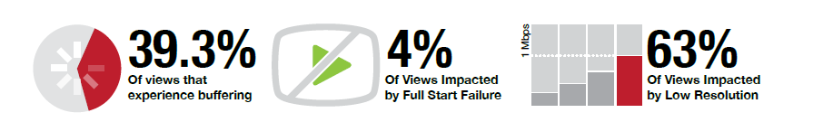
Poor Video Quality of Experience is Pervasive
In 2012, global premium content brands lost $2.16 billion of revenue due to poor quality video streams and are expected to miss out an astounding $20 billion through 2017 [1]
The rapid video traffic growth will only make the problem worse, if not addressed properly
→Future wireless networks including HEW have to deliver satisfying video QoE in order to meet future demands
Slide 5

Slide 6
Outline
Video traffic growth and QoE today
Categories and characteristics of video applications
Slide 6
Notes:
doc.: IEEE 802.11-08/1101r3
September 2008
John R. Barr, Motorola, Inc.
Page 6

Slide 7






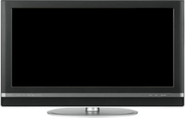




Video Applications Considered
Buffered video streaming
Video Conferencing
Wireless display
STB
Notes:
doc.: IEEE 802.11-08/1101r3
September 2008
John R. Barr, Motorola, Inc.
Page 7

Slide 8

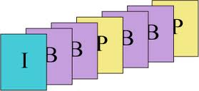

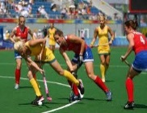
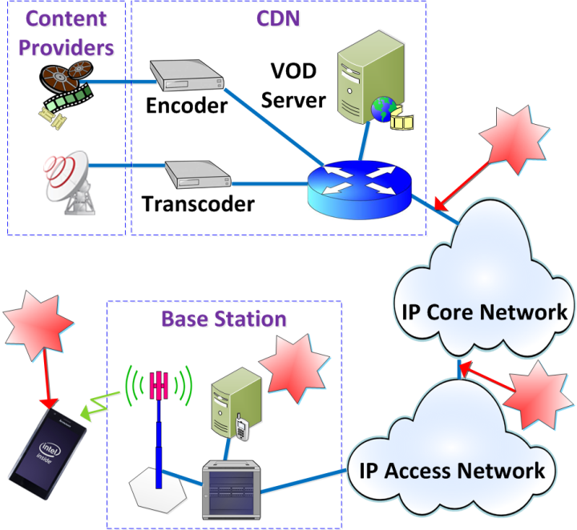




1. Buffered Video Streaming
Video service, encoding, transcoder etc.
Network Transport
IP
IP network
wireless access

Slide 9
1. Buffered Video Streaming (cont.)
Video data is one way traffic, highly asymmetrical at wireless link
Multi-hop, multi-network domain
Uses buffer at the client side to store a few seconds to a few minute of video before playout
  High dependency on client playout buffer and policy capabilities
Typical traffics are natural videos such as movies, news etc.
Typical Protocol stack: HTTP (TCP)
  Provides additional reliability
Slide 9

Slide 10
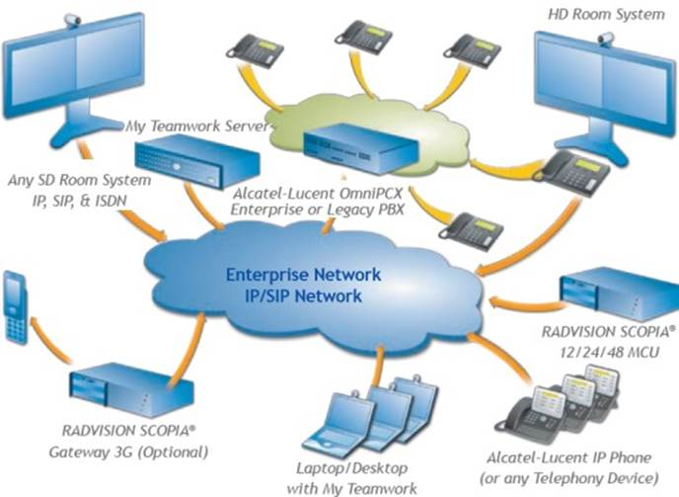
2. Video Conferencing
Two-way traffic
Multi-hop, multi-network domain
Typically traffics: natural video, but more static scenes
  Less traffic load compared to video streaming
Typical protocol: UDP/IP
  Require lower packet loss ratio at MAC since UDP does not provide additional reliability
Slide 10

Slide 11
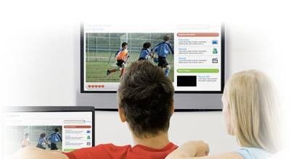
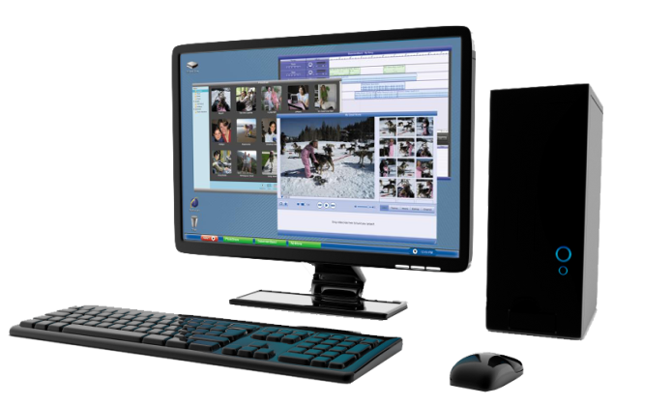
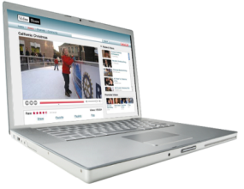
3. Wireless Display
Entertainment wireless display
Movie, pictures
Relaxed viewing experience
Distance ~10 feet
Wireless docking
Productivity synthetic video: Text, Graphics
More static scenes
Highly attentive
Close distance ~2 feet
Highly interactive
Slide 11

Slide 12
3. Wireless Display (cont.)
One way traffic, one hop, single network domain
High resolutions, fine images, high user engagement
  →Requires very high video quality, visually lossless, high data rate
Human interaction, hand-eye coordination involved
  Requires ultra low latency
Slide 12

Slide 13
Characteristics of Various Video Applications
app | Typical content | network | resolution | User engagement | interactivity
Buffered Streaming | Natural video | Multi-hop, multiple network domain | Low, high | Relaxed | No
Video conferencing | Natural video | Multi-hop, multiple network domain, | Low, high | Relaxed | No
Wireless display-entertainment | Natural video | Single-hop | High | Relaxed | No
Wireless display--docking | Productivity video | Single-hop | High | Intense attentive | Yes
Performance requirements can be very different for different type of video applications
Slide 13

Slide 14
Video Bit Rate Variation
Compressed bit rate is highly related to
  Video format: resolution, frame rate, progress/interlaced
  Coding profile/parameters, e.g., I-only, I+P, I+P+B
  Video Content itself
Different video applications can have very different video formats, coding parameters and content characteristics
Therefore, video bit rate can vary significantly and cannot be the only metric for video performance indication
Slide 14

Slide 15
Summary
Video applications will consume the majority of future traffic. However, user are not satisfied with the QoE today
It is critical for HEW to deliver satisfying QoE for video in order to meet such future demand
There are different types of video applications today, and they have very different characteristics
As a result, performance requirements as well as video simulation modeling should be set accordingly for different applications

Slide 16
References
[1] Conviva, H1 2013 Viewer Experience report
[2] Cisco report, Quality of service design overview
[3] 3GPP 23.203, Technical Specification Group services and System aspects; policy and charging control architecture
[4] ITU-T Y.1542, Framework to achieve E2E performance
[5] WiGig Display Market Requirement Document 1.0
[6] 11-13-0787-00-0hew-followup-on-functional-requirements
[7] Lync report, network bandwidth requirement for multimedia traffic
[8] Skype report, how much bandwidth does Skype need
[9] WiGig contribution, H.264 intra quality evaluation
[10] Netflex article, Internet connection recommendation
[11] Youtube article, advanced encoding setting
[12] 11-13-0722-00-0hew-hew-evaluation-methodology
[13] Cisco Visual Networking Index: Forecast and Methodology, 2012–2017
[14] Baek-Young Choi et al., Analysis of Point-to-point packet delay in an operatorational network, Infocom 2004
[15] Verizon report, IP latency Statistics 2012-2013
[16] Cisco white paper, The Zettabyte Era—Trends and Analysis
Slide 16

