Slide 1
Video Applications Characteristics, Requirements and Simulation modeling
Date: 2013-09-15
Authors:
Name | Affiliations | Address | Phone | Email
Guoqing Li | Intel | 2111 NE 25th ave, Hillsboro, OR 97124 | 1-503-712-2089 | Guoqing.c.il@intel.com
Yiting Liao | Intel | 2111 NE 25th ave, Hillsboro, OR 97124 | 1-503-264-6789 | Yitingl.liao@intel.com

Slide 2
Outline
Video traffic growth and QoE today
What are the characteristics of video applications?
How to measure video performance?
How to model video traffic in HEW simulation?
Slide 2
Notes:
doc.: IEEE 802.11-08/1101r3
September 2008
John R. Barr, Motorola, Inc.
Page 2

Slide 3
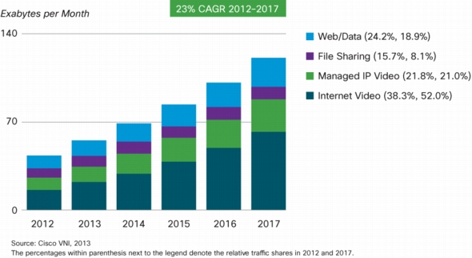
Video Traffic Growth
In 2017, 73% of global IP traffic will be video
→It is difficult to overstate the importance of video traffic demand for HEW networks

Slide 4
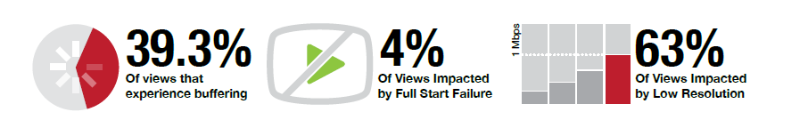
Poor Video Quality of Experience is Pervasive
In 2012, global premium content brands lost $2.16 billion of revenue due to poor quality video streams and are expected to miss out an astounding $20 billion through 2017 [1]
The rapid video traffic growth will only make the problem worse, if not addressed properly
→Future wireless networks including HEW have to deliver satisfying video QoE in order to meet future demands
Slide 4

Slide 5
Outline
Video traffic growth and QoE today
What are the characteristics of video applications?
How to measure video performance?
How to model video traffic in HEW simulation?
Slide 5
Notes:
doc.: IEEE 802.11-08/1101r3
September 2008
John R. Barr, Motorola, Inc.
Page 5

Slide 6






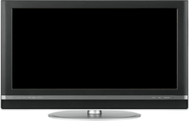




Video Applications Considered
Buffered video streaming
Video Conferencing
Wireless display
STB
Notes:
doc.: IEEE 802.11-08/1101r3
September 2008
John R. Barr, Motorola, Inc.
Page 6

Slide 7

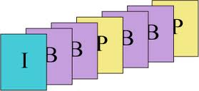

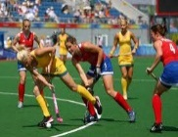
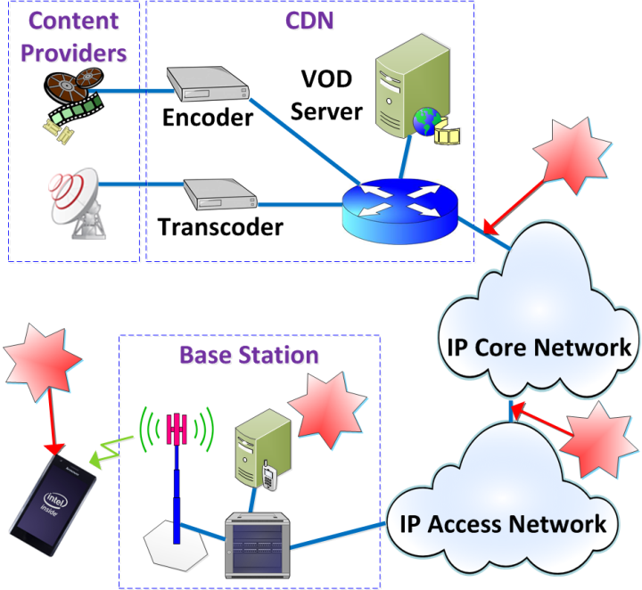




1. Buffered Video Streaming
Video service, encoding, transcoder etc.
Network Transport
IP
IP network
wireless access

Slide 8
1. Buffered Video Streaming (cont.)
Video data is one way traffic, highly asymmetrical at wireless link
Multi-hop, multi-network domain
Uses buffer at the client side to store a few seconds to a few minute of video before playout
  High dependency on client playout buffer and policy capabilities
Typical traffics are natural videos such as movies, news etc.
Typical Protocol stack: HTTP (TCP)
  Provides additional reliability
Slide 8

Slide 9
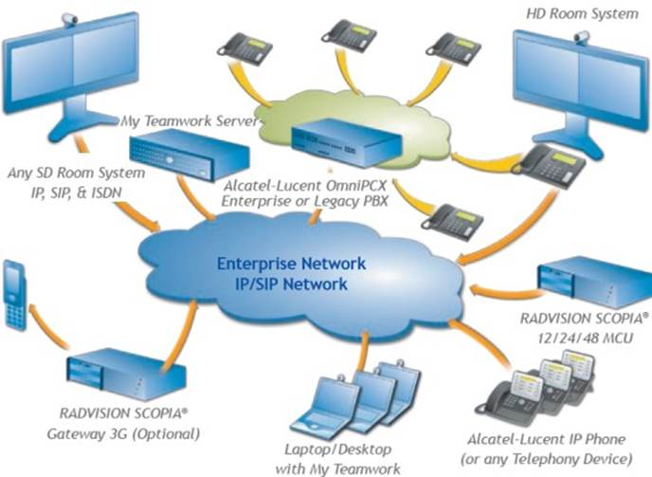
2. Video Conferencing
Two-way traffic
Multi-hop, multi-network domain
Typically traffics: natural video, but more static scenes
  Less traffic load compared to video streaming
Typical protocol: UDP/IP
  Require lower packet loss ratio at MAC since UDP does not provide additional reliability
Slide 9

Slide 10
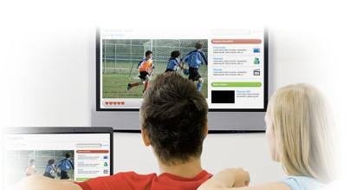
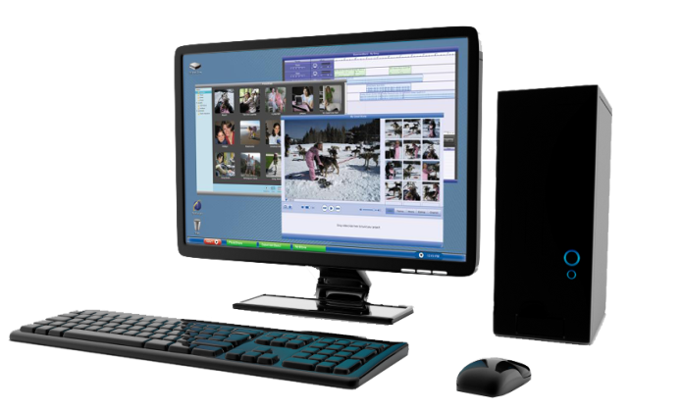
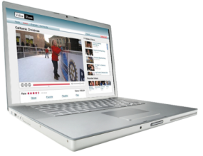
3. Wireless Display
Entertainment wireless display
Movie, pictures
Relaxed viewing experience
Distance ~10 feet
Wireless docking
Productivity synthetic video: Text, Graphics
More static scenes
Highly attentive
Close distance ~2 feet
Highly interactive
Slide 10

Slide 11
3. Wireless Display (cont.)
One way traffic, one hop, single network domain
High resolutions, fine images, high user engagement
  →Requires very high video quality, visually lossless, high data rate
Human interaction, hand-eye coordination involved
  Requires ultra low latency
Slide 11

Slide 12
Characteristics of Various Video Applications
app | Typical content | network | resolution | User engagement | interactivity
Buffered Streaming | Natural video | Multi-hop, multiple network domain | Low, high | Relaxed | No
Video conferencing | Natural video | Multi-hop, multiple network domain, | Low, high | Relaxed | No
Wireless display-entertainment | Natural video | Single-hop | High | Relaxed | No
Wireless display--docking | Productivity video | Single-hop | High | Intense attentive | Yes
Performance requirements can be very different for different type of video applications
Slide 12

Slide 13
Video Bit Rate Variation
Compressed bit rate is highly related to
  Video format: resolution, frame rate, progress/interlaced
  Coding profile/parameters, e.g., I-only, I+P, I+P+B
  Video Content itself
Different video applications can have very different video formats, coding parameters and content characteristics
Therefore, video bit rate can vary significantly and cannot be the only metric for video performance indication
Slide 13

Slide 14
Outline
Video traffic growth and QoE today
What are the characteristics of video applications?
How to measure video performance?
How to model video traffic in HEW simulations?
Notes:
doc.: IEEE 802.11-08/1101r3
September 2008
John R. Barr, Motorola, Inc.
Page 14

Slide 15
Video Quality/Experience Metrics
Video quality
  Subjective, objective
  Mostly related to distortion against original video pixels
Video experience
  Video start time, re-buffering event, latency, bit rate, packet loss rate
  Mostly related to network capacity, QoS provisioning policy along the data path and device capabilities
Slide 15

Slide 16



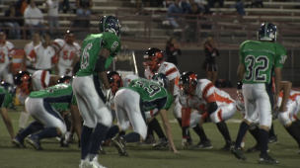
Video Quality Metrics
Subjective scores (MOS): human-involved evaluation score
Objective metrics: an estimate of subjective quality
  Reference-based: e.g., PSNR, SSIM, MS-SSIM
    Not accurate reflection of user experience
    Need to calculate the metrics based on pixels
  Non-reference based: e.g., ITU-P1202
Source: Intel IDF 2012
14 video clips, 96 compressed bit streams
Same PSNR can correspond to MOS from 1.3 (Bad) to 4.6 (excellent)
Slide 16

Slide 17
Video Quality Metrics (cont.)
The video layer quality metrics deal with either
  Human testing
  Pixels-level calculation (e.g., PSNR, MS-SSIM)
  Analysis of compressed bit stream (e.g, P1202.1)
These video quality metrics are NOT suited for HEW evaluation methodology
Slide 17

Slide 18


Video Experience Metrics
  Buffering for video streaming
    Buffer has the largest impact on video streaming experience [1]!
  Rubuffering event = playout buffer is empty when it is time to display the next packet/video unit
  Rebuffering ratio =percentage of time that the video is being rebuffered during the entire viewing duration
For streaming video, a big buffer typically exists for smoothing out large delay and thus individual packet delay does not directly impact video experience
Instead, E2E throughput against video load has more impact on rebufferiing events
0.5%--1% rebuffering ratio is considered above industry-average [1]
Slide 18

Slide 19
Video Experience Metrics (cont.)
Similar to rebuffering, Freezing happens in video conferencing and wireless display
  Caused when the receiver buffer is empty when it is time to display the next packet/video unit
Freezing ratio = percentage of time the video freezes during the entire video conferencing
Unlike buffered steaming, there is no big buffer at RX due to low latency requirement, and thus not able to absorb large individual packet latency
As a result, each packet needs to arrive in time in order to be display at the right time, which means Latency for every packet matters
Freezing event happens when E2E latency for video frames/slices exceed some E2E latency requirement
0.5-1% freezing ratio is recommended based on the number used in buffered streaming?

Slide 20
Video Experience Metrics (cont.)
E2E Latency
  Buffered Streaming video: [2] recommends 5s for initial delay, but no hard requirement on each packet
    As long as video can be downloaded before playout buffer is empty, the system can tolerate large delay variations
  Wireless display
    Home: recommend 50ms based on the requirement in [3]
    Office: recommend 20ms based on wireless display requirement in [5]
  Video conferencing: E2E150ms is recommended [2]
    What is the latency requirement for the HEW portion?
Slide 20

Slide 21
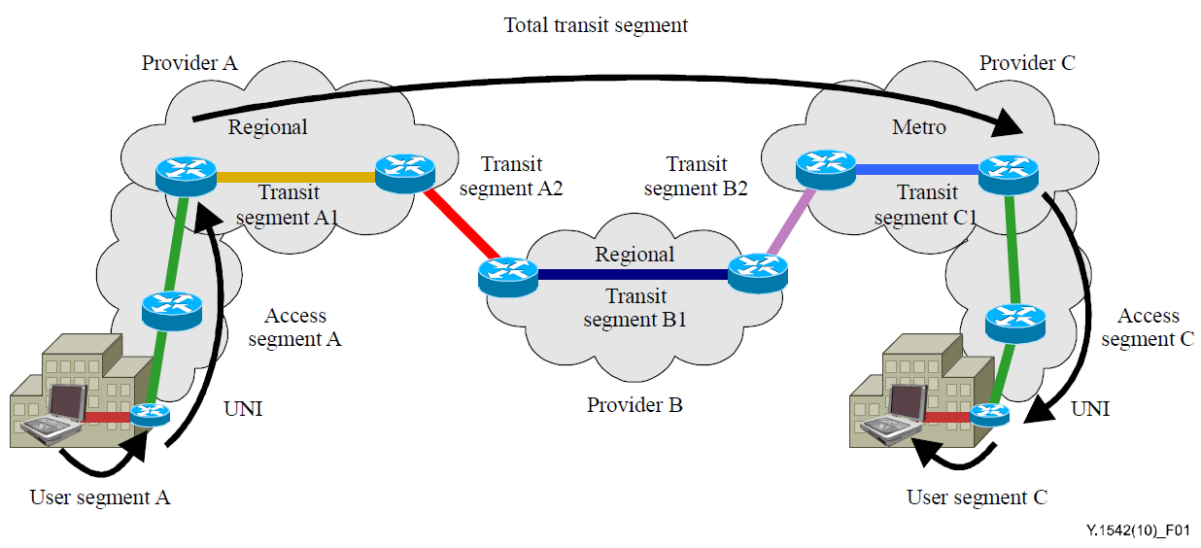
Video Experience Metrics (cont.)
HEW latency
  For Video conferencing
    HEW latency: (150ms-IP network latency)/2
    IP network latency varies significantly in regions, e.g., <45ms within North America, <90ms between London-NY [15]
    →e.g., <30ms HEW latency required if the conf call is between London-NY
  Buffer streaming: no requirement on each packet
  Wireless display: same as E2E latency since it is one-hop
Slide 21

Slide 22
Video Experience Metrics (cont.)
Even though bit rate can vary significantly for different video contents, some empirical data exists that we can consider as video bit rate requirement as well as for traffic modeling
Video bit rate
  For video streaming: 5-8Mbps is recommended for HD [10][11]
  For video conf: 0.5Mbps-2.5Mbps for HD calling [7][8]
  For wireless display
    Docking: recommend 300Mbps@1080p (compression ratio = 10) to achieve visually lossless [9]
    Entertainment: 60Mbps@1080p? (compression ratio=50)
Future video bit rate will increase with the new video formats and more adoption of 3D
  E.g., 4K video bit rate is about 4 times higher than 1080p, i.e., 20-32Mbps
Slide 22

Slide 23
Video Experience Metrics (cont.)
Similarly, some empirical data exists for packet loss requirement
Packet Loss requirement
  For buffered streaming
    5% (IP layer) is recommended in [2]
    Note: after TCP layer, the video PER is close to 0.
  For video conferencing, mostly based on UDP
    1% (IP layer) is recommended in [2]
  For wireless display
    Home: 1e-3 (based on gaming app in [3])?
    Office: 1e-6 (highest requirement in [3])?
Slide 23

Slide 24
Summary of video quality metrics and requirements
app | Packet loss | E2E delay | HEW latency | Rebuffering/freezing ratio | Bit rate per HD stream
Buffered Streaming | 5% | 5s (no requirement) | N/A | 0.5-1% | 5-8Mbps
Video conf | 1% | 150ms (E2E) | 30ms (assume conf between Eruope-NA) | 0.5-1% for Prob (latency>E2E requirement) | 0.5-2.5Mbps
Wireless display-home | 1e-3 | 50ms | 50ms | 0.5%? | 60Mbps?
Wireless display—office/gaming | 1e-6 | 20ms | 20ms | 0.5%? | 300Mbps
Slide 24

Slide 25
Outline
Video traffic today and tomorrow
What are the characteristics of video applications?
How to measure video performance?
How to model video traffic in HEW simulation?
Notes:
doc.: IEEE 802.11-08/1101r3
September 2008
John R. Barr, Motorola, Inc.
Page 25

Slide 26
Video Traffic Modeling
[12] gives some details regarding video traffic model, but it did not suggest the average video bit rate
We suggest to set the average bit rate as follows for different video applications, assuming 1080p:
  Buffered video: 6Mbps
  Video Conf: 1.5Mbps
  Wireless display at home: 60Mbps
  Wireless display in enterprise: 300Mbps
Slide 26

Slide 27
Summary
Video applications will consume the majority of future traffic. However, user are not satisfied with the QoE today
It is critical for HEW to deliver satisfying QoE for video in order to meet such future demand
There are different types of video applications today, and they have very different characteristics
As a result, performance requirements as well as video simulation modeling should be set accordingly for different applications
  On performance requirements: we recommend buffer/freezing ratio, latency, packet loss as performance metrics for HEW evaluation instead of video layer metrics
  On simulation modeling: we recommend different bit rates for different video applications
Slide 27

Slide 28
References
[1] Conviva, H1 2013 Viewer Experience report
[2] Cisco report, Quality of service design overview
[3] 3GPP 23.203, Technical Specification Group services and System aspects; policy and charging control architecture
[4] ITU-T Y.1542, Framework to achieve E2E performance
[5] WiGig Display Market Requirement Document 1.0
[6] 11-13-0787-00-0hew-followup-on-functional-requirements
[7] Lync report, network bandwidth requirement for multimedia traffic
[8] Skype report, how much bandwidth does Skype need
[9] WiGig contribution, H.264 intra quality evaluation
[10] Netflex article, Internet connection recommendation
[11] Youtube article, advanced encoding setting
[12] 11-13-0722-00-0hew-hew-evaluation-methodology
[13] Cisco Visual Networking Index: Forecast and Methodology, 2012–2017
[14] Baek-Young Choi et al., Analysis of Point-to-point packet delay in an operatorational network, Infocom 2004
[15] Verizon report, IP latency Statistics 2012-2013
[16] Cisco white paper, The Zettabyte Era—Trends and Analysis
Slide 28

