Slide 1
Dynamic Sensitivity Control Improvement to area throughput
Date: 2013-09
Authors:

Slide 2
Revision 2
Corrected signal levels and added text in Slides 8 and 9.
Edits to Slides 4, 17.

Slide 3
Background
802.11 uses CSMA/CA carrier sense multiple access with collision avoidance.
STA listens before transmitting
Two methods of sensing the medium
Physical Carrier Sense Is there RF energy present?
Virtual Carrier Sense Is there an 802.11 signal present?
Clear Channel Assessment (CCA)
OFDM transmission => minimum modulation and coding rate sensitivity (6Mbps) (-82dBm for 20MHz channel, -79dBm for 40MHz channel)
If no detected header, 20 dB higher, i.e. -62dBm

Slide 4
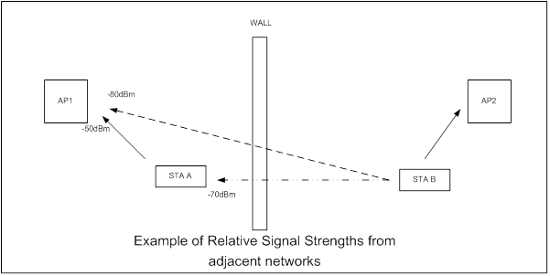
Example – background to idea
AP1 to STA A -50dBm, (also AP2 to STA B)
STA B is 4x as far from AP 1 as STA A.
Therefore AP1 receives STA B at -80dBm (50 + 20* +10 wall) *10dB per octave
STA A receives TX from STA B at -70dBm (50 +10* +10wall)
Note: AP1 receives AP2 <-82dBm so CCA is not exerted
STA A and STA B could both transmit successfully to their APs at the same time
BUT each is prevented by CCA.

Slide 5
Dynamic Sensitivity Control - DSC
Imagine a scheme where STA measures the RSSI of the AP Beacon (R dBm)
Then sets its RX Sensitivity Threshold at (R – M) dBm, where M is the “Margin”
Hence, for example:
STA receives Beacon at -50dBm, with Margin = 20dB STA sets RX Sensitivity Threshold to -70dBm.
Also set an Upper Limit, L, to Beacon RSSI at, say, -30 or -40dBm to cater for case when STA is very close to AP.
Need to ensure that all the STAs in the wanted area do see each other. Hence if one STA very close to AP, then it could set RX Sensitivity too high.

Slide 6
RX Sensitivity
L = Upper Limit M = Margin R = Received RSSI
RX Sensitivity, RxS
RxS = L for (R-M) >= L
RxS = (R – M) for (R-M) < L
Example, FOR L = -40dBm and M = 20dB
RSSI, R dBm | R - M dBm | Rx Sensitivity, dBm
-5 | -25 | -40 (R-M >L)
-10 | -30 | -40 (R-M >L)
-20 | -40 | -40 (R-M =L)
-30 | -50 | -50 (R-M< L)

Slide 7
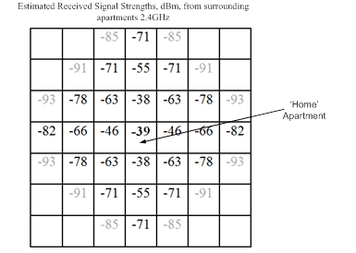
Apartments
Apartment block scenario
Mean signal strengths received at the Home apartment from surrounding appts
Note that 24 surrounding apartments will exert CCA (if same channel)
If CCA Threshold was -50dBm, then only 4 surrounding apartments ‘interfering’
Within Home apartment, wanted to unwanted (any apartment not one of the 4)
is ~24dB, so no problem if unwanted is transmitting.
In this scenario if all STAs reduced Rx Sensitivity then everyone is better off.
e.g. Upper Limit -30, Margin 20 = -50dBm, worse case = -39 – 20 = -59dBm (cf -63dBm)
Note, am alternative is if all STAs reduced their TX power by 30dB BUT the difference is that it does not rely on all other networks to do it as well.

Slide 8
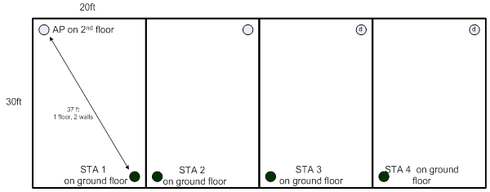
Terraced Houses - worst case scenario
STA in each house is at extreme position. But, at worst position to interfere with STA 1
The relative RSSIs are:
STA 1, STA 2, STA 3 and STA 4 to respective APs is -46dBm (30.5ft, 2 walls.1 floor)
STA 1 will receive STA 2 at about -29dBm (4ft, 1 external wall)
STA 1 to STA 3 is -69dBm (24ft, 2 external walls)
STA 1 to STA 4 is -78dBm (44ft, 3 external walls)
Note STAs 1 and 3 could communicate with their AP at the same time with 23dB margin, but that CCA will stop this. Also STA’s 1 and 4 will exert CCA on each other – VERY INEFFICIENT
Set DSC Margin to 20dB. STA 1 effective CCA is now -66dBm. (-46 – 20dBm)
We can see that almost every STA in House 3 is now unseen and both networks can transmit unimpeded.

Slide 9
Enterprise Networks, Hotspots
Conventional 7- cell cluster
Assume 7 channels (@ 5GHz)
STA A at extreme of Cell 4
STA B at worst case position in cell 4’
Assume 3dB obstruction between cells
STA A receives STA B at -26dB cf AP 4
IF DSC MARGIN = 20dB
BOTH CAN TX AT SAME TIME
If Cell Radius 50feet
STA A to AP 4 -44dBm
STA A to STA B -70dBm
AP 4 to AP 4’ -80dBm
STA B and AP 4’ both would exert CCA at STA A and vice versa
Set DSC Margin 20dB
Effective CCA = -64dBm
In this environment, AP could tell its STAs what Margin and Upper Limit (e.g. 40 and 20)
Overall capacity greatly enhanced

Slide 10
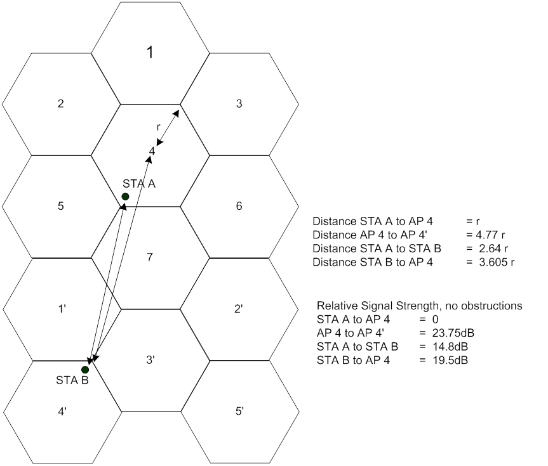
Enterprise and Hotspots
Note if STA A moves, then
it loses the DSC protection and then
it is encouraged to switch channels
as now has lower throughput.
Note that this type of cell cluster is impossible
without TPC or DSC. TPC fails if any one not complying
But also would make TX at highest data rates difficult.
DSC ensures highest data rates used.

Slide 11
Other
Upper Limit and Margin can be adjusted to suit the application for an optimum result (AP could control)
20dB Margin suggested as 20dB is approx required SNR for higher data rates
Upper Limit can be used to define the network coverage area. (This is shown later)

Slide 12
Legacy STAs – No problem if in separate network
In each of the cases considered, Apartments, Houses, Cell Cluster, the legacy STA is UNAFFECTED
If the legacy STA is in a separate network, we see that in examples, both STA A and STA B can TX at the same time.
If STA B does not use DSC then:
If already started to TX it will complete (STA A can TX at same time)
If STA B has not started to TX it will hold off with CCA in the normal fashion if STA A is TX – no difference
DSC simply allows the STA using it to TX at the same time.
Legacy network performance improves as need not wait so long for DSC network to TX (simultaneous TX)

Slide 13
Legacy STA – Same Network
If any STA is outside the coverage area set by the DSC, then it is at a disadvantage as its TX could be stepped on by the DSC STA that is close to the AP. This is the same situation as “hidden STA”.
“Hidden STA” situation exists now so nothing new
Detection area is set by the Upper Limit and Margin.
Set correctly, possibility of ‘hidden STA’ is greatly reduced
See area graphic on next slide
Note distances and compare to house sizes. Hence, possibility of hidden legacy or DSC STA is remote.
Consider also need to keep high data rates hence want to restrict range. (Especially if using 40MHz channels or higher).
Finally
If outdoor and large area coverage required, DSC could be disabled by AP IE.

Slide 14
Legacy STA – Same Network
Upper Limit -30dBm Margin 20dB
Good for Apartment/House
Upper Limit -40dBm Margin 20dB
Good for Office, open area
Network coverage controlled by setting Upper Limit.

Slide 15
Lone DSC STA
If just one STA uses DSC what is the effect on others?
If in house, apartment, 7-cell cluster examples, LITTLE TO NO EFFECT
Coverage is such that all STAs in the network should be covered
Probability for a STA to be compromised based on
Probability DSC STA is close to AP (On Upper Limit)
Probability DSC STA transmits
Probability that other STA is at far range (> 20dB or 4x range away)
Probability that other STA also transmits
Look at coverage circles on previous slide
If used for a Wi-Fi Phone then 1 packet every 20ms is definitely insignificant effect on other STAs

Slide 16
Discussion
We can expand the examples to specific enterprise, office environments.
Network coverage is NOT simple circles. It is bounded by walls, floors, obstructions such that the propagation is not dB linear it suffers from jumps, e.g. 10dB per outside wall, 3 – 6dB inside walls.
Network coverage can be made ‘cell like’ so as to improve the overall coverage.
If only one network uses DSC it does not impact performance on other network – in fact it lessens impact as now TX simultaneously so other network does not need to wait so long.
DSC Limit can be set to cover desired network area. STAs in same network, are at disadvantage only if at far distance.
Can be mitigated with correct choice of Upper Limit.
Also probability comes into play, chance of close STA, chance it is TX, etc. In practice not a significant problem
DSC combined with channel selection can mitigate OBSS.
DSC can improve overall Wi-Fi throughput in an area.
AP can control settings – see next slide

Slide 17
AP Considerations
AP could set the Upper Limit and Margin parameters for STAs
Advertises settings (similar to EDCA parameters)
AP bases its own CCA on the DSC parameters it advertises
Based upon location (home, enterprise)
Based upon desired coverage
AP can issue “No DSC” to be used
For large area coverage outdoors, for example.
AP could learn OBSS situation while simply listening to Beacons from other network(s). Set Upper Limit accordingly.
Part of Channel Selection process (as per 11aa)
Sets Upper Limit so that OBSS is mitigated
Could be dynamic with periodic scans
All could be covered in 802.11 Standard now
Directly applicable to HEW SG as it improves the effective throughput in an area

Slide 18
Considerations – Way ahead
11mc could be changed to incorporate edits that would allow this
Applicable now for 11a/g/n
Simple edit to Standard for STAs
Could add IE for advertising Upper Limit and Margin for AP
HEW?

Slide 19
Straw Poll
Do you think that DSC merits further consideration?
Yes (a lot)
No (zero)

