Slide 1
802.1AS Synchronization Services for 802.11ak Links
Date: 2013-09-09
Authors:

Slide 2
Abstract
This presentation describes 802.1AS synchronization services for 802.11ak links

Slide 3
802.1AS for 802.11 Links (1)
Specified in IEEE Std 802.1AS-2011 Clause 12
Path Delay measurement + time propagation
Peer delay mechanism
Use the Timing measurement procedure defined in IEEE 802.11v specified in IEEE 802.11-2012 Section 10.23.5
MLME-TIMINGMSMT Primitives
Messages are the “timing measurement action frame” and its corresponding “ACK”
Vendor Specific (OUI of 802.1) information element contains various time-synchronization parameters, including an entire Follow_Up message

Slide 4
802.1AS for 802.11 Links (2)
Messages
All media-dependent frames are generated and consumed by the lower-layer 802.11 MLME
Messages are timestamped by the MAC/PHY
Determination of “asCapable”
Per-port global variable
Set to FALSE if the timing measurement bit in the ExtendedCapabilities information element indicates that the peer IEEE 802.11 station is incapable of participating in the timing measurement protocol
Otherwise, may be set to TRUE

Slide 5
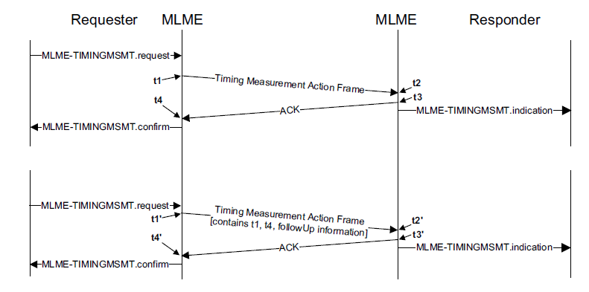
Timing Measurement Procedure for 802.11 Links

Slide 6
Propagation of Sync and Follow_Up Messages on 802.11ak Links (1)
Timing measurement procedure for 802.11 links introduces a one Sync_interval delay per 802.11ak link to the propagation of the Sync message

Slide 7
Sync Msg Propagation for .11ak Links Option #1
Same procedure as for .11 links
Pros:
No change to 802.1AS
Cons:
Sync msg propagation is delayed by one Sync_interval per .11ak link (the default Sync_interval for 802.11 link is 1/8 sec)
This delay is accumulative per 802.11ak hop
The “maximum_time_accumulation” that could be sustained by the sync msg propagation is a function of the clock frequency stability (values will be provided by the 802.1AS experts)
Max nbr of 11ak hops = fct (maximum_time_accumulation, Sync_interval)

Slide 8
Sync Msg Propagation for .11ak Links Option #2
For .11 links, two consecutive Time Measurement Action Frames are generated for the Sync and Follow_Up messages
Pros:
Eliminates the one Sync_interval delay
Cons:
Makes the protocol more “chatty” (but fewer packets than on Ethernet)
Requires a Modification of the MD State Machine (and the 802.1AS Specs for .11ak links)

Slide 9
Fine Timing Measurement 802.11mc (1)
New MLME primitive MLME-FINETIMINGMSMTRQ to provide improved timing measurement accuracy included in IEEE P802.11-REVmc/D1.5, June 2013

Slide 10
Fine Timing Measurement 802.11mc (2)
Almost the same syntax as MLME-TIMINGMSMTRQ
timestamp precision of 0.1ns
Issue: An STA supporting MLME-FINETIMINGMSMTRQ does not support MLME-TIMINGMSMTRQ
as currently defined in IEEE Std 802.1AS this STA will not be “asCapable” (cf slide 4 - the timing measurement bit in the ExtendedCapabilities information will be different…)
Solution: Support for Fine Timing Measurement could be added to P802.1ASbt
as IEEE Std 802.1AS describes the .11v’s MLME-TIMINGMSMTRQ primitive only
**if** the 802.11mc timeframe could match the P802.1ASbt timeframe

Slide 11
Fine Timing Measurement 802.11mc (2)
Almost the same syntax as MLME-TIMINGMSMTRQ
timestamp precision of 0.1ns
Issue: An STA supporting MLME-FINETIMINGMSMTRQ does not support MLME-TIMINGMSMTRQ
this STA will not be “asCapable” as currently defined in IEEE Std 802.1AS (cf slide 4 - the fine timing measurement bit in the ExtendedCapabilities will be a different bit …)
Solution: Support for Fine Timing Measurement could be added to P802.1ASbt
as IEEE Std 802.1AS describes the .11v’s MLME-TIMINGMSMTRQ primitive only
**if** 802.11mc is completed in a timeframe compatible with the P802.1ASbt timeframe

Slide 12
Timestamping of 802.1AS Sync Messages over 802.1Qbz Bridge and 802.11ak Link
Disclaimer:
The three following slides are INFORMATIVE only and implementation related.
Their aim however is to raise the awareness of the needed synchronization between the 802.1Qbz Bridge and 802.11ak time domains

Slide 13
Timestamping of 802.1AS Sync Messages over 802.1Qbz Bridge and 802.11ak Link
Residence time of the 802.1Qbz bridge includes 2 time domains: 802.1Qbz bridge and 802.11
Two mutually exclusive options:
Option 1: Bridge and STA clocks are synchronized
Option 2: Bridge and STA clocks are independent free running clocks. In this case:
Sync messages must be timestamped at the “Infrastructure” and “STA/Bridge” interfaces
The Timestamping is identical to the timestamping at the portal interface in a Time Aware 802.11 AP STA

Slide 14
802.1Qbz / 802.11ak Sync Msg Timestamping (1)
Option#1 : Bridge & STA free running clocks

Slide 15
802.1Qbz / 802.11ak Sync Msg Timestamping (2)
Option#2 : Bridge & STA clocks are synchronized

Slide 16
Questions ?

Slide 17
Thank you

