Slide 1
802.11 Supplementary Plenary Information - September 2013
Date: 2013- September -15
Authors:
Name
Company
Address
Phone
email
Bruce Kraemer
Marvell
5488 Marvell Lane,
Santa Clara, CA, 95054
+1 (321)
751-3958
bkraemer@
marvell
.com
Abstract: Additional Information on topics for 802.11 Plenary meeting – September 2013
being held in Nanjing, China
Notes:
November 2011

Slide 2
Monday
Notes:
November 2011

Slide 3
IEEE LOA Database – September 15, 2013
Friday Agenda Item 3.2.1
http://standards.ieee.org/db/patents/pat802_11.html
32 entries with 2013 submission dates
Request for LOAs - pending Chair’s issuance

Slide 4
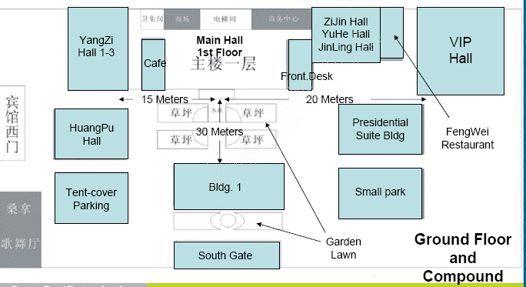
Meeting Areas
Monday Agenda Item 4.1.3

Slide 5
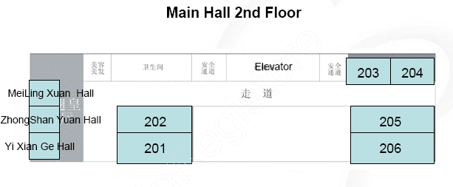
Meeting Areas
Monday Agenda Item 4.1.3

Slide 6
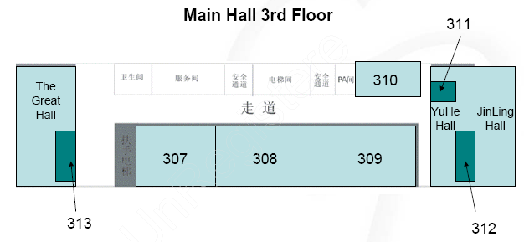
Meeting Areas
Monday Agenda Item 4.1.3

Slide 7
Other
- Please also make sure you wear your name badges during the meeting. Hotel staff have been asked to check badges before entering session rooms.
- Please call 8666 from your hotel room should you need anything. This is a dedicated line for IEEE delegates, and the hotel will provide English speaking staff to assist you.
Monday Agenda Item 4.1.3
Wireless Interim Meeting, Nanjing, China
15 – 20 September 2013

Slide 8
Taxi’s
- Taxi peak hour is from 0730 – 0900 and
1600 – 1900. If you are departing around this time for the airport or any other location, please allow additional time to get to your destination. E.g, allow an extra hour to get to the airport during these times.
- Taxi changeover also occurs in the afternoon
Monday Agenda Item 4.1.3
Wireless Interim Meeting, Nanjing, China
15 – 20 September 2013

Slide 9
Joint Meetings
Monday Agenda Item 4.1.4
External:
none
Internal:
ARC and 802.11AK Tuesday am2 room 313

Slide 10
September 2013 PARS
Monday Agenda Item 4.1.5
No PARS in September

Slide 11
Group Room assignments
Monday Agenda Item 4.1.6
WG | Building | Room
1
16
18 |  | 202
19 |  | 204
21 |  | 205
22 |  | 206
24 |  | 313
OMNIRAN |  | 307
Notes:
November 2011

Slide 12
Group Room assignments
Monday Agenda Item 4.1.6
WG | Building/Floor | Room
802.11 Plenary | Main/3rd | Great Hall
MC | Main/3rd | 308
AC | Main/3rd | 308, 313
AF | Main/3rd | 307, 309
Editors | Main/3rd | 311
AH | Main/3rd | Great Hall, 313
AI | Main/3rd | 307
AJ | Main/3rd | 307, 309
AK | Main/3rd | 313
AQ | Main/3rd | 307
REG | Main/3rd | 309
WNG | Main/3rd | Great Hall
JTC1 | Main/3rd | 307
HEW | Main/3rd | Great Hall
ARC | Main/3rd | 309
Notes:
November 2011

Slide 13
Badge Color Codes
Jiangsu Conference Centre, Nanjing, China
15 – 20 September 2013
Jiangsu Conference Centre, Nanjing, China
15 – 20 September 2013
Jiangsu Conference Centre, Nanjing, China
15 – 20 September 2013
STAFF
UNIVERSITY OUTREACH
Staff
University Outreach
Attendee
Jiangsu Conference Centre, Nanjing, China
15 – 20 September 2013
Jiangsu Conference Centre, Nanjing, China
15 – 20 September 2013
STUDENT
WEDNESDAY SOCIAL
Student
Nanjing VIP

Slide 14
WG Agendas
Monday Agenda Item 4.1.6
18: Agenda 18-13-0099 r4
Opening Report 18-13-
19: Agenda 19-13-0109 r0
Opening Report 19-13-
21: Agenda 21-13-0153 r0
Opening Report 21-13-
22: Agenda 22-13- 0136 r0
Opening Report 22-13-
24: Agenda 24-13-0033 r1
Opening Report 24-13-0034 r0
OmniRAN Agenda omniran-13-
Opening Report omniran-13-

Slide 15
802.18 topics – Timeslots to be assigned
Monday Agenda Item 4.1.6
Status Updates, Open FCC Proceedings: FCC 5 GHz U-NII Band NPRM, FCC TV Band Incentive Auction, etc
Ofcom: Consultation_future_spectrum sharing_Licensed_sharing_Wi-Fi_dynamic_spectrum_access.pdf (18-13/98r0)
European Commission: ECstudy_Impact_of_Offloading_on Demand_for_Wireless_Broadband_Spectrum.pdf (18-13/100r0)
Reconsideration of Draft submission to the FCC in support of the IEEE USA petition for rules above 95 GHz (18-13/090r2. 18-13/055r3)
Discussion of scheduling regular visits to the FCC to update the Commission (or at least OET) on status of standards development.
EC Radio Spectrum committee Draft Mandate to CEPT to study and identify harmonised compatibility and sharing conditions in 5350-5470 MHz & 5725-5925 MHz, (18-13/103r0)
Ofcom consultation: TV White Spaces: Approach to Coexistence (18-13/104r0)

Slide 16
November 10-15, 2013 Dallas, Texas, US
Monday Agenda Item 4.1.7
IEEE 802.11 Interim Session
Hotel Registration OPEN
Meeting Registration OPEN
  Early bird discount closes Friday October 4
http://www.ieee802.org/11/Meetings/Meeting_Plan.html

Slide 17
Nanjing Meeting Registration (~296)
Monday Agenda Item 4.1.8
802.1
802.3
802.11 208
802.15 60
802.16
802.18 6
802.19 6
802.21 5
802.22 5
802.24 6

Slide 18
Delegate Origin
Monday Agenda Item 4.1.8
COUNTRY BREAKDOWN
AUSTRALIA | 2 | 0.6%
CANADA | 8 | 2.6%
CHINA | 85 | 27.4%
FINLAND | 1 | 0.3%
FRANCE | 2 | 0.6%
GERMANY | 3 | 1.0%
INDIA | 3 | 1.0%
IRELAND | 1 | 0.3%
ITALY | 1 | 0.3%
JAPAN | 32 | 10.3%
KOREA, REPUBLIC OF | 41 | 13.2%
NETHERLANDS | 3 | 1.0%
SINGAPORE | 9 | 2.9%
SWEDEN | 2 | 0.6%
TAIWAN | 11 | 3.5%
UK | 5 | 1.6%
USA | 100 | 32.3%
USA VIRGIN ISLANDS | 1 | 0.3%
TOTAL | 310 | 100.0%

Slide 19
IEEE Staff on site
Monday Agenda Item 4.1.9
Meng Zhao – IEEE Beijing Office

Slide 20
Meals
BREAKFAST:
- if you didn’t book breakfast as part of your accommodation booking, you can still purchase breakfast from the hotel reservation desk for 58 Yuan.
- Breakfast will be served from 0630 – 0830 in the ZiJing Hall. Please note the hotel tends to pack down the breakfast promptly at 0830, so make sure you get there on time.
Monday Agenda Item 4.1.10
Wireless Interim Meeting Nanjing, China
15 – 20 September 2013

Slide 21
Meals
- Morning and Afternoon tea will be served from the foyer of level 2 and 3
- Lunch (1230 – 1330) will be served from the ZiJing Hall (same venue as breakfast)
Monday Agenda Item 4.1.10
Wireless Interim Meeting Nanjing, China
15 – 20 September 2013

Slide 22
Social
- Will be held in the ZiJing Hall
- Please make sure you wear your name badge to the social
- The Host, Nanjing City Government, will be inviting many senior people from every government department in Nanjing. This will be a great chance to meet and greet the invited guests.
Monday Agenda Item 4.1.10
Wireless Interim Meeting, Nanjing, China
15 – 20 September 2013

Slide 23
Suggestions for Restaurants
- for suggestions for restaurants in the area, please visit the registration desk for a list of restaurant ideas
Monday Agenda Item 4.1.10
Wireless Interim Meeting, Nanjing, China
15 – 20 September 2013

Slide 25
Current Membership Status - September
Monday Agenda Item 4.1.11
Status | Number
Aspirant | 90
Potential Voter | 36
Voter | 334
Definitions:
  Aspirant: a member who has attended 1 qualifying meeting
  Potential Voter: a member who has attended 2 qualifying meetings and will become a voter at the start of the next plenary they attend
Data as of 2012-11-06

Slide 26
Wednesday Plenary Topics
Monday Agenda Item 4.1.12
AK proposal for TAG stacking change
Document 11-13-1055
https://mentor.ieee.org/802.11/dcn/13/11-13-1055-00-00ak-tag-stacking-change.pptx
1900.1 participation offer
November EC workshop topics

Slide 27
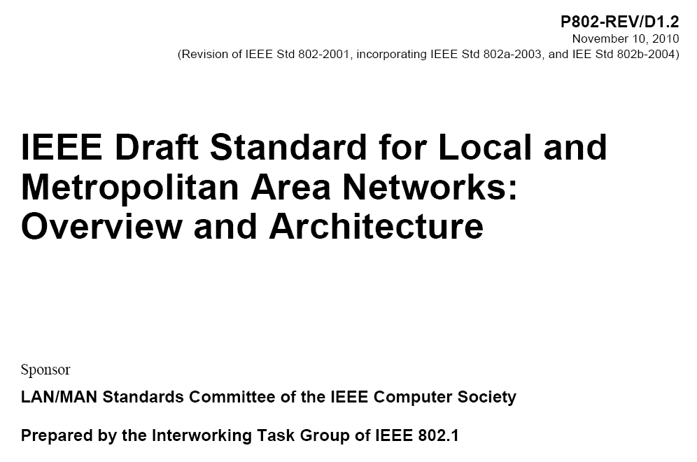
802.1 Architecture Document
Monday Agenda Item 4.1.13
Expecting recirculation sponsor ballot in September
ARC discussion topic Wednesday

Slide 28
802.11 Topics for November 2013 EC
Monday Agenda Item 4.1.15
Begin Sponsor Ballot? X
Submit to RevCom? AC, AF
New project PAR to NesCom? X
PAR Extension ? X
Revision PAR? X
Study Group start up? Depends upon results of WNG meeting
Study Group extension? HEW (11-13-1100)
Press Release? AC publication, AF publication

Slide 29
November Tutorials
Monday, July 15, 2013
Monday Agenda Item 4.1.16
http://ieee802.org/Tutorials.shtml
Monday, Nov 11, 2013
Ethernet 40th Celebration (7:00 - 9:00pm) Presentation John D'Ambrosia, Dell Bob Metcalfe
Tuesday, Nov 12, 2013 Tutorial #1 (6:00–7:30 pm): Wireless SDN in Access and Backhaul Roger Marks, EthAirNet Associates Juan Carlos Zuniga, InterDigital Antonio de la Oliva, Universidad Carlos III de Madrid Nader Zein, NEC
Tutorial #2 (7:30–9:00 pm): Tutorial #3 (9:00 – 10:30)

Slide 30
Notable ExCom or SA Activities
Monday, July 15, 2013
Monday Agenda Item 4.1.17
802 operations manual changes Modification of 5Cs postponed to November EC Workshop in November
40th Anniversary of Ethernet celebration planned for Nov Special event on Monday Tutorials shifted to Tuesday IEEE election period open until October 5

Slide 31
Wednesday
Notes:
November 2011

Slide 32
Social in Nanjing
Wednesday Agenda Item 2.7
TIME: 530pm - 8.00pm.
Official start is 6.30pm, beverages will start at 530pm, food will start at 6.30pm
LOCATION: ZiJing Hall (same place as breakfast and lunch)
SPEECHES: at 6.30pm and will only be short
STYLE: stand up buffet
DRESS: Casual

Slide 33
Wednesday Agenda Item 4.2
1900.1 Participation Offer
Dear Colleagues,
The IEEE 1900.1 Standards Working Group (http://grouper.ieee.org/groups/dyspan/1/) is preparing a revision of its published IEEE Std 1900.1™-2008 standard, entitled: “IEEE Standard Definitions and Concepts for Dynamic Spectrum Access: Terminology Relating to Emerging Wireless Networks, System Functionality, and Spectrum Management”. The key purpose of IEEE 1900.1 is to promote a common understanding among experts and to act as a baseline in the definition of a number of key terms pertinent to dynamic spectrum access, cognitive radio, spectrum sharing, opportunistic spectrum access, and other related technologies, capabilities and functionalities. It is intended that though such ends, the prospects for dynamic spectrum access and related technologies are enhanced.
We hereby invite you to contribute to the development of this revision standard. Your contribution can enhance the standard by introducing new prominent concepts to the terms and definitions covered therein. It can also give the opportunity to express your opinion on any necessary changes to terms and associated definitions in the current standard. Moreover, IEEE 1900.1 also aims to guide professionals on aspects such as the relationship between the various concepts in the scope of dynamic spectrum access and related technologies, as covered in the standard. Your contribution could also cover such aspects.
Contributing to IEEE 1900.1 will present many benefits to you and to your organization, particularly if you or your organization have interest in or are stakeholders in dynamic spectrum access and related beyond 2020 mobile communications or next generation wireless technologies. IEEE 1900.1 is a highly cited standard and guide to the understanding of next generation radio concepts within the mobile and wireless community. Further, your personal input will be acknowledged in the standard (if desired).
Should you wish to contribute to the standard, please express your interest to the Chair of IEEE 1900.1 (Oliver Holland, oliver.holland@kcl.ac.uk) and Secretary (Michael Gundlach, michael.gundlach@nsn.com). The “Subject” field of your email should be the exact following text: “IEEE 1900.1 Revision Expression of Interest”, and your email text should included some brief information about you, your organization, and you and your organization’s work and interest areas. Based on your emailed expression of interest, we will contact you with more detail on the process for contributing to the revision standard, and you will be invited to participate in future IEEE 1900.1 meetings in order to present and discuss your contribution/opinion.
The deadline for you to respond to this call for interest is the end of 30 September 2013, US Eastern Daylight Time. Any emailed responses received after that time will not be processed.
Many thanks for your kind attention to this email.
Kind regards,
Oliver Holland, IEEE 1900.1 Chair
Michael Gundlach, IEEE 1900.1 Secretary

Slide 34
Wednesday Agenda Item 4.2
1900.1 Participation Offer
IEEE 1900.1 Working Group on "Definitions and Concepts for Dynamic Spectrum Access: Terminology Relating to Emerging Wireless Networks, System Functionality, and Spectrum Management"
IEEE 1900.1 aims to standardize terms and definitions in the field of dynamic spectrum access and related technologies. It is hoped that through this effort a common understanding on such technologies will be achieved among interested stakeholders, therefore the prospects of these technologies will be further enhanced.
The baseline IEEE 1900.1 standard was published on September 26th, 2008. The standard can be obtained at:http://standards.ieee.org/findstds/standard/1900.1-2008.html.
From February 2011 until December 2012 the 1900.1 Working Group worked on a new amendment project, IEEE 1900.1a, primarily aiming to incorporate updated terms and definitions from other IEEE 1900 Working Groups into the standard. This work, entitled "1900.1a:IEEE Standard Definitions and Concepts for Dynamic Spectrum Access: Terminology Relating to Emerging Wireless Networks, System Functionality, and Spectrum Management Amendment: Addition of New Terms and Associated Definitions" was published in January 2013 and is available here:http://standards.ieee.org/findstds/standard/1900.1a-2012.html.
Since January 2013 the IEEE 1900.1 Working Group has been concentrating on preparing a root-and-branch revision of the original baseline standard that was published in 2008. It is intended that this revision will provide an up-to-date viewpoint on the associated fast-moving technology areas. It is also intended that this revision will enhance the informative content detailing the relationship between the various concepts covered by the standard.
Should you wish to be involved in IEEE 1900.1, please contact the Chair and Secretary as listed at the end of this page.
Contacts
Oliver Holland, Ph.D.
IEEE 1900.1 Working Group Chair
Michael Gundlach, Ph.D.
IEEE 1900.1 Working Group Secretary

Slide 35
Wednesday Agenda Item 4.2
Should you wish to contribute to the standard, please express your interest to the Chair of IEEE 1900.1 (Oliver Holland, oliver.holland@kcl.ac.uk) and Secretary (Michael Gundlach, michael.gundlach@nsn.com). The “Subject” field of your email should be the exact following text: “IEEE 1900.1 Revision Expression of Interest”, and your email text should included some brief information about you, your organization, and you and your organization’s work and interest areas. Based on your emailed expression of interest, we will contact you with more detail on the process for contributing to the revision standard, and you will be invited to participate in future IEEE 1900.1 meetings in order to present and discuss your contribution/opinion.

Slide 36
Wednesday Agenda Item 5.1
Room Changes
Remove time slots for
xx
Add time slots for
TGah, if possible. Thursday AM1 or PM1.
Notes:
November 2011

Slide 37
Wednesday Agenda Item 5.2
Revised Agenda Graphic
If needed

Slide 38
Wednesday Agenda Item 5.3
Mid-week Officer Changes
If needed

Slide 39
Friday

Slide 40
802.11 Meeting Documents - September
Friday Agenda Item 1.2
Agenda 11-13-0931r6
Snapshots 11-13-0932r2
Supplementary 11-13-0933r3
Adrian’s Vice Chair report 11-13-0096r5
Jon’s Vice Chair report 11-13-1107r0
Treasury report 11-13-1063r0
Publicity
Newcomers material 11-13-0049r2
Closing Reports 11-13-0960r0
Motions 11-13-0959r0

Slide 41
IEEE LOA Database – Sep 15, 2013
Friday Agenda Item 2.08
http://standards.ieee.org/db/patents/pat802_11.html
32 entries with 2013 submission dates
Request for LOAs - pending Chair’s issuance

Slide 42
IEEE Store Contents - September 2013
Friday Agenda Item 2.09
http://www.techstreet.com/ieeegate.html
http://standards.ieee.org/about/get/802/802.11.html
Amendment | Draft in TechStreet July 12 | Draft in Members Area | Publication in Get 802 September
AF | D5.0 $250 pdf | 5.0
AC | D6.0 $250 pdf | 6.0
AD-2012 | $360 print |  | P
AE-2012 | $105 print |  | P
AA-2012 | $180 print |  | P
802.11 -2012 | $540 print |  | P
b, k, i, n, p, y, r, w, u, v, z, s | $100 - $305
802.11-2007
Notes:
November 2011

Slide 43
802.11 drafts to ISO/IEC JTC1/SC6
Friday Agenda Item 2.10
Task Group | After Vancouver | After Geneva
TGac | D5.0 | D6.0
TGaf |  | D5.0
Notes:
November 2011

Slide 44
Ad hoc Venue Advisory Committee
Friday Agenda Item 2.12
Provide assistance to Jon in preparing for meeting at each venue
Key pieces of information needed by global attendees
Transportation
Local restaurants, bars (by type)
Local shops (convenience store,…)
Local sites/tours
Taxi info
Hotel menu plan
……
Chair, Volunteers for Dallas venue?
Teleconference schedule

Slide 45
WG11 Task & Study Group Officers – September 2013
Friday Agenda Item 3.1.5
Cat | Group | Chair | Vice Chair | Technical Editor | Secretary
WG | WG11 | Bruce Kraemer | Jon Rosdahl Adrian Stephens | Adrian Stephens Peter Ecclesine | Stephen McCann
TG | MC | Dorothy Stanley | Mark Hamilton, Jon Rosdahl | Adrian Stephens | Jon Rosdahl
TG | AC | Osama Aboul-Magd | Menzo Wentink, Joonsuk Kim | Robert Stacey | David Yang
TG | AF | Richard Kennedy | Peter Ecclesine, Zhou Lan | Peter Ecclesine | Zhou Lan
TG | AH | Dave Halasz | Yongho Seok | Minyoung Park | Li Chia CHOO
TG | AI | Hiroshi Mano | Marc Emmelmann, | Lee Armstrong Ping Fang | Hitoshi Morioka
TG | AJ | Xiaoming Peng | Eldad Perahia, Haiming Wang | OPEN | HAO Peng
TG | AK | Donald Eastlake | NYRQ | Donald Eastlake Norm Finn | ZHUANG Yan
TG | AQ | Stephen McCann | Yunsong YANG, | Dan Gal | Dapeng Liu
SC | WNG | Clint Chaplin | Jim Lansford
SC | ARC | Mark Hamilton | OPEN
SC | JTC1 | Andrew Myles
SC | REG | Richard Kennedy
SG | HEW | Osama Aboul-Magd |  |  | Yasuhiko Inoue
NYRQ = Not yet required, nominations are not open
OPEN = Candidate Nominations are open
NEW

Slide 46
Future Venues -2013
Friday Agenda Item 6.3
2013
# 137 January 13-18, 2013 - --Hyatt Regency Vancouver, BC, CA
#137.5 January 23-24, Grand Mercure, Shenzhen, CN
# 138 March 17-22, 2013 –Caribe Royale, Orlando, FL, USA
# 139 May 12-17, 2013 ----Hilton Waikoloa, Big Island, HI
#139.5 April 24-25 – Beijing, China
# 140 July 14-19, 2013 --- Geneva , CH ITU headquarters
# 141 September 15-20, 2013- Zhong Shan Hotel, – Nanjing, China
# 142 Nov 10-15, 2013 Hyatt Regency Dallas, TX, USA
Notes:
November 2011

Slide 47
Future Venues - 2014
Friday Agenda Item 6.3
2014
# 143 January 19-24, 2014 -Hyatt Century Plaza, Los Angeles, CA, US
#143.5 January 8-9, 2014 - Sanya, China
# 144 March 16-21, 2014 – Beijing, China
# 145 May 11-16, 2014 ----Hilton Waikoloa, Big Island, HI
#145.5 May 21-22, 2014 - China
# 146 July 13-18, 2014 - Manchester Grand Hyatt, San Diego, CA, US
# 147 September 14-19, 2014----Athens, Greece
#147.5 September2 4-25, 2014 - China
# 148 November 2-7, 2014 Hyatt Regency San Antonio, TX, US
Notes:
November 2011

Slide 48
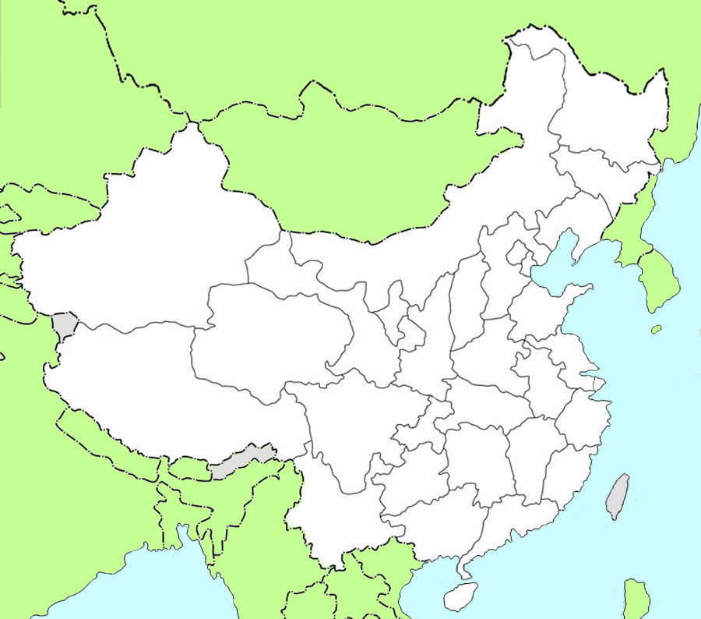

Sanya, China
三亚
Friday Agenda Item 6.3
January 8,9 2014 TGaj Interim
20 five-star hotels
by 2015

Slide 49
Future Venues - 2015
Friday Agenda Item 6.3
For Year 2015 |  | Session | Type
January | Hyatt Regency Atlanta, Atlanta, GA, USA | 149 | Interim*
March | Singapore (TBD) | 150 | Plenary
May |  | 151 | Interim*
July |  | 152 | Plenary
September | European / Asian venue TBD | 153 | Interim*
November | Hyatt Regency, Dallas, TX, USA | 154 | Plenary

Slide 50
November 10-15, 2013 Dallas, Texas, US
Friday Agenda Item 7.0
IEEE 802 Plenary Session
Hotel Registration OPEN
Meeting Registration OPEN
  Early bird discount closes Friday October 4
http://www.ieee802.org/11/Meetings/Meeting_Plan.html

Slide 51
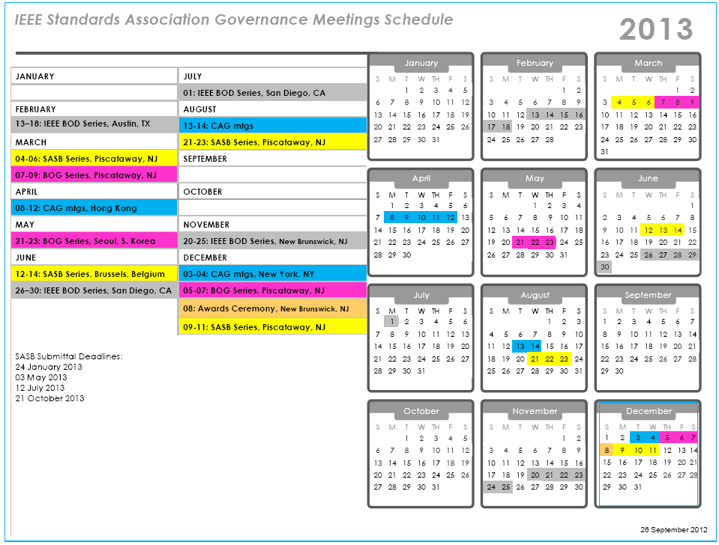
Next SASB deadline:
21 October 2013

Slide 52
