Slide 1
Report on the TGai Berlin AdHoc in July 2013
Date: 2013-07-15
Authors:
Name | Company | Address | Phone | email
Marc Emmelmann | Fraunhofer Fokus |  | +49 30 3463 7268 | emmelmann@ieee.org

Slide 2
Abstract
Summary of the TGai Berlin AdHoc in July 2013

Slide 3
Berlin AdHoc Agenda
Wednesday: 9.00h – 17.30h
TGai Ad-Hoc MEETING CALLED TO ORDER
CALL FOR ESSENTIAL PATENTS AND POLICIES & PROCEDURES REMINDER
Modify and/or Approve Agenda
Discussion & Straw Polls on comment resolutions
Recess until Thursday
Thursday: 9.00h – 17.30h
Call meeting to order
Continue discussion & straw polls on comment resolutions
Recess until Friday
Friday: 9.00h – 17.30h
Call meeting to order
Continue discussion & straw polls on comment resolutions
Adjourn

Slide 4
Submission List
11-13-0733 (Lin Cai)
11-13-0732 (Lin Cai)
11-13-725 (George Calcev)
11-13-0714-00 (Hitoshi Morioka) & 11-13/735
11-13-0698-00 (Lei Wang)
11-13-0699-00 (Lei Wang)
11-13-721r0 (& 13-573r2) (Jarkko Kneckt)
11-13-565r2 (& 13-572r2) (Jarkko Kneckt)
11-13-718r0 (Jarkko Kneckt)
11-13-708 (Jeong Ki) (& 11-13/736)
Mail from Dan Harkins (suggestion how to address security comments assigned to him) – Discussion lead by Chair11-13-0752-00-00ai-tgai-d0-5-resolution-for-comments-assigned-to-dan-h.xlsx
11-13-742 (Rob Sun)
Note: revisions were made to the submission based on the ad-hoc discussion before taking them as a baseline for comment resolution.
Note that updates of submitted documents were made during the ad-hoc.
Refer to 11-13/495r12 to see the final comment resolution as drafted during the adhoc

Slide 5
Straw Poll at Berlin AdHoc
Do you support approving the comment resolutions as contained in the “2013-07-AdHoc” Tab contained in 11-13/495r12 ?
Yes: 10
No: 0
Abstain: 0
Note: The tab contains the resolution of 185 comments as agreed on during the AdHoc.

Slide 6
Open Items for Geneva
Run motion to approve
Comment resolutions produced in Berlin
Comment resolution produced during Geneva Monday AM1 AdHoc Slot
38 Unresolved comments that need submissions and discussion (additional resolutions after the Berlin ad-hoc were drafted during the Monday AM1 adhoc slot in Geneva)
Close security related comments
Discussion of CID 1334 (Dan H. & Rene S.)
Pending submissions from Dan
Note: Rene will not attend the f2f meeting.
➔ Assigned all security related comments to „Security Task Force“ consisting of Dan, Rene, Rob Sun, George Cherian
Discussion of 13/718r2 (Lei, George Cherian, Jarrko)
Addresses CIDs 1220, 1142, 1447, 1446
Discussion of CID 1079 (Editor and Chair)
Draft wording for resolution for several open comments (George, George, Santosh)
Please See E-Mail sent to TGai Reflector as copied to next slide

Slide 7
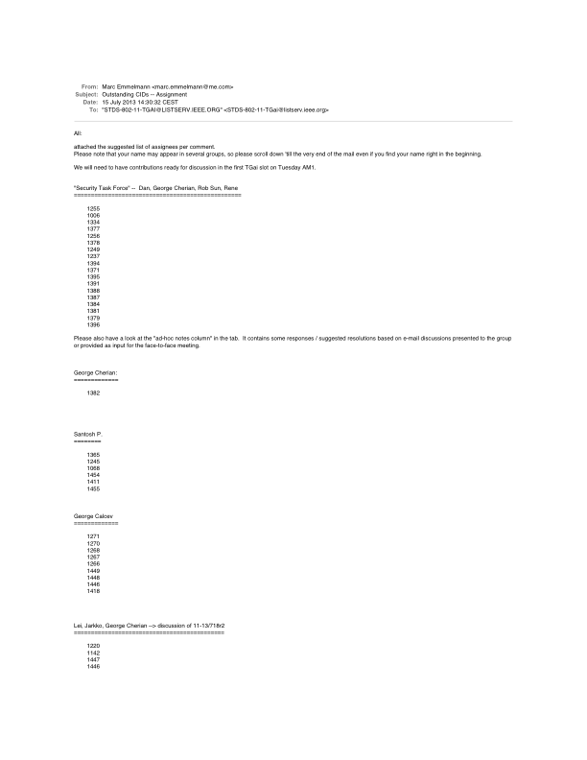
CID Assignment (per Mail sent to TGai Reflector 2013-07-15)

