Slide 1
Issues of Low-Rate Transmission
Date: 2013-07-18
Authors:

Slide 2
Introduction
Since so many WLAN devices have been already deployed in many places, we need to consider the impact of those legacy devices in the HEW usage models.
  Some discussions are in progress concerning the impact of low-rate transmissions by these legacy devices [1].
Compared with high-rate transmissions, low-rate transmissions by legacy STAs, especially 802.11b devices, consume more wireless channel time. It results to degrade the performance of STAs complying with latter standards.
This presentation introduces current situations of the use of 802.11b low-rate transmissions from the results measured in Tokyo. Besides, some experiments show how low-rate transmissions degrade throughput of high-rate transmissions.

Slide 3
Issues of Low-Rate Transmission
A large number of low-rate management frames degrade efficiency in dense scenario
  The newer standard comes, the larger the Beacon size become.
  In fact, the size of the 11n Beacon is approximately from 2 to 2.5 times larger than that of 11g. (See Appendix.A)
Low-rate transmissions by legacy STAs consume more wireless channel time
  The chance of transmission for all STAs shall become impartial according to the policy of IEEE802.11.
  In dense environment, data traffic will be saturated and these low-rate transmissions will prevent high-rate transmissions because of the policy.

Slide 4
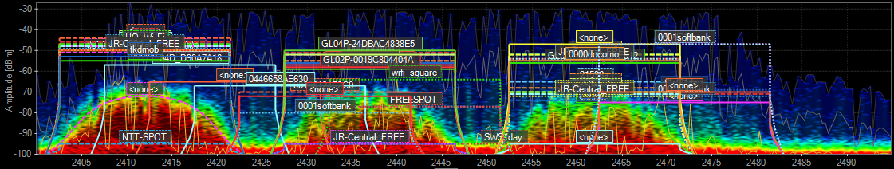
Condition of Packet Capture in Tokyo
Packet capture is conducted in dense environment:
  Date: June 28
  Location: Shinagawa Station
  Measured Channel: ch 1 (2.4GHz)
  Measured Time: 5m25s
  The number of all captured packets:160,574
  The number of measured SSIDs:20 (at ch 1)
The whole 2.4GHz channel condition at the location

Slide 5
Results of Packet Capture in Tokyo [1]
More than 70% of the whole captured frames are 802.11/11b format
  Most of the frames are transmitted in 1Mbps of 802.11/11b.
  Those frames are mainly management or control frames transmitting to correspond to 802.11/11b.

Slide 6
Results of Packet Capture in Tokyo [2]
Most management frames are 802.11/11b format
  Most management frames are 802.11b format in order to ensure interoperability and to reach farther distance.
  In control frames, the ratio of 11b and 11g is in halves.

Slide 7
Results of Packet Capture in Tokyo [3]
More than 50% of the data frames are 802.11/11b format
  11g or 11n STAs use 11b mode if their RSSI is low due to distance, interference, or fading.

Slide 8


The effect of Low-Rate Beacons:
Experimental Result [1]
An experiment was conducted in order to measure degradation of FTP file transfer by a large number of Beacons.
System configuration
  FTP data was continuously transmitted from the FTP server to the PC via the 11n (or 11g) AP.
  2~30 APs without any connected device were located in 5 meter distance from the target AP.
  Under the condition, the throughput of the FTP transmission was observed.
FTP file (50Mbyte) transfer
AP
BSS1 (11n or 11g) [Target]
PC1
Server
SW
6ch/20MHz Fixed
5m
APs
(2～30 units)
6ch
The ratio of the number of 11n APs and 11g APs was equal (See Appendix.A).
・・・
10m

Slide 9
The effect of Low-Rate Beacons:
Experimental Result [2]
Experimental result
  The FTP throughput decreases by about 50% when 30 APs just exists.
  Consumption of the wireless channel time by a number of low-rate Beacons is not negligible in the dense scenario.
Throughput Characteristics
Throughput Characteristics (Normalized)

Slide 10
The effect of Low-Rate Transmissions:
Experimental Results [1]
Experiments were conducted in order to measure degradation of FTP file transfer by single low-rate transmission
  Two BSSs were set to measure the effect of low-rate transmission via FTP transfer.
  The BSS1 was target to measure and used 11n mode for its transmission.
  The BSS2 using 11b or 11n mode was the source of interference.
System configuration
FTP file (50Mbyte) transfer
AP1
BSS1 (11n) [Target]
PC1
Server
SW
6ch/20MHz Fixed
FTP file (50Mbyte) transfer
BSS2 (11b or 11n) [Interference]
PC2
AP2
6ch/20MHz Fixed
10m

Slide 11
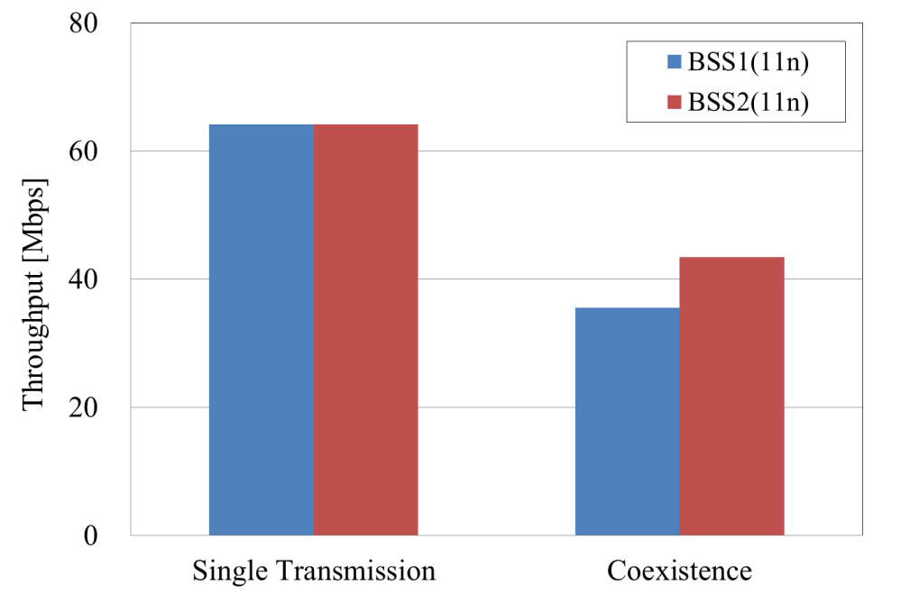
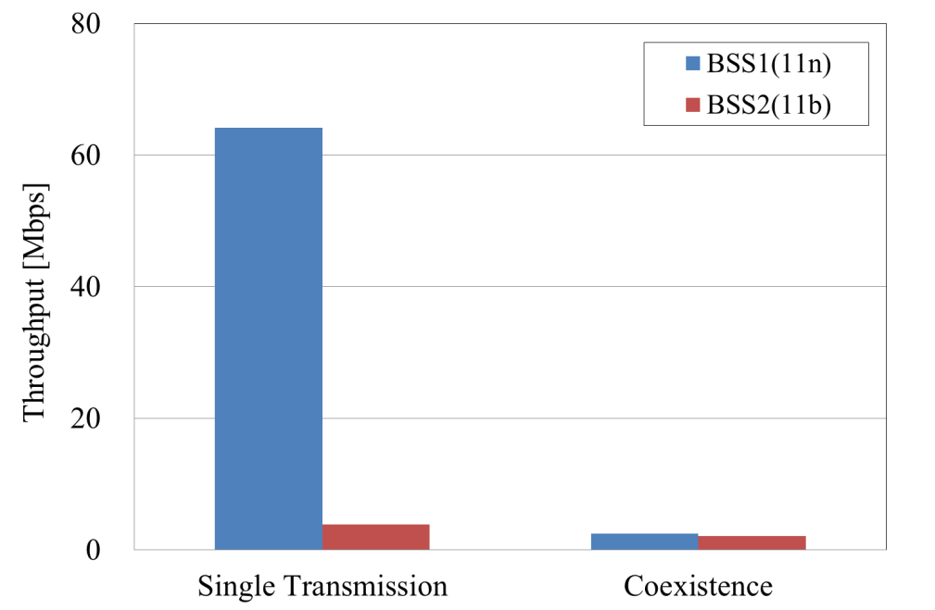
The effect of Low-Rate Transmissions:
Experimental Results [2]
Experimental results
  Throughput when BSS2 adopted 11b mode greatly decreased.
  This problem might occur in the case not only with 11b STAs but also with low-rate transmission by distant APs or STAs.
Throughput of each BSS (BSS2:11n)
Throughput of each BSS (BSS2:11b)
45% decrease
96% decrease

Slide 12
Summary and Next Steps
Our field investigation shows that there are still a lot of low-rate transmissions in current situations.
  Most of management frames are broadcasted in 1Mbps.
  More than 50% of the data frames are 802.11/11b format
In the HEW, coexistence with legacy devices should be considered in usage model.
  A number of low-rate Beacons consume much wireless channel time in dense scenarios.
  Even a single low-rate transmission is not negligible.
It should be considered to minimize the impact of a lot of low-rate management frames or low-rate transmissions.
  It should be considered not to support 11b STAs in the HEW.
  Some techniques that raise MAC Efficiency irrespective to the existence of legacy STAs is necessary.

Slide 13
Reference
[1] 11-13-0416-03-000m-cid-32-11b-is-poison.pptx

Slide 14
Appendix.A
List of Beacon size for each SSID using the experiment

Slide 15
Backup Slides

Slide 16
Issue of Low-Rate Transmission
Unfairness of the medium time by a low-rate transmission
wait
wait
wait
High-rate STAs
wait
wait
wait
Low-rate STA

Slide 17

The effect of Low-Rate Transmissions:
Experimental Results [3]
Experiment was conducted in order to measure degradation of FTP file transfer by low-rate web browsing by a mobile gaming machine
  A mobile gaming machine was deployed as the interference instead of the PC2.
  Due to limitations of feature of the gaming machine, manual web browsing was conducted instead of FTP transmission.
System configuration
FTP file (50Mbyte) transfer
AP1
BSS1 (11n) [Target]
PC1
Server
SW
6ch/20MHz Fixed
Web Browsing
The Internet
BSS2 (11b) [Interference]
Gaming
Machine
AP2
6ch
10m

Slide 18
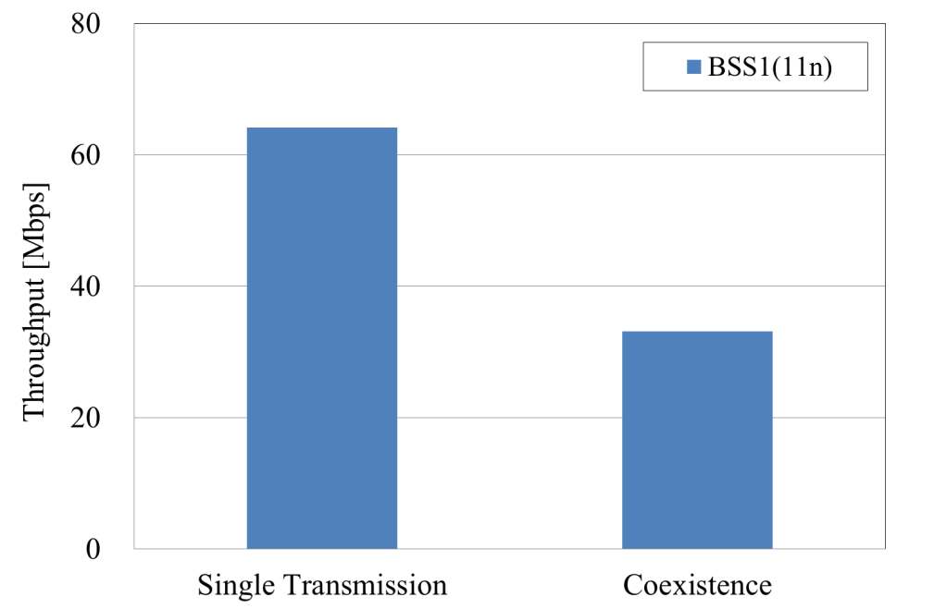
The effect of Low-Rate Transmissions:
Experimental Results [4]
Experimental result
  Throughput decreased by about 50%.
  Even a single low-rate transmission is not negligible.
Throughput of BSS1 (BSS2:11b)
48% decrease

