Slide 1
HEW Usage Scenarios Categorization
Date: 2013-07-14
Authors:

Slide 2
Abstract
In this presentation we follow on from 13/0514 and categorize usage models, down select models to cover a range of categories, and provide more detail on select usage models.

Slide 3
Usage Scenario Categorization
AP Density
Client Density
Single versus multiple management domains
Indoor/Outdoor

Slide 4
Single Management Domain

Slide 5
Applications and Requirements in Single Management Domain
Large Office Enterprise
Unified communications
Cloud-based Virtual Desktop Infrastructure: 100 Mbps, best effort.
Wireless display
desktop, projector
Tele-presence / video conferencing
VHD: ~600Mbps, jitter is <30 ms, delay is < 30ms, 1.0E-7 PLR*.
Multicast
Wireless docking and storage
Large indoor
Other
Many devices associating to an AP simultaneously (e.g. start of class, lecture, or public transportation)
Online gaming; 100 Mbps, < 20 ms jitter; < 20 ms latency
Video on Demand, 20Mbps / STA
*under review, aim to relax requirement by resiliency of upper layers
Stadium
Video
Point-of-Sight Selective Mobile Broadcasting
Event broadcast, multicast
Reception of VHD video feed highly compressed, 100 Mbps
Internet/Server Access
User upload
Internet access; 20 Mbps
ESPN (or equivalent) for supplemental content
Cellular offload
Cellular tethering / mobile hotspot
1 AP / 50-100 sq.m.; up to 100 STAs / AP
Large indoor or outdoor

Slide 6
Multiple Management Domains

Slide 7
Applications and Requirements in Multiple Management Domains
Dense Outdoor Hotspot
Video streaming, 20-100 Mbps / STA
Internet/Server Access, 10-20 Mbps / STA
Online gaming; 20 Mbps
The inter-AP distance 10~200m
User density .1-1 user/m^2
Cellular offload
D2D discovery
Real-time Video Analytics & Augmented Reality
wearable devices
Seamless hand-over between Cellular & WiFi
Dense Apartment / Residential (indoor)
Building automation and connectivity (e.g. security, utilities)
Cellular offload
Compressed video streaming, 20-100 Mbps
Uncompressed streaming, > 1 Gbps
Internet access, 20 Mbps
Online gaming
Inter-AP distance 5-30m
Other
Indoor location
Push, data download (e.g. coupons at the mall)

Slide 8
Usage Model: Dense use of wireless docking in large office enterprise
Pre-Conditions:
User has operational WLAN network for Internet access and general data networking. The wireless network used for storage and display may or may not be part of the other operational WLAN network.
Application:
User can wirelessly display the output of the computer to monitor.
User can wirelessly store data from a computer to a harddrive.
Environment:
Devices are operating in close proximity to other similar clusters in a multi-cube office. Transmissions are mostly LOS.
Traffic Conditions:
Potential interference from overlapping networks (e.g. neighbors, other WLANs). Data transfers and video display should be operational simultaneously.
Use Case:
User sits down to their desk, turns on their computer.
Computer wirelessly forms an association to an external hard drive and the display with minimal user configuration.
User works for extended hours without a visible sign that the display is using wireless technology.
User stops working, then turns off computer.

Slide 9
Further details
Docking / P2P
Wireless Display
target video rate: up to 300-600 Mbps
Latency: <30 msec (30 frames/ sec; 1 frame latency)
Connection: mobile device to display
Keyboard, mouse:
Low latency
Low throughput
Connection: K/M to mobile device
External storage & other peripherals
storage
Short bursts of peak rate (e.g. USB3): 500-600 Mbps
Connection: bi-directional between mobile device and external storage
Other peripherals
Data rate:
Latency:
Standard network access from AP
10-20 Mbps
Cubicle size
3x3 meter
Docking solution every cube

Slide 10
Usage Model: Stadium
Covered in 11-13/0657r1, slide 17

Slide 11
Usage Model: Dense Outdoor Hotspot
Covered in 11-13/0657r1, slides 37-40

Slide 12
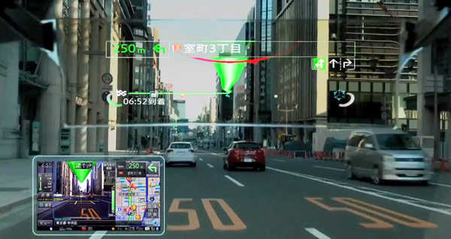
Further details on Real-time Video Analytics & Augmented Reality
Upload of image/video
Image
uplink
descriptor data rate: 100kbps
Latency not an issue
Video
Video on uplink
Round trip delay (for getting information back): 10’s msec
data rate: ?
Textual/vector information on downlink
Density of devices, many people using on their smart phone in close proximity

Slide 13
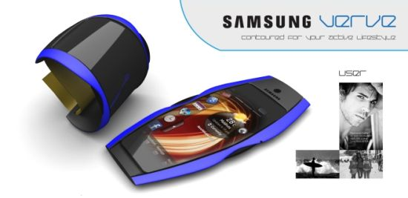
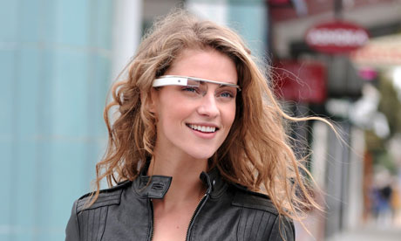
Further details on wearable devices
Propagation environment
Body area network
Multimedia requirements
640x480 : 1-2 Mbps
PLR: 10^-5 or 10^-6*
Quality: MOS
Latency: 10’s of msec
Uplink
Severe limitations on power consumption, size, antennas and EIRP
Connectivity: either to an AP or companion device
Density of devices: many people wearing in close proximity

Slide 14
Usage Model: Dense Apartment / Residential
Covered in 11-13/0657r1, slides 33-34

Slide 15
References
https://mentor.ieee.org/802.11/dcn/13/11-13-0657-01-0hew-hew-sg-usage-models-and-requirements-liaison-with-wfa.ppt
https://mentor.ieee.org/802.11/dcn/13/11-13-0514-00-0hew-usage-scenarios-and-applications.pptx
https://mentor.ieee.org/802.11/dcn/07/11-07-2988-04-0000-liaison-from-wi-fi-alliance-to-802-11-regarding-wfa-vht-study-group-consolidation-of-usage-models.ppt

