Slide 1
Mobile Slotted Aloha
Date: 2013-07-16
Authors:

Slide 2
Abstract
MS-Aloha is a synchronous, decentralized and connection oriented MAC.
Proposed in ETSI (TR 102 861, TR 102 862) as a possible solution against the poor performance of congested VANETs.
It has been proved to be deterministic, scalable and non blocking and to prevent hidden terminals.
Transparent back-compatibility to CSMA/CA is being studied.
MS-Aloha is here presented to investigate possible future applications in IEEE 802.11 and other IEEE 802 groups.
Based on RR-Aloha; Patented (Europe)[EP2256993]

Slide 3
Outline
Motivations and rationale
MS-Aloha mechanisms
MS-Aloha results
  Comparative analysis to CSMA/CA
  A deeper insight into MS-Aloha results
    Spatial multiplexing
Open issues
Points of strength and potential applications
References

Slide 4
Motivations and Rationale
Two main weaknesses in IEEE 802.11 for VANETs
  Poor performance with growing traffic load
    Decentralized Congestion Control (DCC): being revised by ETSI
  Hidden-terminal prone
Could they both be solved by a connection-oriented, synchronous and decentralized approach?
  Proposed in ETSI STF395 (TR 102 861, TR 102 862)
  Unlike other connection-oriented approaches, transmissions are coordinated over multiple hops (not only by sensing)
    Better interference, no hidden terminals
  Open issues: slot re-use, reactivity, backward-compatibility
MS-Aloha could suite also….
  Wireless automation (over 802.11?), mesh slotted WMAN (802.16), …

Slide 5
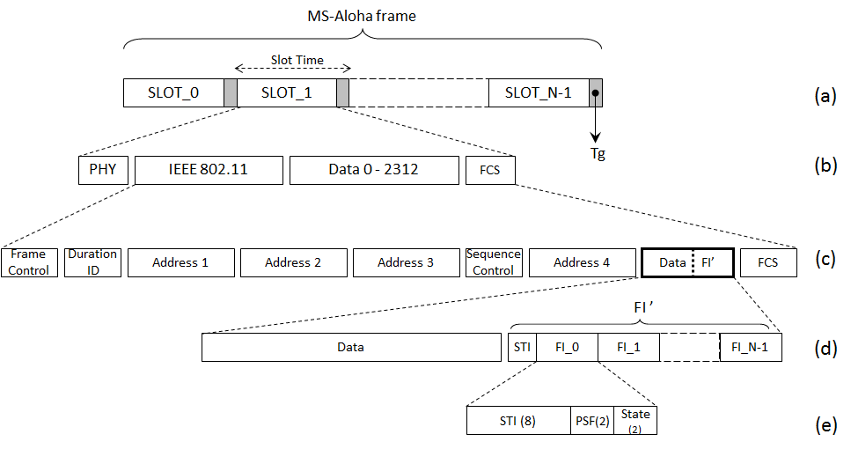
Mechanisms: framing
Backward compatible to 802.11
  Signaling information can be nested in the data
  Guard-time counteracts time of flight and clock hold-on (details follow)
    Examples: period 100ms, Tg≈100µs, Payload 200B (+UDP/IP)
    → 125 slots @6Mb/s
    → 200 slots @12Mb/s

Slide 6
Mechanisms: signaling
Each node appends to its transmissions its
view of all the slots (FI)
  Against hidden stations; to enable collision detection
  Potentially dangerous overhead
    Prevented by using temporary short identifier (next slide)
Contention Phase (slot reservation) – it takes 1 period
  Nodes start competing for slot assignment listening to
    N Frame Information coming from its neighbors
  The node transmits a data packet into an idle slot (together with its FI)
  It checks if the transmission is acknowledged by all the other nodes (FI)
    In the period slot(K)-slot(K+N) the channel is monitored
When slot(K) begins, the node transmits its packet if the reservation still holds
  Continuous monitoring to face mobility or topology changes
  All the information about slot K gets refreshed at slot K → timely reactivity
Slot state
Priority of reservation
(preemption)
Identifier of the node using the slot

Slide 7
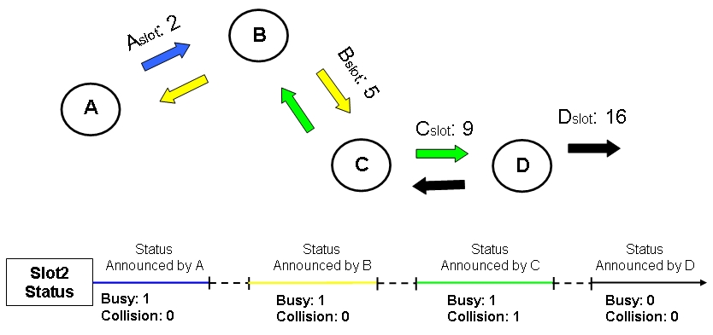
Mechanisms: slot-reuse
The channel-state is described by two bits in the Frame Information.
  Previously (RR-Aloha+), only 3 states used
    free ‘00’, busy ‘10’, collision ‘01’
  The non-used configuration (‘11’) is exploited to keep trace of number of hops the information is forwarded over
When some information on slot reservation is not directly detected, it is announced as 2-hop (’11’)
  Nodes which receive it know that they should not use the slot but should not forward this information either
This solution:
  Decreases the logical radius of propagation of
  a slot reservation
    It is not indefinitely forwarded
  Improves the resource re-use keeping however
  3 hops free
Busy
Busy
2-Hop
Free

Slide 8
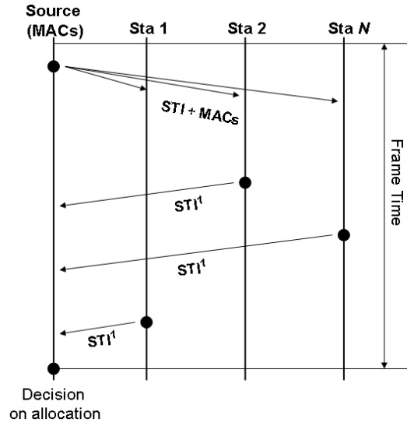
Short Identifiers for scalability
8-bit (or less) labels STI to identify each node inside the reachable area
  STI are used to identify what node is using each reserved node
  STI are used instead of MAC addresses to avoid excessive overheads in the FIs
  In crowded areas the label space may be a very strong limit
However the same label can be re-used in different slots
  The purpose of STI is collision detection - different nodes using the same slot
  Label+Slot → Node Identification
  Still not-negligible probability that 2 nodes chose the same slot and the same STI
Scalability solved by a “temporary meaning” of STI
  STI changed by the nodes directly receiving from node A into STI’
  They know also A’s MAC and can compute the new STI’
    The nodes which do not receive from A just know STI’. The other know that STI and STI’ represent the same node A
  At next period the STI’ is changed by A into STI’’ and so on.
    Collision are, soon or later, detected

Slide 9
Mechanisms: non-blocking re-use
Slot re-use can be further improved setting a higher threshold on minimum reception power
  If the received power is lower than a given “threshold” the message is received but its signaling discarded
    It conceptually corresponds to lowering the radius of cluster of nodes which perceive a slot x assigned to a node A
  Acting on the transmitted power would affect the SNR
Further improvement by introducing a mechanism which regulates the “threshold” dynamically
  Defined by each node based on the free slots
  The reception gets worsened by slot reuse only at
  longer distances (always 100% if close proximity)
This mechanism is optional. One can also…
  … either completely disable it and accept channel blocking
  … or set a maximum threshold, to upper-bound reuse

Slide 10
Mechanisms: preemption and coexistence
Forced Coexistence.
  This is a trivial coexistence: some stations run the synchronous protocol, other ones CSMA/CA (they can sense MS-Aloha)
  Asynchronous transmissions are however a threat for (MS-Aloha’s) reservations
Time-Based Coexistence.
  A time-based periodic structure (of period t) can be defined separating MS-Aloha and CSMA/CA transmissions
Transparent Coexistence.
  This coexistence, currently, applies only to synchronous MAC with pre-emption (priority of slot reservation, as supported by MS-Aloha)
  For example, if a station X has to transmit in slot J, then it has to check the slots preceding J. If they are not all engaged, then X reserves with low-priority connections (and with fake traffic) the free ones.
    The other MS-Aloha stations are not affected – they can still preempt transmissions - while CSMA/CA, due to carrier sensing, will not transmit traffic potentially affecting MS-Aloha reservations.

Slide 11
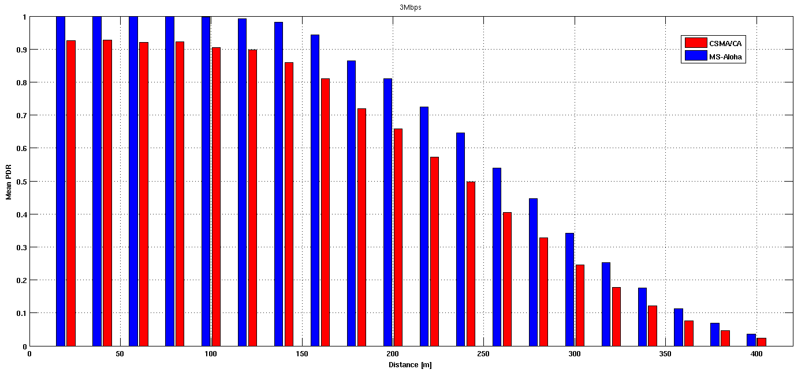
Results: line of sight (LoS)
Even when non-heavily congested, over 10% PDR gain
  What is more: ideal (MS-Aloha) vs lossy (CSMA/CA)
    600 nodes (2Km radius), opposite lanes (120km/h avg), 3Mb/s rate, 20dBm, 300B frames (@10Hz)
  Even worse with heavier load (not yet simulated with 20dBm transm. power)
    Over 15% already demonstrated (see refs at the end)
    This is not the main point…

Slide 12
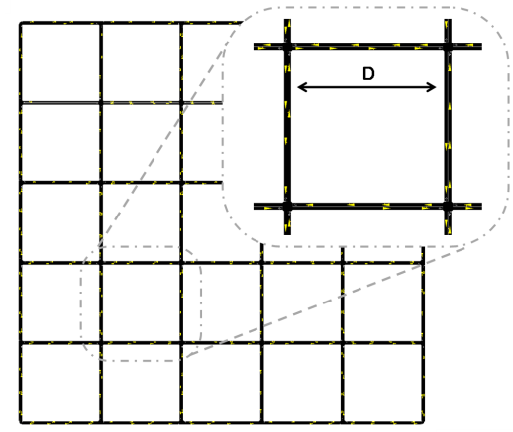
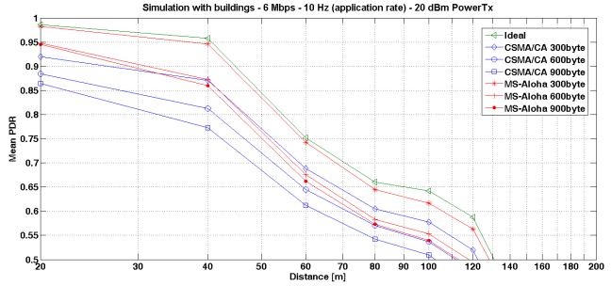
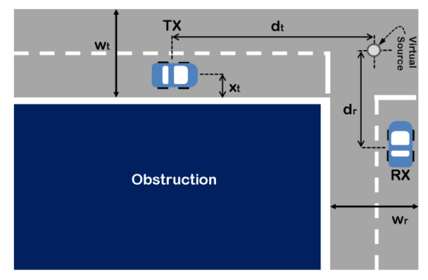
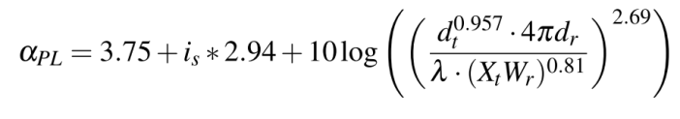
Results: non-LoS
Including model for turning corner with obstructions
  Far from congestion due to the obstructions
  Several simulations. Below mean PDR for…
    750 nodes, Manhattan grid (6x6 150m-wide grid) – 40 km/h, 6Mb/s rate, 20dBm
    300-900B frames (@10Hz)

Slide 13
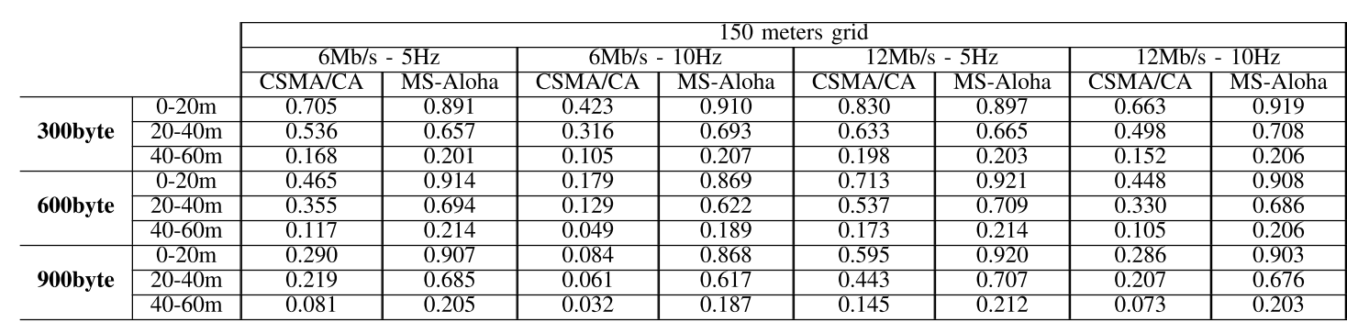
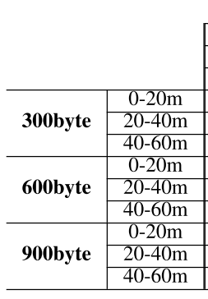
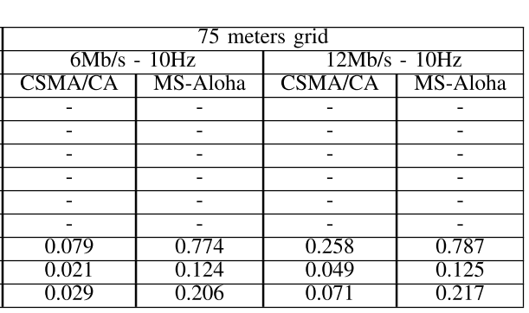
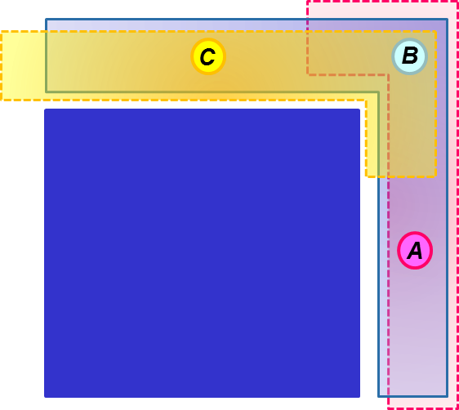
Results: non-LoS… in the centers of the crossroads

Slide 14
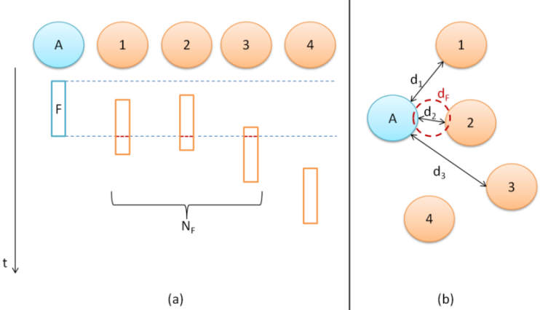
Interpretation
Multi-hop coordination
Maximization of distance for simultaneous transmissions
  Evaluation of minimum distance for simultaneous transmissions
  Different for MS-Aloha and CSMA/CA
    MS-Aloha: min_i(t) is the minimum distance for the reuse of the same slot, (depending on time t)
      1) Average and 2) Minimum over the number of slots i and then over the sampling period
    CSMA/CA: simultaneous transmissions computed for each new frame on air as is the picture: minima min_j are computed for each frame j
      1) Average and 2) Minimum over the number of slots i and then over a sampling period (2s)

Slide 15
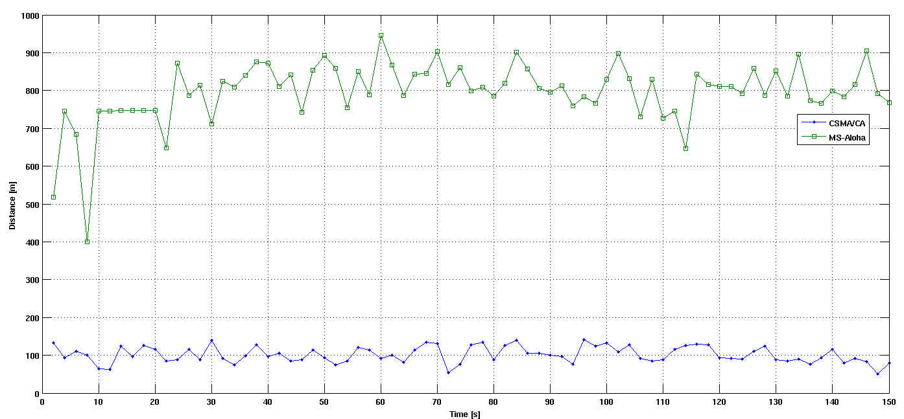
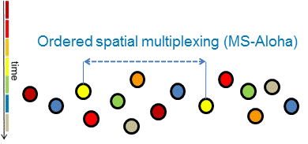
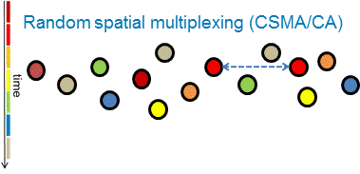
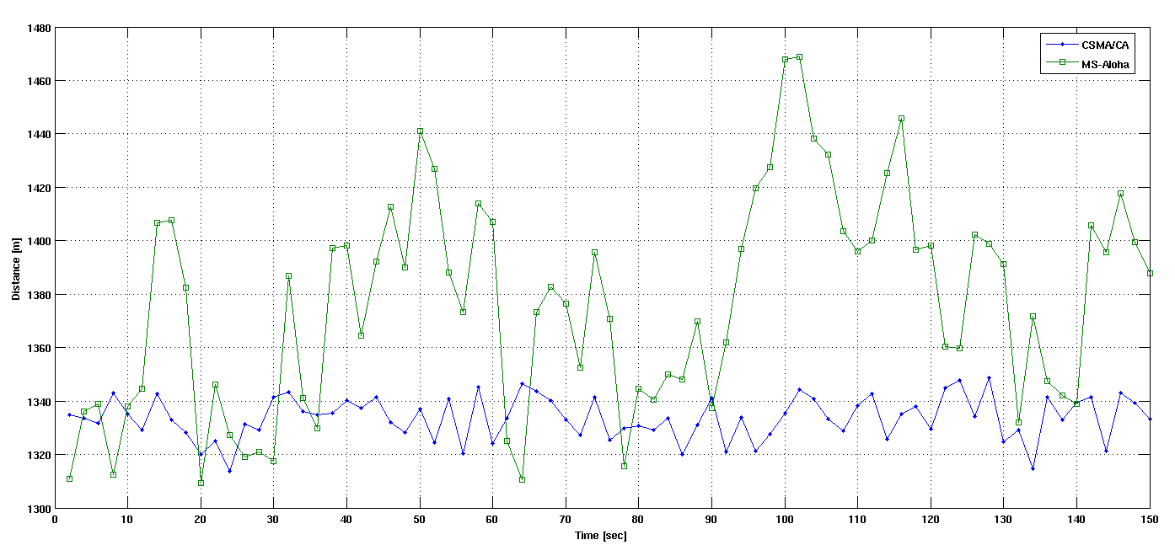
Interpretation (LoS)
Minimum of minima
Avg of minima

Slide 16
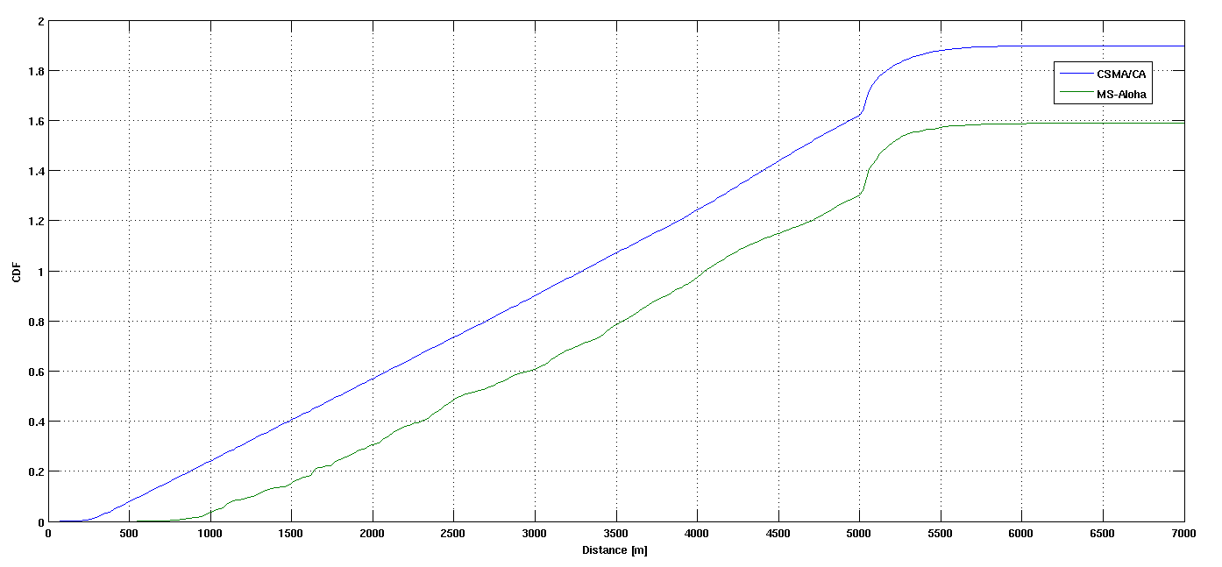
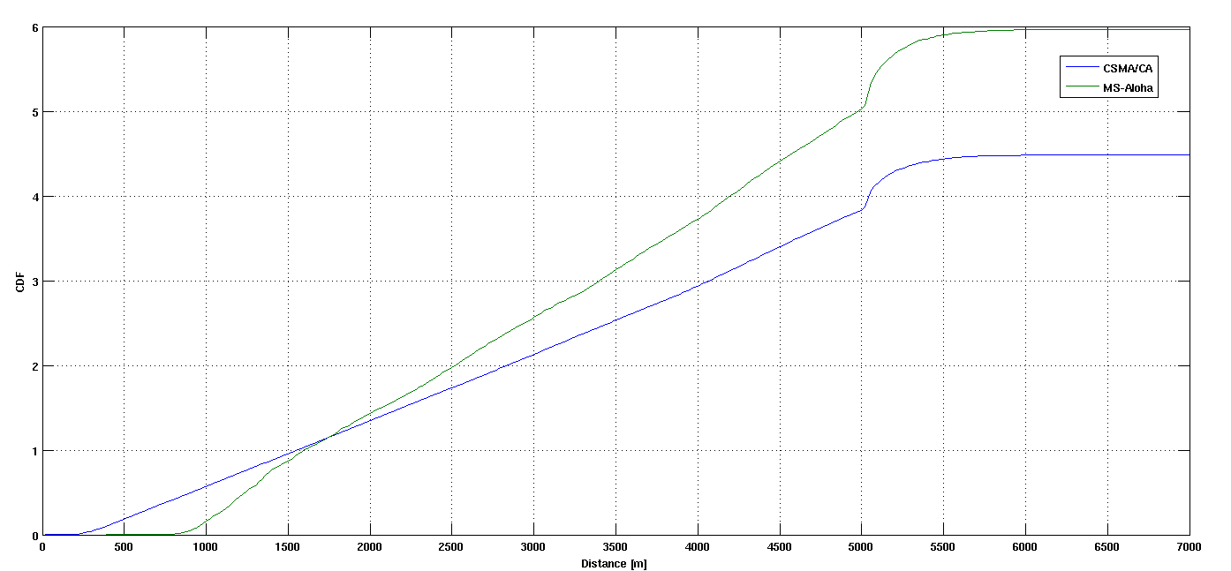
Interpretation (LoS)
Graphs:
Cumulative average number of simultaneous transmitters at a distance lower than x
400 nodes, 6 Mb/s
600 nodes, 3 Mb/s
In all the cases simulated MS-Aloha deterministically segregates interference beyond 800m

Slide 17
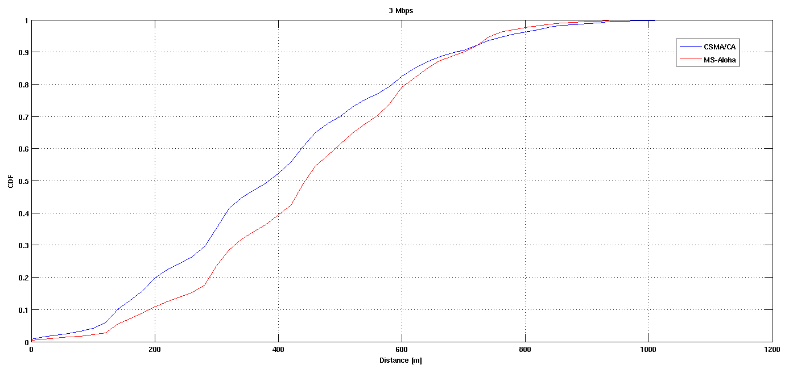
Interpretation (Non-LoS)
Graph:
400 nodes, 3 Mb/s
6x6 750m-wide, obstructed Manhattan grid

Slide 18
Other features
Reactiveness
  The protocol is very fast since its initial phase: it lasts just one period for multi-hop sensing
  After one period the node is connected
  MS-Aloha reacts to any topology changes in one period-time
    Despite this, very stable, thanks to multi-hop information
  If not required, one could relax the refresh and get a lower protocol overhead
    By the way, simulations have demonstrated that the overhead is not an issue - MS-Aloha recovers thanks to a better spatial multiplexing
Acknowledgments
  A powerful resource of MS-Aloha consists in the continuous update of the channel state by all the nodes.
  This provides also a tacit acknowledgment to all transmissions – both unicast and broadcast.

Slide 19
Open issues
Synchronization
  What are the limitations by GNSS (GPS-Galileo)
    What reasonable Tg?
      What precision under mobility?
      What hold-on (missing GNSS signal) with frequency-steering?
  What other sources for precise synchronization?
    GPS repeater (indoor), IEEE 1588 over 802.11 (refs), IEEE 1588 over 802.11af or 802.22 (white spaces), others…
  Is it possible to monitor clock quality?
    Fall-back to CSMA/CA?
Coexistence/Fall-back?
  Extensive simulations needed
Best setting of parameters?
  What possible applications? What settings for each target application?
    Non continuous transmissions of FIs…
  Best setting for multi transfer-rate
    Slot as a transmission opportunity to transmit at a basic or higher transfer rate

Slide 20
Potential applications
Vehicular communications (IEEE 802.11)
  Maybe VANETs 2.0?
    Backward compatibility and coexistence should be proved
    Robust synchronization (GNSS +…)
  Vulnerable roadusers?
    Interesting scalability – maybe in different bandwidth
Wireless automation (IEEE 802.11)
  Deterministic performance, hidden-terminal free
  Interesting coexistence
Additional MAC for Deterministic and Decentralized WiFi
  “DD-WiFi” as additional HCCA MAC
Enforcement of synchronous solutions
  802.15.3, Wireless USB, …

Slide 21
References
MS-Aloha
Scopigno, R., and H. A. Cozzetti, "Mobile Slotted Aloha for Vanets", 70th IEEE Vehicular Technology Conference Fall (VTC 2009-Fall), 09/2009.
Scopigno, R., and H. A. Cozzetti, "Evaluation of Time-Space Efficiency in CSMA/CA and Slotted Vanets", 72nd IEEE Vehicular Technology Conference Fall (VTC 2010-Fall), pp. 1 -5, 09/2010.
Cozzetti, H. A., and R. Scopigno, "Scalability and QoS in MS-Aloha VANETs: Forced slot re-use versus pre-emption", 14th International IEEE Conference on Intelligent Transportation Systems (ITSC), Washington, DC (USA), pp. 1759 - 1766, 10/2011.
Campolo, C., H. A. Cozzetti, A. Molinaro, and R. Scopigno, "Impact of urban radio obstructions on the effectiveness of moving WAVE providers", 7th International Wireless Communications and Mobile Computing Conference (IWCMC), pp. 1506 - 1512, 07/2011.
Cozzetti, H. A., D. Brevi, R. Scopigno, P. Ferrari, E. Sisinni, and A. Flammini, "MS-Aloha: Preliminary Analysis of Its Suitability for Wireless Automation", 17th IEEE International Conference on Emerging Technologies and Factory Automation, Cracow, Poland, 09/2012.
ETSI TR 102 861: Intelligent Transport Systems (ITS); On the Recommended Parameter Settings for Using STDMA for Cooperative ITS; Access Layer Part
ETSI TR 102 862: Intelligent Transport Systems (ITS); Performance Evaluation of Self-Organizing TDMA as Medium Access Control Method Applied to ITS; Access Layer Part
Synchronization
Kannisto, J.; Vanhatupa, T.; Hannikainen, M.; Hamalainen, T.D., "Software and hardware prototypes of the IEEE 1588 precision time protocol on wireless LAN," Local and Metropolitan Area Networks, 2005. LANMAN 2005. The 14th IEEE Workshop on , vol., no., pp.6 pp.,6, 18-18 Sept. 2005
J. Kannisto, T. Vanhatupa, M. Hännikäinen, T.D. Hämäläinen, “Precision Time Protocol Prototype on Wireless LAN,” Telecomm. and Networking - ICT 2004 Lecture Notes in Computer Science Volume 3124, 2004, pp 1236-1245, Springer Berlin Heidelberg
Cooklev, T.; Eidson, J.C.; Pakdaman, A., "An Implementation of IEEE 1588 Over IEEE 802.11b for Synchronization of Wireless Local Area Network Nodes," Instrumentation and Measurement, IEEE Transactions on , vol.56, no.5, pp.1632,1639, Oct. 2007

