Slide 1
Follow-up Discussions on HEW
Functional Requirements
Date: 2013-7-15
Authors:

Slide 2
Discussion Points
To recap on the consensus observed from the technical discussions in Waikoloa
2) To focus on the key issues that were raised during the Waikoloa meeting and conference calls
Slide 2
Wu Tianyu
Notes:
doc.: IEEE 802.11-08/1101r3
September 2008
John R. Barr, Motorola, Inc.
Page 2

Slide 3
Items for further discussion
Spectrum efficiency
Area throughput
3) Real world performance: QoE
Slide 3
Wu Tianyu
Notes:
doc.: IEEE 802.11-08/1101r3
September 2008
John R. Barr, Motorola, Inc.
Page 3

Slide 4
Spectrum Efficiency (1)
Improve the spectrum efficiency
Consensus
  Achieve spectrum efficiency comparable to current state-of-art
Discussions
  Should HEW offers an mode that provides higher bits/Hz than currently achieved with 11ac?
    The theoretical spectrum efficiency is 43.3bps/Hz for 11ac which is very high.
    Further improvement of spectrum efficiency rely on problematic PHY tech such as
      Massive MIMO: 12/16 spatial streams?
      Higher MCS: 1024QAM?
    It is possible to further improve the spectrum efficiency, but should it be considered the first priority requirement for HEW?
Slide 4
Wu Tianyu
Notes:
doc.: IEEE 802.11-08/1101r3
September 2008
John R. Barr, Motorola, Inc.
Page 4

Slide 5
Spectrum Efficiency (2)
  Should we consider other metrics to replace spectrum efficiency in function requirements of HEW? For example:
    MAC efficiency
      Work out a minimum MAC efficiency requirement for HEW
      The requirement might be different under different scenarios. For example, the requirement can be a function of AP density and STA density.
    Throughput of AP
      Based on the usage models[1,2] we can easily calculate the HEW requirements on the throughput of AP.
        For example, in wireless office scenario, the requirement on AP throughput is about 10Gbps
Slide 5
Wu Tianyu
Notes:
doc.: IEEE 802.11-08/1101r3
September 2008
John R. Barr, Motorola, Inc.
Page 5

Slide 6
Area Throughput (1)
Increase the area throughput
  We have some discussions on the unit of area throughput in Waikoloa.
  The most acceptable definition of “area throughput” is bits/second/m².
Area throughput is a good performance metric for high density deployment scenarios.
  We need to define what is dense deployed scenario.
    In [1], the HEW usage model document has a tentative footnote that states:
      * More than 30 (TBD) STAs per AP should be considered as high density
      * More than 500 (TBD) APs/km² should be considered as high density
    Another way to get the STA and AP density is directly calculate from the environment definitions in the usage models.
Slide 6
Wu Tianyu
Notes:
doc.: IEEE 802.11-08/1101r3
September 2008
John R. Barr, Motorola, Inc.
Page 6

Slide 7
Area Throughput (2)
  High density scenarios:
  1a-Stadium: High density of users (0.5users/m²), inter-AP distance between 12 and 20 meters.
  1b-Airport/trains: Each AP serves 120 users in a 200m² area (0.6 users/m²). The inter-AP distance is in the range of 15~20m. Single/multiple operators.
  1c- Exhibition halls: Each AP serves 100 users in a 100m² (1 user/ m²) area. The inter-AP distance is in the range of 5~10m.
  1d- Shopping malls: High density of users and high density of APs (undefined # user/m²)
  1e-Education: Dense STAs (40~60 STAs) in one classroom with one AP. Class room size is ~ 300 m² (0.2 user/ m²).
Slide 7
Wu Tianyu
Notes:
doc.: IEEE 802.11-08/1101r3
September 2008
John R. Barr, Motorola, Inc.
Page 7

Slide 8
Area Throughput (3)
  High density scenarios:
  2a-Wireless office: Typical distances between STAs and AP in the room are < 50m. 20-30 STAs per AP . Max. user/ m² =30/(3.14*50^2)= 0.04
  3a-Dense apartment building: Building with 100 apartments. One AP in each apartment of 10mx10m randomly positioned. 5 STA per AP randomly positioned in the apartment. Max user/ m² = 0.01
Slide 8
Notes:
doc.: IEEE 802.11-08/1101r3
September 2008
John R. Barr, Motorola, Inc.
Page 8

Slide 9
Area Throughput (4)
  Based on the above scenarios, a high density STA deployment consists of:
  Inter AP distance = 20 m
  Coverage of AP = 400 m²,
  Target area = 100mx40m = 4,000 m²
  Total no. of APs = 10
  Total No. of STAs = 1,000
  No. STAs/AP = 100
  Proposal:
    The number of STAs / AP is 100 for HIGH DENSITY STA deployment
    The number of APs/ 100 m² is 0.25 for HIGH DENSITY AP deployment
Slide 9
Notes:
doc.: IEEE 802.11-08/1101r3
September 2008
John R. Barr, Motorola, Inc.
Page 9

Slide 10
  Real World Performance: QoE (1)
What is QoE
  Quality of experience(QoE) is a subjective measure of a customer's experiences with a service (web browsing, phone call, Video conference, etc).
Measurement of QoE
  Typically, QoE is assessed by Mean Opinion Score(MOS). To calculate MOS, a large number of customer’s opinion score need to be collected. → MOS is not a practical metric for HEW to assess the QoE.
  An alternative way to assess QoE is using a set of parameters that map to MOS.
    Delay, Jitter, Packet loss etc.
    Jitter can be converted to delay by Jitter buffer . → Delay and Packet loss are the key metrics
Slide 10
Wu Tianyu
Notes:
doc.: IEEE 802.11-08/1101r3
September 2008
John R. Barr, Motorola, Inc.
Page 10

Slide 11
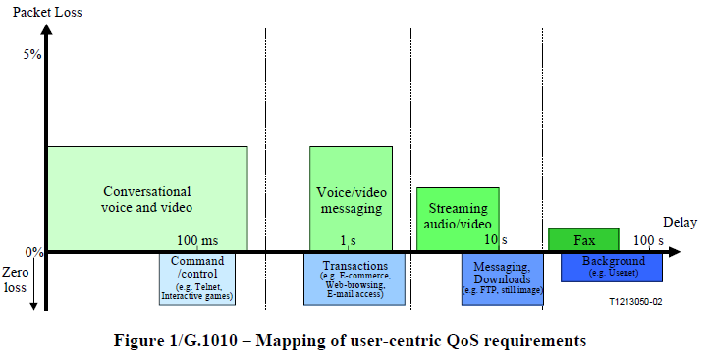
  Real World Performance: QoE (2)
Delay requirements for different applications [3]
Slide 11
Wu Tianyu
Notes:
doc.: IEEE 802.11-08/1101r3
September 2008
John R. Barr, Motorola, Inc.
Page 11

Slide 12
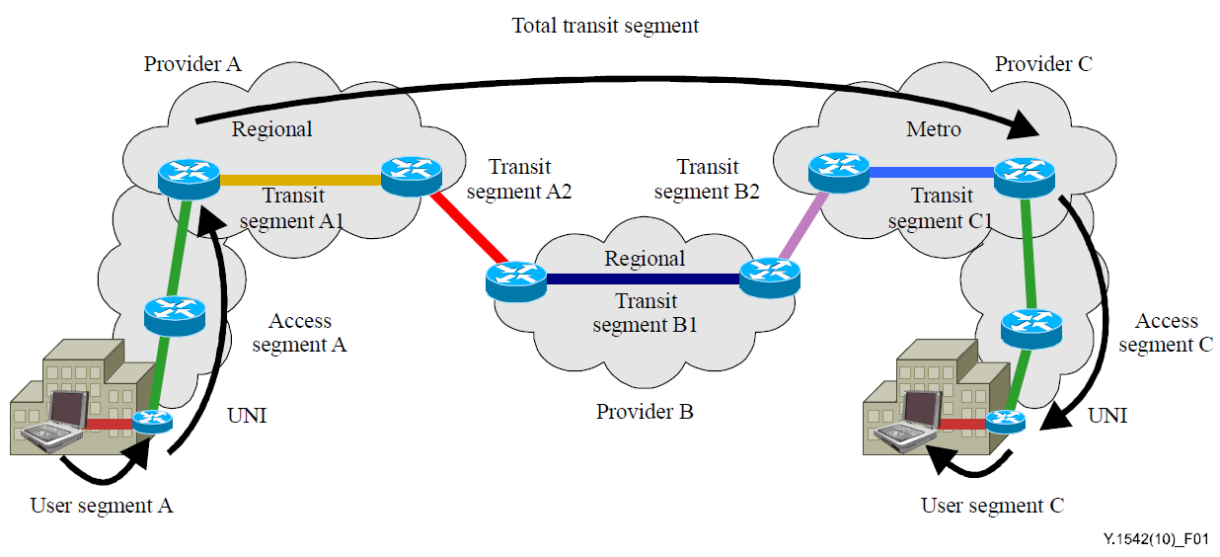
  Real World Performance: QoE (3)
End to end delay of the communication system [4]
  End to end delay includes delay of HEW and delay of other transmit segments.
  We need an delay estimation of other transmit segments to get the delay requirements for HEW system. Example:
    The average delay of WAN in US is around 100ms
    For conversational
    voice and video,
    end to end delay
    requirement is ~
    150-200ms
    Delay requirement
    for HEW is ~ 25-50ms
Slide 12
Wu Tianyu
Notes:
doc.: IEEE 802.11-08/1101r3
September 2008
John R. Barr, Motorola, Inc.
Page 12

Slide 13
References
July 2013
[1] 11-13-0657-02-0hew-hew-sg-usage-models-and-requirements-liaison-with-wfa
[2] 11-13-0313-00-0wng-usage-models-for-next-generation-wi-fi
[3] ITU-T Rec.G.1010(11/2001) End user multimedia QoS categories
[4] ITU-T Rec.Y.1542(06/2010) Framework for achieving end-to-end IP performance objectives
Slide 13
Slide 13
Wu Tianyu
Notes:
doc.: IEEE 802.11-08/1021r0
July 2008
Peter Loc
Page 13
doc.: IEEE 802.11-08/1101r3
September 2008
John R. Barr, Motorola, Inc.
Page 13

