Slide 1
TD-uCSMA
Date: 2013-07-17
Authors:

Slide 2
Abstract
TD-uCSMA aims to provide CSMA/CA with a QoS-capable MAC able to support reservations
TD-uCSMA puts together CSMA and TDMA in a novel way, taking the best of both (reservation and statistical re-use). It is backward compatible to EDCA and has already been implemented over Atheros chipsets
Patented (Europe)[EP2282599]

Slide 3
Outline
Motivations and Rationale
TD-uCSMA Mechanisms
TD-uCSMA Results
Simulation results
Feasibility: Implementation
Open issues
References

Slide 4
Motivations
High-efficiency WLAN (HEW) addresses “(…) the improvement of WLAN efficiency with dense networks”
“Covering (…) segments such as: (…) service providers, (…) TV/Video”
How can it be interpreted?
Parameterised and guaranteed QoS
Limited number of collisions for increased efficiency
Today only the (formerly) IEEE 802.11e std. is available
It introduces the Hybrid Coordination Function (HCF) that deﬁnes two channel access mechanisms
Enchanced Distributed Channel Access (EDCA) for differentiated QoS
HCF Controlled Channel Access (HCCA) for parametrized QoS
HCCA could be the answer, however
Centralized
It has not met a great practical success

Slide 5
Rationale
The solution should be built on the top of EDCA
EDCA is really available
The solution should be decentralized
Many network scenarios are ad-hoc
Mesh Access Networks
Home networking
The solution should take the best of EDCA and TDMA
Deterministic channel access
Automatic re-usage
The solution should work in both the following cases
A-priori configuration
Dynamical signalling

Slide 6
Time-Division Unbalanced CSMA TD-uCSMA
Channel access is CSMA/CA based
TD-uCSMA node
Maintains 2 (or more) sets of EDCA parameters:
High-priority set EDCA^{H}.
low-priority set EDCA^{l}.
Handles traffic as a single aggregate.
Changes the set of EDCA parameters over time (TD).
The EDCA parameters are “unbalanced” such that ..
Node i contending for channel access in accordance to EDCA_{H} has strict priority over node j using EDCA_{l}. For example:
AIFS^{H}=2, CW_{min}^{H}=CW_{max}^{H}=1
AIFS^{l}=7, CW_{min}^{l} =31, Cw_{max}^{l} =1023
TXOP NOT USED!!!

Slide 7
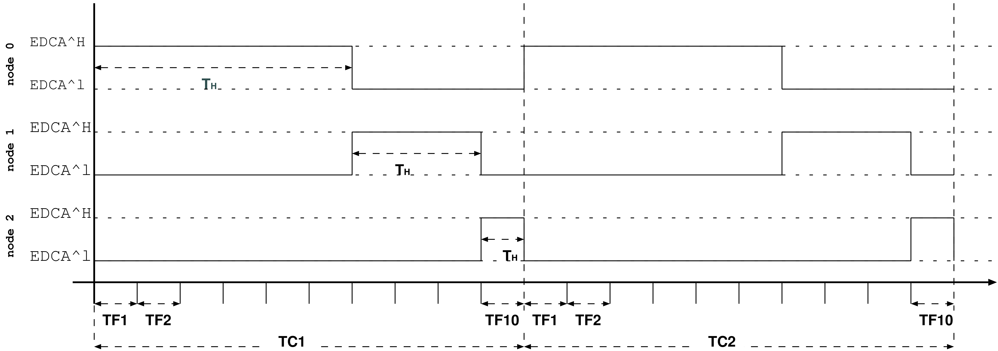
TDuCSMA mechanisms in action
The underlying idea:
Time-driving the contextual switch of EDCA parameters inside nodes.
One node contends for channel access in accordance to EDCA^{H} at a time.
All nodes maintain EDCA^{H} for a predefined periodical time interval.

Slide 8
Effects of TDuCSMA mechanisms
Each node i tends to gain access to the channel and to maintain it for the full period T_{i}^{H} (~TDMA)
NOTE !! Because of EDCA parameters in EDCAH and not due to a stiff predefined TDM channel access right
Competing nodes get policed
Resource re-use takes place (~CSMA)
If one node reserves a period and do not use it other nodes will use it
WiFi efficiency gets improved
CW inside EDCA^{H} can be minimized to reduce back-off time between two consecutive transmissions without affecting collision probability
Minor loss of time
If one node i uses its T_{i}^{H} with poor efficiency (short packetsI, it does not affect other nodes
Synchronization is not critical
Slow switching of priorities (slots lasting multiple frame-lenghts)
CSMA still works underneath

Slide 9
Reservation model (i)
NON-Traffic-Aware: the service provider assigns a certain percentage of the bandwith to a node/user
Each node decides how to use it
This leverages the independence of TD-uCSMA overall traffic on individual behaviors

Slide 10
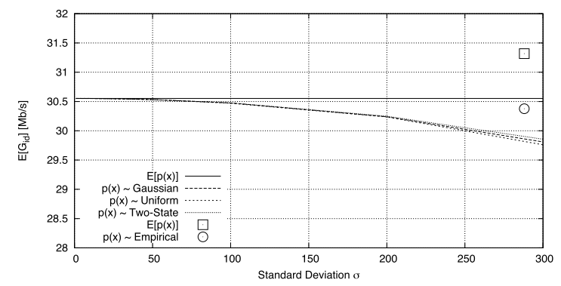
Reservation model – Traffic-aware (ii)
STEP1: Compute the ideal available bandwidth G_{id} as if all the transmissions followed his profile
The computation depends on the transfer rate, frame length, RTS/CTS, broadcast/unicast
Here the case with unicast and constant frame length
Here the case with variable frame length, according to a distribution p(x), with the mean value of transmission time for the payload <t_{payload}>=T
The mean is sufficient
The approximation works thanks to the hyperbolic nature of the function
Not heavy dependence on the standard deviation or on the nature of distribution either
≈

Slide 11
Reservation model – Traffic-Aware (iii)
STEP 2. Get the available banwidth G_{A} by lowering G_{id} of 2-5%
To account for switching losses
STEP 3. Compute the bandwidth needed G_{i} in the same way, considering the packet generation rate
Known for example in voice
With video one knows the bit-rate and the average length
STEP 4. Compute the needed number n_{i} of high-priority slots T_{i}^{H}
k is the number of priority frames in a TDuCSMA cycle
T_{c} is the duration of a cycle
T_{f} is the duration of a frame

Slide 12
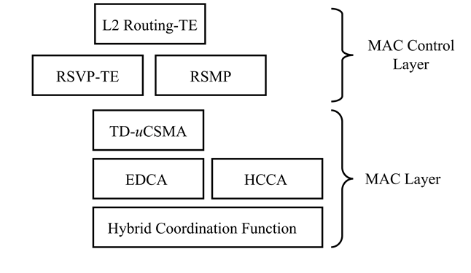
Configuration
Static planning
Remote configuration of each node
Element/Network Management
Dynamical: two signalings
RSMP: Reservation State Management Protocol
Novel, defined to forward each node’s reservation information (what priority slots are available)
RSVP-TE*
Extension to RSVP-TE to support e2e reservation
Usefull to integrate TD-uCSMA as a last-hop MPLS reservation

Slide 13
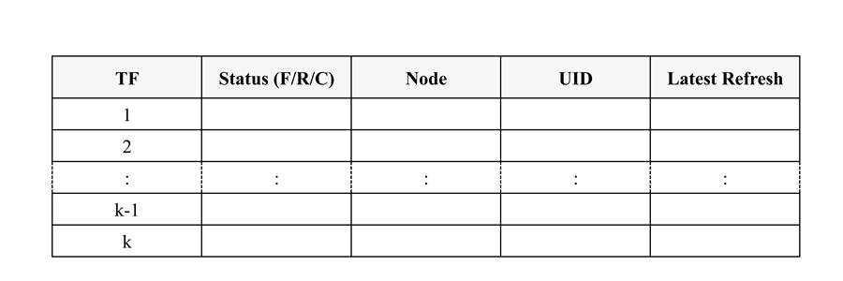
Optional Signaling
RSMP
It is meant to propagate the information about the reservations
Loops are prevented by timeouts and soft-reservations by RSVP-TE
RSVP-TE*
The topology and the reservation (RSMP) are known
One can reserve with a source-reservation
Explicit routing object (ERO)

Slide 14
Simple Scenarios
Data rate = 54 Mb/s
Basic rate = 1 Mb/s
SIFS = 16μs
SlotTime = 9μs
T²_{H}/TC= 1/10
Long-lasting CBR data flows
T¹_{H}/TC= 3/10
T⁰_{H}/TC= 6/10
In TD-uCSMA Simulations
AIFS_{i} = SIFS + slotTime · AIFSN_{i} ∀i=H,l
AIFSN_{H} = 2 and AIFSN_{l} = 7
CW^{H}_{min} = CW^{H}_{max} = 1
CW^{l}_{min} = 31 CW^{l}_{max} = 1023.
In CSMA/CA Simulations
DIFS = AIFS_{H} = SIFS + 2 · slotTime
CW_{min} = 31 and CW_{max} = 1023.

Slide 15
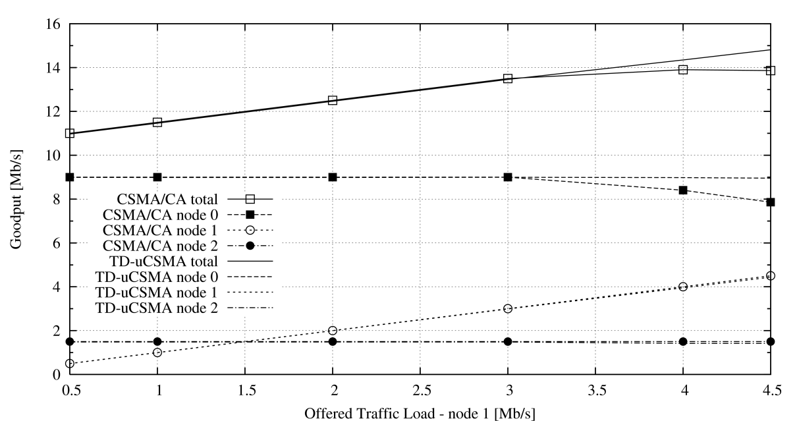
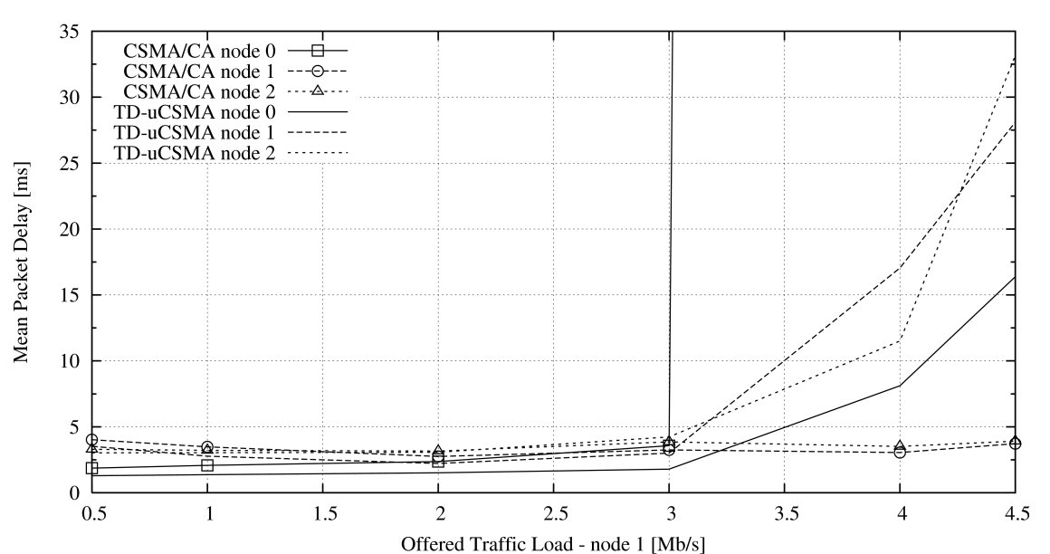
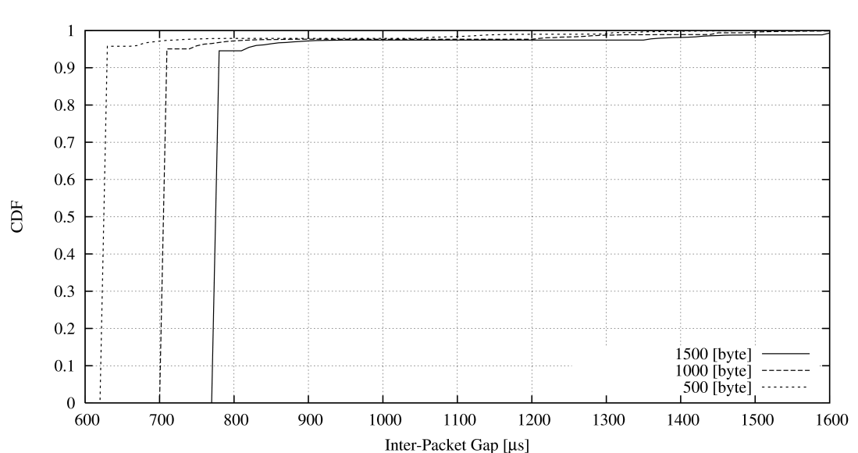
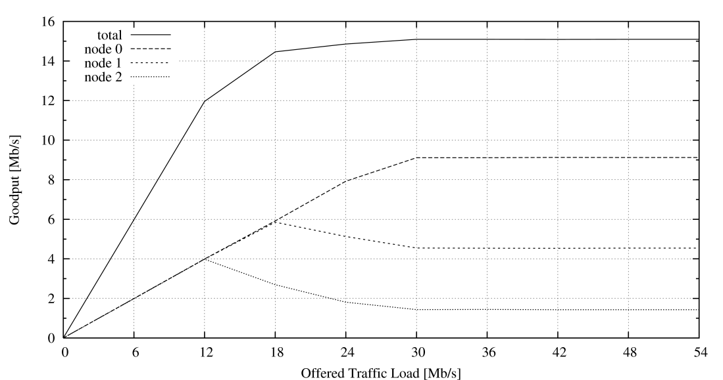
Policying, Bandwidth Division: Better efficiency approaching saturation + Traffic Management
Under saturation condition:
Less than 5% packet have bad effects due to borter effect of time switching

Slide 16
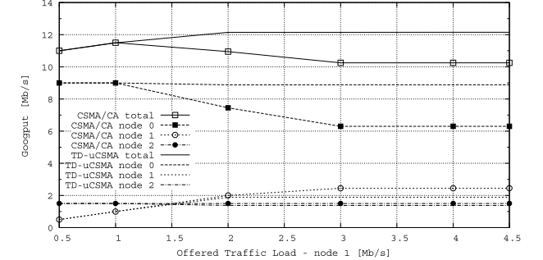
Effect of packet sizes: TD-uCSMA vs CSMA/CA
Saturation starts here: payload effect before
Node 0 and node 2 transmit at 1500 bytes
Node 1 transmits 500bytes and grows
Two phenomena
Discard policy against excess traffic in TD-uCSMA (see next)
Even before saturation, other flows get affected but not with TD-uCSMA

Slide 17
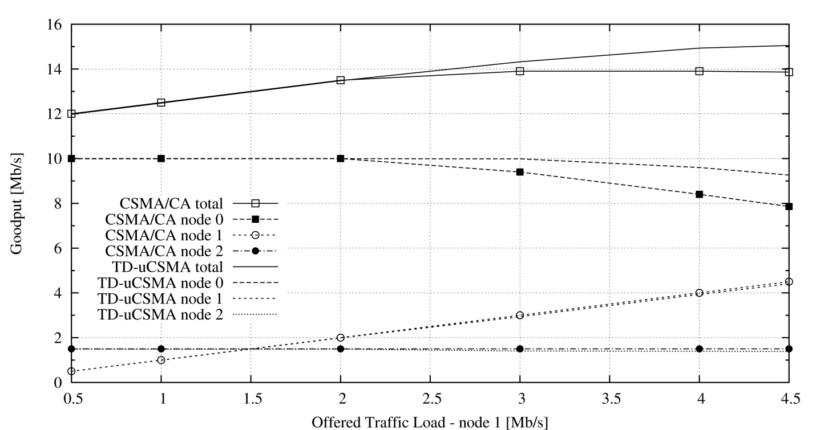
Effect of Misbehaving Nodes Policy in Details
around 9Mb/s
Adaptive
Policing

Slide 18
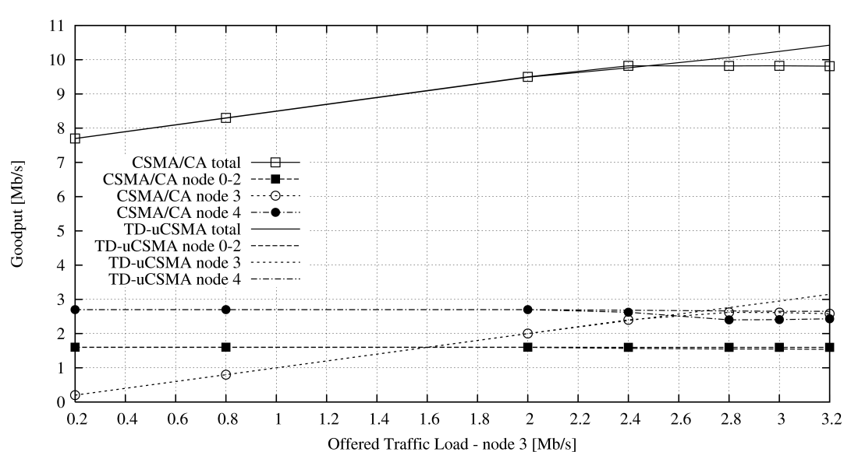
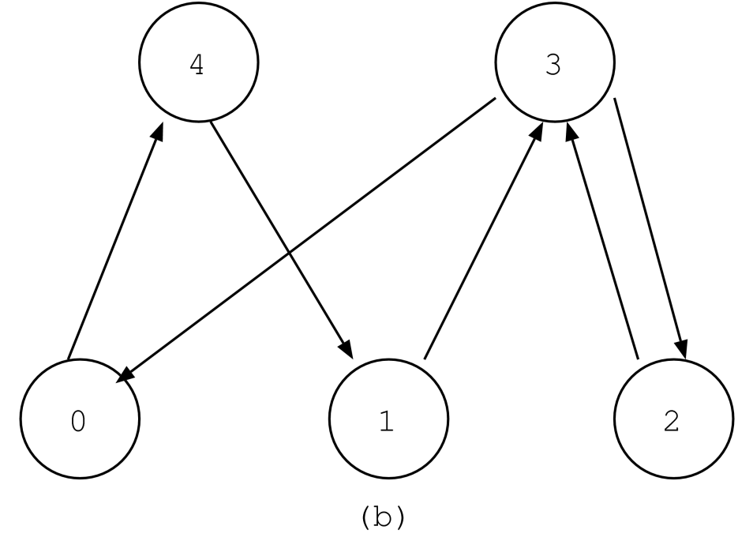
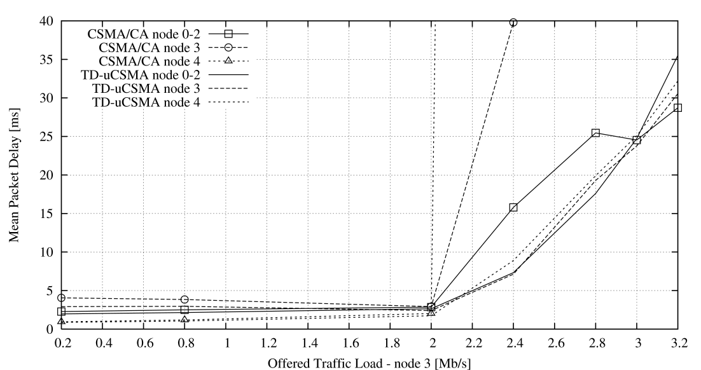
Asymmetric scenario
T⁴_{H}/TC= 5/20
T³_{H}/TC= 6/20
T^{i}_{H}/TC= 3/20

Slide 19
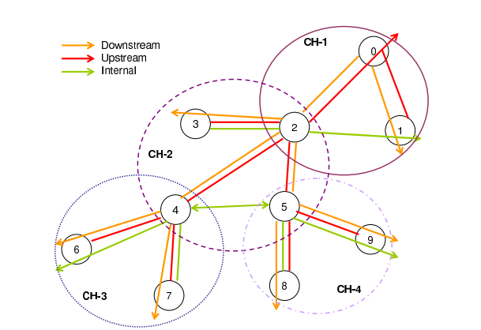
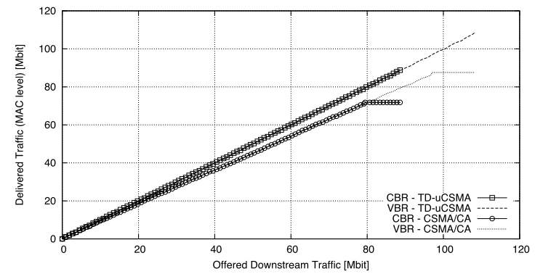
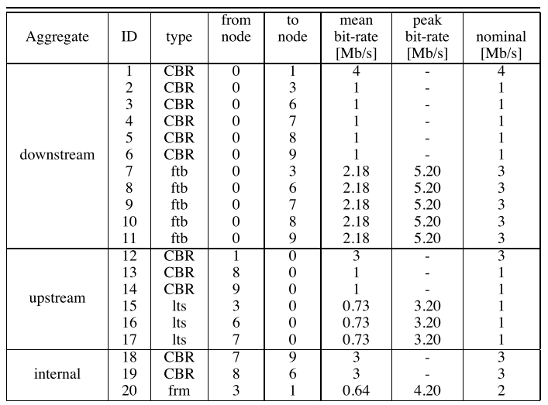
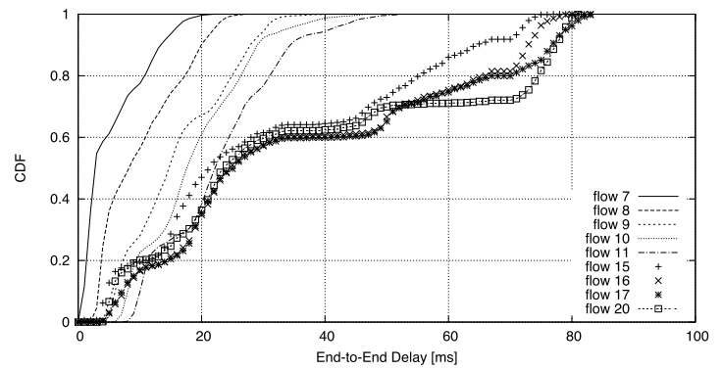
More complex scenarios multihop + variable traffic

Slide 20
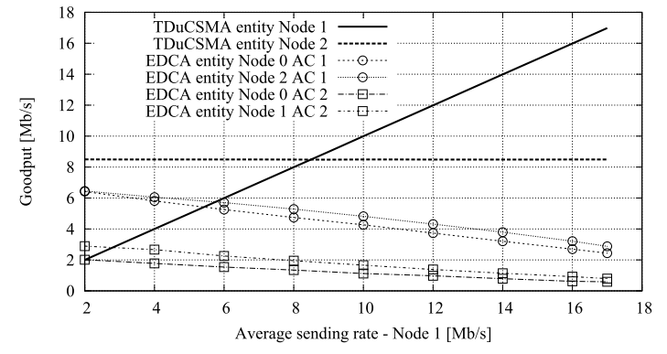
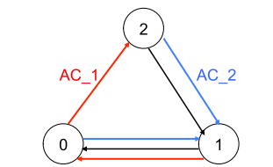
Additional scenarios can be built

Slide 21
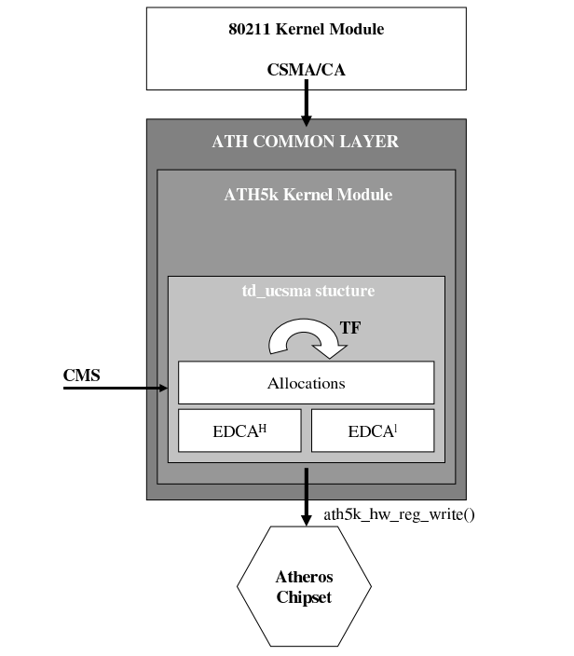
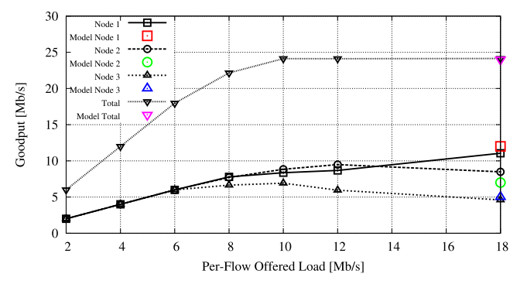
Implementation
Implemented over Atheros Chipsets
OpenWRT Linux distribution
Atheros chipset, ATH5K kernel module
Several minor changes to the driver including some new functions
Changes aimed at enabling the switching of contention parameters in accordance with the CTR structure and TF allocations.
The basic CSMA/CA operations implemented by the mac80211 kernel module are not altered
This fact itself conﬁrms that TDuCSMA is IEEE 802.11 standard compliant
Theoretical results are confirmed

Slide 22
Open Issues
Synchronization is not critical, but how?
GNSS (GPS, Galileo), GPS repeater (indoor), IEEE 1588 over 802.11 (refs), IEEE 1588 over 802.11af or 802.22 (white spaces), others…
Maybe mutual synchronization is sufficient… (refs)
How does the protocol worsen depending on clock precision?
Extend the reservation model
Unicast (availble)
Broadcast (easy)
RTS/CTS (against hidden terminals)
One pending workaround to prevent HTs without RTS/CTS
Further implementations
Configuration platform, leaderless synchronization, signalling
Any ideas for the funding?

Slide 23
References
TD-uCSMA
Vesco, A., and R. Scopigno, "Time-division access priority in CSMA/CA", 20th IEEE International Symposium on Personal, Indoor and Mobile Radio Communications, pp. 2162 -2166, 09/2009
Scopigno, R., and A. Vesco, "A distributed bandwidth management scheme for multi-hop wireless access networks", Wireless Communications and Mobile Computing Conference (IWCMC), 2011 7th International, pp. 534 -539, 07/2011
Vesco, A., and R. Scopigno, "Advances on Time-Division Unbalanced Carrier Sense Multiple Access", Computer Communications and Networks (ICCCN), 2011 Proceedings of 20th International Conference on, pp. 1 -6, 08/2011.
Vesco, A., Scopigno, R. chapter 4 “A Weakly Synchronous and Distributed Coordination Function for QoS Management in CSMA/CA Wireless Access Networks”, in "Developments in Wireless Network Prototyping, Design, and Deployment: Future Generations", IGI Global, June 2012, doi: 10.4018/978-1-4666-1797-1
Synchronization
Kannisto, J.; Vanhatupa, T.; Hannikainen, M.; Hamalainen, T.D., "Software and hardware prototypes of the IEEE 1588 precision time protocol on wireless LAN," Local and Metropolitan Area Networks, 2005. LANMAN 2005. The 14th IEEE Workshop on , vol., no., pp.6 pp.,6, 18-18 Sept. 2005
J. Kannisto, T. Vanhatupa, M. Hännikäinen, T.D. Hämäläinen, “Precision Time Protocol Prototype on Wireless LAN,” Telecomm. and Networking - ICT 2004 Lecture Notes in Computer Science Volume 3124, 2004, pp 1236-1245, Springer Berlin Heidelberg
Vesco, A., F. Abrate, and R. Scopigno, "Convergence and performance analysis of leaderless synchronization in Wi-Fi networks", Proc. of the 6th ACM workshop on Performance monitoring and measurement of heterogeneous wireless and wired networks, New York, NY, USA, ACM, pp. 49–58, 2011

