Slide 1
Network Optimization for Expected HEW Traffic Patterns
Date: 2013-07
Authors:

Slide 2
Abstract
This presentation discusses the need for optimization of HEW networks for both video services and bursty data with short packets.
To account for high QoE for these expected traffic types, we suggest two criteria for the evaluation of HEW proposals.

Slide 3
Data Traffic Patterns
What kind of data will flow through HEW networks?
Video
Expected to drive the main data volume
“Two-thirds of the world’s mobile data traffic will be video by 2017”
Support video traffic in both UL and DL
Social networking, including OTT (e.g. Skype, Facebook) and IMS
Always active background traffic
Minor part of total data volume
Including Voice over IMS (VoLTE / VoWiFi)
Web
Bursty data of all sizes
Real time (E.g. WebRTC) and non-real time applications (Browsing)
Ref: Cisco Visual Networking Index: Global Mobile Data Traffic Forecast Update, 2012–2017

Slide 4
Video Content Characteristics
Display resolution increase in all CE devices
E.g., support for 4K & 8K/Ultra-HD by time of HEW completion
Video typically uses the available bandwidth to increase resolution/fps and decrease compression losses
Active session during a defined time period
Utilizing full Ethernet frames 1500B
Allows long aggregated frames
Allows buffering
Short transport level ACKs in opposite direction

Slide 5
VoIP (OTT and IMS) Characteristics
Voice over 3GPP and 802.11 will be seamless
Packet inter arrival times typ. 20 - 40 ms
Packet sizes 35-70 Bytes for VoIP
High latency requirements
Frames can not be aggregated
Data can not be buffered
Small raw data volume, but high number of individual packets

Slide 6
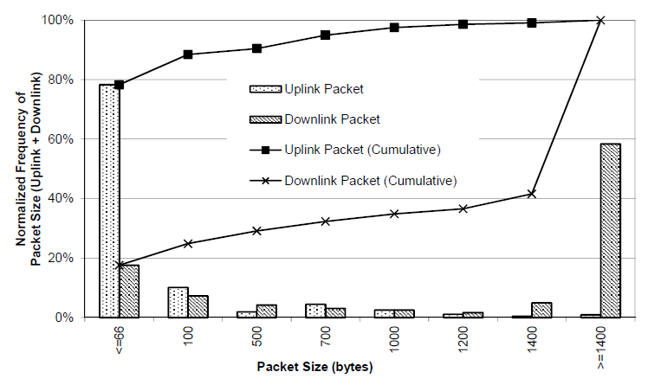
Web Traffic Packet Size Distribution
Research and network statistics show that a large part of traffic is <100 Bytes.
For example transport ACKs, web browsing and social networking traffic
Figure shows distribution of UL and DL packet size for random web browsing
Ref: Anatomy of Wi-Fi Access Traffic of Smartphones and Implications for Energy Saving Techniques, R Palit et al.

Slide 7
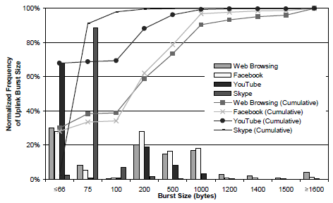
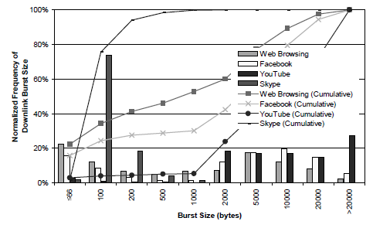
Burst Size per Traffic Type
Looking at bursts of packets
For all traffic types, absolute majority of UL bursts are < 1500 Bytes
Social networking (like voice, Skype, Facebook) bursts are < 100 Bytes
UL video expected to increase, so no clear asymmetry between STA and Infrastructure
Distribution of UL burst size
Distribution of DL burst size
Ref: Anatomy of Wi-Fi Access Traffic of Smartphones and Implications for Energy Saving Techniques, R Palit et al.

Slide 8
Data Traffic Patterns - Conclusions
Data characteristics
Video
Causes the main data volume in one direction
Small ACK packets in the other direction
Similar network requirements, regardless of the data direction
Social networking, including IMS
Always active background traffic
Minor part of total data volume, but major amount of data packets
Streaming real time voice and video disallows buffering and aggregation

Slide 9
Evaluation Criteria: Summary and Next Steps
HEW system must prioritize not only maximizing capacity for bulk data and high throughput, but also highest efficiency for short packets <100 Bytes
Comparison/evaluation of header overhead and efficiency of packet sequencing/prioritization
Capabilities of MAC protocol proposals need to be demonstrated for a distribution of packet sizes and bursts, not only 1500 Bytes
An appropriate network traffic model is needed

Slide 10
References
Cisco Visual Networking Index: Global Mobile Data Traffic Forecast Update, 2012–2017 http://www.cisco.com/en/US/solutions/collateral/ns341/ns525/ns537/ns705/ns827/white_paper_c11-520862.pdf
Anatomy of WiFi Access Traffic of Smartphones and Implications for Energy Saving Techniques http://www.sersc.org/journals/IJEIC/vol3_Is1/1.pdf
VoLTE_Deployment_and_the_Radio_Access_Network http://www.spirent.com/~/media/White%20Papers/Mobile/VoLTE_Deployment_and_the_Radio_Access_Network.pdf

