Slide 1
HEW SG Evaluation Methodology Overview
Date: 2013-07-15
Authors:

Slide 2
Abstract
This presentation gives an overview of a draft HEW SG evaluation methodology document [11-13/0722r0]

Slide 3
PHY Performance
PHY channel models
TGn channel model with some modifications as in TGac [1-2]
TGn Channel Model B, D, E, F
For outdoor, outdoor-to-indoor, indoor-to-outdoor usage scenarios, WINNER II channel models defined in [3] shall be used.
WINNER B1
PHY impairments
Similar to TGac evaluation methodology [4]
Some of the impairments may need to be review
PHY link level simulation (placeholder)
Comparison criteria (placeholder)

Slide 4
Traffic Models
Reuse the traffic models developed in TGad [5]
Lightly compressed video
Local file transfer
Web browsing
Hard disk file transfer
Add
Internet streaming video/audio (e.g. YouTube) [6]

Slide 5
Simulation Scenarios
Scenarios
Wireless office
Residential/apartment building
Hotspot (indoor/outdoor)
Stadium (indoor/outdoor)
AP/non-AP STA configuration
AP STA
Number of antennas: 2-4 (TBR)
Indoor Tx power: max 17dBm
Outdoor Tx power: max 30 dBm
Non-AP STA
Small form factor STAs (i.e. smartphone or tablet)
Number of antennas: 1-2 (TBR)
Larger form factor STAs (i.e. laptop or display or HDD)
Number of antennas: 2-4 (TBR)
Tx power: max 17dBm

Slide 6
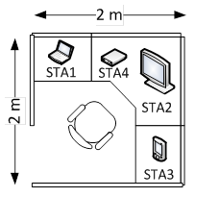
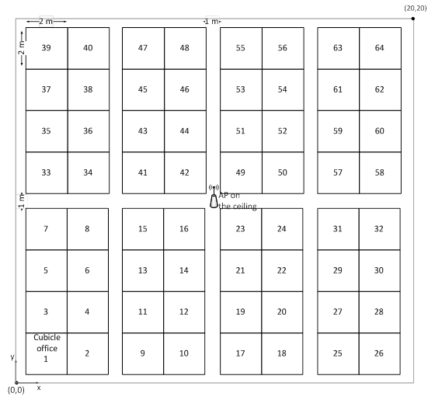
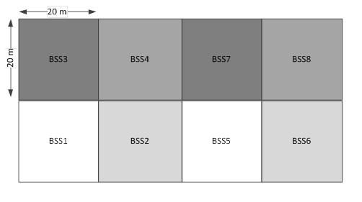
Wireless Office Scenario
64 cubicle offices / BSS
4 STAs / cubicle
Traffic model:
Lightly compressed video (STA1→STA2)
Web browsing (STA1--AP, STA3--AP)
Local file transfer (STA1--AP, STA3--AP)
HDD file transfer (STA1--STA4)
Channel model: TGn Channel Model D
8 BSSs / office floor

Slide 7
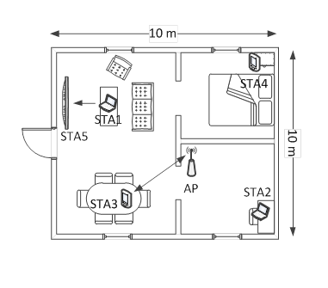
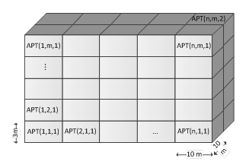
Residential/Apartment Building Scenario
Apartment configuration
Apartment building (nxmx2 apartments)
5 STAs + 1 AP / apartment
Traffic model:
Lightly compressed video (STA1→STA5)
Web browsing (STA2--AP, STA4--AP)
Local file transfer (STA2--P, STA4--P)
Internet streaming video/audio (AP -- STA3)
Channel model: TGn Channel Model B, floor attenuation TBD

Slide 8
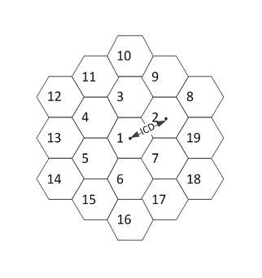
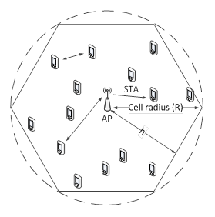
Hotspot Scenario (Indoor/Outdoor)
30 STAs + 1 AP / cell
Traffic model:
Local file transfer, Web browsing (X% of STAs-AP)
Internet streaming video/audro (Y% of STAs-AP)
Local file transfer (Z% of STAs-STAs)
Channel model: WINNER B1 (outdoor), TGn Channel Model E (indoor)
Typical hotspot deployment: 100-200 meters
Dense hotspot deployment: 15-30 meters

Slide 9
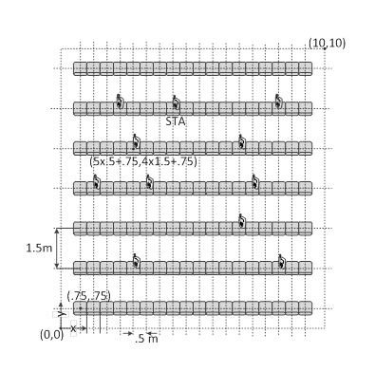
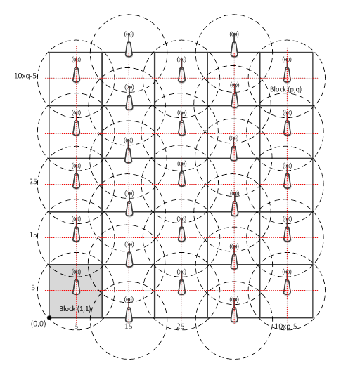
Stadium Scenario (Indoor/Outdoor)
100 STAs / block of seats
Traffic model:
Local file transfer, Web browsing (X% of STAs - AP)
Internet streaming video/audro (Y% of STAs - AP)
Local file transfer (Z% of STAs - STAs)
Channel model: WINNER B1 (outdoor), TGn Channel Model F (indoor)

Slide 10
References
[1] 11-03-0940-04-000n-tgn-channel-models
[2] 11-09-0308-12-00ac-tgac-channel-model-addendum-document
[3] WINNER II Channel Models, Part I Channel Models, Deliverable D1.1.2, v 1.1, 2007 (http://www.ist-winner.org/WINNER2-Deliverables/D1.1.2.zip)
[4] 11-09-0451-16-00ac-tgac-functional-requirements-and-evaluation-methodology
[5] 11-09-0296-16-00ad-evaluation-methodology.doc
[6] Ashwin Rao, et. al. 2011. Network characteristics of video streaming traffic. In Proceedings of the Seventh COnference on emerging Networking EXperiments and Technologies (CoNEXT '11). ACM, New York, NY, USA, , Article 25 , 12 pages. DOI=10.1145/2079296.2079321 http://doi.acm.org/10.1145/2079296.2079321
[7] 11-13-0722-00-0hew-hew-evaluation-methodology

