Slide 1
Supplementary Plenary Information - July 2013
Date: 2013- July -12
Authors:
Name
Company
Address
Phone
email
Bruce Kraemer
Marvell
5488 Marvell Lane,
Santa Clara, CA, 95054
+1 (321) 751-3958
bkraemer@
marvell
.com
Abstract: Additional Information on topics for 802.11 Plenary meeting – July 2013
Notes:
November 2011

Slide 2
Monday
Notes:
November 2011

Slide 3
IEEE LOA Database – July 12, 2013
Friday Agenda Item 3.2.1
http://standards.ieee.org/db/patents/pat802_11.html
24 entries with 2013 submission dates

Slide 4
802 Meeting Rooms
Monday Agenda Item 4.1.3
Building | Room
Montbrillant | Meeting rooms: H1, H2, K1, K2, L1, L2, M1, M2.
Varembé | Meeting rooms: A, E, G1, G2, G3. Other: TIES helpdesk, medical services.
Tower | Meeting rooms: B, C, D, T101, T102, T103, Popov
No food or Drink (except water) in meeting rooms

Slide 5
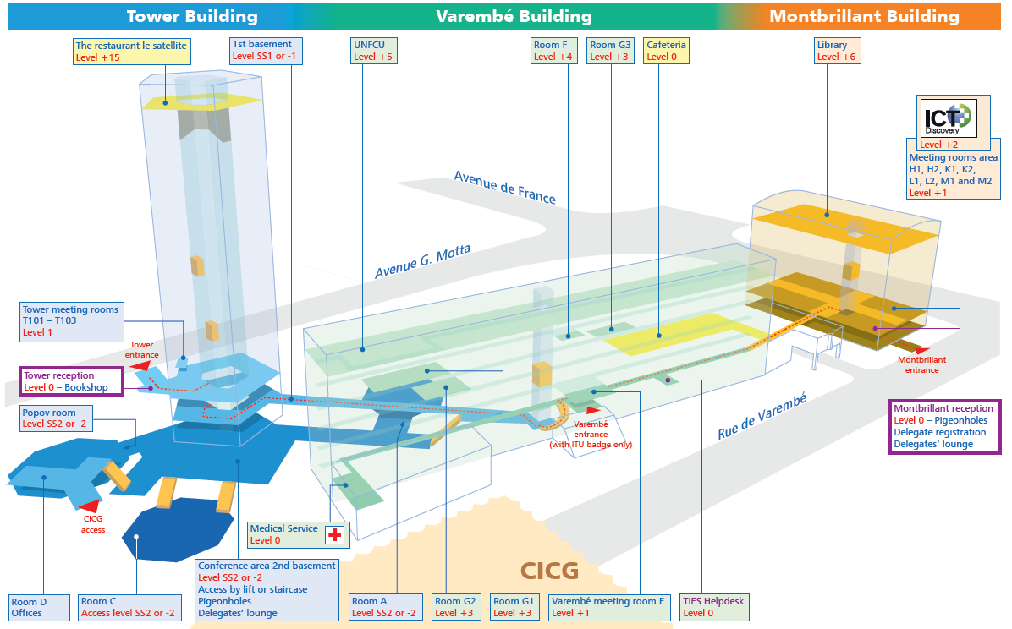
Monday Agenda Item 4.1.3
http://www.itu.int/aboutitu/itu-plan.pdf

Slide 6
ITU Entrances
Monday Agenda Item 4.1.3
There are three entrances:
The Montbrillant entrance (2 rue de Varembé, extension 6788 or 6789) is open from 0600 to 2200 hours, Monday to Friday. It is here that delegate registration takes place.
The Tower entrance (av. Giuseppe Motta, extension 5107 or 5108) is open every day from 0600 to 2200 hours (including weekends, but not official holidays).
The Varembé entrance, accessible only to badgeholders, is open from 0600 to 2200 hours, Monday to Friday.

Slide 7
Geneva Expectations (cont)
Monday, Tuesday, Wednesday and Thursday :
Meetings in CICG and CCV must end before 6:30pm (18:30)
Please leave buildings promptly.
*All Evening Meetings (PM3) after 6pm must be held in ITU.
Note: that Power to ITU meeting rooms will be out from 9pm Tues until 6am Wed.
Friday :
*All Meetings are to be held in ITU.
No food or Drink (except water) in meeting rooms

Slide 8
Joint Meetings
Monday Agenda Item 4.1.4
External:
802.11AK with 802.1 Thursday 8:00 (am1) CICG Room 6
Internal:

Slide 9
July 2013 PARS
Monday Agenda Item 4.1.5
802.1Qcc - amendment for Stream Reservation Protocol (SRP), PAR and 5C
802.1Qcd - amendment for Application Virtual Local Area Networks (VLAN) Type, Length, Value (TLV), PAR and 5C
802.3br - amendment for Specification and Management Parameters for Interspersing Express Traffic, PAR and 5C
802.15.10 - recommended practice on Layer 2 Routing, PAR and 5C
P802.19.1 - PAR Extension

Slide 10
Group Room assignments
Monday Agenda Item 4.1.6
WG | Building | Room
1 | ITU | Popov 1, K1, L1
16 | ITU | M1
18 | CICG | 20
19 | CICG | 16
21 | CICG | 19
22 | CICG | 17
24 | CCV | C
OMNIRAN | CCV | C
Notes:
November 2011

Slide 11
Group Room assignments
Monday Agenda Item 4.1.6
WG | Building | Room
802.11 Plenary |  | CICG 1, CICG 1, ITU Popov 1
MC | CICG | 6 –first, 18 all others
AC | CICG | 6, 6, 18
AF | CICG | 18
Editors | CICG | 14
AH | CICG | 4
AI | CICG | 5
AJ | CICG | 14, 5, 5, 18
AK | CICG | 5/ Joint in 6
AQ | CICG | 6
REG | CICG | 18
WNG | CICG | 1
JTC1 | CICG | 14
HEW | CICG | 1
PAR | CICG | 14
Notes:
November 2011

Slide 12
WG Agendas
Monday Agenda Item 4.1.6
18: Agenda 18-13-0070 r7
Opening Report 18-13-0086 r0
19: Agenda 19-13-0079 r1
Opening Report 19-13-0081 r0
21: Agenda 21-13-
Opening Report 21-13-0120r0
22: Agenda 22-13-
Opening Report 22-13- 0099r0
24: Agenda 24-13-0025 r0
Opening Report 24-13-
OmniRAN Agenda omniran-13-0050 r0
Opening Report omniran-13-

Slide 13
802.18 topics – Timeslots to be assigned
Monday Agenda Item 4.1.6
Status Updates, Open FCC Proceedings
Reply Comments to the FCC 5 GHz U-NII Band Revision NPRM
Report on WP 1A meeting, Question 236/1, and PDNR ITU-R SM.[SMART_GRID] (18-13/084r0, 18-13/085r0 editing baseline)
Discuss FCC Decision on Progeny M-LMS
Discuss Meeting in Nanjing
ITU-R WP 5A Update to M.2227 (18-13/073r0)
ITU-R WP 5A Update to M.2003 (18-13/074r0)
ITU-R WP 5A Update to Draft M.1450-4 (18-13/076r0)
ITU-R WP 5A Liaison Statement on Technologies for Public Protection and Disaster Relief (18-13/077r0)
ITU-R WP 5A Update to Draft F.1763 (18-13/079r0)
ITU-R WP 5A Update to Draft New Report on Cognitive Radio Systems (18-13/081r0)
Discuss Drafting Support for IEEE USA Filing to FCC re: Above 95 GHz Petition (18-12/055r1)

Slide 14
September 15-20, 2013 Nanjing, China
Monday Agenda Item 4.1.7
IEEE 802.11 Interim Session
Hotel Registration Later this week
Meeting Registration Later this week
Visa invitation letter
http://www.ieee802.org/11/Meetings/Meeting_Plan.html

Slide 15
Geneva Meeting Registration (718)
Monday Agenda Item 4.1.8
802.1 56
802.3 239
802.11 254
802.15 100
802.16 11
802.18 6
802.19 5
802.21 11
802.22 11
802.24 3
802.25 2
802.xx 14
None 19

Slide 16
IEEE Staff on site
Monday Agenda Item 4.1.9
Michelle Turner: Document Development Sr. Prgm. Mgr.
Lisa Perry: Technical Program Development Prgm. Mgr.
Karen McCabe: Strat. Mktg and Product Management Sr. Dir
Jodi Haasz: International Programs, Standards Strategist
Bill Ash: Sr. Prgm. Mgr
Walter Pienciak
Sri Chandrasekaran - India

Slide 17
Cafeterias
Monday Agenda Item 4.1.10
Cafeterias:
1. CICG
2. top of the Tower building
3. between the Varembé and Montbrillant buildings.
Open Monday to Friday from 0800 to 1700 hours.

Slide 18
Other Special Events
Monday Agenda Item 4.1.10
Breakfast & Breaks:
No special provisions
Lunch: Included in registration – no fee
No special provisions
Wednesday Social None

Slide 19
Current Membership Status - July
Monday Agenda Item 4.1.11
Status | Number
Aspirant | 100
Potential Voter | 46
Voter | 323
Definitions:
Aspirant: a member who has attended 1 qualifying meeting
Potential Voter: a member who has attended 2 qualifying meetings and will become a voter at the start of the next plenary they attend
Data as of 2012-11-06

Slide 20
Wednesday Plenary Topics
Monday Agenda Item 4.1.12
Pending 802 Operations Manual Changes

Slide 21
802.1 Architecture Document
Monday Agenda Item 4.1.13

Slide 22
802.11 Topics for July 2013 EC
Monday Agenda Item 4.1.15
Begin Sponsor Ballot
Conditional approval for AF - Open Sponsor Ballot Group formation
Requests to submit to RevCom?
x
New project PAR to NesCom?
x
PAR Extension ?
AF
Revision PAR?
Nothing needed at this time
Study Group start up?
Depends upon results of WNG meeting
Study Group extension?
HEW
Press Release

Slide 23
July Tutorials
Monday, July 15, 2013
Monday Agenda Item 4.1.16
http://ieee802.org/Tutorials.shtml
Tutorials in ITU Tower Room: Popov 1&2
Tutorial #1 (6:00–7:30 pm): White Rabbit - Ethernet-based solution for sub-ns synchronization and deterministic, reliable data delivery Presentation Maciej Lipinski, CERN / Warsaw University of Technology
Tutorial #2 (7:30–9:00 pm): Interspersing Express Traffic on IEEE 802.3 Networks Tutorial #3 (9:00–10:30 pm): IEEE-SA IoT Effort Overview and FAQs Presentation Wael William Diab, Broadcom

Slide 24
Notable ExCom or SA Activities
Monday, July 15, 2013
Monday Agenda Item 4.1.17
802 operations manual changes Discussion in 802.11 on Wednesday EC motion on Friday Some modification of 5Cs included
40th Anniversary of Ethernet celebration planned for Nov Special event on Monday Tutorials shifted to Tuesday

Slide 25
Wednesday
Notes:
November 2011

Slide 26
No Social in Geneva
Monday Agenda Item 2.7

Slide 27
Wednesday Agenda Item 5.1
Room Changes
Remove time slots for
Tgaf
JTC1 Thurs pm1
Add time slots for
TGah Wed PM2 and Thur am2
Notes:
November 2011

Slide 28
Wednesday Agenda Item 5.2
Revised Agenda Graphic
If needed

Slide 29
Wednesday Agenda Item 5.3
Mid-week Officer Changes
If needed

Slide 30
Friday

Slide 31
IEEE LOA Database – July 12, 2013
Friday Agenda Item 2.08
http://standards.ieee.org/db/patents/pat802_11.html
24 entries with 2013 submission dates

Slide 32
IEEE Store Contents - July 2013
Friday Agenda Item 2.09
http://www.techstreet.com/ieeegate.html
http://standards.ieee.org/about/get/802/802.11.html
Amendment | Draft in TechStreet July 12 | Draft in Members Area | Publication in Get 802 July 11
AF | D4.0 $300 pdf | 5.0
AC | D5.0 $250 pdf | xxx
AD-2012 | $360 print |  | P
AE-2012 | $105 print |  | P
AA-2012 | $180 print |  | P
802.11 -2012 | $540 print |  | P
b, k, i, n, p, y, r, w, u, v, z, s | $100 - $305
802.11-2007
Notes:
November 2011

Slide 33
Geneva Attendance info (Thursday noon)
Row Labels | # Mtgs | Avg | Total | Min | Max
802.11 Newcomer Training | 1 | 8 | 8
ARC | 1 | 11 | 11
Editors Meeting | 1 | 11 | 11
JTC1 | 2 | 8 | 17 | 8 | 9
PAR Comments | 2 | 4 | 9 | 2 | 7
Reg SC | 4 | 12 | 49 | 7 | 21
TGaf | 3 | 25 | 76 | 10 | 52
TGah | 7 | 37 | 259 | 7 | 133
TGai | 7 | 27 | 193 | 2 | 77
TGaj | 4 | 21 | 84 | 1 | 32
TGak | 1 | 16 | 16
TGaq | 2 | 20 | 41 | 20 | 21
TGmc | 5 | 13 | 69 | 7 | 25
Tutorials | 1 | 111 | 111
WG CAC | 1 | 16 | 16
WG Mid-Session Plenary | 1 | 231 | 231
WG Opening Plenary | 1 | 203 | 203
WNG | 1 | 155 | 155
HEW SG | 8 | 130 | 1045 | 5 | 200
802 Opening Plenary | 1 | 217 | 217
Record attendance here for both morning slots | 1 | 181 | 181

Slide 34
802.11 drafts to ISO/IEC JTC1/SC6
Friday Agenda Item 2.10
Task Group | After Vancouver
TGae
TGaa
TGREVmb
TGad
TGac | D5.0
Notes:
November 2011

Slide 35
Future Venues -2013
Friday Agenda Item 6.3
2013
# 137 January 13-18, 2013 - --Hyatt Regency Vancouver, BC, CA
#137.5 January 23-24, Grand Mercure, Shenzhen, CN
# 138 March 17-22, 2013 –Caribe Royale, Orlando, FL, USA
# 139 May 12-17, 2013 ----Hilton Waikoloa, Big Island, HI
#139.5 April 24-25 – Beijing, China
# 140 July 14-19, 2013 --- Geneva , CH ITU headquarters
# 141 September 15-20, 2013- Zhong Shan Hotel, – Nanjing, China
# 142 Nov 10-15, 2013 Hyatt Regency Dallas, TX, USA
Notes:
November 2011

Slide 36
Future Venues - 2014
Friday Agenda Item 6.3
2014
# 143 January 19-24, 2014 -Hyatt Century Plaza, Los Angeles, CA, US
#143.5 January 8-9, 2014 - China
# 144 March 16-21, 2014 – Beijing, China
# 145 May 11-16, 2014 ----Hilton Waikoloa, Big Island, HI
#145.5 May21-22, 2014 - China
# 146 July 13-18, 2014 - Manchester Grand Hyatt, San Diego, CA, US
# 147 September 14-19, 2014----Athens, Greece
#147.5 September24-25, 2014 - China
# 148 November 2-7, 2014 Hyatt Regency San Antonio, TX, US
Notes:
November 2011

Slide 37
2014
Friday Agenda Item 6.3
For Year 2014 |  | Session | Type
January 19-24 | Hyatt Century Plaza, Los Angeles | 143 | Interim*
January 6-10 | China (TBD) | 143.5 | China Interim
March 16-21 | China World Hotel (TBC) Beijing, China | 144 | Plenary
May 11-16 | Hilton Waikoloa Village, HI, USA | 145 | Interim*
May 20-24 | China (TBD) | 145.5 | China Interim
July 13-18 | Manchester Grand Hyatt San Diego | 146 | Plenary
September 14-19 | Kobe Convention Center, Japan (To be confirmed) | 147 | Interim*
September 23-27 | China (TBD) | 147.5 | China Interim
November 2-7 | Grand Hyatt San Antonio, San Antonio, TX, USA | 148 | Plenary

Slide 38
September 15-20, 2013 Nanjing, China
Friday Agenda Item 7.0
IEEE 802.11 Interim Session
Hotel Registration Later this week
Meeting Registration Later this week
Visa invitation letter
http://www.ieee802.org/11/Meetings/Meeting_Plan.html

Slide 39
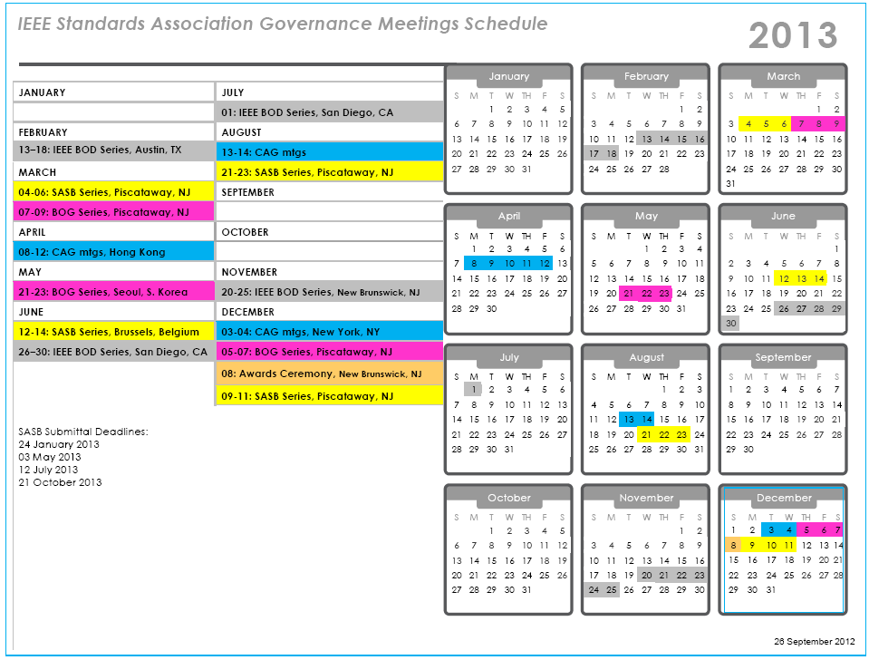

Slide 40
