Slide 1
Ultra High Density WLAN
——Challenges, potential techniques and provisions
Authors:

Slide 2
Abstract
With a fast development of mobile techniques, we are embracing a terminal-equipment bursting era, however, issues and problems to be dealed with are still challenging.
This presentation gives certain motivation facts of why Ultra High Density WLAN is necessary and analyses the requirements and potential techniques in realizing the scheme.

Slide 3
Motivation & Scenarios
  Numerous categories of WiFi-based multimode mobile terminals(pad, laptop,smartphone,smart reader,etc) have emerged and received a worldwide popularity, which leads to an immense increase in data traffic.
  In some typical scenarios(SOHO,public transportation, stadium)where mobile terminals are densely deployed, traditional cellular network resources are inadequate.
  More bandwidth-consuming services(high definition video,immersive interactive multimedia) begin to appear in limited area where users are located together and demand a high bandwidth at the same time.
Dense crowds in downtown areas

Slide 4

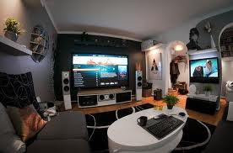
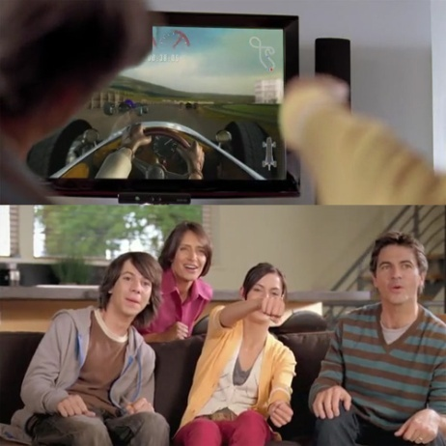
Motivation & Scenarios
  Scenario#1: Home entertainment & Home party
It’s an enjoyable time to have families get together to play games or watch high definition videos. What’s more, in a home party, families and friends gather in the crowded house and they want to log on their social homepage to share the happiness and keep in touch with others.

Slide 5
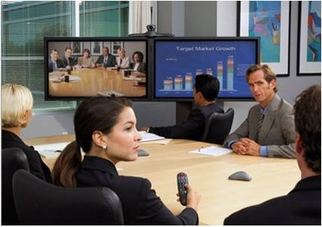
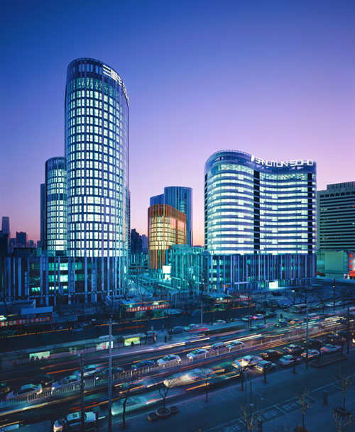

Motivation & Scenarios
  Scenario#2: Business office & SOHO

Slide 6
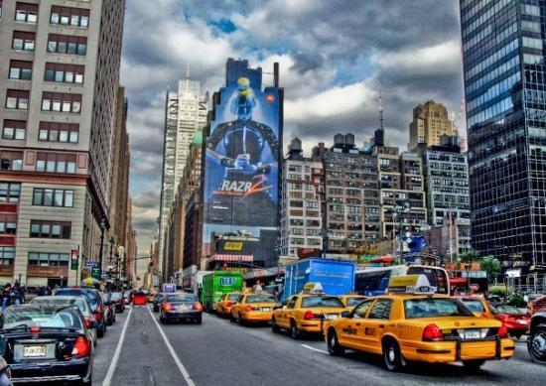
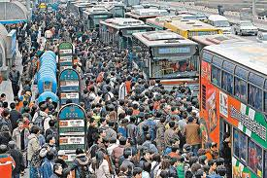
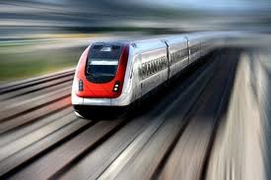
Motivation & Scenarios
  Scenario#3: Public transportation & High-speed railway
It’s always crowded in subways, buses and taxis in rush hours and people on these vehicles love using their mobile terminals to log on social homepages, surf the Internet and watch online videos to kill time. On high-speed rails, it’s more challenging to ensure users’ QoS and handover issues are to be considered to provide real-time services.

Slide 7
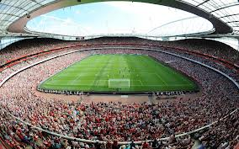
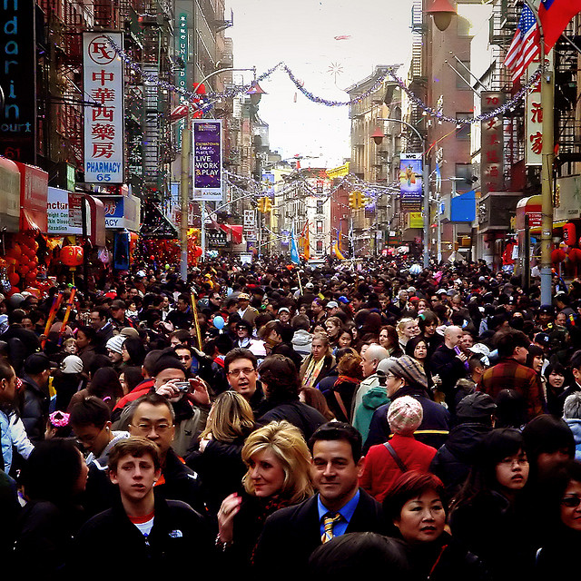
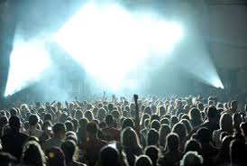
Motivation & Scenarios
  Scenario#4: Commercial activities

Slide 8
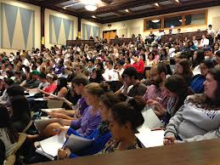
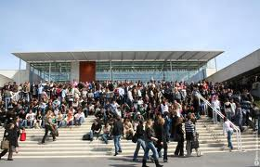
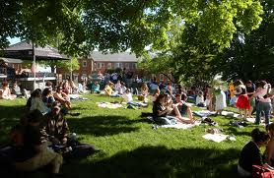
Motivation & Scenarios
  Scenario#5: Campus life
In a campus, WiFi is ought to be provided in the dormitory, teaching building and sports ground. Especially in the dormitory, mobile users are very densely deployed.

Slide 9
Requirements & Challenges
In a word ,Ultra high Density mainly consists of two points:
The density of the mobile terminals(STAs) are ultra high.
The APs are densely deployed.
As for the high density features, problems unavoidably come by, and we are faced with those Highlighted Challenges:
Due to a high locating popularity of STAs and APs, how to reduce interferences from both intra and inter APs?
How to guarantee the network throughput with a large number of users transmitting packets simultaneously?
Improved scalability and mobility control schemes cause more network complexity.
High data rates mean more power consumption, which contributes to a larger OPEX expense.
While some data packets are transmitted for business affairs, security issues are negligible.

Slide 10
Solutions & Potential techniques
1、Cooperative transmission
In high density WLAN, many packets from different users may be transmitted simultaneously and thus cause a high contention rate. Secondary users（SU） are assigned to primary users(PU, located in high density areas) dependent on their locations and BSS. SUs transfer PUs’ packets as relay nodes.
Target: increasing throughput, reducing AP1 BSS contention rate

Slide 11
Solutions & Potential techniques
1、Cooperative transmission
If PU1 can not access AP1, it look for other available relay devices by scanning other frequency bands to access AP2.

Slide 12
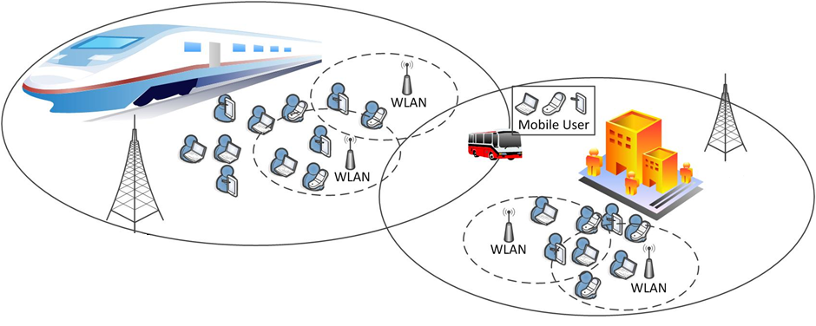
Solutions & Potential techniques
2 、 High density Group Handover
WLAN will become very important part of heterogeneous network，and it will encounter highly dense group handover between different wireless modes.

Slide 13
Solutions & Potential techniques
2 、High density Group Handover
Applied in：
Railway station、High-speed road、SOHO、Campus

Slide 14
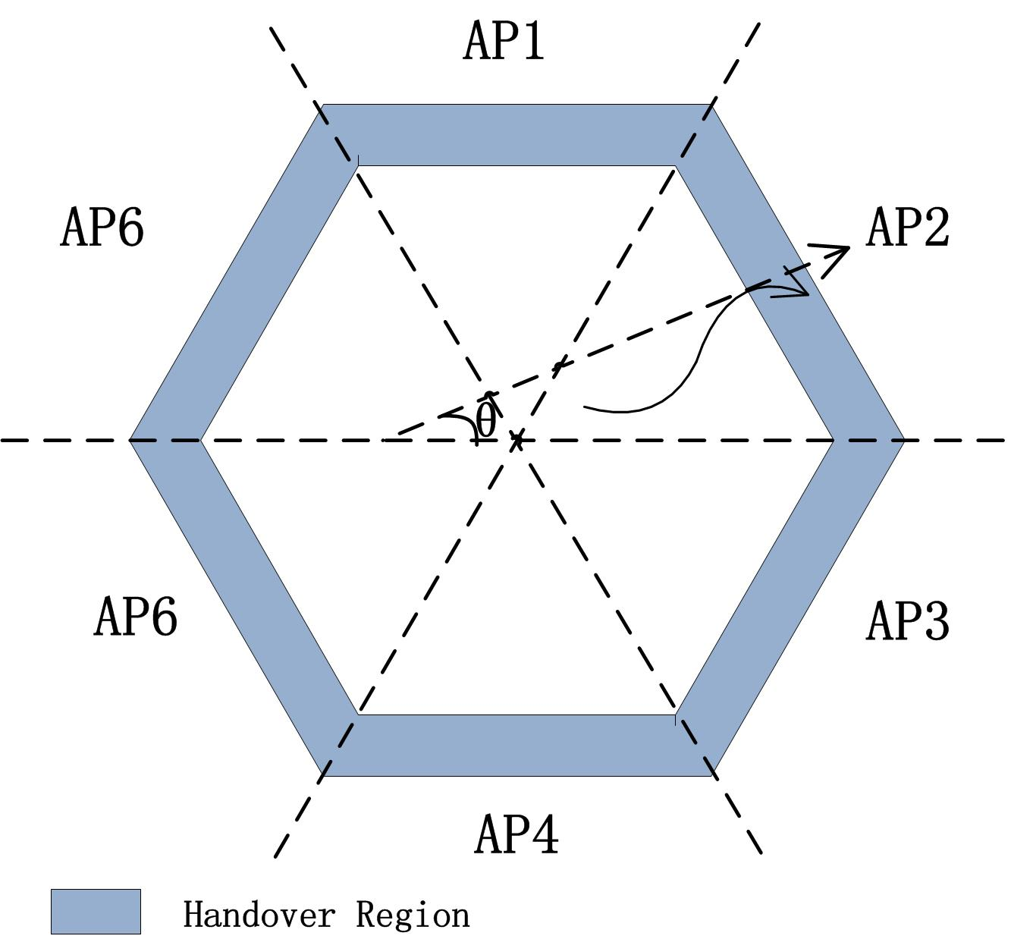
Solutions & Potential techniques
3、Mobility management via Mobility Prediction in dense AP deployment
In WLAN, whenever a STA moves from its current AP to a new AP, it requires handover to a new AP. In high density WLAN where APs are densely deployed, the search time for a new AP can be more than tolerated because there are too many APs to be accessed before the handover is finally executed. By predicting the direction of the mobile node using GPS, the MAC layer scanning process is simplified to find new APs, thus significantly reducing handover latency.
Slope Angle(θ) | Neighbor AP
0°≤θ ＜ 60° | AP2
60°≤θ ＜ 120° | AP1
120°≤θ ＜180° | AP6
180°≤θ ＜ 240° | AP5
240°≤θ ＜ 300° | AP4
300°≤θ ＜ 360° | AP3

Slide 15
Conclusions & Provisions
In this presentation, a brief overview of the future WLAN is given, in which an ultra high density WLAN is foreseen. High densely deployed APs and STAs unavoidably cause such problems as severe interferences and high data traffic demand. To deal with these challenges, several solutions and techniques are discussed.

Slide 16
References
802. 11-13-0113-00-0wng-applications-and-requirements-for-next-generation-wlan
S. Chatterjee, D. Sarddar, J. Saha, S. Banerjee, A. Mondal, and M. K. Naskar, "An improved mobility management technique for IEEE 802.11 based WLAN by predicting the direction of the mobile node," in Computing and Communication Systems (NCCCS), 2012 National Conference on, 2012, pp. 1-5.
M. A. Nazari and F. Ashtiani, "Stable throughput analysis for a cooperative WLAN with primary and secondary users," in Telecommunications (IST), 2012 Sixth International Symposium on, 2012, pp. 535-540.
L. Sun, H. Tian, and P. Zhang, "Decision-making models for group vertical handover in vehicular communications," Telecommunication Systems, vol. 50, pp. 257-266, 2012

Slide 17
Q&A
Thank you!

