Slide 1
IEEE 802.11TGai Closing Report
Date: 2013-5-17
Authors:
Name | Company | Address | Phone | email
Hiroshi MANO | AlliedtelesisR&D center,K.K. | 8F TOC2 Bldg. 7-21-11 Nishi-Gotanda, Shinagawa-ku, Tokyo 141-0031 JAPAN | +81-3-5719-7630 | hmano@root-hq.com

Slide 2
Abstract
This presentation is the closing report for the Waikoloa meeting of the IEEE 802.11 TGai.

Slide 3
IEEE 802.11 FILS TGai – Waikoloa May 2013
Goals for the Meeting:
Approve minutes of past meeting and teleconference
Comment resolution of Task Group review of TGai draft.
Approve Timeline
Approve Teleconference schedule
Approve Plan for July

Slide 4
Accomplishments TGai 1/3
Review and approve March 2013 Orland Session Minutes
March 2013 Orlando Session Minutes
https://mentor.ieee.org/802.11/dcn/13/11-13-0388-01-00ai-march-2013-orlando-session-minutes.doc
Review and approve March-May Teleconference Minutes
March -May Teleconference Minutes 13-0412/05
https://mentor.ieee.org/802.11/dcn/13/11-13-0412-05-00ai-march-may-teleconference-minutes.doc

Slide 5
Accomplishments TGai 2/3
8 regular slots were held.
462 received comment at the beginning by CC008
189 + α solved
273 – α open
Instructed editor to prepare draft 0.6 incorporating these resolutions.
Approved Timeline
Approved Teleconference schedule
Approved Adhoc meeting schedule
Approved Plan for July

Slide 6
Plan for July
Goals for the Meeting:
Approve minutes of past meeting and teleconference
Comment resolution of Task Group review of TGai draft.
Approve to forward the draft to WG LB.
Approve Timeline
Approve Teleconference schedule
Approve Plan for Sep

Slide 7
Time line of TGai (No Change)
PAR Approved, Modified, or Extended 2010-12-08
WG Letter Ballots Initial / Recirc Jul 13/ Nov13
Form Sponsor Ballot Pool / Reform Mar14
MEC Done Mar 14
IEEE-SA Sponsor Ballots Initial / Recirc Jul14/ Sep14
Final 802.11 WG Approval Nov14
Final or Conditional 802 EC Approval Nov14
RevCom & Standards Board Final or Continuous Process Approval Feb15
ANSI Approved N/A

Slide 8
Motion: Adhoc meeting
Motion:
Authorize TGai to hold an ad-hoc meeting on 10th to 12th July in Berlin with the preferred venue being Fraunhofer FOKUS, for the purpose of comment resolution.
Moved: Rob Sun
Seconded: Hitoshi Morioka
Result: 10-0-8

Slide 9
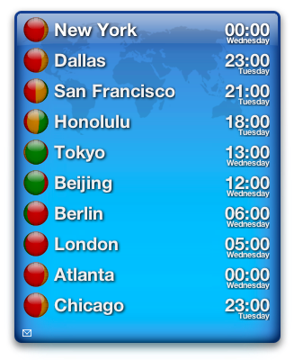
Teleconference Schedule
Motion:
Approve the following schedule of weekly teleconferences.
Tuesdays 00:00ET ( 23:59.59…. on Monday) on 4th June, 18th June and 2nd July 2013 Tuesday
Duration 1Hour
Using WEB-EX that will be provided by Task Group Chair
Moved: Lei
Sconded: Jarkko Kneckt
18-1-2
Approved by unanimous consent

Slide 10
Reference
March 2013 Orlando Session Minutes
https://mentor.ieee.org/802.11/dcn/13/11-13-0388-01-00ai-march-2013-orlando-session-minutes.doc
March -May Teleconference Minutes 13-0412/05
https://mentor.ieee.org/802.11/dcn/13/11-13-0412-05-00ai-march-may-teleconference-minutes.doc
Closing report (include motion slides)

Slide 11
Thanks to all who participated!

