Slide 1
A Mechanism to Provide QoS in IEEE 802.11e
MAC
Date: 2013-05-14
Authors:
Notes:
January 2010
, Cisco Systems

Slide 2
IEEE 802.11e MAC for QoS
IEEE 802.11 employ CSMA/CA at MAC layer to provide best-effort service.
To support MAC-level QoS, IEEE 802.11 standardization committee published IEEE 802.11e, a supplement to the original IEEE 802.11 MAC. The MAC layer defined in IEEE 802.11e employs a contention-based part called Enhanced Distributed Channel Access (EDCA) and a contention-free centrally controlled part called Hybrid coordination function Controlled Channel Access (HCCA).
Slide 2
Notes:
doc.: IEEE 802.11-10/xxxxr0
Xie Gang, Cisco Systems
Page 2
2013/5/17June 2010
Xie Gang, Cisco Systems

Slide 3
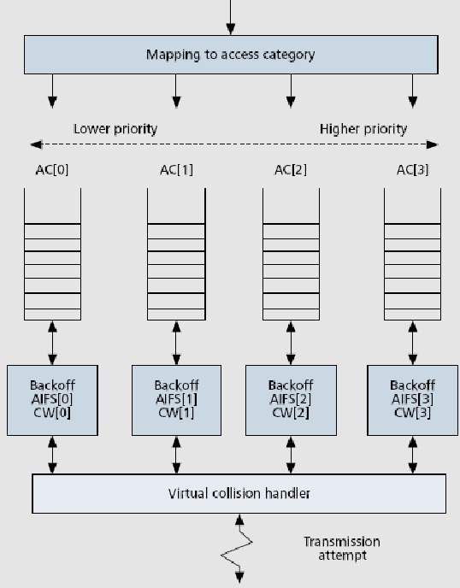
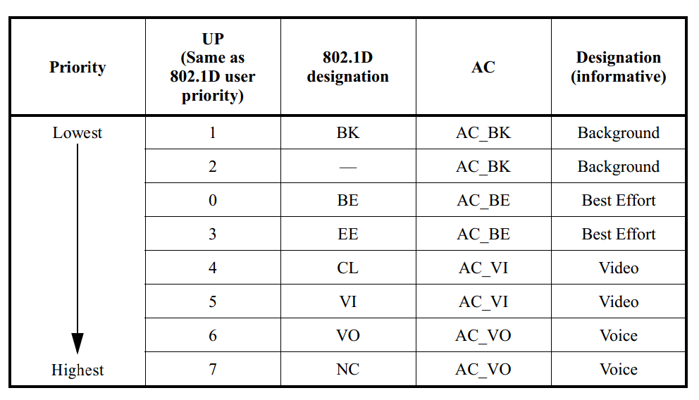
EDCA in IEEE 802.11e
EDCA provides differentiated, distributed access to the wireless medium (WM). It defines four access categories (ACs) to provide QoS for the delivery of traffic at the stations.
Slide 3

Slide 4
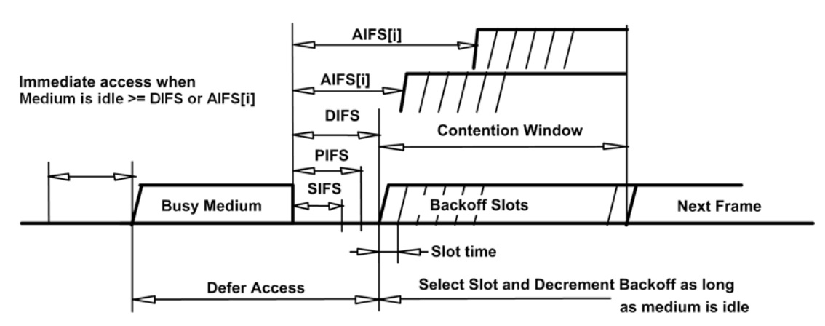
EDCA in IEEE 802.11e
ECDA defines two basic priority mechanisms for accessing the channel:
different per-class setting of the contention window (CW) backoff parameters (CW_{min} and CW_{max})
different per-class setting of the idle time after which a transmission may occur (arbitration inter-frame space, AIFS).
Slide 4

Slide 5
EDCA in IEEE 802.11e
CW differentiation:
The CW differentiation is to lower the contention window size of high priority traffic thus to increase high priority traffic’s channel access probability. So CW differentiation causes more contentions and thus decreases the throughput. With the increase in the number of competing stations, high priority throughput and total throughput is reduced significantly. The throughput differentiation provided by this mechanism is paid for the decrease of throughput.
AIFS differentiation
AIFS differentiation introduces protected slots after every busy channel period in which a lower number of stations compete. The percentage of protected slots significantly increases as long as number of competing stations increases thus low priority stations are penalized while high priority stations don’t experience much throughput reduction.
Slide 5

Slide 6
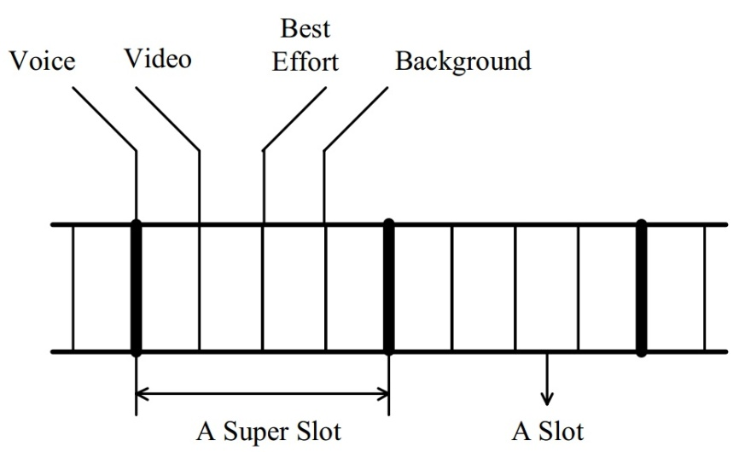
A new mechanism to Provide QoS
This new mechanism is to assemble several slots together to form a super slot, and assign different slots in the super slot for different priority traffic to send frames (Super Slot Mechanism, SSM). If many stations with different class of traffic all want to send frame in a super slot, only the highest priority traffic can get the transmission opportunity (TXOP)
Slide 6

Slide 7
Simulation Parameters
IEEE 802.11b Direct Sequence, 11Mbps, none RTS/CTS, CW_{max}=(CW_{min}+1)*2⁵-1, payload size is uniform 1023 bytes.
A super slot contains two slots, CW_{min}=31. The number of high priority stations is the same as that of low priority stations.
Every station only has one priority traffic.
Every station is under the saturation conditions.
Slide 7

Slide 8
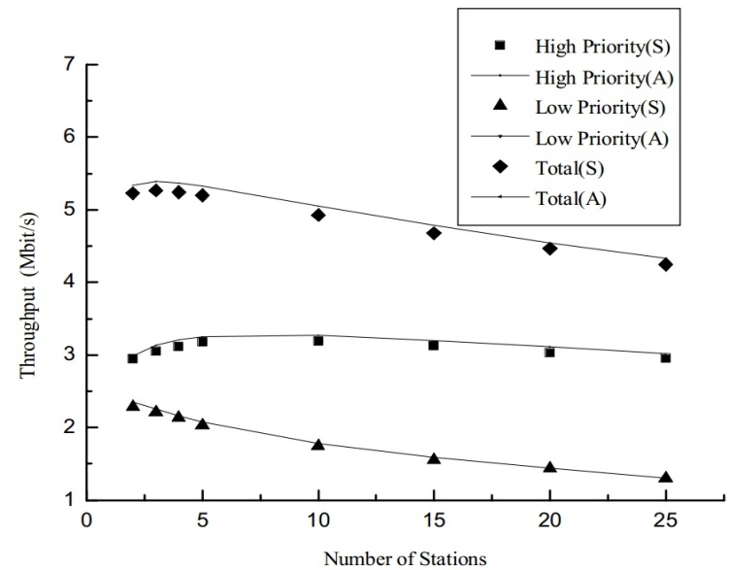
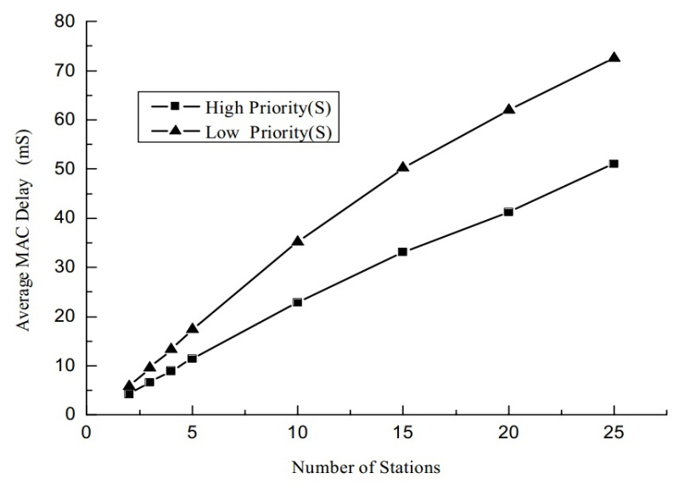
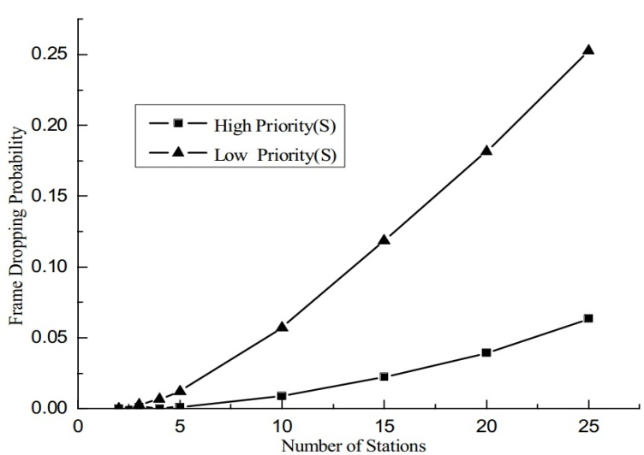
SSM’s Performance
Slide 8

Slide 9
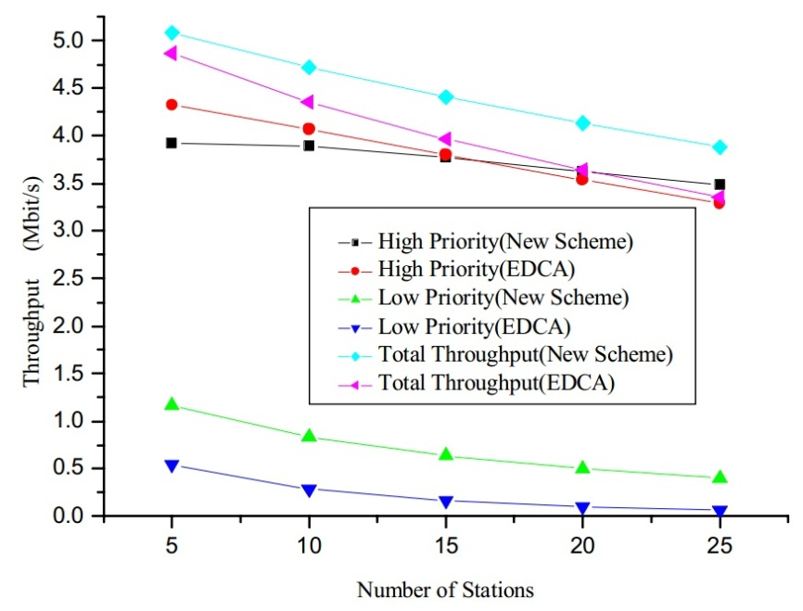
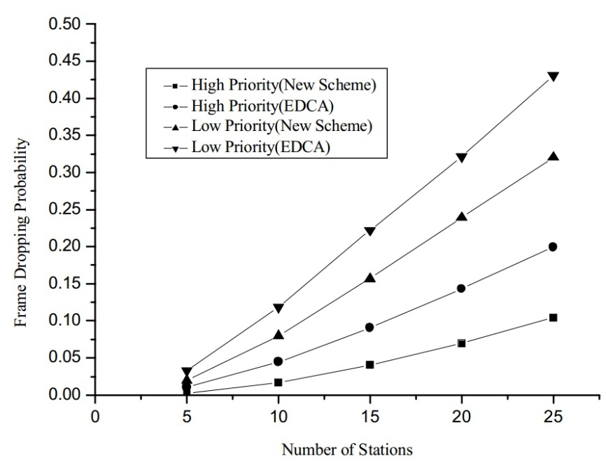
SSM VS. EDCA
 | Type of Priority | CWmin | AIFSN | SSM
New Scheme | High Priority | 24 | 2 | Y
 | Low Priority | 32 | 4 | Y
EDCA | High Priority | 16 | 2 | N
 | Low Priority | 32 | 4 | N
Slide 9

Slide 10
Summary
We propose a new mechanism to provide QoS service in IEEE 802.11 MAC. The new mechanism guarantees the throughput, MAC delay and the frame dropping probability of the high priority traffic. This mechanism is good and robust. Applying this new mechanism can improve the performance of IEEE 802.11e EDCA greatly.
Slide 10

Slide 11
Reference
[1] IEEE P802.11-2010: Wireless LAN Medium Access Control (MAC) and Physical Layer (PHY) Specifications.
[2] Kai Kang, Xiaokang Lin, Aili Wang. A new mechanism to provide QoS in IEEE 802.11 MAC. 64th IEEE Vehicular Technology Conference, 2006. VTC-2006 Fall, Montreal, Canada, September 2006: 2574-2578. (EI Accession number: 20073110737736)
[3] Kai Kang, Xiaokang Lin, Haibo Hu. A virtual collision mechanism to decrease collisions in IEEE 802.11 MAC layer. 65th IEEE Vehicular Technology Conference, 2007. VTC-2007 Spring, Dublin, Ireland, April 2007: 1188-1192. (EI Accession number: 20073110724604)
[3] Kai Kang, Hongqi Jiang, Xiaokang Lin. Research on multi-slot virtual collision mechanism for IEEE 802.11 DCF. 68th IEEE Vehicular Technology Conference, VTC 2008-Fall, Calgary, Canada, September 2008. (EI Accession number: 20090211849682)
[5] Giuseppe Bianchi, Vergata Ilenia Tinnirello. Understanding 802.11e Contention-Based Prioritization Mechanisms and Their Coexistence with Legacy 802.11 Stations. IEEE Network, 2005, July/August: 28-34.
Slide 11

Slide 12
Thank You
Slide 12

