Slide 1
A Virtual Collision Mechanism for IEEE 802.11 DCF
Date: 2013-05-14
Authors:
Notes:
January 2010
, Cisco Systems

Slide 2
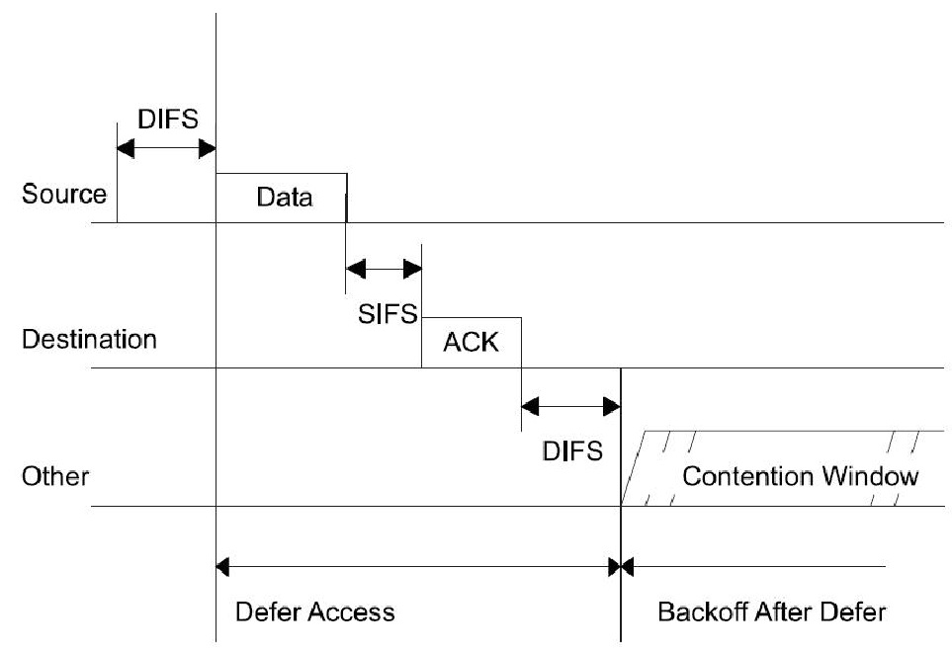
CSMA/CA Mechanism in IEEE 802.11 DCF
Slide 2
IEEE 802.11 Medium Access Control (MAC) layer employs a mandatory contention-based channel access function called Distributed Coordination Function (DCF). DCF adopts a Carrier Sense Multiple Access with Collision Avoidance (CSMA/CA) mechanism with binary exponential backoff.

Slide 3
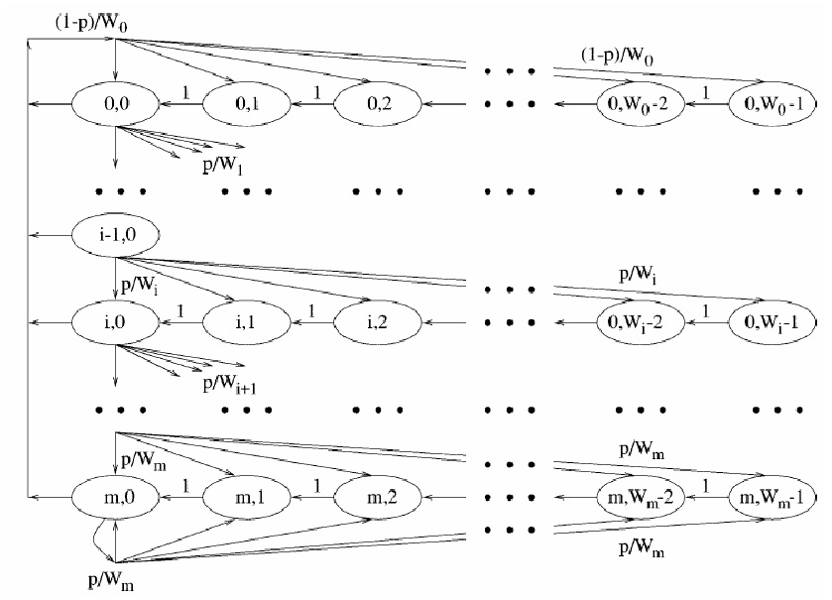
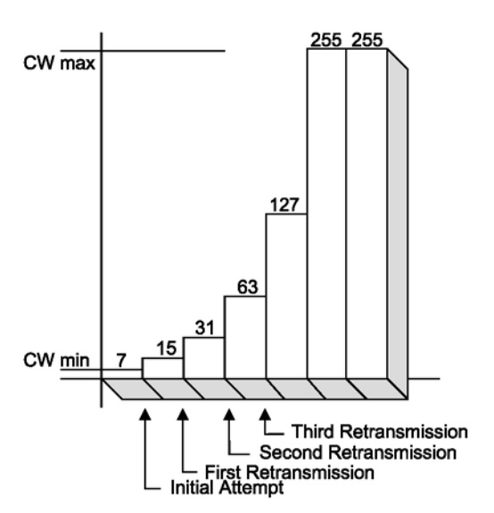
CSMA/CA Mechanism in IEEE 802.11 DCF
It is summarized from current standard that in DCF stations detect the channel status by collisions. If a transmitted packet collides, the station will assume that the channel is busy, then double its contention window size to fit the busy channel and select a new backoff time waiting for retransmission.
Slide 3

Slide 4
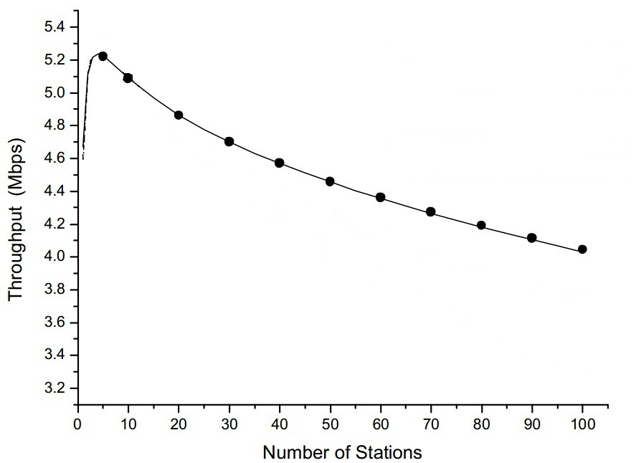
CSMA/CS’s Performance
The CSMA/CA in DCF is very efficient in light load Basic Service Sets (BSSs). But in high load BSSs, a packet will encounter a few collisions before being successfully transmitted. These collisions waste the channel resource and thus decrease the throughput. They also waste energy and lower the battery persistence duration.
Slide 4

Slide 5
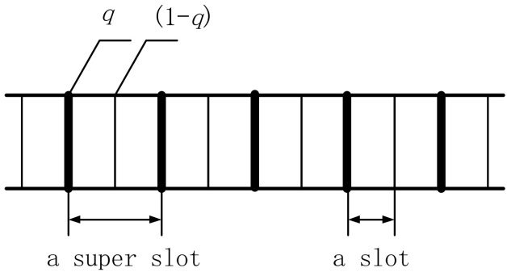
Virtual Collision Mechanism (VCM)
A super slot is defined as a period of time including two slots. In a super slot, every beginning of the two slots is used for stations to send packets. When a station is waiting for transmitting, it monitors the channel activities. The station’s backoff time counter decreases in terms of super slot time as long as the channel is sensed idle, and it does not decrease if the idle time is less than a super slot. Thus one station has one chance to send packets in a super slot at most. When a station sends a packet in a super slot, it sends it at the first slot with probability q and at the second slot with probability (1- q).
Slide 5

Slide 6
The Decrease of Real Collisions In VCM
(q=0.4)
The number of other transmitting stations | DCF | VCM
 | The possibility of real collisions | The possibility of successful transmissions | The possibility of virtual collisions | The possibility of real collisions
1 | 1 | 0.24 | 0.24 | 0.52
2 | 1 | 0.144 | 0.384 | 0.472
3 | 1 | 0.0864 | 0.4704 | 0.4432
4 | 1 | 0.05184 | 0.52224 | 0.42592
Slide 6

Slide 7
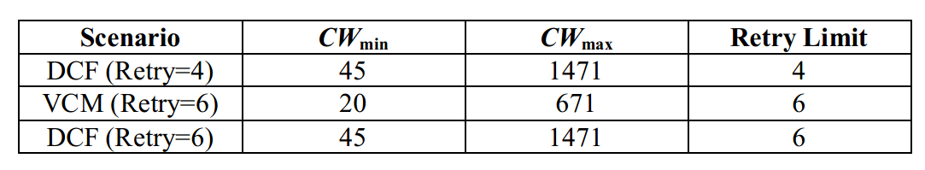
Simulation Parameters
IEEE 802.11b Direct Sequence, 11Mbps, none RTS/CTS, CW_{max}=(CW_{min}+1)*2⁵-1, payload size is uniform 1023 bytes.
DCF (Retry=4) is selected as the reference scenario. Because in VCM a part of collisions are virtual collisions, Retry=6 is used in VCM. We also select DCF (Retry=6) as the reference scenario.
Because the contention window size has great impact on WLAN’s performance, in order to fairly compare the performance between VCM and DCF, in each scenario we select the CW_{min} as the simulation parameter by which the BSS gets its maximum throughput with 5 stations.
Every station is under the saturation conditions.
Slide 7

Slide 8
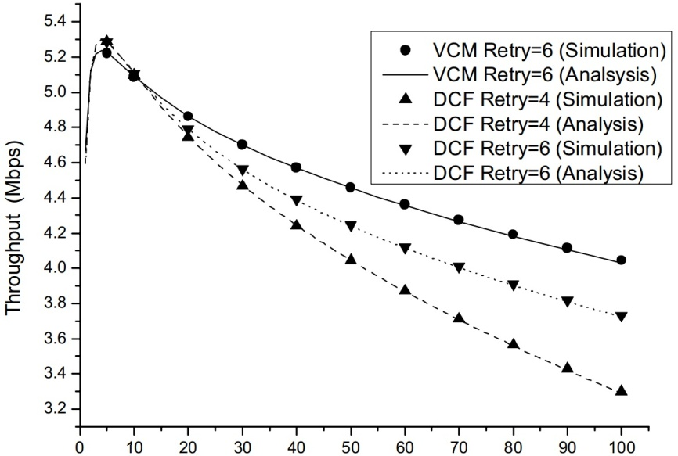
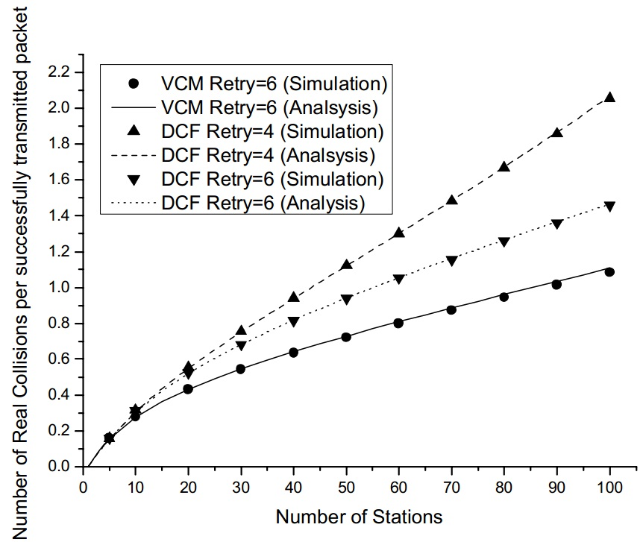
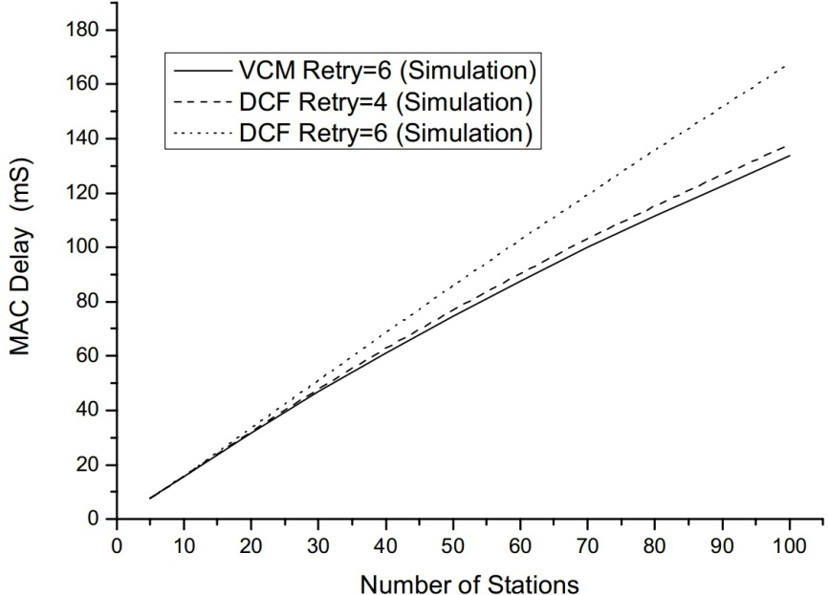
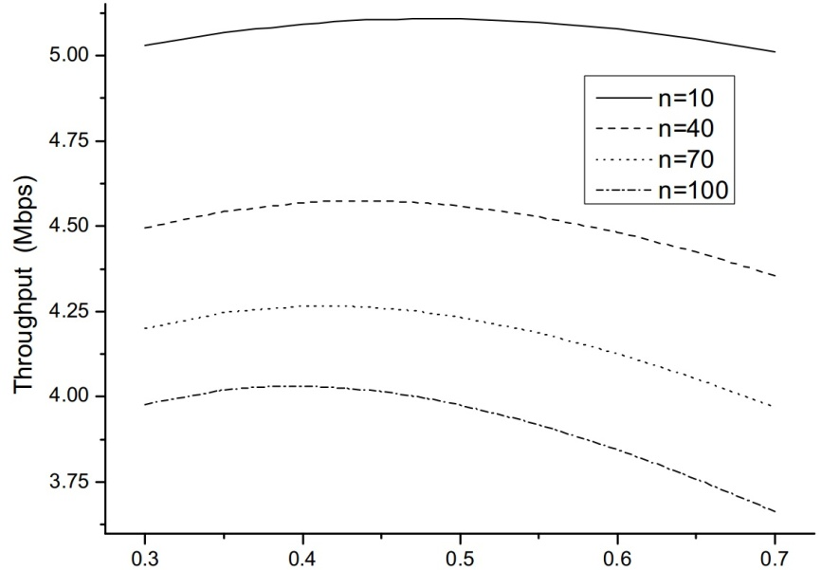
VCM Performance
Slide 8

Slide 9
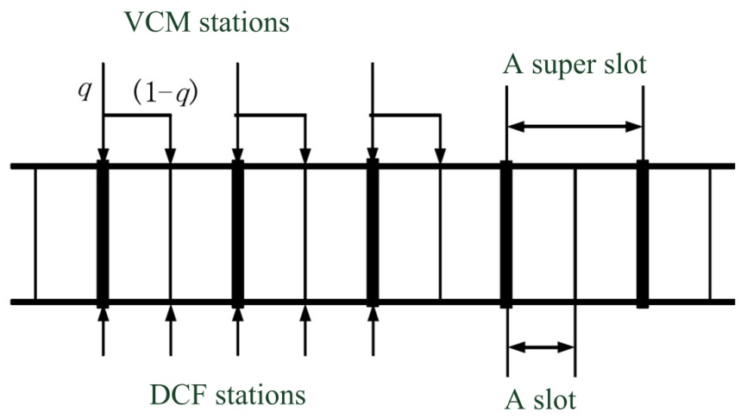
VCM Co-existence
VCM is compatible to DCF and VCM stations can co-exist with DCF stations.
Slide 9

Slide 10
Summary
A mechanism named virtual collision mechanism is proposed to decrease collisions in IEEE 802.11 DCF, which is to assemble two slots into a super slot. When more than one station transmits in a super slot all together, the VCM changes a part of collisions into virtual collisions or successful transmissions, thus the possibility of real collision occurrence is decreased.
When a BSS is under high load, applying the virtual collision mechanism increases the throughput and lowers the energy consumed by collisions considerably. The performance improvement increases as the number of stations increases.
The VCM is a simple, easy way to implement and effective mechanism to decrease collisions. It is compatible to DCF.
Slide 10

Slide 11
Reference
[1] IEEE P802.11-2010: Wireless LAN Medium Access Control (MAC) and Physical Layer (PHY) Specifications.
[2] Kai Kang, Xiaokang Lin, Haibo Hu. A virtual collision mechanism to decrease collisions in IEEE 802.11 MAC layer. 65th IEEE Vehicular Technology Conference, 2007. VTC-2007 Spring, Dublin, Ireland, April 2007: 1188-1192. (EI Accession number: 20073110724604)
[3] Kai Kang, Hongqi Jiang, Xiaokang Lin. Research on multi-slot virtual collision mechanism for IEEE 802.11 DCF. 68th IEEE Vehicular Technology Conference, VTC 2008-Fall, Calgary, Canada, September 2008. (EI Accession number: 20090211849682)
Slide 11

Slide 12
Thank You
Slide 12

