Slide 1
Performance Evaluation for 11ac
Date: 2013-05-15
Authors:
Wu Tianyu

Slide 2
Content
Introduction
Simulation Parameters
Full buffer traffic evaluation
  Single BSS
  OBSS
  Hybrid traffic evaluation
  Single BSS
  OBSS
  Summary
Wu Tianyu

Slide 3
Introduction
Future applications require higher throughput and better QoS in dense deployed scenario[1]
  Real-time multimedia services such as higher definition (3D) video will demand over 600Mbps throughput and very small delay (~10ms).
  Widely adopted cloud services may lead to dense deployment scenario such as wireless office.
802.11ac supports the peak PHY data rate up to 6.93Gbps, can it be meet the requirements for the future high throughput applications?
This presentation gives some simulation results to answer this question.
Wu Tianyu

Slide 4
Simulation Parameters(1/2)
Parameter | Value
General settings | Refer to [2,3] for details. All the parameters and assumptions not explicitly stated here follows these documents.
Central frequency | 5.25GHz
Bandwidth | 160MHz
symbol structure | symbol duration is 4us, CP length is 0.8us,
Transmission power | AP: 17dBm(50mW) STA: 17dBm(50mW)
Downlink transmission scheme | 8x8 closed-loop BF-SU-MIMO, non-quantized pre-coding
Downlink receiver type | MMSE
Uplink transmission scheme | 8x8 closed-loop BF-SU-MIMO, non-quantized pre-coding
Uplink receiver type | MMSE
Wu Tianyu

Slide 5
Simulation Parameters(2/2)
Antenna configuration | Antenna type: omni-directional antenna Vertically polarized antennas AP antenna number:8 STA antenna number: 8 0.5 wavelength separation at STA and AP
Channel estimation | Ideal
Implementation loss | 0dB
Floor noise power spectrum density | -174 dBm/Hz
Noise figure | AP: 10dB STA: 10dB
Channel model | 802.11 TGac channel model D(enterprise scenario)
Traffic model | Full buffer/Video(~600Mbps)/cloud-based VDI(~100Mbps)
Wu Tianyu

Slide 6
Single BSS with Full Buffer Traffic(1/3)
Simulation Topology
  STAs are uniformly placed in the 20mX20m area, and AP is in the centre.
Figure 1
Wu Tianyu

Slide 7
Single BSS with Full Buffer Traffic(2/3)
MAC efficiency with different number of STA and different TXOP(1/2/3ms)
From the curves, the MAC efficiencies are very low, especially for small TXOP.
Figure 2
Wu Tianyu

Slide 8
Single BSS with Full Buffer Traffic(3/3)
Throughput with different number of STA and different TXOP(1/2/3ms)
From the curves, the throughputs are far from the peak PHY data rate, especially for small TXOP.
Figure 3
Wu Tianyu

Slide 9
OBSS with Full Buffer Traffic(1/3)
Simulation Topology
  STAs are uniformly placed in the four 20mX20m areas, and 4 APs in the centre of each area.
Figure 4
Wu Tianyu

Slide 10
OBSS with Full Buffer Traffic(2/3)
MAC efficiency with different number of STA and different TXOP(1/2/3ms)
From the curves, the MAC efficiencies are very low, especially for small TXOP.
Figure5
Wu Tianyu

Slide 11
OBSS with Full Buffer Traffic(3/3)
Throughput with different number of STA and different TXOP(1/2/3ms)
From the curves, the throughputs are far from the peak PHY data rate, especially for small TXOP.
Figure 6
Wu Tianyu

Slide 12
Single BSS with Hybrid Traffic(1/3)
Simulation Topology
  the same as Figure 1
  Simulation Parameters
  Number of STA: 20
  Number of STA with video traffic(~600Mbps):4
  Number of STA with cloud-based VDI traffic(~100Mbps): 16
Wu Tianyu

Slide 13
Single BSS with Hybrid Traffic(2/3)
Video traffic throughput with TXOP of 3ms
From the curves, the throughputs are far from the required video data rate(~600Mbps).
Figure 7
Wu Tianyu

Slide 14
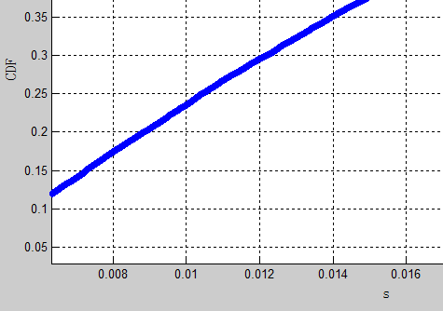
Single BSS with Hybrid Traffic(3/3)
Delay CDF with TXOP of 3ms
From the curves, delay of 76% video packet is larger than 10ms.
Figure 8
Wu Tianyu

Slide 15
OBSS with Hybrid Traffic(1/3)
Simulation Topology
  The same as Figure 4
  Simulation Parameters
  Number of STA in each BSS: 20
  Number of STA with video traffic(~600Mbps) in each BSS:4
  Number of STA with cloud-based VDI traffic(~100Mbps) in each BSS: 16
Wu Tianyu

Slide 16
OBSS with Hybrid Traffic(2/3)
Video throughput with of TXOP 3ms
From the curves, the throughputs are far from the required video data rate(~600Mbps).
Figure 9
Wu Tianyu

Slide 17
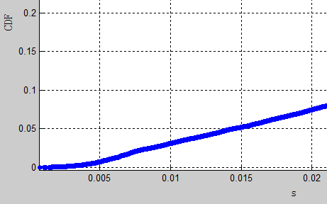
OBSS with Hybrid Traffic(3/3)
Delay CDF with TXOP of 3ms
From the curves, delay of 97% video packet is larger than 10ms.
Figure 12
Wu Tianyu

Slide 18
Summary
Full buffer and hybrid traffics are evaluated in single and overlapped BSS scenario.
  The MAC efficiency decreases with the increasing of STA number, OBSS number and decreasing of TXOP length.
  Delay requirement of HD video traffic is difficult to meet with 802.11ac in dense deployment scenario.
Next steps
  Discussion on the evaluation methodology according to the function requirements and use cases for HEW.
  Discussion on potential technical solutions to fulfill the requirements of HEW.
Wu Tianyu

Slide 19
Appendix
MAC efficiency definition[4]
Total MAC payload (bits)
MAC throughput =
Time consumed transmitting total MAC payload (sec)
MAC throughput
MAC efficiency =
PHY average rate
Wu Tianyu

Slide 20
References
[1] 11-13-0313-00-0wng-usage-models-for-next-generation-wi-fi-r1.pptx, huawei
[2]11-03-0940-04-000n-tgn-channel-models.doc, IEEE
[3]11-09-0569-00-00ac-tgac-channel-model-addendum-supporting-material.doc, IEEE
[4]Analysis on IEEE 802.11n MAC Efficiency, IEEE 802.11-07/2431r0
Wu Tianyu

