Slide 1
Proposed HEW Usage Models
Date: 2013-05-14
Attendees from NTT:

Slide 2
Abstract
During the March 2013 session, Huawei presented an initial usage models for HEW[1].
This slide set contains important usage models for operators, i.e., home and public access (hotspot) scenarios, proposed for consideration in the HEW SG.

Slide 3
Future Wireless Home Network Scenario
As Samsung presented in January[2], there are many emerging applications for the WLANs such as UDH 4K and UHD 8K videos.
High speed wireless home network
  In addition to the existing use cases, the HEW system should support emerging rich applications.
High density deployment
  As the channel bandwidth is extended up to 160 MHz by 802.11ac, consideration for high density deployment will be very important.

Slide 4


Future Public Access (Hotspot) Scenarios
The WLANs have been an important infrastructure for the operators’ services and are expected to support increasing mobile data traffic together with the cellular systems.
User should be able to come and go between the cellular and WLAN service areas without regard to the difference of the medium
AAA, DHCP, DNS, ANQP, etc.
Macro cell area
Femto cell/Pico cell area
WLAN area
Co-located area of femto/pico-cells and WLAN BSSs

Slide 5
Usage models
In addition to the Use Models presented in March 2013 session, we would like to propose some Usage Models for consideration.

Slide 6


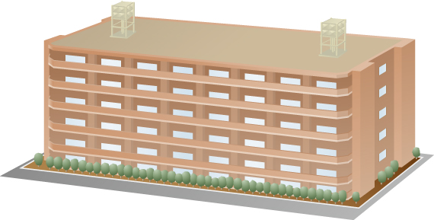

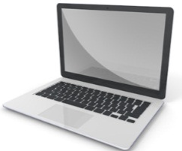
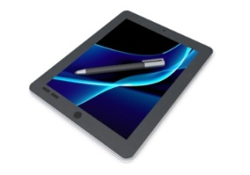
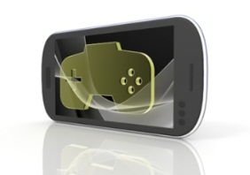
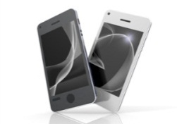
Home Usage Case
4k or more …
Cloud service
Tablet, PC and
Smartphone
Portable / TV Game
High bandwidth applications stimulate growth in demand on Next Generation WLAN
Higher adoption of real-time multimedia services and evolving higher definition video formats require bigger pipe/higher bandwidths, QoS, and the implementation of converged networks.
At the same time, consideration for the OBSS will be required in some cases such as apartment house scenarios.
Guest Access may be provided over the residential hotspot using multiple SSID

Slide 7
Home
Pre-Conditions
Many WLAN networks installed by the home users operate in high density environment (overlapping each other). Home users have a variety of terminals such as TV, PVR, PCs, tablets and game terminals and access the personal cloud services and/or SNS over the WLAN.
Environment
Most of the home users have one or more WLAN APs. Distance between two APs ranges from 5 to 20 m and the WLAN areas overlap each other.
Applications
Video Stream (from cloud or YouTube etc.)
Video chat or VoIP (smart phone)
Online game
Cloud-based application as big storage
Traffic Conditions
Potential interference from overlapping networks (e.g. neighbors, other WLANs). Data transfers and video display should be operational simultaneously. Consideration for QoS for the streaming applications such as VoIP and high quality video will be needed.
Use Case
Users watch the high quality video contents coming from the Internet or video contents stored in their PVR with VHD Display. There may be another video streams to be recorded in the Blu-ray deck.
People enjoy playing online games or local game machine with two or more people.
There may be other users just accessing the Internet for email access, web browsing, etc.
Tele-work using VPN

Slide 8
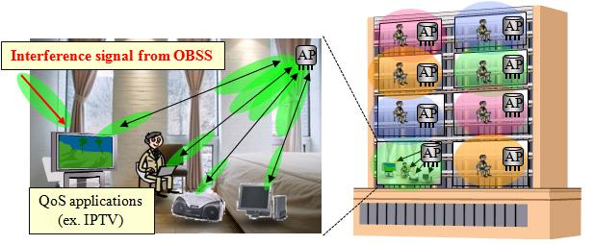
Statistical analysis for the number of OBSSs according to “Housing and Land Survey*” in Japan
The Japanese governmental survey shows:
  More than 40% houses are apartment houses (about 20 million in all of 49.6 million dwellings).
  The average area of floor space per dwelling in apartment house is about 520 ft² (= 48 m²).
  About 75% apartment houses are made of reinforced steel-framed concrete.
Operators’ perspective:
  It is expected that 802.11ac standard will extend capacity of wireless home network which conveys network services (ex. on-demand video streaming services) to subscribers not only detached house but also apartment house users.
It is important to examine the wireless environment in apartment house users
*“Housing and Land Survey in 2008” done by
Statistics Bureau in Ministry of Internal Affairs and Communications, Japan. http://www.stat.go.jp/english/data/jyutaku/index.htm

Slide 9
Statistical analysis for the number of OBSSs according to “Housing and Land Survey*” in Japan
Evaluation conditions:
  Ave. dimensions of each apartment*: W / L / H = 16.5 / 33 / 10 [ft]
  Tx power: 13 dBm@5GHz
  Power loss of room wall and floor: 13 [dB]
  APs location: Each AP is placed at the center of each apartment house
  Carrier sense level (which is equal to interference threshold):
  -82dBm@20MHz / -79dBm@40MHz / -76dBm@80MHz / -73dBm@160MHz
Bandwidth expansion to more than 40MHz causes one or more OBSSs in above apartment environment.
  Some kinds of techniques to reduce the influence of OBSSs should be considered.
* Based on the “Housing and Land Survey, 2008.”
Bandwidth per channel | The # of interfering BSSs | The # of available channels | The # of OBSSs in expectation
20MHz | 10 | 19 | 0
40MHz | 10 | 9 | 0.22
80MHz | 8 | 4 | 1.25
160MHz | 4 | 2 | 1.50
Interference level [dBm] in each apartment because of the AP in the top left apartment.
(AP)
-60.33
-83.87
-52.72
-75.71
-97.53
-76.25
-93.20
-112.2
-95.42
-110.4
-127.2

Slide 10
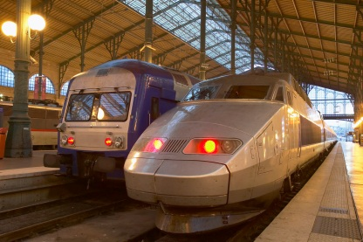
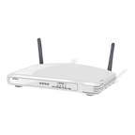




Public Access – Airports and Train Stations
Airports and train stations are typical places where many service providers install their APs and many passengers use WLAN services.
The Next Generation Wi-Fi is expected to provide very high capacity for the people using bandwidth consuming applications in a dense deployed environments.
VPN access to the office
Talking over
video phone
streaming video

Slide 11
Public Access in Airports and Train Stations
Pre-Conditions
High density users access internet through multiple operators’ WLAN network. WLAN network operators may control multiple operators’ WLAN networks uniformly.
Environment
The environment is very complex and may suffer severe interference
Each AP serves 120 users in a 200m2 area. The inter-AP distance is in the range of 15~20m. Single/multiple operators.
Applications
Video based applications: TV, VOD, Video conference; VHD highly compressed. 60 x 100 Mbps = 6 Gbps
VPN applications; 20 x 20 Mbps = 0.5 Gbps
Game online; 100 Mbps, < 20 ms jitter; < 20 ms latency. 20 users x 100 = 2 Gbps
Internet access: email, twitter, web surf, IM. 20 users x 20 Mbps, best effort = 0.8 Gbps
Traffic Conditions
Potential interference from overlapping networks (e.g. neighbors, other WLANs). Data transfers and video display should be operational simultaneously.
Use Case
Travelers are using the network to surf websites, watch movies, play online games and access cloud services.

Slide 12
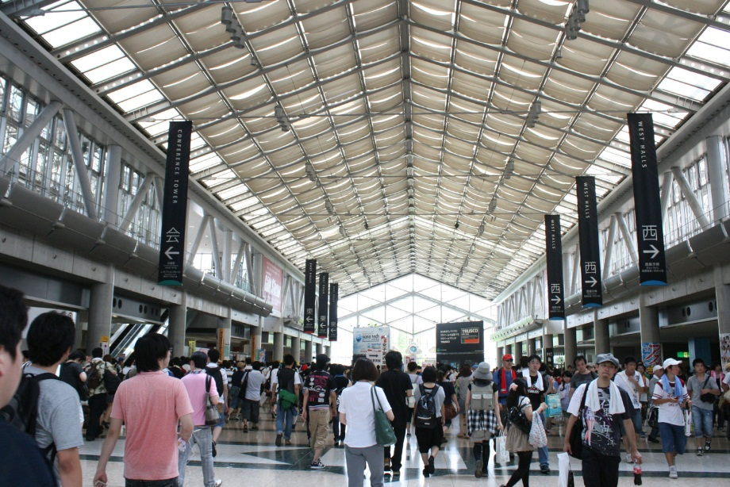
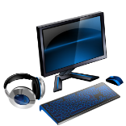


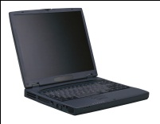
Public Access – Exhibition Hall
Exhibition halls are another examples of high density deployment use cases. There may be many WLAN networks installed be the exhibitors and event coordinator.
People access the digital contents such as demonstration and promotion video files that the exhibitors prepared from the exhibitors’ APs or from the APs provided by the event coordinator. People also access the internet to see exhibitors’ web sites, to send reports to the companies, etc.
VPN access to the office

Slide 13
Public Access in an Exhibition Hall
Pre-Conditions
High density users access internet and local contents prepared by the exhibitors. Exhibitors may have their own APs installed or use the shared AP that the event coordinator.
Environment
There will be many APs and STAs and may suffer severe interference. Each AP serves 100 users in a 100m2 area. The inter-AP distance is in the range of 5~10m.
Applications
Video based applications: VOD, Contents Downloading; VHD highly compressed. 60 x 100 Mbps = 6 Gbps
VPN applications; 20 x 20 Mbps = 0.5 Gbps
Contents (Picture) Uploading;
Internet access: email, twitter, web surf, IM. 20 users x 20 Mbps, best effort = 0.8 Gbps
Traffic Conditions
Potential interference from overlapping networks (e.g. neighbors, other WLANs). Data transfers and video display should be operational simultaneously.
Use Case
Uses may download the digital contents such as demonstration and/or promotion video files to their laptops or tablets.

Slide 14
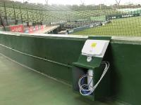
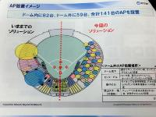
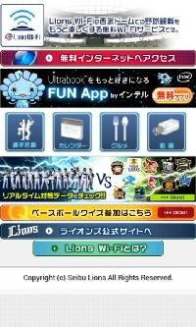
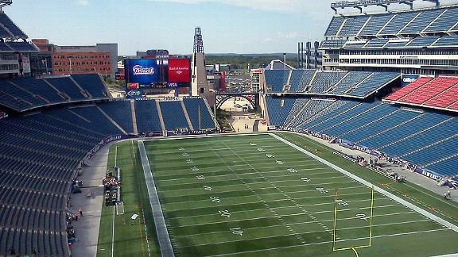
Public Access in a stadium
High bandwidth applications stimulate growth in demand on Next Generation WiFi
Higher adoption of real-time multimedia services and evolving higher definition video formats require bigger pipe/higher bandwidths, QoS, and the implementation of converged networks

Slide 15
Usage in Stadium - Public Access
Pre-Conditions
High density users have operational WLAN network for Internet access. The traffic is bursty in time and is uneven according to different users' participation in physical space.
Environment
Open area with few obstacles and single/multiple operators’ deployed multiple APs. Most of the transmissions are LOS and the layout of APs are frequently changed.
Applications
200 users at 20 Mbps best effort accessing the internet for recreational content 4 Gbps
20% of the users are following ESPN event or similar blog as supplemental event content.
40% of the users are receiving VHD video feed highly compressed. 80 x 100 Mbps = 8 Gbps
Traffic Conditions
Potential interference from overlapping networks (e.g. neighbors, other WLANs). Data transfers and video display should be operational simultaneously.
Use Case
users are attending an event in an outdoor stadium.
Users access the internet for recreational content, supplemental event content, and live video and/or audio event content.

Slide 16
Summary
Expectation for the HEW system:
  to support the demands for mobile data communications together with cellular system, such as LTE-Advanced.
Some Usage Models for HEW presented.
  Home scenario
  Public access scenarios
Comments and feedbacks for the usage models are appreciated!

Slide 17
References
[1] 13/0313r0 “Usage Models for Next Generation Wi-Fi,” Osama Aboul-Magd (Huawei)
[2] 13/0113r0 “Applications and Requirements for Next Generation WLAN,” Huai-Ron Shao (Samsung)
[3] 13/0287r3 “Beyond 802.11ac - a very high capacity WLAN,” Yasuhiko Inoue (NTT)
[4] 10/1293r3 “Performance evaluation of MU-RTS under OBSS environment,” B. A. Hirantha Sithira Abeysekera (NTT)
[5] 08/1470r4 “Overlapping BSS Analysis of Channel Requirements”, Graham Smith (DSP Group)

