Slide 1
Coexistence and Optimization of Wireless LAN: Time, Frequency, Space, Power, and Load
Date: 2013-05-16
Authors:

Slide 2
Abstract
This presentation addresses some issues in “Technical Feasibility” in the 5C
A review of space-time-frequency waterfilling techniques
  Current time-frequency-space optimization techniques
  Some recent research
    WiFox
  In HEW, we will want to optimize
    Distribution of bits/packets across space-time-frequency-power-load
    Across multiple APs
  Issues of managed vs. unmanaged environments
Technical issues in developing Feasible HEW Solutions
Notes:
doc.: IEEE 802.11-yy/xxxxr0

Slide 3
Technical Feasibility – Criterion 4
4 Technical Feasibility
  For a project to be authorized, it shall be able to show its technical feasibility. At a minimum, the proposed project shall show:
  a) Demonstrated system feasibility.
  b) Proven technology, reasonable testing.
  c) Confidence in reliability.

Slide 4
What problem are we really trying to solve?
Robustness with high densities of APs and STAs
Two ways to view the problem:
  We’re trying to replicate the wired experience in a wireless environment - “Wireless is a noisy, unreliable, insecure piece of wire”
  What we are trying to do is space-frequency-time-power waterfilling
In either case, we are trying to deliver a specified bandwidth (bits/sec) to a point in space¹ in the presence of passive channel impairments, interference (non-802.11) and congestion (802.11), where we may care how long it takes to deliver a good packet (latency)
¹ Not necessarily an area

Slide 5
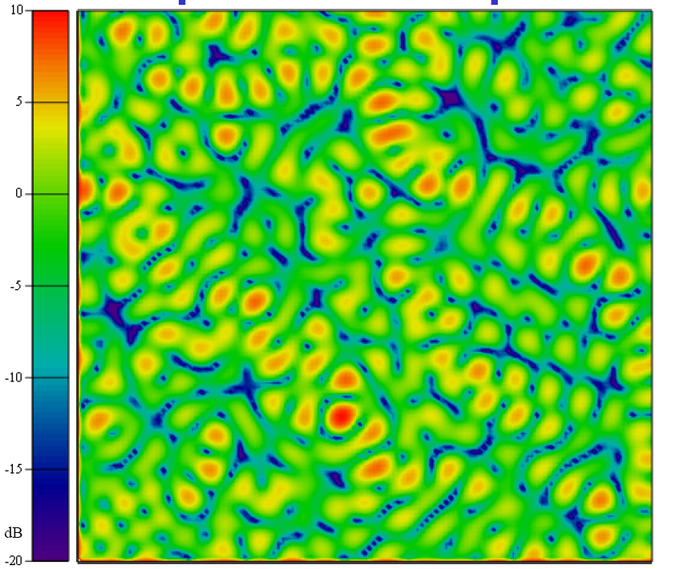
Channel impairments
We have a lot of tools in our toolbox to combat fading in frequency and space
  Equalization
  Diversity techniques
  OFDM
  And of course MIMO
MU-MIMO extends this concept
Optimally loading this 2-D space with signal energy is a waterfilling problem

Slide 6
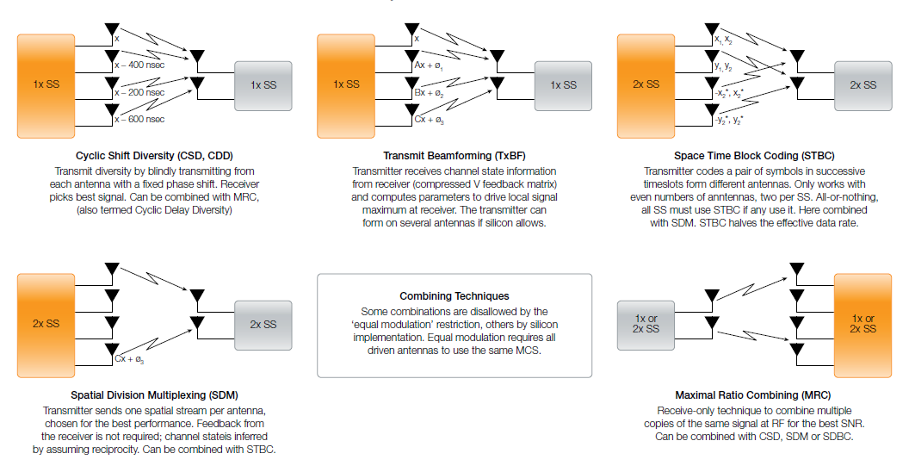
Space-frequency techniques
Source: Aruba white paper
With multiple antennas, we have lots of new options for space and frequency optimization

Slide 7
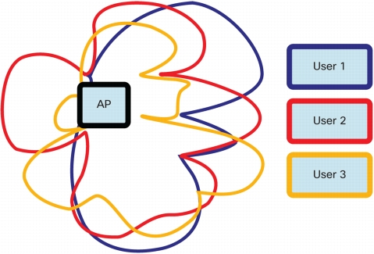
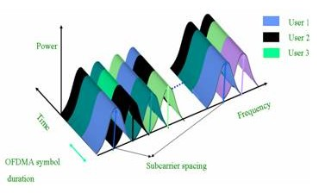
MU-MIMO, beamforming, and OFDMA add additional waterfilling capability
Source: Cisco white paper
Source: TU-Delft
DL-MU-MIMO shapes the transmit stream
Beamforming can also null interference and “rogue” (non-managed) APs
Both are forms of spatial waterfilling
OFDMA allows fine grained frequency-time waterfilling

Slide 8
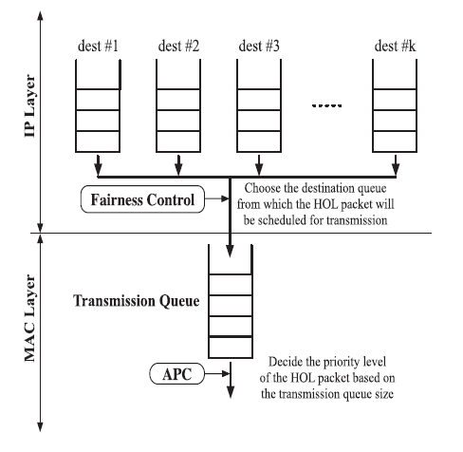
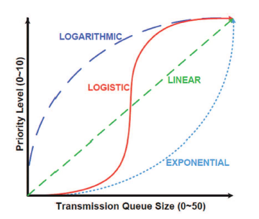
Time optimization
Numerous papers have been published on improving fairness, backoff, load balancing, and optimizing uplink-downlink traffic (see references for samples)
Most recent publication: “WiFox” from NC State [6]
  Prioritizes traffic at an AP based on queue depth
Source: WiFox paper [6]
Source: WiFox paper [6]

Slide 9
Robustness matters
Based on 10000 packets
At 25% PER, a 450mW chipset consumes the same power as a 600mW with negligible PER
Packet errors due to interference and congestion are especially catastrophic – “wasted air”
  Increases latency
  Lowers delivered throughput
  Increase effective power consumption of WLAN system
An optimal solution for HEW should minimize retries

Slide 10
What’s different about HEW?
Almost all the techniques we use or in the literature are designed to optimize performance around an access point or within a BSS
  Managed ESS is done by vendors
  Non-managed “sea of APs“ like an apartment building is generally not addressed
The lack of time-frequency-space-power-load optimization in non-managed environments is our biggest scaling problem
  “Tragedy of the Commons”
  Billions of devices that will never have any way to modify their behavior for HEW enhancements

Slide 11
Managed vs non-managed environments
Managed environments are not as chaotic
  With a controller, frequency and load can be managed
    If controllers had more information, could manage space and power better
  Manufacturers can and do use proprietary management algorithms
    Multi-vendor interoperability is preferable, however
Non-managed environments are a challenge
  Interference (OBSS or other) isn’t easily managed
    Antenna pattern nulling helps (CU student capstone project)
  Load balancing may not be possible
  Apartments and public spaces have multiple independent AP/BSS
    Interference management, spatial beam coordination, channel cannot be coordinated between APs today
    RTS/CTS is a sledgehammer
    P2P is also a major issue
  STAs that report more than 11k (PER, SINR, etc) would be helpful

Slide 12
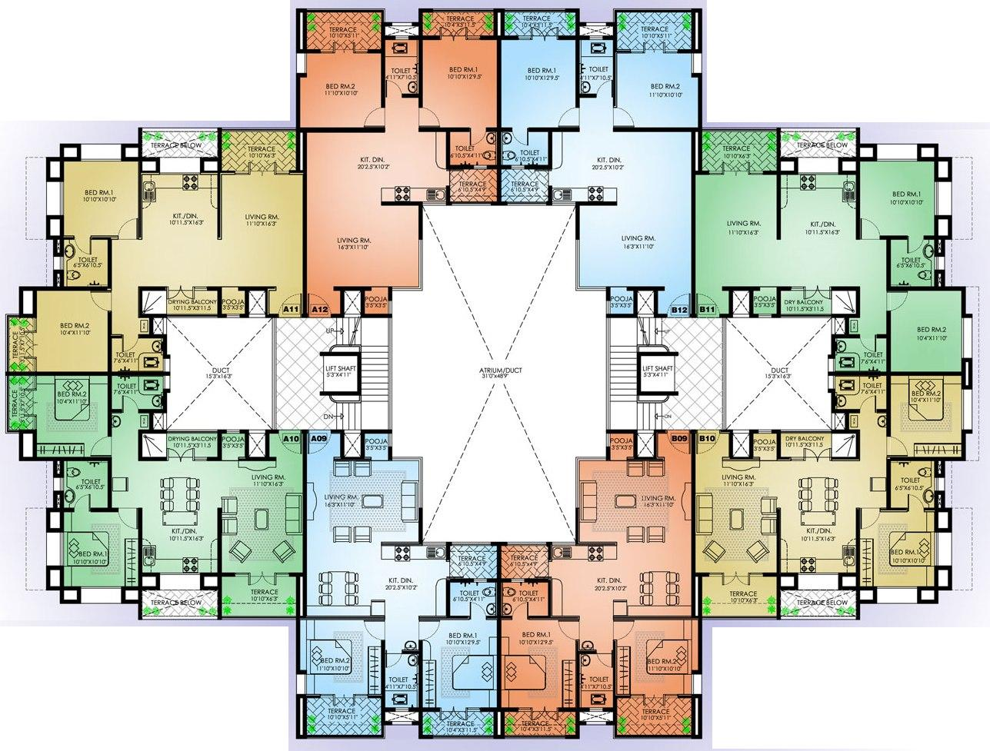
An example – apartment building
A high density environment could have:
  HEW APs and STAs
  Non-HEW APs and STAs
  802.11ac APs and STAs (MU-MIMO & beamforming)
Non-HEW APs can’t adapt in frequency-space-time-power
Security may not allow roaming
HEW systems must waterfill but still serve STAs
STAs can help AP “learn” interference map
P2P connections will complicate this!
This is just one floor
Non-HEW-AP
11ac-AP
HEW-AP
Non-HEW-AP
Non-HEW-AP
HEW-AP
HEW-AP
Non-HEW-AP
= AP
= STA

Slide 13
What is needed?
Techniques for distributed optimization
  AP-AP communication via DS, IAPP [☺], or 802.11aa
  Algorithms that globally (and autonomously) optimize:
    Antenna patterns
    Power levels
    Channel assignments
    Load (if STA is allowed to get packets from adjacent BSS)
    Making sure P2P doesn’t massively disrupt the optimization
Smarter access points
  Learn interference environment from other APs and STAs that report position, RSSI, SINR, and other parameters from that AP as well as other APs the STA can hear (enhanced 802.11k, including position reporting)
  Manage their own traffic loads more efficiently (WiFox?)
  Shields itself and members of its BSS from interference (antenna pattern nulling)
How do we globally optimize Time, Frequency, Space, Power, and Load, especially in non-managed environments?

Slide 14
Some References
Waterfilling
[1] “A Theoretical Framework for Capacity-Achieving Multi-User Waterfilling in OFDMA,” [from IEEExplore] http://ieeexplore.ieee.org/stamp/stamp.jsp?tp=&arnumber=5649661&isnumber=5648872
[2] “Multi-dimensional adaptation and multi-user scheduling techniques for wireless OFDM systems, [from IEEExplore] http://ieeexplore.ieee.org/stamp/stamp.jsp?tp=&arnumber=1204066&isnumber=27115
[3] “An efficient waterfilling algorithm for multiple access OFDM,” http://ieeexplore.ieee.org/stamp/stamp.jsp?tp=&arnumber=1188165&isnumber=26632
[4] “Comparison of Space-Time Water-filling and Spatial Water-filling for MIMO Fading Channels,” http://users.ece.utexas.edu/~jandrews/publications/SheHea_Globecom04.pdf
[5] OFDM Wireless LANs: A Theoretical and Practical Guide, Heiskala and Terry, pp. 154-159
Time scheduling
[6] “WiFox: Scaling WiFi Performance for Large Audience Environments,” http://conferences.sigcomm.org/co-next/2012/eproceedings/conext/p217.pdf
[7] “Runtime Optimization of IEEE 802.11 Wireless LANs Performance,” http://www.cs.unibo.it/bononi/Publications/tr_bon03.pdf
[8] “Channel Access Throttling for Overlapping BSS Management,” http://www2.research.att.com/~slee/pubs/CAT-OBSS-icc09.pdf

