Slide 1
Direction and Use Cases for HEW
Date: 2013-05-12
Authors:

Slide 2
Abstract
This document includes direction and use cases for HEW.

Slide 3
Direction for HEW : Wireless All over Wi-Fi
So far, Wi-Fi is used restrictively since it is a solution more fit to
single-link throughput than system throughput
indoor than outdoor
nomadic than mobile
non-real-time service than real-time
Motivation is becoming large to use Wi-Fi in most of ‘times’ and ‘places’, for most of ‘services’ and ‘devices’, by most of ‘business players’
“Wireless All over Wi-Fi” as a direction for HEW to reflect that motivation.

Slide 4
Direction for HEW : Wireless All over Wi-Fi
For “Wireless All over Wi-Fi”, enhancements on the followings are essential:
Single-Link Throughput
Peak per-user data rate
Most clear driver for the promotion of “HEW”
System Throughput
Maximum aggregated throughput, especially in dense situation
Most differentiating driver for “HEW”
Mobility
Especially for real-time services
Ease of Use
QoE guarantee of simultaneous services of a device
Enhanced peer-to-peer capabilities
Interworking with cellular systems

Slide 5
Single-Link Throughput
Possible ways to increase Single-Link Throughput:
Bandwidth
Need to consider the channel larger than 160 MHz in 5GHz.
Need to consider the channel larger than 40MHz in 2.4GHz?
# of Antennas
More than 8 antennas (e.g. 16 antennas) in both AP and device?
Maybe not, but, need to be considered for marketing purpose?
Others
Modulation order higher than 256-QAM?
Channel code rate higher than 5/6?

Slide 6
System Throughput
Possible ways to increase system throughput:
Bandwidth
Same logic with single-link throughput, i.e. up to 2 times in 5GHz
# of Antennas
More than 8 antennas only in AP? Can be carefully discussed in HEW
BSS density
BSS density can not be captured by aggregated throughput
BSS density can be captured by areal throughput
Do we need the concept of areal throughput to capture BSS density?
Overhead
PHY overhead reduction (e.g. STF/LTF)?
MAC overhead reduction (e.g., Acknowledge, procedural overhead)?
Need to discuss about the proper metric for system throughput and the following evaluation methodology.

Slide 7
Mobility
Do we need to enhance mobility over Wi-Fi? If so, how much?
In PHY scope,
Link level verification in medium-to-high mobility
In MAC scope,
Latency analysis of inter-AP handover for real time services
Need to discuss evaluation methodology for link level verification
Need to discuss analysis method for handover latency

Slide 8
Ease of Use
Need to discuss on the followings to enhance ‘ease of use’ of Wi-Fi
QoE guarantee of simultaneous services of a device
Enhanced peer-to-peer capabilities
Interworking with cellular systems

Slide 9
More on HEW
Need to discuss on the followings:
Spectrum usages
Including or excluding new bands in 2.4GHz and 5GHz?
How about new bands outside 2.4GHz and 5GHz below 6GHz (e.g. bands in 3GHz)?
Coexistence with legacy devices
HEW must not harm performance of legacy devices
Need to discuss about fairness with legacy devices
Do we need some way to relax coexistence with legacy according to the migration?
Multi-band operation between 2.4GHz and 5GHz
Do we need to consider it explicitly in standards?

Slide 10
Usages for HEW
In March meeting, basic terminologies and some usage models for HEW have been presented in [1]
Before going deeply, we may need to summarize all the usages proposed for HEW and among them, we can select which is really proper for HEW.
For that purpose, usages are summarized in [2].
Some usages that we think to be focused more in HEW are shown in the following pages.

Slide 11
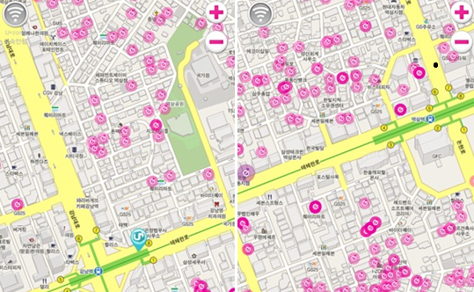
Urban Street – Public Access
Pre-Conditions
High density users access internet through multiple operator’ WLAN network. The traffic is bursty in time and is uneven according to different users' participation in physical space.
Environment
Outdoor with many obstacles and single/multiple operators’ deployed multiple APs. The inter-AP distance is in the range of 10 ~ 20m. User distribution density is about 0.5~ 1 user/ m².
Applications
Assume that there are 100 users per a AP: total 3.6 Gbps is required with low mobility supporting.
- 20% users: Video based applications (TV, VOD): UHD (4k*2k) highly compressed. 100 Mbps *20= 2Gbps.
- 20% users: Game online: 20 Mbps * 20 = 0.4 Gbps.
- 60% users: Internet access (email, twitter, web surf): 20 Mbps * 60= 1.2Gbps.
Traffic Conditions
Potential interference from overlapping networks (e.g. neighbors, other WLANs). Data transfers and video display should be operational simultaneously.
Use Case
Users are walking on GangNam street in Seoul, Korea.
Users see some high-quality video clips and access the internet to surf websites, watch Youtube, listen music streaming, play online games and/or chat with friends. QoE needs to be guaranteed as user is moving. Services are seamlessly continued through cellular and WLAN.
* A operator’s WLAN networks in GangNam (each 500x700m)

Slide 12
Smart Home – home entertainment/control
Pre-Conditions:
User has operational WLAN network at home. User can access the home entertainment/control system(internal) and internet (external) through multi appliances and smart devices.
Environment:
Devices are operating in close proximity in a multi-cube room. Typical distances between STAs and AP in the room are < 50m.
Application:
Total 12.1 Gbps are required for this usage.
- Uncompressed UHD (4k*2k) streaming: 6Gbps * 2 devices = 12Gbps.
- Audio streaming: 0.05Mbps * 8 devices = 0.4Mbps.
- Internet access (email, twitter, web surf): 20Mbps*3devices= 60Mbps.
- Game online: 20 Mbps * 2 devices = 40Mbps.
- Appliance control: 0.2Mbps * 10 devices = 2Mbps.
Traffic Conditions
Potential interference from overlapping networks (e.g. neighbors, other WLANs). Data transfers and video display should be operational simultaneously.
Use Case
Smart display: Uncompressed UHD streaming is through smart TV. UHD video can be real-time transferred between smart TV and smart phone. When user enters home, the video which the user is watching in his/her smart phone through cellular system is seamlessly played in the smart TV. User does mirroring of his/her smart phone’s display to smart TV while doing real-time streaming at the smart phone at the same time.
Wireless speaker: Each room has a wireless speaker. User listens the music at any room with wireless speaker controller.
Home control: User controls most of home appliances through the smart devices at hoome.
* Wireless speaker by DTS

Slide 13
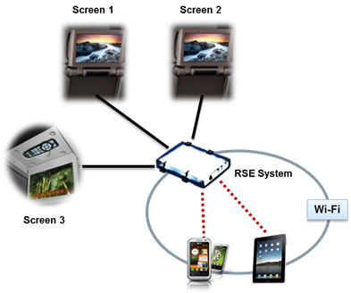
Smart Car – Car Entertainment
Pre-Conditions
User has operational WLAN network for internet access and service sharing between devices in a moving car.
Environment
In a car, embedded devices such as head unit, real seat displays and user devices such as smart phones, smart pads, and notebooks exist. Devices in a car are operating in close proximity. Transmissions are mostly LOS. Typical distances between STAs and AP are < 5m. But there might be interferences from the neighbor cars. Smart Car has an ability to internet access using cellular network.
Applications
Total 1.8 Gbps is required.
Video based applications (TV, VOD, Video conference): lightly compressed UHD (4k*2k). 600 Mbps * 3= 1.8Gbps
Internet access (email, twitter, web surf): 20 Mbps * 1= 20Mbps.
Game online: 20 Mbps * 1 = 20Mbps.
Traffic Conditions
Potential interference from overlapping networks (e.g. neighbors, other WLANs). Data transfers and video display should be operational simultaneously.
Use Case
Users operate many devices in a car.
Parents show different videos to different back seat screens or children’s tablets through AP and/or P2P.
* RSE: Real Seat Entertainment

Slide 14
References
[1] 11-13-0313-00-0wng-usage-models-for-next-generation-wi-fi
[2] 11-13-0535-00-00hew-Use_cases_for_HEW

