Slide 1
HEW Functional Requirements
Date: 2013-5-17
Authors:

Slide 2
Purpose of this submission
To stimulate technical discussions on limited functional requirements for HEW for the purpose of developing input suitable for Scope and Purpose content.
Slide 2
Wu Tianyu
Notes:
doc.: IEEE 802.11-08/1101r3
September 2008
John R. Barr, Motorola, Inc.
Page 2

Slide 3
Focus of HEW SG
High efficiency WLAN (HEW) SG is started to enhance 802.11 PHY and MAC in 2.4 and 5GHz with a focus on: [1]
  Improving spectrum efficiency and area throughput
  Improving real world performance in indoor and outdoor deployments
    in the presence of interfering sources, dense heterogeneous networks
    in moderate to heavy user loaded APs

Slide 4
Key items to consider
Spectrum efficiency
Area throughput
Real world performance with presence of interference source, dense deployed heterogeneous network
Real world performance for moderate to heavy user loaded APs
Slide 4
Wu Tianyu
Notes:
doc.: IEEE 802.11-08/1101r3
September 2008
John R. Barr, Motorola, Inc.
Page 4

Slide 5
Spectrum Efficiency Requirements
Improve the spectrum efficiency
  Achieve spectrum efficiency comparable to current state-of-art in other major high efficient air interface technologies???
Slide 5
Wu Tianyu
Notes:
doc.: IEEE 802.11-08/1101r3
September 2008
John R. Barr, Motorola, Inc.
Page 5

Slide 6
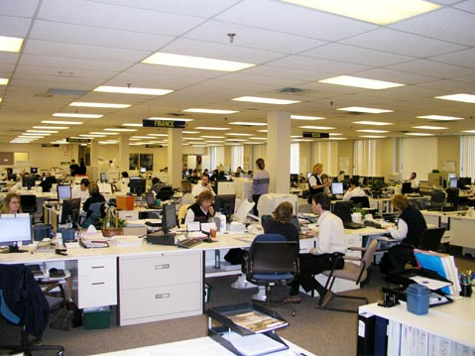
Area Throughput Requirements
Increase the area throughput
  Introduce a new performance metric “area throughput” which is defined by : bits/second/m²/[Watt]?
  The area throughput performance shall support the dense deployed use cases such as wireless office where a large number of devices in a limited area
  require a very high total throughput. [2]
Slide 6
Wu Tianyu
Notes:
doc.: IEEE 802.11-08/1101r3
September 2008
John R. Barr, Motorola, Inc.
Page 6

Slide 7
  Real World Performance in Indoor and Outdoor Deployments (1/2)
Improve the real world performance
  Increase the MAC efficiency
    For light to moderate loaded APs, achieve MAC efficiency comparable to current state-of-art in other air interface technologies.
    For heavy user loaded APs or densely deployed APs, avoid large degradation in MAC efficiency.
  The quality of experience (QoE) for HEW users shall be much better than 11n/ac users
    Higher probability to have smaller delay and jitter
Slide 7
Wu Tianyu
Notes:
doc.: IEEE 802.11-08/1101r3
September 2008
John R. Barr, Motorola, Inc.
Page 7

Slide 8
Real World Performance in Indoor and Outdoor Deployments (2/2)
Good QoE with the presence of interference sources including:
  Interference from dense deployed heterogeneous network such as Bluetooth, LTE, etc.
  Interference from legacy systems such as 11n/ac operating in co-located BSSs or overlapped BSSs.
In moderate to heavy loaded APs
  Users shall have good experience for delay sensitive applications such as voice and video in moderate loaded APs.
  Users shall have acceptable experience for delay sensitive applications in heavy loaded APs.
Slide 8
Wu Tianyu
Notes:
doc.: IEEE 802.11-08/1101r3
September 2008
John R. Barr, Motorola, Inc.
Page 8

Slide 9
Next Steps
May 2013
To continue with the discussion until we have some consensus
Slide 9
Slide 9
Wu Tianyu
Notes:
doc.: IEEE 802.11-08/1021r0
July 2008
Peter Loc
Page 9
doc.: IEEE 802.11-08/1101r3
September 2008
John R. Barr, Motorola, Inc.
Page 9

Slide 10
References
May 2013
[1] 11-13-0339-10-0wng-high-efficiency-wlan-straw-poll
[2] 11-13-0313-00-0wng-usage-models-for-next-generation-wi-fi
Slide 10
Slide 10
Wu Tianyu
Notes:
doc.: IEEE 802.11-08/1021r0
July 2008
Peter Loc
Page 10
doc.: IEEE 802.11-08/1101r3
September 2008
John R. Barr, Motorola, Inc.
Page 10

